Slide 1
Project Management

Slide 2
2. Project Team and Management
2.1 Project Leadership
Roles and Responsibilities of Project Managers
Project Management as a Leader-Intensive Profession
Project Management Professionalism
2

Slide 3
Learning Objectives
Understand how project management is a leader-intensive profession
Distinguish between the role of a manager and the characteristics of a leader
Be aware of career options and training possibilities

Slide 4
What is the role of a project manager?
Notes:
A project manger is a title, but it encorportates many roles.
To ensure we have a common understanding of what a project manager does, we have to quickly review the roles of a project manager
Any experience in the room? What were your roles and responsibilities?
What are roles and responsibilities of a project manager?
Let students brainstorm and gather on mindmap on board

Slide 5
Roles of Project Managers
Notes:
Planner – ensures, that project is defined properly, all necessary people engaged
Organizer – events, break down structure
Contact Point - serves as the central contact point
Quatermaster – ensures that the project has all needed resources, materials. Etc.
Facilitator – ensures that team / Stakeholders which come from different perspectives understand each other
Persuader – gains agreements from different stakeholders
Problem solver –
Umbrella – works to shield project team from “noise”
Coach
Bulldog – performs follow-up to make sure commitments are maintained
Librarian – manages information
Insurance agent – identifies risks
Police officer – reviews correct implementation
Salesman – sells benefits of project

Slide 6
Skills of Project Managers
Stress and Frustration Tolerance
Planning
Human Resources
Team Spirit
Endurance
Making Decisions
Notes:
Explain with examples from your own project management experience
i.e.: endurance: long workdays (maybe describe the schedule of a project workshop day as a manager)

Slide 7
Differences Between Managers and Leaders
Leaders
Managers
Do the right things
Develop new processes
Innovate + originate
Earn their position
Command respect
Focus on people
Inspire trust
Focus on potential
Have long-term goal
Do Things right
Maintain status quo
Administer and imitate
State their position
Demand respect
Focus on systems
Strive for control
Focused on the bottom line
Short-term view
Project management is leader intensive!
Source: Pinto (2015).
Notes:
Exchange of purpose
A right to say no
Joint accountability
Absolute honesty
“The ability to inspire confidence and support among the people who are needed to achieve organizational goals.”

Slide 8
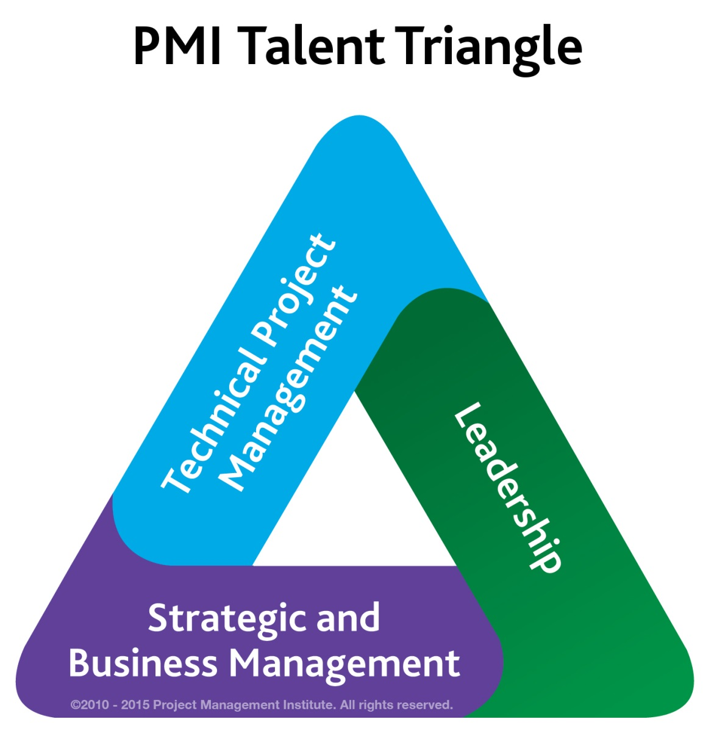
Talent Triangle (According to PMI)
www.pmi.org
Notes:
PMI – Project Management Institut
Most organizations say that technical skills are hardest to find but easiest to teach.
66% of organizations say that leadership skills are not as teachable but are most important for early success in project management.
83% of organizations report difficulty in finding qualified project management candidates to fill open PM positions in the past year.
1.57 million project management roles will be created globally every year until 2020, according to a 2012 study by PMI

Slide 9
The Project Leadership Matrix
Video
Notes:
Leadership coach Susanne Madsen at https://www.projectmanager.com/traini... graphs the project leadership matrix and explains its meaning in this short video.
https://www.youtube.com/watch?v=4HdjKSfORck
Video last 3.10 min.
In case your students have not heard about leadership styles before, I reconmend this short video on Goleman‘s leadership styles as well: https://youtu.be/fOGWwcQC7fw

Slide 10
Choosing the Appropriate Project Management Structure
Organisation (Form) Considerations
Size of project
Strategic importance
Novelty and need for innovation
Need for integration (number of departments involved)
Environmental complexity (number of external interfaces)
Budget and time constraints
Stability of resource requirements
How important is the project to the firm’s success?
What percentage of core work involves projects?
What level of resources (human and physical) are available?
Project Considerations

Slide 11
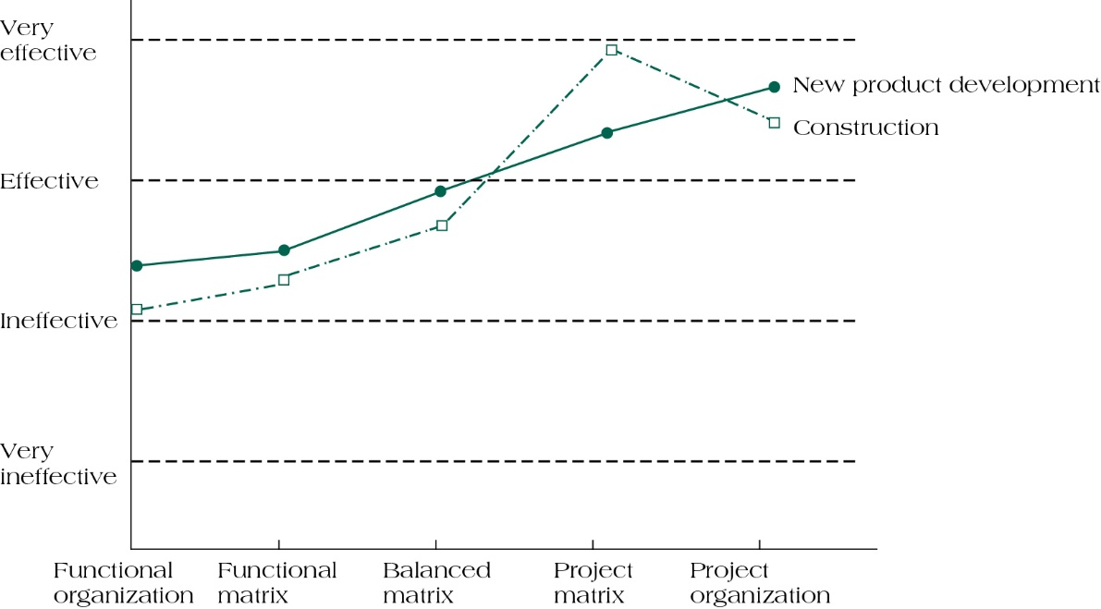
Manager‘s Perceptions of Effectiveness of Various Structures on Project Success
Source: Gobeli; Larson (1987). „Relative Effectiveness of Different Project management Structures“, Project Management Journal, 18 (2): 81:85.

Slide 12
The Project Management Office
Plan changes in projects
Successful execution of a project is complex
Requires the use of planning, budgeting, scheduling, and control tools
Contractual, administrative, and reporting duties must be performed in accord with the law
Purpose of PMO
Establish project administrative procedures
Ensures the firm’s project portfolio supports its overall goals and strategies
Gradual assimilation of project management practices into the entire firm
Facilitator of projects, not the doer of projects
Forms of PMOs
Information centre
Establish procedures and practices
Establish a resource database and monitor inter-project dependencies
Notes:
No project has ever been completed precisely as it was planned
Successful execution of a project is a complex managerial task
PMO Has to be very adapted to project. Hence very wide description
Tasks:
Establish and enforce good practices
Improve maturity
Improve project management systems
Offer training
Help with administrative details
Establish a process for dealing with risk
Determine if a project is a good fit
Identify impact of changes on projects
Conduct project reviews and audits
Maintain and store project archives
Serve as a champion to pursue project management
Serve as a home for project managers
Collect and disseminate lessons learned
Assist in project termination

Slide 13
Project Management Professionalism
The need for project management professionalism:
Through the decade ending in 2020, 15.7 million new project management roles will be created
Profession is expected to grow by US$6.61 trillion
In 10 countries (Australia, Brazil, Canada, China, Germany, India, Japan, Saudi Arabia, United Arab Emirates, and the United Kingdom) with established or quickly developing project-intensive sectors, project management roles are expected to grow by 13.4 million through 2020
Source: PMI (2013)“Talent Gap: Project Management through 2020, PMI Report.

Slide 14
Project Success Rates
Software & hardware projects fail at a 65% rate
Over half of all IT projects become runaways
Only 30% of technology-based projects and programmes are a success
Ten major government contracts have over $16 billion in cost overruns and are a combined 38 years behind schedule
Only 2.5% of global businesses achieve 100% project success and over 50% of global business projects fail
More than $8 billion of the $53 billion the Pentagon spent on Iraqi reconstruction projects was lost due to fraud, waste, and abuse
Source: Pinto (2015).
14
Notes:
Some numbers on success rates…
→ That’s why we need more project management education

Slide 15
Exercise: Why do projects go wrong?
List reasons why projects go wrong
Give examples from projects you have been involved with or heard about
15
Notes:
Causes for success:
Based on NASA study of 650 projects:
Excellent Project Manager
Good planning and control
Committed and capable project team
Strong task orientation
Clear 'criteria for success'
Accurate cost estimates
Good funding availability
Lack of bureaucracy
and a strong ‘Project Champion’

Slide 16
Why are projects important?
Shortened product life cycles
Narrow product launch windows
Increasingly complex and technical products
Emergence of global markets
An economic period marked by low inflation
Source: Pinto (2015).
16

Slide 17
Five Dimensions of Professionalism
Breadth
Knowledge → through training/ education/guidebooks
Depth
Competencies → through training/ education/competence measurements
Achievement
Certification
Commitment
Continuous development
Accountability
Code of conduct/affiliation
Notes:
APM FIVE Dimensions of Professionalism
The Association for Project Management, the Chartered body for the project profession, supports professional values. The APM FIVE Dimensions of Professionalism provide a framework that helps you develop your career.
Breadth
The APM Body of Knowledge defines the knowledge needed to manage any kind of project. It underpins many project management standards and methods including the National Occupational Standards in Project Management.
Depth
The APM Competence Framework provides a guide to project management competences. It is part of your professional toolkit; mapping levels of knowledge and experience to help you progress your skills and abilities.
Achievement
APM qualifications take your career in new and exciting directions. They are recognised across the profession and aligned with IPMA’s Four Level Certification Program.
Commitment
Continuing Professional Development helps develop your project management practice. A targeted development plan will enhance your project management career.
Accountability
The APM Code of Professional Conduct outlines the ethical practice expected of a professional. Becoming an APM member shows your commitment to the Code and sets you apart from others.
→ Breadth and Depth we try to tackle with this course. The rest is in your hands.

Slide 18
Project Management Certification - Types
GPM (Deutsche Gesellschaft für Projektmanagement )/ICB | Prince2 (Association in Project Management Group) | PMI (Project Management Institute)
Pros The common standard in Germany Provides a global content view in all PM topics Personal qualification is the main aspect Qualification is not mandatory 4 steps of qualification Cons Very time intensive No process model | Pros Simple certification process Exam and course are separated Low examination fee Less preparatory expenses 2 steps of qualification Cons Low penetration in Germany Only a few providers in Germany One-dimensional certification exam | Pros World-wide recognised degree of brand awareness Process understanding for PM Flexible configuration of training courses (no mandatory education book) Examination fees lower than with GPM Cons One-dimensional certification exam (only multiple choice) Certification is in focus Certification only in a testing centre possible Complicated application procedures
Notes:
For the achievement dimension: here the most common PM certifications

Slide 19
Project Management Body of Knowledge (PMBoK)
Initiating Processes
Planning Processes
Project Management
4. Project Integration Management
5. Project Scope Management
6. Project Time Management
Controlling Processes
Executing Processes
4.1 Develop Project Charter 4.2 Develop Project Plan 4.3 Direct and Manage Project
Work
4.4 Monitor and Control Project
Work
4.5 Perform Integrated Change
Control
4.6 Close Project or Phase
5.1 Plan Scope Management 5.2 Collect Requrements 5.3 Define Scope 5.4 Create WBS 5.5 Validate Scope
5.6 Control Scope
6.1 Plan Schedule Mgmt. 6.2 Define Activities 6.3 Sequence Activities 6.4 Estimate Activity Resources 6.5 Estimate Activity Duration
6.6 Develop Schedule
6.7 Control Schedule
Closing Processes
8. Project Quality Management
7. Project Cost Management
9. Project Human Resource Management
8.1 Plan Quality Mgmt 8.2 Perform Quality Assurance 8.3 Control Quality
7.1 Plan Cost Mgmt.
7.2 Estimate Costs 7.3 Determine Budget 7.4 Control Costs
9.1 Plan Human Resource Mgmt. 9.2 Acquire Project Team 9.3 Develop Project Team
9.4 Manage Project Team
10. Project Commu- nications Managem.
11. Project Risk Management
12. Project Procurement Management
13. Project Stakeholder Management
10.1 Plan Communication Mgmt. 10.2 Manage Communications 10.3 Control Communications
11.1 Plan Risk Management 11.2 Identify Risks 11.3 Perform Qualitative Risk
Analysis 11.4 Perform Quantitative Risk
Analysis
11.5 Plan Risk Responses
11.6 Control Risks
12.1 Plan Procurement Mgmt. 12.2 Conduct Procurements. 12.3 Control Procurements 12.4 Close Procurements
13.1 Identify Stakeholder
13.2 Plan Stakeholder Mgmt 12.3 Manage Stakeholer Engagement 13.4 Control Stakeholder Engagement
Source: Project Management Institute

Slide 20
PMI Certification - Prerequisites
CAPM | PMP
Secondary degree (high school diploma, associate’s degree or the global equivalent) + 1,500 hours of project experience | Secondary degree (high school diploma, associate’s degree or the global equivalent) + 7,500 hours leading and directing projects + 35 hours of project management education
or: 23 hours of project management education completed by the time you sit for the exam | or: Four-year degree + 4,500 hours leading and directing projects + 35 hours of project management education
Notes:
Working hours/year: depends on country. Roughly 1500hrs/year → 4500hrs=3years

Slide 21
PMI Certification - Process
CAPM | PMP
- Register online Prove fulfilment of prerequisites Wait for confirmation Pay Schedule Test Take test
MC Exam | MC Exam
Repeat Exam after 5 years | 60 PDUs every 3 years
Notes:
The certification cycle for the CAPM certification is five years. During the fifth year of the cycle, you move into a renewal period of one year. During this period, you must re-take and pass the exam (before your certification expires).
o maintain your PMP, you must earn 60 professional development units (PDUs) every three years.

Slide 22
IPMA Certification- Processes
http://www.ipma.world
Notes:
Depending on the organisation’s size and the complexity of the assessment, the certification process takes between 3 and 9 months.

Slide 23
Learning Objectives
Understand how project management is a leader-intensive profession
Distinguish between the role of a manager and the characteristics of a leader
Be aware of career options and training possibilities

Slide 24
Summary
A project manger is a title, but it encorportates many roles.
Project management is leader intensive!
There are different Project Management Certification, some focus on knowledge others on competences

Slide 25
References
Gobeli; Larson (1987): Relative Effectiveness of Different Project management Structures, Project Management Journal, 18 (2): 81:85.
Horine, Greg (2013): Absolute Beginner’s Guide to Project Management, Que Sams/Pearson Education, 3rd ed.
IPMA (2017): IPMA Certification Process. http://www.ipma.world
Pinto, J. K. (2015): Project management. Achieving competitive advantage, Pearson Education, Harlow, Essex, 4th ed.
Project Management Institute (2013): Talent Gap: Project Management through 2020, PMI Report.
Project Management Institute (2013): A Guide to the Project Management Body of Knowledge: PMBOK(R) Guide, Project Management Institute; 5th ed.

Slide 26
Additional Reading to Prepare for Next Class
Oertig, M., & Buergi, T. (2006). The challenges of managing cross-cultural virtual project teams. Team Performance Management: An International Journal, 12(1/2), 23-30.
Rees-Caldwell, K., & Pinnington, A. H. (2013). National culture differences in project management: Comparing British and Arab project managers' perceptions of different planning areas. International Journal of Project Management, 31(2), 212-227.
Review your knowldege on Intercultural Management!

Slide 27
2. Project Team and Management
2.2 Team Management
Roles and Responsibilities of Team Members
Team Development
Team Roles
Teams in Transition
27

Slide 28
Examination
Module-accompanying study-test-performance
Project group work (5 students per team)
Written project plan (incl. 6 tools: WBS, stakeholder analysis, time plan, budget plan, risk management, and monitoring plan; + Team reflection)
80% of final grade
Final due date:
Project pitch
20% of final grade
*Insert Date* (Everyone needs to be present)
Notes:
Example. Please adapt

Slide 29
Does this sound familiar?
Video
Notes:
The aim is: to find a better structure so you will not end up like Karla

Slide 30
Roles and Responsibilities of Team Members
Notes:
Lost in Desert – see seperate worksheet
Questions for Debriefing:
Did participants avoid conflict or change their minds simply to come to agreement?
How were decisions made?
Who influenced the decisions and how?
How could better decisions have been made?
Did people listen to each other? if not, why not?
What roles did group members adopt?
How was conflict managed?
What kinds of behavior helped or hindered the group?
How did people feel about the decisions? Were their satisfied?
What have you learnt about the functioning of this group?
How would you do the activity differently if you were asked to do it again?
What situations at work/home/school do you think are like this exercise?

