Slide 1
C1.4.2. Logistics Plan

Slide 2
Learning Objectives
The student can define the basic concepts of logistics (transportation and inventory) and understand the influence of logistics to company’s other functions
The students train their practical skills related to looking for suppliers from different sources and thinking about the logistical challenges with the chosen suppliers

Slide 3
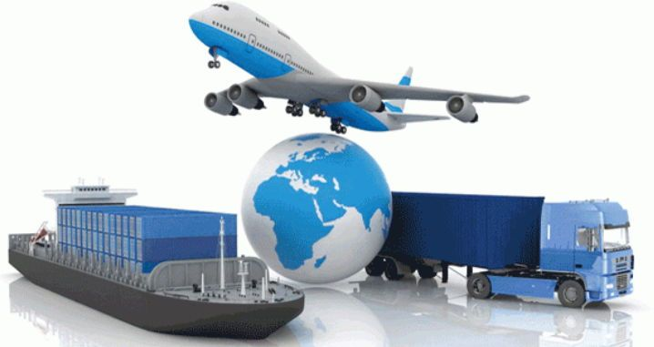
What is logistics?
Includes the major part of:
The total flow of materials (finished and unfinished)
Information, both:
Downstream (processing the materials collected during the upstream stage into a finished product and actual sale)
Upstream (searching for and extracting raw materials)
Includes activities such as transport, storage, inventory management, materials handling, and order processing
"Dieses Foto" von Unbekannter Autor ist lizenziert gemäß CC BY-NC-ND
Notes:
was long associated with military activities, like coordinating the movements of troops
applied first time to business about 40 years ago
includes the major part of the total flows of materials (finished and unfinished) and information both downstream (processing the materials collected during the upstream stage into a finished product and actual sale) and upstream (searching for and extracting raw materials)

Slide 4
The Elements of the Marketing Mix for International Companies
BUSINESS STRATEGIES
MARKETING MIX
PLACE: Basic questions concerning logistics, how to arrange the transportation and inventory (centralised or near the customer)?
* Differentiation * Cost Leadership * Focus
PRODUCT
PRICING
PROMOTION
PLACE
Get products/services into customers hands via transportation

Slide 5
Advantages and Disadvantages of Different Modes of Transportation
Transportation Mode | Advantages | Disadvantages | Sample Products
Train | Safe Reliable Inexpensive Low emissions | Limited to rail routes Slow | Automobiles Grains Heavy products Chemicals
Airplane | Safe Reliable | Expensive Limited access High emissions | Jewelry Medicine Light products
Truck | Versatile Inexpensive | Small size High emissions | Consumer goods
Ship | Inexpensive Good for large products | Slow Indirect High emissions | Automobile Furniture Bulk products
Pipeline | Inexpensive | Unusable for many products Limited access | Gas Oil
(Wall&Rees, International Business)
Notes:
the most obvious issue related to the distribution of the company is the selection of a mode (or modes) of transportation for shipping the company’s goods from their point of origin to their destination → a clear trade-off between time and money

Slide 6
The Relative Performance of Each Mode of Transport
Operation’s Performance Objective | Road | Rail | Air | Water | Pipeline
Delivery speed | 2 | 2 | 1 (fastest) | 5 | 4
Delivery dependability | 2 | 3 | 4 | 5 | 1
Quality | 2 | 3 | 4 | 5 | 1
Cost | 3 | 4 | 5 (most expensive) | 2 | 1
Route flexibility | 1 | 2 | 3 | 4 | 5
(Scale 1-5)
(Wall, Rees, 2004)
Notes:
as can be seen from the table, the faster modes of transportation are more expensive than slower modes
the transportation mode selected affects also to the inventory costs and customer service level of the company, as well as the product’s useful shelf life, exposure to damage and packaging requirements

Slide 7
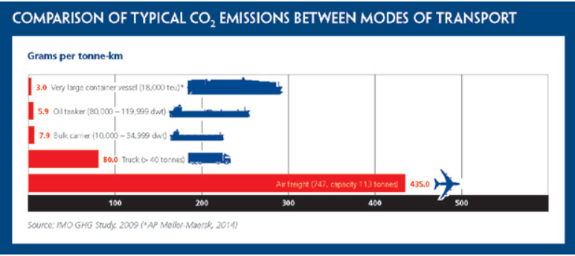
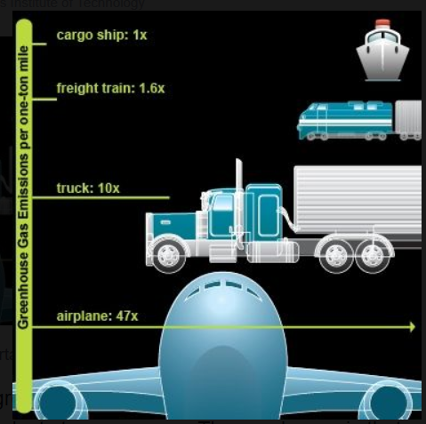
CO₂ Emissions
Source: ICS 2019
Source: Pyscg Org 2010
Notes:
More information on carbon emission of transportation options: http://lowcarbonfreight.eu/

Slide 8
Impacts of Transportation Mode
Mode of Transport
Inventory
Order Cycle
Buffer Stock
Packaging
(Wall, Rees, 2004)
Notes:
if the company relies on slower modes of transportation, it has to maintain higher levels of inventory
if the company selects unreliable modes, it’s difficult to predict the exact time when the shipments will actually arrive and then the company has to increase buffer stocks in its inventory to avoid stock-outs (Buffer stock: ”A supply of inputs held as a reserve to safeguard against unforeseen shortages or demands.” (www.businessdictionary.com)
Slower modes of transportation also increase the company’s international order cycle – the time between the placement of an order and its receipt by the customer
products with short self life (like cut flowers) are shipped by air
less perishable products are shipped using less expensive modes
packaging has direct effect on cost; materials, weight of the packing material, the shape, size and measurements of the package
packaging can also reduce loading and unloading costs, minimize theft and pilferage, f.ex. intermodal containers (large metal boxes, easy-to-move-unit, fit on trucks, railroad trains, airplanes →reduce handling costs and theft losses)
packaging depends the product and the transportation mode: f.ex. long ocean voyages may need special packaging to protect the products from humidity and damage

Slide 9
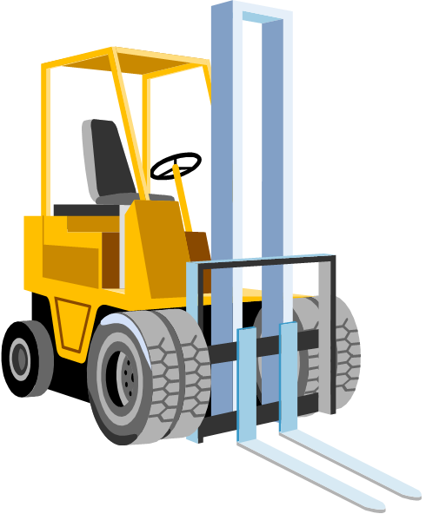
Inventory Costs
(Wall&Rees, International Business)
Holding/carrying costs
3) Stock-out costs
Insurance, storage costs (staff, equipment, handling, deterioration, obsolescence, security)
2) Order costs
Occur when obtaining stock
The costs of clerical and administrative work in raising and order, any associated transport costs, inspection of stock on arrival
Difficult to quantify
a) Stock-out of materials and work-in-progress, may result in machine and operator idle time
b) Stock-out of finished goods may result in:
Missed orders from occasional customers
Missed delivery dates →Deterioration in customer/supplier relations
Penalty clauses incurred for late delivery
c) Stock-out of tools and spares → may result in an increase in downtime of machinery and loss production
→ Possibly overtime payments to catch up on missed production

Slide 10
Stock Carrying/Holding Costs
Can be expected to rise as the order size increases
Stock ordering costs can be expected to fall as the order size increases
If stock-out costs (difficult to quantify) are ignored, we can regard the total (inventory) costs as the sum of carrying and ordering costs →EOQ (Economic Order Quantity)

Slide 11
Economic Order Quantity
The right order quantity can be optimised as follows:
EOQ = √$\frac{2DC0}{Ch}$
D= annual demand for stock C0= ordering costs for one order Ch = holding costs for one item
EOQ minimises total holding and ordering costs for the year
Even if all the assumptions don’t hold exactly, the EOQ gives a good indication of whether or not current order quantities are reasonable
Notes:
EOQ (Economic Order Quantity) tells us HOW MUCH to order and Reorder point tells WHEN we should order

Slide 12
Reorder Point/Order Level in Warehouse:
Number of units of an item on hand, when a purchase order for its replenishment is to be issued
(production/sales/year ) × lead time + safety stock
365
(Average daily usage rate)
Consumption of an item during order lead time
Notes:
EOQ (Economic Order Quantity) tells us HOW MUCH to order and Reorder point tells WHEN we should order
The reorder point can be different for every item of inventory, because every item may require differing amounts of time to receive a replenishment delivery and may have a different usage rate
For example, a company buys the same part from two different suppliers; the first supplier maybe requires one day to deliver an order and the other supplier requires three days →the reorder point for the first supplier would be when there is one day's supply left on hand, or three days' supply for the second supplier

Slide 13
The Importance of Safety Stock
The maximum Growth of Late Stockout stock demand delivery
Safety stock
Time

Slide 14
Short Assignment 1.
ABC Ltd. is engaged in the sale of footballs. Its cost per order is 400 euros and its holding cost is 10 euros per unit per annum. The company has a demand for 20,000 units per year. a) What is the EOQ? b) Total number of orders required during a year? c) Total ordering cost for the year?
Notes:
Answers: a) 1264,91 = 1265 pieces, b) 16 orders, c) € 6400

Slide 15
Short Assignment 2.
A company needs a product 6000 pieces/year. The delivery time is 5 days. What is the reorder point if you know that the consumption varies a little bit and the company wants to have a safety stock for 2 days?
What is the reorder point if the delivery time is 20 days and the company wants to have a safety stock for 5 days?
Notes:
Answers: a) 115 pieces, b) 411 pieces

Slide 16
Short Assignment 3.
Research information about the different modes of transportation in your own country:
Which are the most important ones and what’s the reason for this?
Is there a difference if you compare importing to your country and exporting from your country?
You can also look for information of some other country and compare the results

Slide 17
Centralised versus Decentralised Inventory
Centralised Inventory
Decentralised Inventory
Notes:
the predominant trend in logistics has been towards the centralisation of inventory holding
generally it has been perceived that the resulting savings in stock-holding costs outweight any increases in transport and related costs resulting from a geographically extended distribution system

Slide 18
Iceberg Model
Initial
Purchase
price
Transportation
costs
Visible part
Installation
User training
Operating energy, fuel
Repairs and Spare parts
Administrative/Purchasing costs
Disposal costs etc.
Notes:
The initial purchase price is usually just the’ tip of the iceberg’ in terms of the costs you will incur. There are many hidden costs under the water line. You need to look beyond purchase price to identify all other expenses and income over the whole-of-life of the goods or service→
TCO (Total Cost of Ownership); costs before, during and after the purchase
Iceberg model means that most of the costs are under the water line. Purchasing price and transportation costs are easier to evaluate but there might be a lot of other costs when you think the whole product life cycle.

Slide 19
Supply Market Research
External factors determine the degree of availability of a certain product, not influenced by individual companies
The number of customers or buyers in a market
The number of suppliers
The market structure (transparency, pricing method)
The stock situation of the product in question
Speed of technological innovation
Notes:
”Systematic gathering, classification and analysis of data considering all relevant factors that influence the procurement of goods and services for the purpose of meeting present and future company requirements” (van Weele)

Slide 20
Subjects of Supply Market Research
Materials, goods, and services
Different pricing methods; raw-materials, components etc.
Suppliers
New, potential suppliers
Existing suppliers with quality problems, etc.
Systems and procedures
Information systems
Administrative procedures

Slide 21
Where to find information?
Internet sources:
www.industrystock.com
www.corporateinformation.com
www.europages.com
www.kompass.com
Other sources:
Visits to suppliers
Catalogues
Fairs
Magazines
Statistics
Discussions with other companies or purchasers

Slide 22
Electronic Sources of Supply Market Information (e-marketplaces) Van Weele
Industry
Automotive
Aviation
Building and construction
Chemicals
E-marketplace
www.covisint.com
www.supplyon.com
www.aeroxchange.com
www.exostar.com
www.bravosolution.com
www.elemica.com
There are about 1000 e-marketplaces for businesses globally

Slide 23
Electronic Sources of Supply Market Information (e-marketplaces)
Industry
Food and beverages
Healthcare and pharmaceutical
Transportation and logistics
Retail and consumer goods
E-marketplace
www.transora.com
www.ghx.com
www.transcore.com
www.globalsources.com

Slide 24
Summary
Basic questions concerning logistics: how to arrange the transportation and inventory (centralised or near the customer)?
The mode of transport influences: inventory, order cycle, buffer stock, and packaging

Slide 25
Learning Objectives
The student can define the basic concepts of logistics (transportation and inventory) and understand the influence of logistics to company’s other functions
The students train their practical skills related to looking for suppliers from different sources and thinking about the logistical challenges with the chosen suppliers

Slide 26
Self-Study
Required reading: Waters, D. & Rinsler, S. (2010). Global Logistics, 7th edition, Kogan Page Ltd, pp. 1-11, 29-47.

Slide 27
Assignment
Assignment Logistics
Source: Moodle

Slide 28
References
Griffin, R., & Pustay, M. (2010). International Business. Pearson Prentice Hall.
Ritvanen, V., Inkiläinen, A., von Bell, A. & Santala,J. (2011). Logistiikan ja toimitusketjujen hallinnan perusteet. Suomen Huolintaliikkeiden Liitto ry & Suomen Osto- ja Logistiikkayhdistys LOGY ry.
Sakki, J. (2009). Tilaus-toimitusketjun hallinta. Jouni Sakki Oy.
Wall, S., & Rees, B. (2004). International Business. Pearson Education Limited.
Van Weele, A. (2014). Purchasing and supply chain management. Cengage Learning EMEA.

