Slide 1
C1.4.1 International Marketing Plan

Slide 2
Learning Objectives
Students can explain what distinguishes international marketing from marketing focusing on the home country
Students can recall two main approaches: Standardisation and Adaption
Students understand the main management approaches affecting international marketing: Ethnocentric, Regiocentric, Polycentric, and Geocentric
Students can apply global positioning strategies

Slide 3
In what country is the parent company located?
Dove
Mini
IBM ThinkPad
Bombay Sapphire
Bugatti
H&M
Firestone Tire
Guinness
Financial Times
Tetley Tea
Notes:
Optional discussion about perceptions of brand and to show impact of globalization

Slide 4
In what country is the parent company located? (Answers)
Dove UK/Netherlands (Unilever)
Mini Germany (BMW)
IBM ThinkPad China (Lenovo)
Bombay Sapphire Bermuda (Bacardi)
Bugatti Germany (VW)
H&M Sweden
Firestone Tire Japan (Bridgestone)
Guinness UK (Diageo)
Financial Times Japan (Nikkei)
Tetley Tea Tata (India)

Slide 5
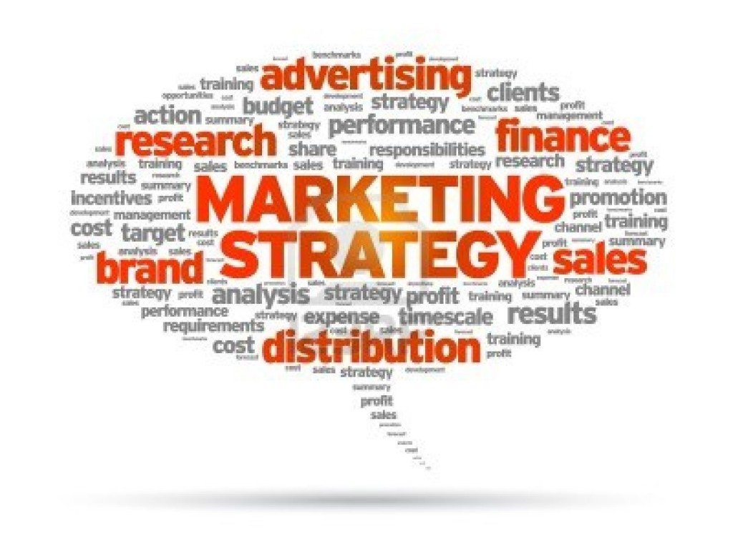
Marketing Review
"Dieses Foto" von Unbekannter Autor ist lizenziert gemäß CC BY-SA-NC
Notes:
Collect previous knowledge either by creating a mind map on the board or by creating and interactive word-cloud of your students (use:https://www.mentimeter.com/features)

Slide 6
Definitions of International Marketing
Marketing
International Marketing
The process of planning and executing the conception, pricing, promotion, and distribution of ideas, goods, and services to create exchanges that satisfies customers’ current and future needs at a profit
Source: Kotabe/Helsen 2004
Simple: making one or more marketing mix decisions across national boundaries
Complex: it involves the firm in establishing manufacturing/processing facilities around the world and coordinating marketing strategies across the globe
The main difference is the scope of activities, international marketing occurs in markets outside the organization’s home country

Slide 7
Global Marketing: What it isn’t and what it is
Global marketing does not mean doing business in all country markets
Global marketing does not necessarily mean that products can be developed anywhere on a global scale
Global marketing does mean widening business horizons to encompass the world in scanning for opportunities and threats
The economic geography, climate, and culture affect how companies develop certain products
Notes:
The next slide compares, simply, the two options of being single-country or global. Afterwards, you see the evolution of marketing and a deeper look at the types of marketing orientations

Slide 8
Single-Country Marketing vs. Global Marketing
Single-Country Marketing Strategy | Global Marketing Strategy
Target Market Strategy | Global Market Strategy
Marketing Mix Development: | Marketing Mix Development:
Product | Product adaptation or standardisation
Price | Price adaptation or standardisation
Promotion | Promotion adaptation or standardisation
Place | Place adaptation or standardisation
 | Concentration of marketing activities
 | Coordination of marketing activities
 | Integration of competitive moves
Source: Keegen/Green 2004
Notes:
Global market participation is the extent to which a company has operations in major world markets. standardisation versus adaptation is the extent to which each marketing mix element can be standardized (i.e., executed the same way) or adapted (i.e., executed in different ways) in various country markets. GMS has three additional dimensions that pertain to marketing management.
First, concentration of marketing activities is the extent to which activities related to the marketing mix (e.g., promotional campaigns or pricing decisions) are performed in one or a few country locations.
Coordination of marketing activities refers to the extent to which marketing activities related to the marketing mix are planned and executed interdependently around the globe.
Integration of competitive moves is the extent to which a firm’s competitive marketing tactics in different parts of the world are interdependent. The GMS should be designed to enhance the firm’s performance on a worldwide basis.

Slide 9
The Global Marketing Mix
Video
Notes:
Video is 12:12 min. decide of watching in class or as self study.

Slide 10
Standardisation versus Adaptation
Standardisation
Developing standardised products marketed worldwide with a standardised marketing mix
Essence of mass marketing
Adaptation (Global Localisation)
Mixing standardisation and customisation in a way that minimises costs while maximising satisfaction
Think globally, act locally!
Notes:
To begin, discuss the idea of standardisations v. Adaptation, later on we delve deeper into the product side of this.
Insert a global product...where does it differ and how from home country?
McD‘s menu or delivery as an option, Starbucks‘ menu (green tea frapaccinios in Asia, red bean scones), Coke‘s sugar content, price of gatorade. In addition, the brand message often changes, see Bud ads

Slide 11
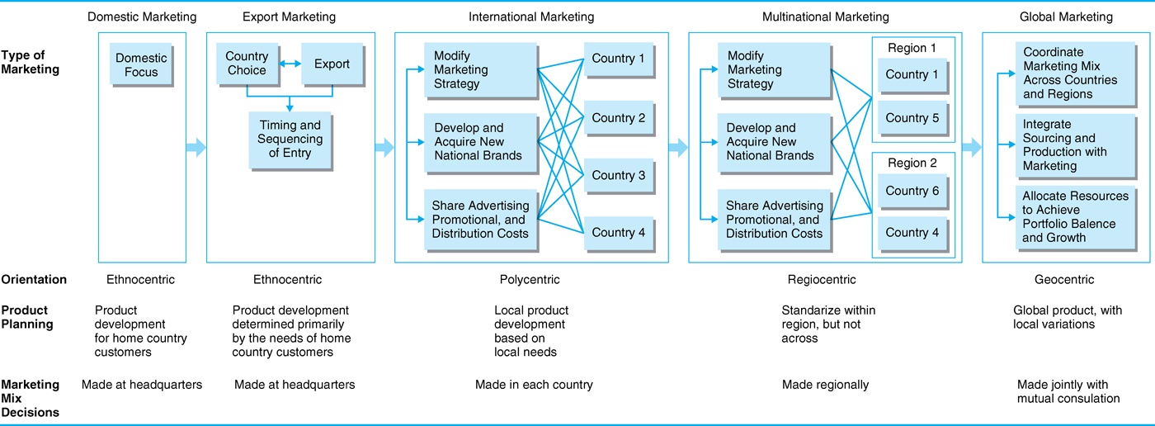
Evolution of International Marketing
Kotabe, Helsen 2004, p.14
Source: Kotabe/Helsen 2004
Notes:
This chart isnt legible for students so well, but outlines the evolution of the process well. Also should help connect with internationalization process, e.g. Uppsala method.

Slide 12
Evolution of International Marketing
Domestic Marketing (ethnocentric orientation)
Export Marketing (ethnocentric orientation)
International Marketing (polycentric orientation)
Multinational Marketing (regiocentric orientation)
Global Marketing (geocentric orientation)
Notes:
Domestic marketing: Marketers are ethnocentric and pay little attention to what is going on in the international market place
Companies focus on domestic sales and markets
This strategy is based on domestic needs and domestic competition only
Export marketing:
Companies tend to take an ethnocentric view toward strategy formulation
Product development is determined primarily by the needs of home country customers
Businesses may experience many difficulties:
Import/export restrictions
Cost and availability of shipping
Exchange rate fluctuations
International Marketing: Polycentric orientation with marketing decisions made in each country
Local product development/adaptation based on local needs
The extreme of this phase is to establish an independent foreign subsidiary in each and every foreign country (multi-domestic marketing)
Multinational marketing:
The company markets its products in many countries around the world and has a regiocentric orientation
The company consolidates on a regional basis:
Product planning may be standardized within a region but not across regions
Regional advertising might be accomplished
Regional brands might be developed
Global marketing:
Geocentric orientation focusing resources on global market opportunities and threats
The marketing activities emphasize:
standardisation efforts -- standardizing marketing programs across different countries.
Coordination across markets -- reducing cost inefficiencies and duplication of efforts at the national and regional levels.
Global integration -- participating in many major world markets to gain competitive advantage.

Slide 13
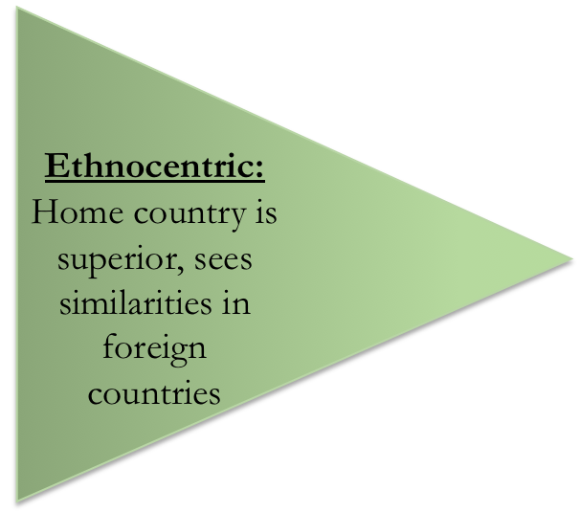
Management Orientations
Polycentric:
Each host country is
unique, sees
differences in
foreign countries
Regiocentric:
Sees similarities in a world
region; is ethnocentric or
polycentric in its view of
the rest of the world
Geocentric:
World view, sees
similarities and
differences in home
and host countries
Source: Keegan/Green 2005
Notes:
Ethnocentrism is sometimes associated with attitudes of national arrogance or assumptions of national superiority. Company personnel with an ethnocentric orientation see only similarities in markets, and assume that products and practices that succeed in the home country will be successful anywhere.
Ex.: Tchibo
The term polycentric describes management’s belief or assumption that each country in which a company does business is unique. This assumption lays the groundwork for each subsidiary to develop its own unique business and marketing strategies in order to succeed; the term multinational company is often used to describe such a structure.
Ex.: Ford in the 90s,
In a company with a regiocentric orientation, a region becomes the relevant geographic unit; management’s goal is to develop an integrated regional strategy.
Ex.: Renault-Nissan (Dacia); Nestlé
A company with a geocentric orientation views the entire world as a potential market and strives to develop integrated world market strategies.
Ex.: Toyota

Slide 14
Why is global marketing imperative?
Saturation of domestic markets in the industrialised parts of the world
Global competition around the world is on the rise
Need for global cooperation; marketing opportunities abroad  Big Emerging Markets (BEMs)
Internet revolution
Notes:
Marketing opportunities abroad  Big Emerging Markets (BEMs): In the next ten to twenty years, BEMs such as the Chinese Economic Area (CEA), India, South Korea, Mexico, Brazil, Argentina, South Africa, Poland, Turkey, and the Association of Southeast Asian Nations (ASEAN) will provide many opportunities in global business.

Slide 15
Product Policy Decisions in International Marketing
What new products should be developed for what markets?
What products should be added, removed, or modified for the product line in each of the countries in which the company operates?
What brand names should be used?
How should the product be packaged and serviced?
Notes:
A cornerstone of a global marketing mix program is the set of product policy decisions that multinational companies (MNCs) constantly need to formulate.

Slide 16
Factors Affecting Product Adaptation Decisions
Regional, Country, or
Local Characteristics
Government regulations
Nontariff barriers
Customer characteristics, expectations, and preferences
Purchase patterns
Economic status of potential users
Stage of economic development
Competitive offerings
Climate and geography
Product Characteristics
Product constituents
Brand
Packaging (e.g., size, styling, color)
Functions, attributes, features
Method of operation or usage
Durability quality
Ease of installation
Maintenance, after sale service
Country of origin
Company Considerations
Profitability
Market opportunity (e.g. market potential, product-market fit)
Cost of adapting
Policies (e.g. commonality, consistency)
Organisation
Resources
Adapted from V.Yorio, Adapting Products for Export (New York; Conference Board, 1983), 7. Czinkota/Ronkainen, 2004, p. 253
Decision to Alter Product for Export

Slide 17
Adaptation: Mandatory or nice to have?
Mandatory Adaptation:
Adapting products to local requirements so that they can legally and physically operate in the respective countries
Examples:
Left-side driving in the United Kingdom
220 volt appliances in Europe, 110 volt appliances in the U.S.
Non-Mandatory Adaptation:
Adapting a product to better meet the needs of the local market, or developing new brands for individual local markets, even though such adaptation is not required
Examples: McDonald's selling vegetarian burgers in India

Slide 18
International Positioning Strategies
Uniform versus localised positioning strategies
Universal positioning
Positioning themes:
Specific product features/attributes
Product benefit, solutions for problems
User category
User application
Heritage
Lifestyle
Notes:
Companies use new markets as opportunities to position themselves differently, also a response to local wants.

Slide 19
Global Positioning Strategies
Global Consumer Culture Positioning (GCGP)
Identifies the brand as a symbol of a particular global culture or segment (e.g. Nokia, Motorola, Apple)
Local Consumer Culture Positioning (LCCP)
Brand as an intrinsic part of the local culture
e.g. Baileys (Irish)
Foreign Consumer Culture Positioning (FCCP)
Associates the brand’s users, use occasions, or product origins with a foreign country or culture
e.g. Haagen-Dazs (really launched by an American company)
Notes:
Applicable to high tech, high touch products. Can be both.
High tech ->Computers, cellular phones, leisure and recreation products (Adidas, Canon)
High touch ->Appeal to senses more than intellect. Luxury perfume, designer fashion, fine champagne
Both high tech and high touch (i.e., combination of performance and design)
Cell phones, computers
Foreign consumer culture positioning
Associates the brand’s users, use occasions, or product origins with a foreign country or culture
Fosters “Australian for Beer”
Haagen-Dazs (really launched by an American company)
Harley Davidson (very American)
Local consumer culture positioning
Associates the brand with local cultural meanings, reflects local cultures’ norms, portrays the brand as consumed by local people in the national culture or depicts the product as locally produced for local consumers.
Budweiser’s US advertising highlighting Clydesdale horses which associates brand with small town American culture.

Slide 20
Brand Positioning and Brand Name Selection
Marketers should establish a mission and vision for the brand when positioning it
Desirable qualities for a brand name should:
Be based on the product’s benefits and qualities
Be easy to pronounce, recognise, and remember
Be distinctive and extendable
Translate easily into foreign languages
Be capable of registration and legal protection
Notes:
Marketers need to position their brands clearly in target customers’ minds. They can position brands at any of three levels. At the lowest level, they can position the brand on product attributes. At the next level, a brand can be better positioned by associating its name with a desirable benefit. In the final level, the strongest brands go beyond attribute or benefit positioning. They are positioned on strong beliefs and values and engage customers on a deep, emotional level.
Finding the best brand name begins with a careful review of the product and its benefits, the target market, and proposed marketing strategies. There are a number of desirable qualities for a brand name. It should suggest something about the product’s benefits and qualities, and it should be easy to pronounce, recognize, and remember. The brand name should be distinctive, be extendable, translate easily into foreign languages, and be capable of registration and legal protection.

Slide 21
International Product Branding Strategies
ADAPTATION
= different products for different countries
STANDARDISATION
= same product for different countries
Product
ADAPTATION
= different brands for different countries
STANDARDI-SATION
= same brand for different countries
Brand
Notes:
Ask students for further examples

Slide 22
Local Product & Branding Strategies
Local Branding
Interbrew has a portfolio of 200 local and regional brands across the globe
Coca Cola in India: Thums Up
Reasons for Local Brands
Acquisition of established local brands (Chinese brands account for 80% of Danone's sales in China)
Name already used (Merck Germany vs. USA)
Negative image of home country (Mecca Cola in France)
Cultural barriers
Notes:
Coca cola left the Indian market in the 1970s, later re-entering by purchasing “thums up”, a local drink, in order to gain market share in the industry and local knowledge.

Slide 23
Global Brands
A truly global brand is one that has a consistent identity with consumers across the world
Advantages:
The development costs for products launched under the global brand name can be spread over large volumes
A global brand has much more visibility than a local brand
The fact of being global adds to the image of a brand country
Global brands are also able to leverage the country association for the product

Slide 24
Country of Origin as Brand Element
Perceptions about and attitudes toward particular countries often extend to products and brands known to originate in those countries. e.g.:
Germany
France
Italy
Japan
Notes:
One of the facts of life in global marketing is that perceptions about and attitudes toward particular countries often extend to products and brands known to originate in those countries. Such perceptions contribute to the country-of-origin effect; they become part of a brand’s image and contribute to brand equity. This is particularly true for automobiles, electronics, fashion, beer, recorded music, and certain other product categories. Perceptions and attitudes about a product’s origins can be positive or negative. On the positive side, as one marketing expert has pointed out, “‘German’ is synonymous with quality engineering, ‘Italian’ is synonymous with style, and ‘French’ is synonymous with chic.”

Slide 25
International Brand Equity
The value of a global brand (brand equity) usually varies a great deal from country to country
Inter-country gaps in brand equity may be due to following factors:
History
Competitive climate
Marketing support
Cultural receptivity to brands
Product category penetration

Slide 26
Local or Global Brands? Checklist to Analyse Globalisation Possibilities
What is the cost of creating and maintaining awareness and associations for a local brand versus a global one?
Are there significant economies of scale in the creation and running of a communication programme globally?
Is there value to associations of a global brand or of a brand associated with the source country?
What local associations will be generated by the global name? symbol? slogan? imagery?
Is it culturally and legally do-able to use the brand name, symbol, slogan across the different countries?
What is the value of the awareness and associations that a regional brand might create?

Slide 27
Summary
International marketing occurs in markets outside the organisation’s home country and needs to consider different institutional environments
Companies need to decide between Standardisation
(developing standardised products marketed worldwide) and Adaptation (Global Localisation)
The four major management orientations influencing marketing are ethnocentrism, polycentrism, regiocentric orientation, and geocentric orientation
Global Positioning Strategies are Global Consumer Culture Positioning (GCGP), Local Consumer Culture Positioning (LCCP), and Foreign Consumer Culture Positioning (FCCP)

Slide 28
Learning Objectives
Students can explain what distinguishes international marketing from marketing focusing on the home country
Students can recall two main approaches: Standardisation and Adaption
Students understand the main management approaches affecting international marketing: Ethnocentric, Regiocentric, Polycentric, and Geocentric
Students can apply global positioning strategies

Slide 29
References
Albaum, G. S., Albaum, G., & Duerr, E. (2008). International marketing and export management. Pearson Education.
Bradley, F. (2005). International marketing strategy. Pearson Education.
Czinkota, M. R., & Ronkainen, I. A. (2004). International Marketing, Ohio.
Czinkota, M. R., & Ronkainen, I. A. (2013). International marketing. Cengage Learning.
Doole, I., & Lowe, R. (2008). International marketing strategy: analysis, development and implementation. Cengage Learning EMEA.
Keegan, W. J., Green, M. C., & Fu, H. (2005). Global marketing (Vol. 7). Upper Saddle River, NJ: Prentice Hall.
Kotabe, M., & Helsen, K. (2004). Global Marketing Management, John Wiley&Sons.
Yorio, V. M. (1983). Adapting products for export. Conference Board.

