Slide 1
C.1.3.2. Import/Purchasing:
Supply-Chain Management
Outsourcing
Supplier Relations
Incoterms
Payment Methods

Slide 2

Four parts
Supply Chain Management
  Handled during lectures & self-study
Global Sourcing Process
  Handled during lectures & self-study
Incoterms 2010
Outsourcing
  Self study

Slide 3
Supply Chain
Second-tier supplier
First-tier supplier
First-tier customer
Second-tier customer
End customer
Supply side
Demand side
Purchasing and supply management
Physical distribution management
Information flow
Logistics
Physical flow
Materials management
Supply chain management
Slack, Brandon-Jones and Johnston, Operations Management, 7th edition 2014

Slide 4
Learning Objectives
Students can explain what supply chain is and its different components and what kind of things affect the supply chain of some certain product/company
Students can recall the benefits, elements, risks, and mitigation tactics of supply chain management and can apply a suitable purchasing strategy in different situations
Students understand the different steps in the global sourcing process and know what elements to research during every step before decision making

Slide 5
Learning Objectives
Students understand the importance of supplier relations for the purchasing company and how it affects the level of cooperation to the criteria of supplier selection
The student can explain the basic idea of 11 different terms and analyse what would be the best Incoterms for companies in different situations;
Students train their research and analytical skills by studying the cases and looking for the answers to questions by comparing the information given during lectures and in other readings and what happened with the case companies

Slide 6
Self Study
Required reading: Van Weele, Arjan. J. (2014). Purchasing and Supply Chain Management. United Kingdom: Cengage Learning EMEA, 6th edition, pp. 3-19, 115-130, 173-191
Teaching video: https://www.youtube.com/watch?v=Mi1QBxVjZAw
Notes:
Video: What is Supply Chain Management?
8 min

Slide 7
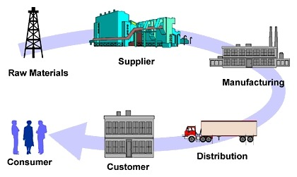
Introduction to Supply Chain Management
"Dieses Foto" von Unbekannter Autor ist lizenziert gemäß CC BY-SA-NC

Slide 8
Supply Chain - Definition
Network of connected and mutually dependent organisations which
Cooperate together on
Control, management, and improvement of material, information, and financial resources flow
From suppliers to final user

Slide 9
Supply Chain
Second-tier supplier
First-tier supplier
First-tier customer
Second-tier customer
End customer
Supply side
Demand side
Purchasing and supply management
Physical distribution management
Information flow
Logistics
Physical flow
Materials management
Supply chain management
Slack, Brandon-Jones and Johnston, Operations Management, 7th edition 2014

Slide 10
Supply Chain – Example
Second-tier supplier
First-tier supplier
First-tier customer
Second-tier customer
Oil refinery
Wholesale
PET producer
Retail
Plastic bottles producer
Cardboard producer
Retail
Box producer
Dye producer
Direct delivery
Information
(Slack, Brandon-Jones and Johnston, 2014)

Slide 11
Supply Chain Exercise
Create supply chain for:
Yogurt producer
Hospital
City library
Shopping mall
Cookie producer
Notes:
Based on the previous slide student should make groups and do exercise about supply chain on different examples - total time for this 15 mins

Slide 12
Supply Chain Management
Management of the interconnection of organisations that relate to each other through upstream and downstream linkages between the processes that produce value to the ultimate consumer in the form of products and services
Concerns flow between a string of operations
(Slack, Brandon-Jones & Johnston, 2014)

Slide 13
Supply Chain Management
Includes managing the flow of products, services, and information through the supply chain synchronisation of all its parts
Goal – Customer satisfaction delivering quality products at a scheduled time with a minimum price
Task – Structuring the supply chain in order to maximise the company's competitive advantage and the benefits for the end customer
Keys to success – information, communication, cooperation, reliability, and trust

Slide 14
Supply Chain Management
‘Upstream’ flow of customer
Requirements
Long-term plans and requirements
Market research information
Individual orders
Payment
Potential new products and services
Flow between processes
Flow between processes
Flow between processes
Consumer
Operation 1
Operation 2
Operation 3
Products and services
New products and services
Delivery information
Payment request/credit
‘Downstream’ flow of products and services for customer
Fulfilment
(Slack, Brandon-Jones and Johnston, 2014)
Notes:
In every supply chain management there are two flows: upstream flow which is going from customer and downstream flow which is going toward customer.

Slide 15
Supply Chain Management
Need
Improving operations
Benefit
Increasing levels of outsourcing
Reduce transport costs
Pressure from competition
The growth of globalisation
The growing importance of e-commerce
The complexity of supply chains
Inventory management
Lower inventory level
Higher productivity
Greater agility
Shorter delivery time
Higher profits
Increased customer loyalty

Slide 16
Supply Chain Management
Functions
Forecasting
Purchasing/ Procurement
Inventory management
Information management
Quality management
Scheduling
Production and deliveries
Customer services

Slide 17
Supply Chain Management
Questions
Strategic
Supply chain design
Partnership
Tactical
Inventory policies
Supply policies
Production policies
Transport policies
Quality policies
Operational
Quality control
Production planning and control

Slide 18
Supply Chain Management
Element
Typical question
Buyers
Determining what buyer wants
Forecasting
Quantity and time forecasting
Design
Including buyers’ wishes, products, and time
Production
Quality control, work schedule
Inventory
Meeting the demand and inventory costs management
Purchasing
Evaluation of suppliers and support operations
Suppliers
Monitoring the quality of suppliers, delivery, and relationships
Location
Determining the location of objects
Logistics
Decide how to transport and store materials in the best way

Slide 19
Six Sourcing Strategies #1
Many suppliers | Few suppliers | Vertical integration
Commonly used for commodity products Purchasing is typically based on price Suppliers compete with one another Supplier is responsible for technology, expertise, forecasting, cost, quality, and delivery | Buyer forms longer term relationships with fewer suppliers Create value through economies of scale and learning curve improvements Suppliers more willing to participate in JIT programs and contribute design and technological expertise Cost of changing suppliers is huge Trade secrets and other alliances may be at risk | Developing the ability to produce goods or services previously purchased Integration may be forward, towards the customer, or backward, towards suppliers Can improve cost, quality, delivery, and inventory but requires capital, managerial skills, and demand Risky in industries with rapid technological change

Slide 20
Six Sourcing Strategies #2
Keiretsu networks | Joint ventures | Virtual companies
A middle ground between few suppliers and vertical integration Supplier becomes part of the company coalition Often provide financial support for suppliers through ownership or loans Members expect long-term relationships and provide technical expertise and stable deliveries May extend through several levels of the supply chain | Formal collaboration Enhance skills Secure supply Reduce costs The challenge is to cooperate without diluting brand or conceding competitive advantage | Rely on a variety of supplier relationships to provide services on demand Fluid organisational boundaries that allow the creation of unique enterprises to meet changing market demands Relationships may be short- or long-term Exceptionally lean performance, low capital investment, flexibility, and, speed
Notes:
Keiretsu is a business network composed of manufacturers, supply chain partners, distributors and financiers who remain financially independent but work closely together to ensure each other's success. In Japanese, the word keiretsu means “group.”

Slide 21
Supply Chain Risks and Mitigation Tactics
Risk
Mitigation Tactics
Fewer suppliers increases dependence
Compounded by globalisation and logistical complexity
Vendor reliability and quality risks
Political and currency risks
More reliance on supply chains means more risk
Research and assess possible risks
Innovative planning
Reduce potential disruptions
Prepare responses for negative events
Flexible, secure supply chains
Diversified supplier base

Slide 22
The Bullwhip Effect
Manufacturers orders to its suppliers
Wholesalers orders to manufacturer
Stores orders to wholesaler
Sales from store
Orders
Orders
Orders
Orders
0
Time
0
0
Time
0
Time
Time
Supplier
Manufa-cturer
Whole-saler
Retail Store
Consumers
Materials
Information
(Slack, Brandon-Jones and Johnston, 2014)
Notes:
The bullwhip effect can be explained as an occurrence detected by the supply chain where orders sent to the manufacturer and supplier create larger variance then the sales to the end customer. These irregular orders in the lower part of the supply chain develop to be more distinct higher up in the supply chain. This variance can interrupt the smoothness of the supply chain process as each link in the supply chain will over or underestimate the product demand resulting in exaggerated fluctuations.
There are many factors said to cause or contribute to the bullwhip effect in supply chains; the following list names a few: Disorganization between each supply chain link; Lack of communication between each link in the supply chain makes it difficult for processes to run smoothly. Free return policies; customers may intentionally overstate demands due to shortages and then cancel when the supply becomes adequate again, without return forfeit retailers will continue to exaggerate their needs and cancel orders; resulting in excess material; Order batching; companies may not immediately place an order with their supplier; often accumulating the demand first. Companies may order weekly or even monthly. This creates variability in the demand as there may for instance be a surge in demand at some stage followed by no demand after; Price variations – special discounts and other cost changes can upset regular buying patterns; buyers want to take advantage on discounts offered during a short time period, this can cause uneven production and distorted demand information; Demand information – relying on past demand information to estimate current demand information of a product does not take into account any fluctuations that may occur in demand over a period of time.
Video explanation: https://www.youtube.com/watch?v=d1K6i9sMcbo

Slide 23
Supply Chain Optimisation
Reducing waste and removing activities that do not contribute to values (i.e. quality, stock)
Increase in customer service responsibility (i.e. shorter delivery times)
Increasing communication within the chain (especially with forecasting and forecasting)
Reducing the time of new product development
Coordinate all links in the chain
Notes:
Why is there a need for supply chain optimization? Because of ….

Slide 24
Efficient Supply Chain
Efficiency Creators:
Challenges:
Quality
Cost
Flexibility
Speed
Customer services
Organisation integration obstacles
Have higher management support
Dealing with compromises
Small companies
Variations and insecurity
Long delivery terms

Slide 25
References
Slack, N., Branden-Jones, A. & Johnston, R. (2014). Operations Management, 7. Pearson.

Slide 26
Questions
Any questions?

Slide 27
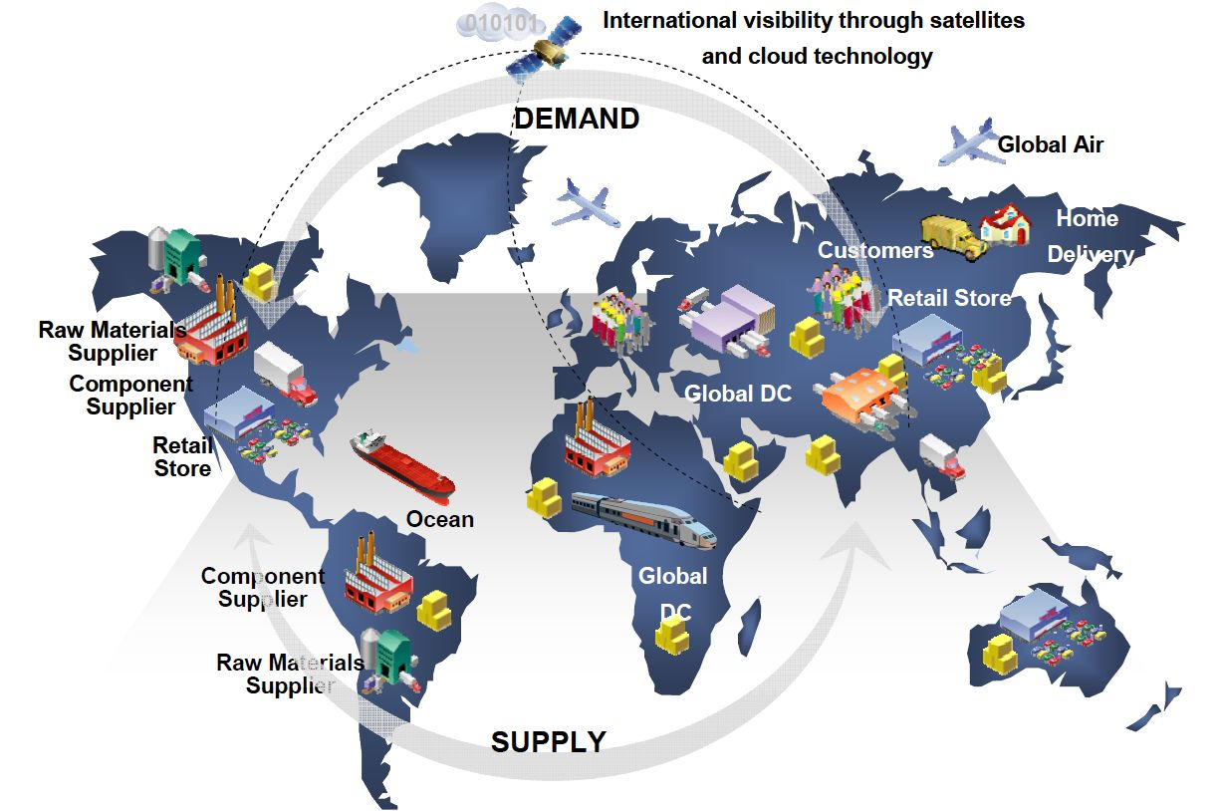
Global Sourcing Process and Supplier Relations
"Dieses Foto" von Unbekannter Autor ist lizenziert gemäß CC BY-SA-NC

Slide 28
Remember?
Internalisation advantage
Internalisation vs. Externalisation Transaction cost → Are transaction costs lower when internalising the foreign activities?
Internalisation
“Make”
Externalisation “Buy”
Notes:
Remember? We discussed at Dunning‘s Eclectic Paradigm.

Slide 29
Internalisation
“Make”
Externalisation “Buy”
Internalisation/Externalisation
Outsourcing
Procurement of selected value-adding activities, including production of intermediate goods or finished products from external independent suppliers
Usually companies internalise activities that are core competencies
Noncore products or services at lower cost or from suppliers specialised in providing them
Notes:
Companies have to decide whether each value-adding activity should be conducted in house (internalization) or by an external, independent supplier (externalization)→ outsourcing
Outsourcing: procurement of selected value-adding activities, including production of intermediate goods or finished products from external independent suppliers
Usually companies internalize activities they consider part of their core competencies
Companies usually source from external suppliers when they can obtain noncore products or services at lower cost or from suppliers specialized in providing them

Slide 30
Global Progression in the Purchasing Function
1. Domestic purchasing only
2. Foreign buying based on need
3. Foreign buying as part of a procurement strategy
4. Integration of global procurement strategy
→ centralisation/decentralisation dilemma
Be aware: This is following the Uppsala approach, Born Globals do not follow this
Notes:
However, there is also born global companies that start global
sourcing when they are founded (Born global companies).

Slide 31
Sourcing Strategies in the Global Context
Assign domestic buyers for foreign purchasing
Use foreign subsidiaries or business agents
Establish international purchasing offices
Assign the responsibility for global sourcing to a specific business unit or units
Integrate and coordinate worldwide sourcing
Coordinate worldwide purchasing with competitor companies
Notes:
Coordinate worldwide purchasing with competitor companies (f.ex. automakers Nissan and Renault; about 40% of the parts of the vehicles are the same→ joint purchasing agreements)

Slide 32
Steps and Questions in the Global Sourcing Process
1) Evaluate operating and competitive environments
How intensive and extensive does the global sourcing effort need to be?
Is global sourcing a valuable competitive option?
2) Define scope of
international purchasing effort
Can global sourcing help us better meet customers’ real needs?
What items should we source globally?
What structure and infrastructure are needed?
What skills will our purchasers need?
Does a cost-benefit analysis support the selected scope?

Slide 33
Steps and Questions in the Global Sourcing Process
3) Identify and evaluate
potential suppliers worldwide
Who are the best suppliers for each item?
Where are they located worldwide?
Can they provide world-class support to our global operations?
What is the total order performance?
total cost; delivery; quality; innovation; responsiveness
4) Determine appropriate nature of buyer-supplier relationship
Given our needs, the supplier’s location and capabilities, and the channel’s logistical challenges, what type of buyer-supplier relationship should we establish?

Slide 34
Steps and Questions in the Global Sourcing Process
5) Request/evaluate
proposals from suppliers
Are the proposals truly comparable at the total-ownership level?
6) Select “best” supplier, establish contract terms and conditions, and build desired relationship
Is future negotiation needed?
Who is the best supplier in the short term? Long term?
Are roles and responsibilities clearly understood?
Are performance expectations clearly stated and understood?
How are resources, risks, and rewards going to be shared?

Slide 35
Steps and Questions in the Global Sourcing Process
7) Continual re-evaluation of implementation status, requirements, and capabilities
Is the buyer-supplier relationship fully established? Effective?
Is the selected supplier performing at world-class standards?
Based on changes in our own operations, our competitive requirements, and our customers’ needs, does this relationship still make sense?

Slide 36
Short Exercise
Work as a group of two students and choose one country from
  Asia
  Europe
  Africa
What kind of risks and benefits you would get if you would start to purchase from suppliers located in the countries you selected?
Notes:
5 min per group + 5 -10 min discussion. Pick 2-3 groups
In total 15 min

Slide 37
The Need for Supplier Evaluation
The risks related to suppliers grow
New suppliers
Current suppliers,
Changes coming
Current suppliers,
No changes
The complexity of the
product grows
Standard products Simple parts Special parts
Notes:
Supplier evaluation is more important when the risks and the complexity of the product grows and you need special parts.

Slide 38
All the suppliers are not selected with the same criteria, but it depends on the level of cooperation between the supplier and the purchaser:
Planning together technical
solutions and processes
Project contracts
possible
Price main
criteria
Competition
Long-term
contracts
Total costs, cooperation, and quick solutions are
most important factors
Product according to specifications
Occasional
supplier
2. Supplier on
yearly basis
Levels of
Cooperation
Evaluation criteria:
- availability
- reliability
- same vision
- developing ability
- same values
- flexibility
- willingness and ability
for growth
3. Partnership
Network with companies
working closely together
Procedures
planned
together
Constant relationship
Development programmes

Slide 39
- delivery time and reliability
2. Big volumes →capacity
1. Availability
6. Other reasons
like
- confidential
information
What can make your
supplier critical
and important?
3. Technology used
4. Logistics
5. Assisting services
- technical support

Slide 40
Test of Seven M’s
Men Measurements
quality of work inspections
tools
Machines Milieu
capacity environmental policy
shape tidiness
Materials
quality Money
handling economic
situation
Methods
production planning
Notes:
One example easy to remember about the criterion when choosing and comparing possible suppliers.

Slide 41
Some Features Concerning Supplier
Relationships
1) Complexity
2) Relationships as investments →their long-term nature
3) Adaptations
4) Reciprocal trust rather than formality →security in a relationship
must develop over time
5) Power and dependence →usually varies with the general state of the
economy
6) Conflict and cooperation →the parties have both contradictory
interests and shared ones →balance between them
Supplier relations – a critical resource

Slide 42
Various Types of Adaptations
Technical → fit of data systems
Knowledge-based →combine the know-how of both parties
Administrative →joint communication, systems etc.
Economic → economic support
Legal → same legislative regulations

Slide 43

Supplier Relations – A Critical Resource
More than half of the total turnover of the firm is handled within these relationships
They comprise major investments
They are built up through human effort and human contacts → they are dynamic in a number of respects
They must be under continual development
All the relationships a company has are interrelated and interdependent →network

Slide 44
Strategic Options
Cost leadership
Differentiation
Reliability, economy, after-sales services, esteem, value, etc. aim at creating customer loyalty and brand preference → reduces the importance of price
Focus strategy
A combination of a) and b) directed at a particular target, e.g. a national/international market/specific group of customers
Unique products
Try to serve a specific group in an optimal way
Reduce the cost price of the end product
Cost structure, product experience, special skills, systems, and technologies

Slide 45
How Corporate Strategy Impacts Supply Chain Decisions
 | Low-cost strategy | Differentiation strategy | Response strategy
Primary supplier selection criteria | Cost | Product development skills Willing to share information Jointly and rapidly develop products | Capacity Speed Flexibility
Supply chain inventory | Minimise inventory to hold down costs | Minimise inventory to avoid product obsolescence | Use buffer stock to ensure speedy supply
Distribution network | Inexpensive transportation Sell through discount distributors/retailers | Gather and communicate market research data Knowledgeable sales staff | Fast transportation Provide premium customer service
Product design characteristics | Maximise performance Minimise cost | Modular design to aid product differentiation | Low setup time Rapid production ramp-up

Slide 46
The Effect of Company Strategy on the Supplier Selection
Company Strategy: Supplier:
Cost Leadership → → → → Efficient
- Company in forest industry, - Fast, direct, safe deliveries
a sawmill, or cellulose factory - high volumes
delivering bulk-products - No variations in product quality
- Effective order-delivery process - Continuous reduction in product
prices
- continuous developments in
logistical chain

Slide 47
The Effect of Company Strategy on……..
Company Strategy: Supplier:
Customer Orientation → → → → Flexible
- Machine shop or furniture - Flexibility
company with solutions for - Ready to produce different versions of
individual customers, quick modules of the product
production changes, and - Quick reactions
product modules - Interaction
- Integration of IT-systems

Slide 48
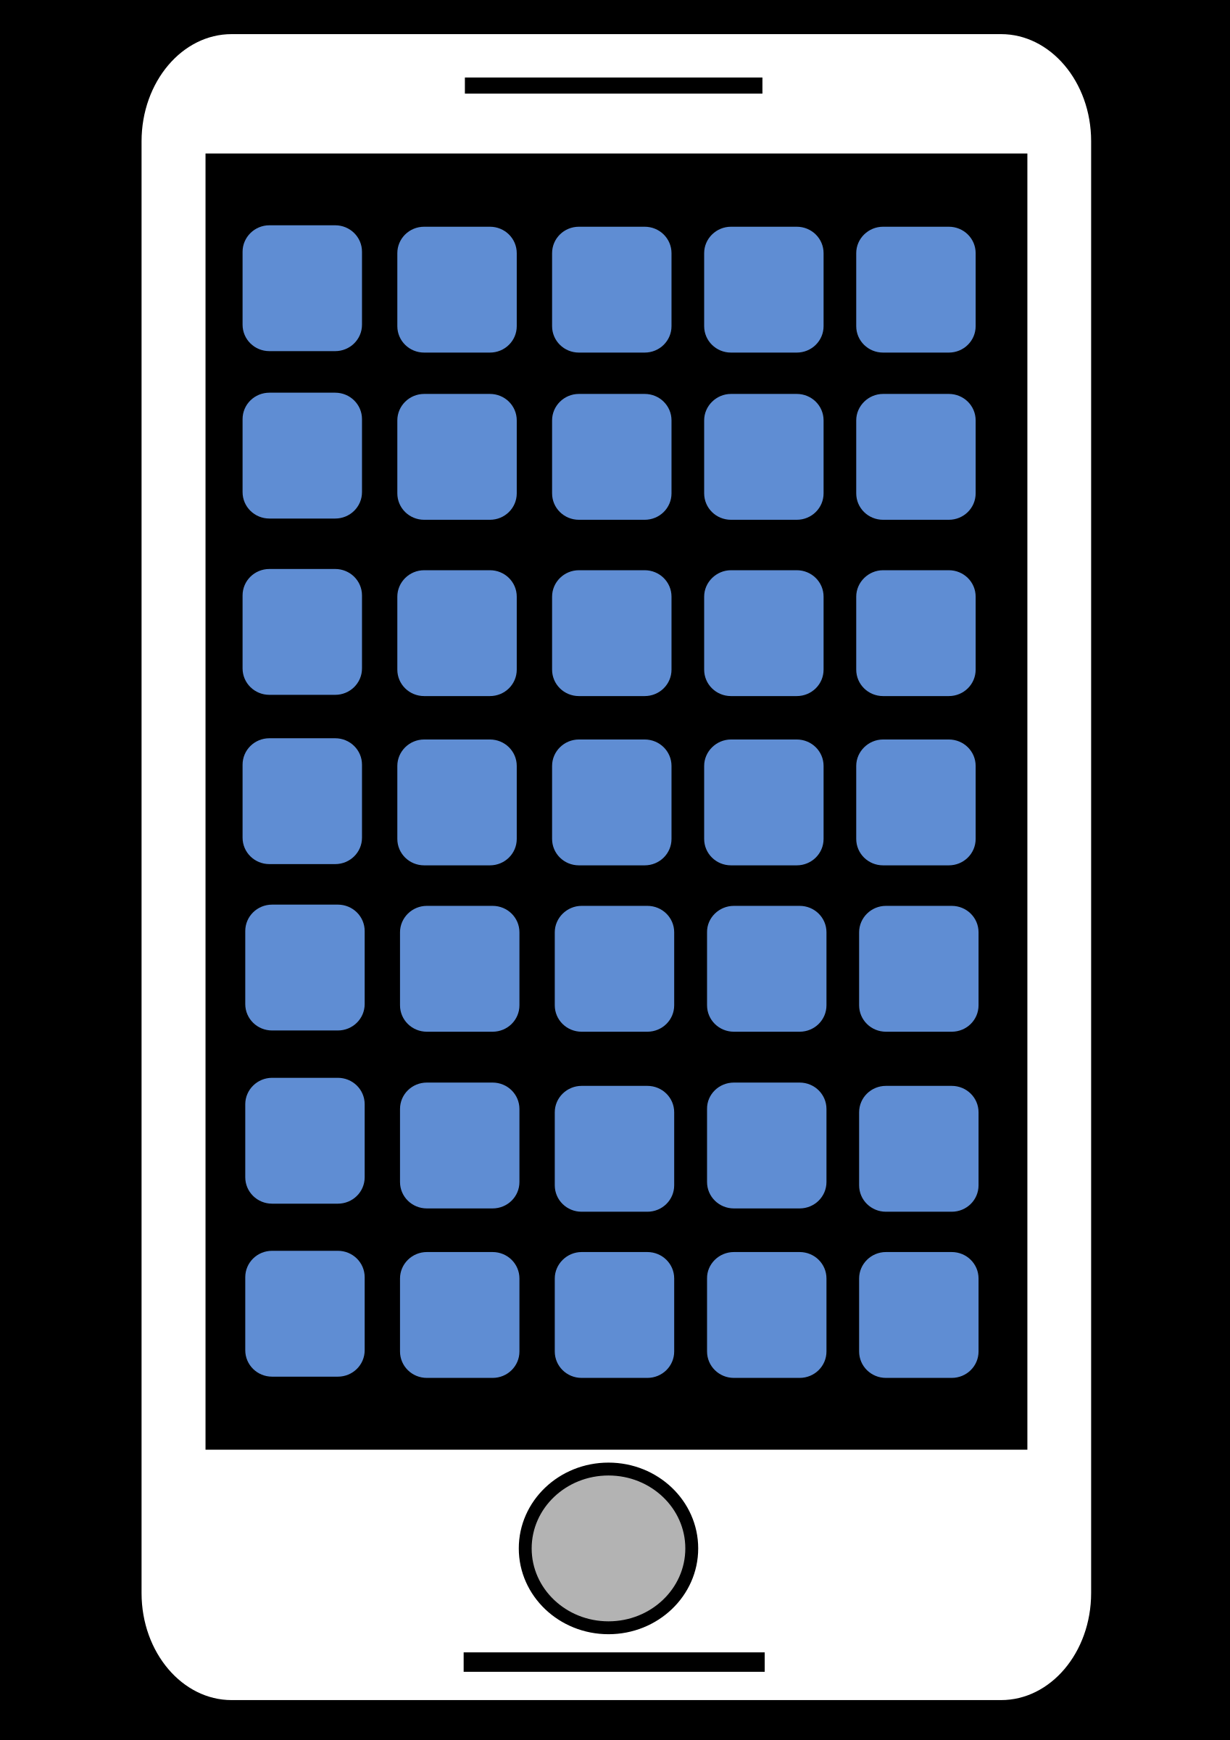
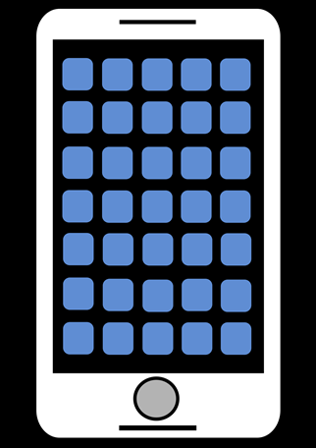
The Effect of Company Strategy on…..
Company Strategy: Supplier:
Product Leadership → → → →Pioneer
- Technology company known as - Fast product development
fast innovator, product developer, - High level of knowledge in its own
and new models field
- Ready for deep cooperation in supply chain

Slide 49
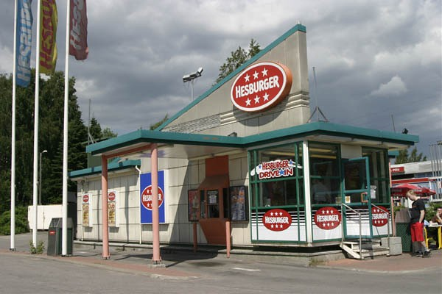
The Effect of Company Strategy on…
Company Strategy: Supplier:
Market Leadership → → → → → Invader
- A company that is expanding its - Ability and willingness to grow its
functions quickly, e.g. a fast food functions
chain - Willingness for investments

Slide 50
Strategic Questions
The most important strategic questions in purchasing:
• How to secure the availability of the most important and most critical raw
materials and services?
• How to secure the competitiveness and continuous development of products
and operations?
• How to optimise the need for capital and maximise it’s return on assets →
make or buy? Inventory costs, payments etc.
• How to maintain and develop flexibility in quickly changing markets?
• Local or global sourcing? How we put it into practice?
• How purchasing integrates into other functions in the company?

Slide 51
References
Cavusgil, S., Knight, G. & Riesenberger, J. (2017). International Business. The New Realities. Pearson Education Limited.
Cousins, P., Lamming, R., Lawson, B. & Squire, B. (2008). Strategic Supply Management. Priciples, Theories and Practice. Pearson Prentice Hall.
Daniels, J., Radebaugh, L. & Sullivan, D. (2009). International Business. Environments and Operations. Pearson Prentice Hall.
Heizer, J., Render, B. & Munson, C. (2017).Operations Management. Sustainability and Supply Chain Management. Pearson Education Limited.
Iloranta,K. & Pajunen-Muhonen, H. (2015). Hankintojen johtaminen. Ostamisesta toimittajamarkkinoiden hallintaan. Tietosanoma Oy.
Van Weele, A. (2014). Purchasing and Supply Chain Management. Cengage Learning EMEA.
Wild, J., Wild, K. & Hahn, J. (2010). International Business. The Challenges of Globalization. Pearson Prentice Hall.

Slide 52
Incoterms 2010

Slide 53
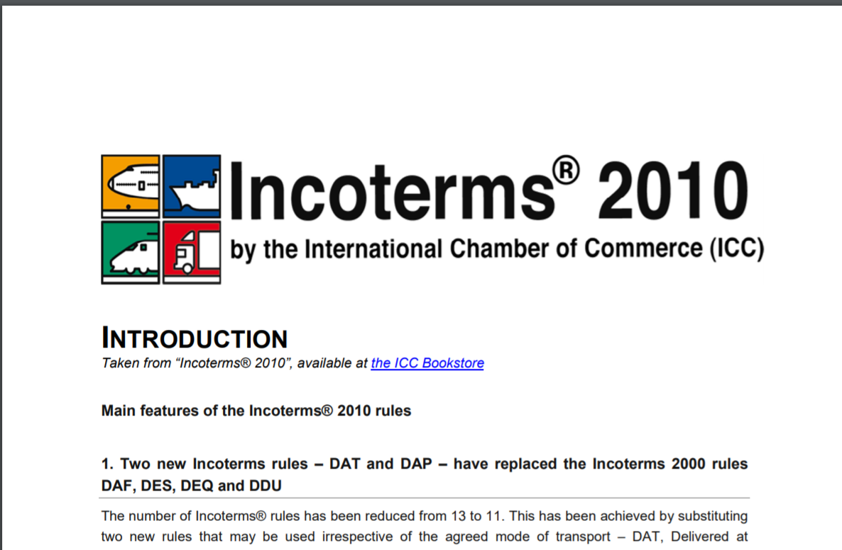
Introduction to Incoterms

Slide 54
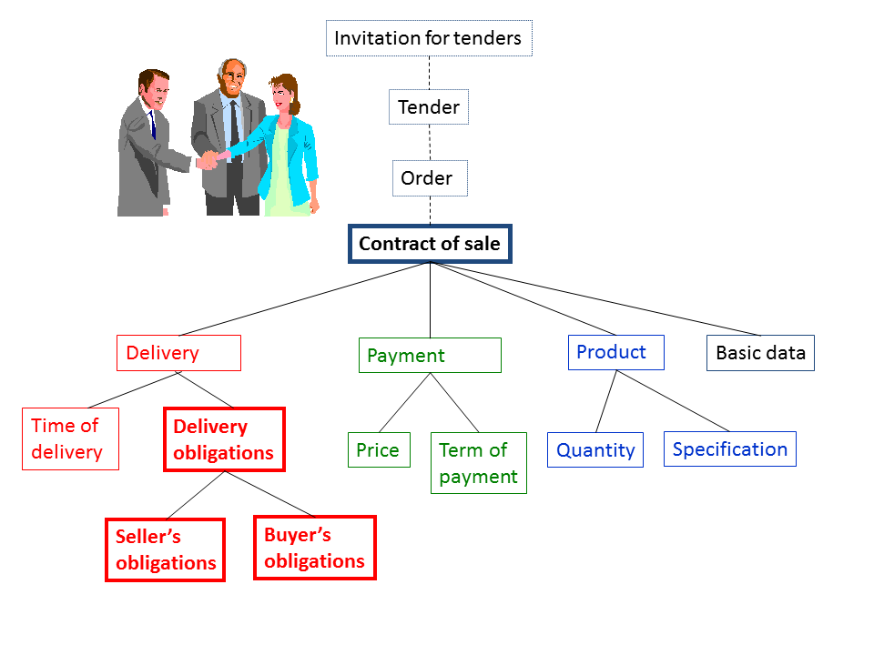
The contents of a contract of sale (Source: www.logistiikanmaailma.fi)
Notes:
INCOTERMS describe many things related to seller’s and buyer’s obligations (risks, costs, tasks involved in the delivery of goods)

Slide 55
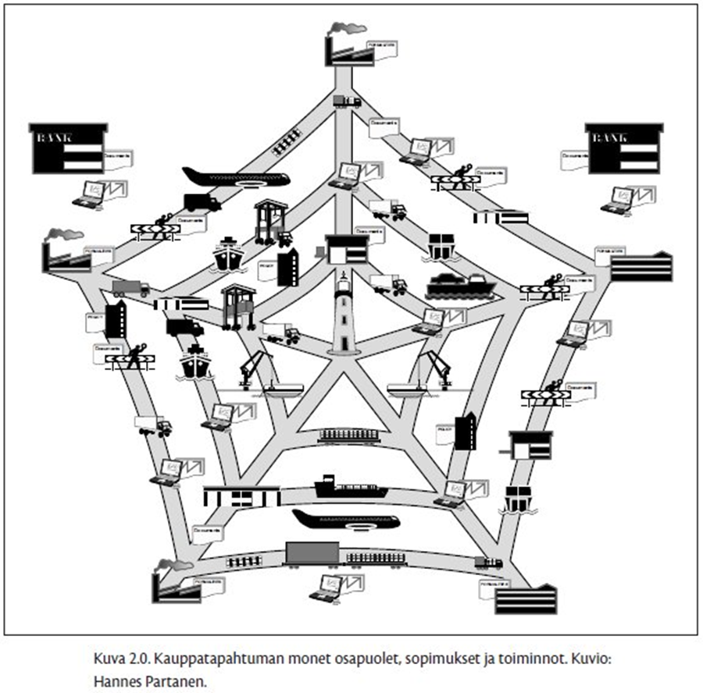
Business transactions include many parties, contracts, and activities
(Source: INCOTERMS 2010 käyttäjän käsi-
kirja)

Slide 56
Incoterms
Incoterms are a set of rules which define the responsibilities of sellers and buyers for the delivery of goods under sales contracts
They are published by the International Chamber of Commerce (ICC) and are widely used in commercial transactions
First created in 1936
Current version are the Incoterms 2010
They include 11 different rules
They say nothing about the price or payment method, neither deal with the transfer of ownership of the goods or the consequences of a breach of contract

Slide 57
Incoterms (=International Commercial Terms)
Explain business-to-business practices in contracts for the sale of goods
Describe mainly the tasks, costs, and risks involved in the delivery of goods from sellers to buyers
Delivery
Costs
Risk
Until which point the seller can give instructions about and bear the delivery risk concerning the goods
Which costs of delivery are to be paid by the seller
Possibility of damage to or loss of goods or general average during transit, or of delay of delivery
From which point the buyer gives instructions and bears the risk
Which costs are to be paid by the buyer
Notes:
The Incoterms or International Commercial Terms are a series of pre-defined commercial terms published by the International Chamber of Commerce (ICC) relating to international commercial law. They are widely used in international commercial transactions or procurement processes and their use is encouraged by trade councils, courts and international lawyers.^{[1]} A series of three-letter trade terms related to common contractual sales practices, the Incoterms rules are intended primarily to clearly communicate the tasks, costs, and risks associated with the global or international transportation and delivery of goods. Incoterms inform sales contracts defining respective obligations, costs, and risks involved in the delivery of goods from the seller to the buyer, but they do not themselves conclude a contract, determine the price payable, currency or credit terms, govern contract law or define where title to goods transfers.
The Incoterms rules are accepted by governments, legal authorities, and practitioners worldwide for the interpretation of most commonly used terms in international trade. They are intended to reduce or remove altogether uncertainties arising from differing interpretation of the rules in different countries. As such they are regularly incorporated into sales contracts^{[2]} worldwide.
11 different terms/rules
say nothing about the price to be paid or the method of its payment, neither deal with the transfer of ownership of the goods or the consequences of a breach of contract
created by International Chamber of Commerce (Incoterms 2010, Incoterms 2000, Incoterms 1990 etc. the first Incoterms in 1936)

Slide 58
The Terms of Delivery
Defines the following things in mutual relation between the seller and the buyer:
    Delivery and taking delivery
    Division of costs
    Transfer of risk
    Other mutual obligations
Does not define:
    Relationship between the seller/buyer and any third party
    Title to the goods (“ownership”)

Slide 59
Incoterms Clearly Mentioned in:
Request for quotations
Orders
Confirmations
Contracts
Invoices
Example: FCA Hamburg, Incoterms 2010
If you agree on something differently than stated in Incoterms, you’ll have to mention it in the contract

Slide 60


Two Different Groups
1) All modes of transport
  EXW, FCA, CPT, CIP, DAT, DAP, DDP
2) Only for sea and inland waterway transport
  FAS, FOB, CFR, CIF

Slide 61
How to choose the right Incoterms?
Nowadays many companies want to control the whole material chain:
  Companies can control the whole transportation chain
  They can use domestic insurance and transportation companies
  Can effect to the speed, mode of transport, and route
  Which one (seller or purchaser) has higher transportation volumes → effects the price, better contracts
  Acquired habits or earlier experiences may also strongly effect to the use of Incoterms

Slide 62
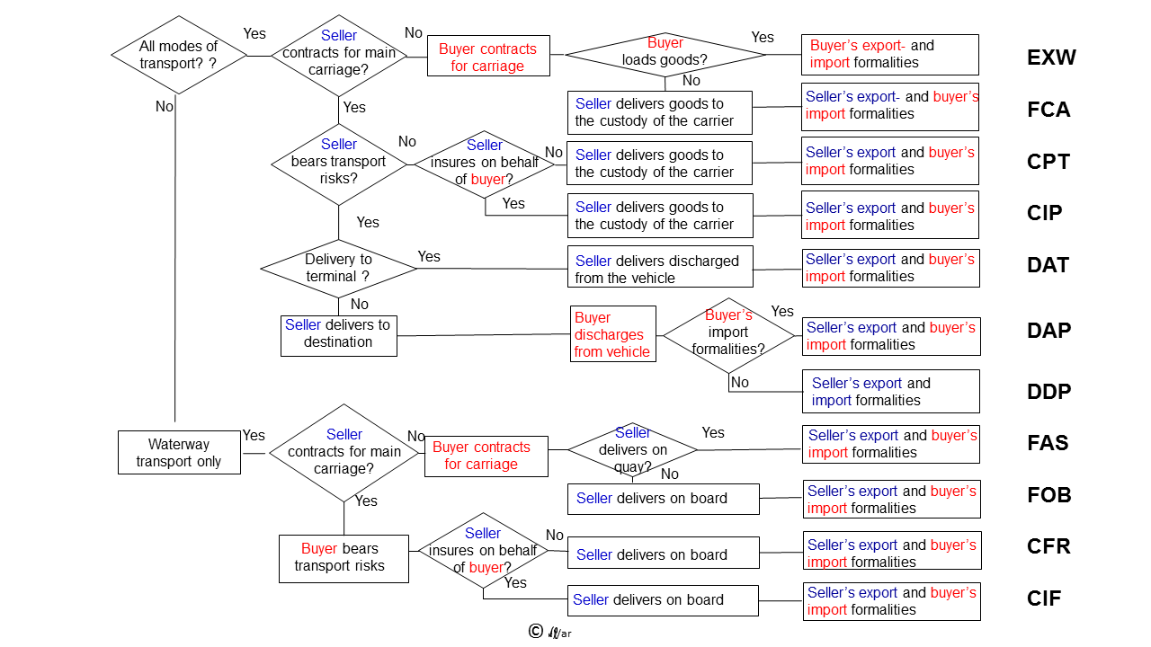
(Source: www.logistiikanmaailma.fi)

Slide 63
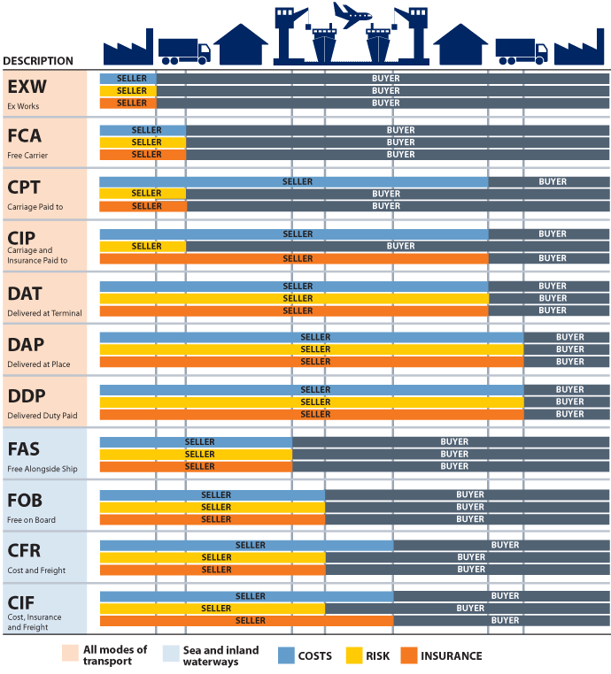

Slide 64
1. EXW (Ex Works), Named Place of Delivery
Suitable for all modes of transport
Means a minimum obligation for the seller; the seller “delivers” when it places the goods at the disposal of the buyer at the seller’s premises or at another named place (i.e. factory, warehouse, etc.)
The buyer bears all risks of loss or damage to the goods from the time they have been delivered (at the warehouse etc. → loading is already on buyer’s risk)
If you want the seller to take care of export formalities, you may use the term “ex works cleared for export”
To avoid problems with loading, FCA would be more preferred

Slide 65
2. FCA (Free Carrier); Named Place of Delivery
Suitable for all modes of transport; also for container traffic
The seller “delivers” the goods to the carrier or another person nominated by the buyer at the seller’s premises or another named place (the point has to be specified as clearly as possible)
The buyer bears all risks of loss or damage to the goods from the time they have been delivered as mentioned above (general rule: the goods are at the disposal of the buyer in the vehicle arriving at the terminal)
The seller clears the goods for export, where applicable
The seller has no obligation to make a contract of carriage, but if the buyer requests it or it’s commercial practice, the seller may contract for carriage on usual terms at the buyer’s risk and expense (but the seller may also decline to make it)
In container transport it is generally advised to use FCA instead of FOB

Slide 66
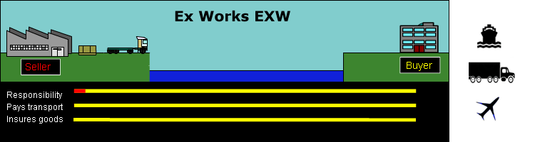
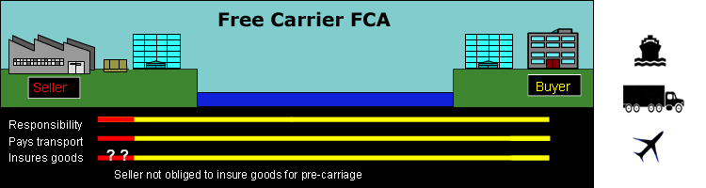

Slide 67
3. CPT (Carriage Paid To), Named Place of Destination
For all modes of transport and especially container traffic
The seller pays the freight to the named place of destination
The seller may decide the carrier and the place where the goods are delivered to this carrier
The buyer bears all risks of loss of or damage to the goods from the time they have been delivered to the carrier contracted (place of delivery)
In the contract it’s important to define the place of delivery (transfer of risks) and the named place of destination, where the seller makes the transportation contract
Clearer rule than CFR or CIF

Slide 68
4. CIP, (Carriage and Insurance Paid to), Named Place of Destination
For all modes of transport
The buyer bears all risks of loss of or damage to the goods from the time they
have been delivered to the carrier contracted (place of delivery)
In the contract it’s important to define the place of delivery (transfer of risks) and the named place of destination, where the seller makes the transportation contract
The seller must obtain a cargo insurance on behalf of the buyer with an insurance company of good reputation from the place of delivery to the place of destination
The insurance must be contracted at least with minimum terms; in most cases goods
are insured with widest possible terms
The insured value is at least the CIP-value + 10 %

Slide 69
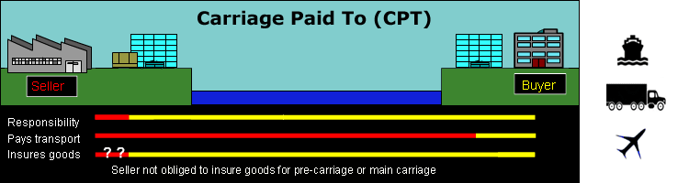
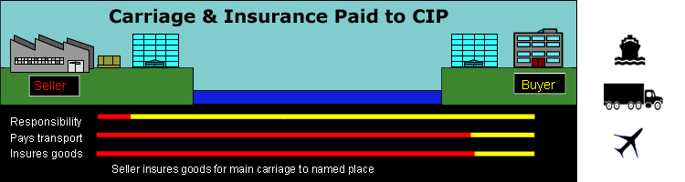

Slide 70
5. DAT (Delivered At Terminal), Named Terminal at Port or Place of Destination
For all modes of transport
The seller “delivers” when the goods, once unloaded from the arriving means of transport, are placed at the disposal of the buyer at a named terminal at the named port or place of destination
’Terminal’ usually near the buyer, after the main transportation
’Terminal’ includes any place, whether covered or not, such as a quay, warehouse, container yard or road, rail or cargo terminal
The buyer obtains import licenses or other official authorisation and carries out all customs formalities for the import of the goods

Slide 71
6. DAP (Delivered At Place) Named Place of Destination
For all modes of transport
The seller “delivers” when the goods are placed at the disposal of the buyer on the arriving means of transport ready for unloading at the named place of destination
The seller bears all risks involved in bringing the goods to the named place
The buyer clears the goods for import and pay import duties, taxes, etc.

Slide 72
7. DDP (Delivered Duty Paid), Named Place of Destination
For all modes of transport
The seller “delivers” when the goods are placed at the disposal of the buyer, cleared for import on the arriving means of transport ready for unloading at the named place of destination
The seller bears all the costs and risks involved in bringing the goods to the place of destination and clears the goods also for import, pays duties and carries out all customs formalities
The seller should know the circumstances in purchaser’s country
The seller also pays the VAT → the seller has to be registered in purchaser’s country or it has a tax representative on that country → often DAP is a better choice

Slide 73
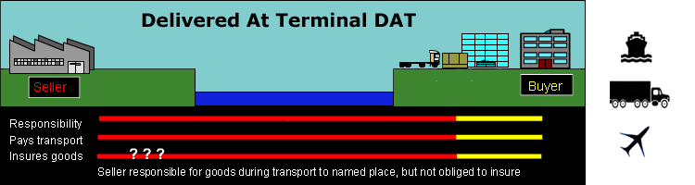
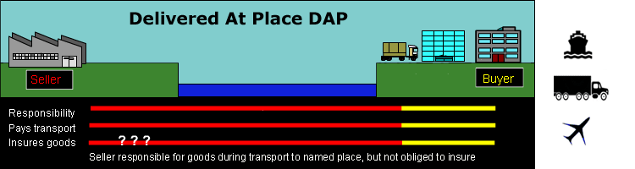
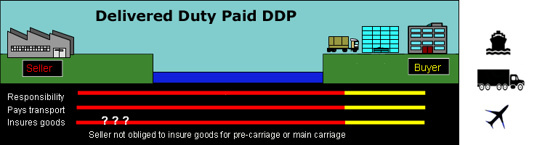

Slide 74
8. FAS (Free Alongside Ship), Named Port of Shipment
For sea or inland waterway transport (sawn timber)
Not good for terminal transportation
The seller “delivers” when the goods are placed alongside the vessel (e.g. on a quay) nominated by the buyer at the named port of shipment
The risk of loss of damage to the goods passes when the goods are alongside the ship, and the buyer bears all costs from that moment onwards

Slide 75
9. FOB (Free On Board), Named Port of Shipment
Sea or inland waterway transportation
The seller “delivers” the goods on board the vessel nominated by the buyer at the named port of shipment
The risk of loss or of damage to the goods passes when the goods are on board the vessel (the first safe place on the vessel) and the buyer bears all costs from that moment onwards
The seller clears the goods for export, where applicable

Slide 76
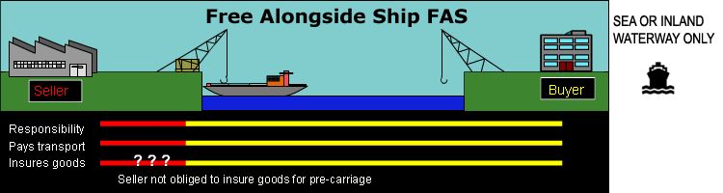
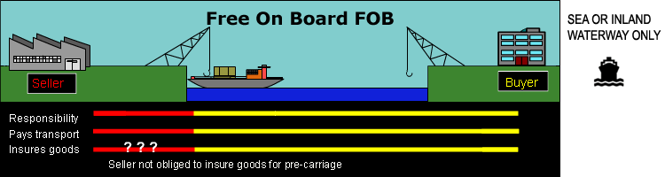

Slide 77
10. CFR (Cost and Freight), Named Port of Destination
Sea or inland waterway transportation
The seller delivers the goods on board of the vessel
The risk of loss of or damage to the goods passes when the goods are on board the vessel (the first safe place)
The seller pays the freight to the named port of destination
The seller has to deliver the shipping document to the purchaser without delay

Slide 78
11. CIF (Cost, Insurance and Freight), Named Port of Destination
Sea or inland waterway transportation
The seller delivers the goods on board of the vessel
The risk of loss of or damage to the goods passes when the goods are on board the vessel (the first safe place)
The seller pays the freight to the named port of destination
May not be appropriate where goods are handed over to the carrier before they are on board the vessel, e.g. goods in containers → CIP would be better

Slide 79
CIF and Insurance
The seller also contracts, at its own expense, for insurance cover against the buyer’s risk of or damage to the goods during the carriage
The cargo insurance must comply at least with the minimum cover (CIF-price + 10%) provided by clause (C) of the Institute Cargo Clauses or any similar clauses
When required by the buyer, the seller shall provide, at the buyer’s expense, any additional cover, such as clauses (A) or (B) of the Institute Cargo Clauses (+ War Clauses, + Strike Clauses)

Slide 80
CIF, What the Buyer Should Take Into Account Concerning Insurance
How much is the insurance payment compare with domestic payments?
Is the insurance valid only to the port of destination or to the buyer’s inland warehouse?
Has the insurance been taken only on minimum cover (fire on board, sinking, running aground); is it suitable to the products that are transported?

Slide 81
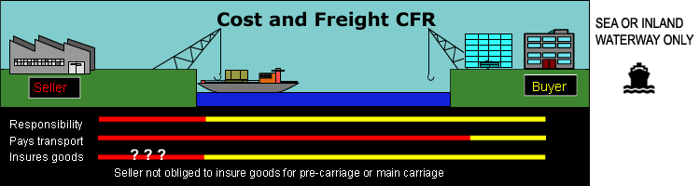
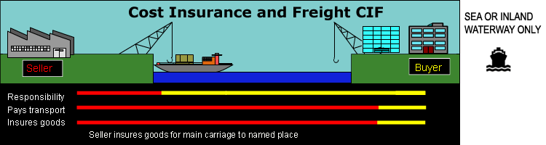
https://www.incotermsexplained.com/wp-content/uploads/2013/10/cfr.gif

Slide 82
Important to Notice
When CPT, CIP, CFR, or CIF are used, the seller fulfils its obligation to deliver when it hands the goods over to the carrier and not when the goods reach the place of destination
There are two critical points, because risk passes and costs are transferred at different places
While the contract will always specify a destination port, it might not specify the port of shipment, which is where risk passes to the buyer. If the shipment port is important to the buyer, it should be identified as precisely as possible in the contract

Slide 83
Legislation
If there are not any agreements concerning legislation on contracts:
F- and C-terms: the legislation of seller’s country
D-terms: the legislation of buyer’s country

Slide 84
Examples
Price lists: FCA
Request for quotations: e.g. FCA, DAP (the seller might have cheap transportation agreements)
Offers: DDP/DAP (the price of the goods are easy to compare with domestic suppliers, but you have to find out if there are any import payments)

Slide 85
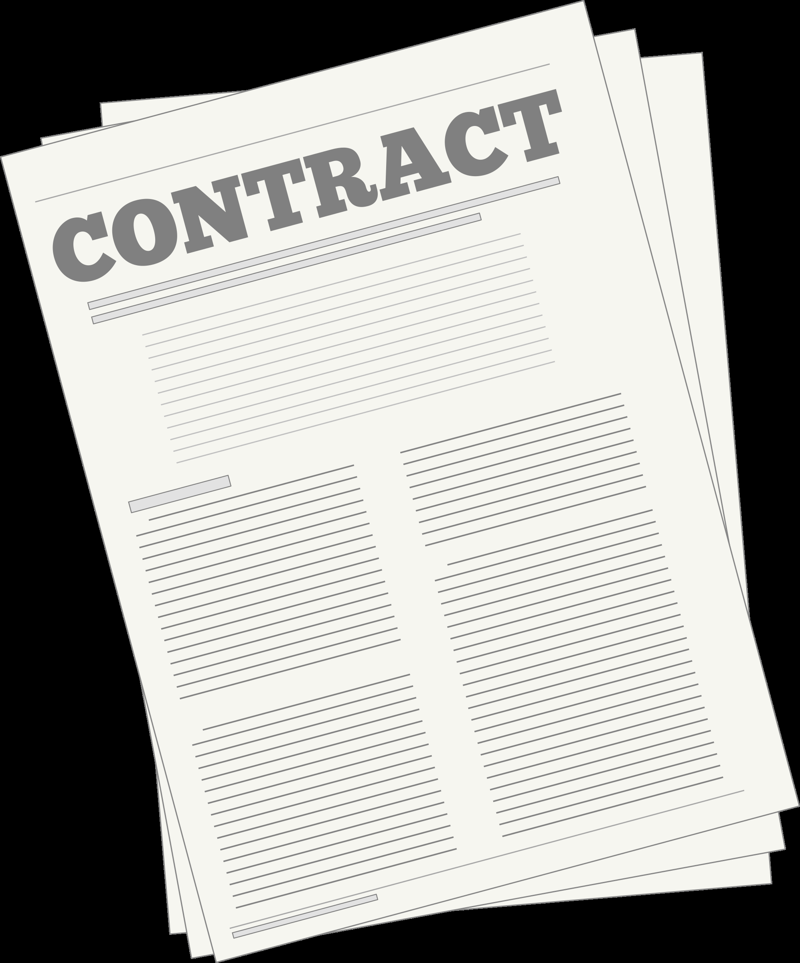
Transportation Agreements
Purchaser makes the agreement:
  EXW, FCA, FAS, FOB
Seller makes the agreement:
  CPT, CIP, CFR, CIF, DAT, DAP, DDU

Slide 86
Assignment 1
You are purchasing 300 components from a Polish supplier in Warsaw. You know the following costs:
Selling price 300 €/unit
Transportation costs in Warsaw to the terminal named by purchaser 50 €
Transportation costs Warsaw-Gdansk 200 €
Loading costs in Gdansk150 €
Freight Gdansk-Helsinki 500 €
Unloading in Helsinki 150 €
Transportation to purchaser’s warehouse 80 €
Insurance Gdansk-Helsinki 300 €
You don’t have to notice other costs. What is the price for the purchaser with following terms:
EXW Warsaw (Incoterms 2010)
CIF Helsinki (Inc…..)
FOB Gdansk (Inc….)
FCA Warsaw (Inc….) (Schenker terminal)
Notes:
You can change the city acording to the country (CIF Hamburg, CIF Rotterdam etc.). The right answers: EXW Warsaw: 91 430, CIF Helsinki: 90 230, FOB Gdansk: 91 030, FCA Warsaw (Schenker terminal: 91 380.

Slide 87
References
Iloranta,K. & Pajunen-Muhonen, H. 2015. Hankintojen johtaminen. Ostamisesta toimittajamarkkinoiden hallintaan. Tietosanoma Oy.
International Chamber of Commerce.2010. Incoterms 2010. ICC Publication No. 715E-FIN.
Logistiikan maailma: www.logistiikanmaailma.fi/en
Logistiikka-magazin 7/2010, 8/2011, 1/2012.
Melin, K. 2011. Ulkomaankaupan menettelyt. Vienti ja tuonti. Amk-kustannus Oy.
Wild, J. & Wild, K. 2012. International Business. The challenges of globalization. Pearson Education Limited.
https://www.sepa.ch/en/home.html
http://www.wcl-shipping.com/wcl-17/wcl/images/pdf/incoterms_2010_chart.pdf
https://www.incotermsexplained.com/the-incoterms-rules/incoterms-2010-rules/)

Slide 88
Import/Purchasing; Supply-Chain Management; Outsourcing; Supplier Relations
Summary

Slide 89
Supply chain
Second-tier supplier
First-tier supplier
First-tier customer
Second-tier customer
End customer
Supply side
Demand side
Purchasing and supply management
Physical distribution management
Information flow
Logistics
Physical flow
Materials management
Supply chain management
(Slack, Brandon-Jones & Johnston, 2014)

Slide 90
Summary
Supply Chain Management is the management of the interconnection of organisations that relate to each other through upstream and downstream linkages
Six main sourcing strategies can be differentiated: many suppliers, few suppliers, vertical integration, keiretsu networks, joint ventures, and virtual companies
The bullwhip effect can be explained as an occurrence detected by the supply chain where orders sent to the manufacturer and supplier create larger variance then the sales to the end customer
Companies have to decide whether each value-adding activity should be conducted in-house (internalisation) or by an external, independent supplier (externalisation) or outsourcing

Slide 91
Summary
Supplier relations are a critical resource and must fit the company strategy
Incoterms are a set of rules which define the responsibilities of sellers and buyers for the delivery of goods under sales contracts

Slide 92
Learning Objectives
Students can explain what supply chain is and its different components and what kind of things affect the supply chain of some certain product/company
Students can recall the benefits, elements, risks, and mitigation tactics of supply chain management and can apply a suitable purchasing strategy in different situations
Students understand the different steps in the global sourcing process and know what elements to research during every step before decision making

Slide 93
Learning Objectives
Students understand the importance of supplier relations for the purchasing company and how it affects the level of cooperation to the criteria of supplier selection
The student can explain the basic idea of 11 different terms and analyse what would be the best Incoterms for companies in different situations
Students train their research and analytical skills by studying the cases and looking for the answers to questions by comparing the information given during lectures and in other readings and what happened with the case companies

Slide 94
Short Assignment
In groups of two students write down three questions related to the topics of this chapter
Also, highlight if there are still some unclear issues or where you would have liked to get more information

