Slide 1
C.1.2.4. Strategic Alternatives
Notes:
How to organize international business

Slide 2
Learning Objectives
Understand the necessary steps to develop an international strategy
Be able to evaluate different strategic alternatives
Understand the relevance deciding for a strategic alternative for Internationalising

Slide 3
Steps in Developing International Strategies
1. Mission and Objectives
2. External Analysis
3. Internal and Competitive Analysis
4. Strategy Alternatives
5. Strategic Choice, Implementation, Feedback, and Control
Notes:
However, developing an international strategy is far more complex than developing a domestic one. Managers developing an international strategy must understand and deal with multiple governments, currencies, accounting systems, political systems, and legal systems, as well as a variety of languages and cultures. They must also implement strategic plans among business units located in different parts of the world, as well as monitor and control strategic outcomes.

Slide 4
Step 1: Establish Mission and Objectives
Purpose
Values
Directions
Notes:
The international strategic planning process begins with the creation of a mission statement, which clarifies the organization’s purpose, values, and directions. It may specify such factors as the firm’s target customers and markets, principal products or services, geographical domain, core technologies, concerns for survival, plans for growth and profitability, basic philosophy, and desired public image.
A multinational enterprise may have multiple mission statements—one for the overall firm and one for each of its foreign subsidiaries. Of course, a firm that has multiple mission statements must ensure that they are compatible.

Slide 5
Steps in Developing International Strategies
1. Mission and Objectives
2. External Analysis
3. Internal and Competitive Analysis
4. Strategy Alternatives
5. Strategic Choice, Implementation, Feedback, and Control
Notes:
Remember?

Slide 6
Step 4: Evaluate International Strategic Alternatives
Alternative Strategies
Pressure for Local Responsiveness
Pressure for Global Integration
Notes:
Global Business Strategies
A major concern for managers deciding on a global business strategy is the tradeoff between global integration and local responsiveness. Global integration is the degree to which the company is able to use the same products and methods in other countries. Local responsiveness is the degree to which the company must customize their products and methods to meet conditions in other countries.
The strategic planning process involves considering the advantages (and disadvantages) of various strategic alternatives in the light of the competitive analysis. While weighing alternatives, managers must take into account the goals of their firms and the competitive status of other firms in the industry.
Firms face two conflicting pressures:
Pressures for global integration
the process of combining differentiated parts into a standardized whole
maximize efficiency
Pressures for local responsiveness
the process of disaggregating a standardized whole into differentiated parts
optimize effectiveness

Slide 7
Some Research about SMEs
SMEs have limited financial and personnel resources (Brouthers & Nakos, 2004; Nakos & Brouthers, 2002)
SMEs have a high level of sensitivity to external influences (Cheng & Yu, 2008; Krishna Erramilli & D′ Souza 1995), → entry mode that allows them to deal effectively with host country risks
SMEs have different ownership structure and management characteristics (family-owned and/or ownermanaged) (Cheng, 2008; Pinho, 2007) Family-owned firms are often less willing to share control with a partner (Fernandez & Nieto, 2006).
Notes:
SMEs have limited financial and personnel resources (Brouthers & Nakos, 2004; Nakos & Brouthers, 2002)
SMEs have a high level of sensitivity to external influences (Cheng & Yu, 2008; Erramilli & D’Souza, 1995), making it particularly important for SMEs to find an entry mode that allows them to deal effectively with the risks that arise in the host country
SMEs have different ownership structure and management characteristics (Cheng, 2008; Pinho, 2007), as many SMEs are family-owned and/or ownermanaged. Therefore, their choice of entry mode may differ from that of large multinationals. Family-owned firms are often less willing to share control with a partner (e.g. in an equity joint venture) (Fernandez & Nieto, 2006).

Slide 8
Market Entry Mode influenced by:
Host country knowledge:
Context-specific resources:
Legitimacy:
Acquiring takes time, → costly and inefficient, and leads to mistakes (Dierickx & Cool, 1989) → that are more difficult for an SME than a larger firm to bear.
→ expensive to acquire and time costly. → could be obtained from network, relationships, distribution channels and even government authorities when formal institutions are weak (Peng & Heath, 1996).
SMEs with small resources and a lack of proven products on the market lack legitimacy and attractiveness for collaboration.
Notes:
Host country knowledge: Acquiring this knowledge through incremental experience accumulation takes time, can prove costly and inefficient, and leads to mistakes (Dierickx & Cool, 1989) that are more difficult for an SME than a larger firm to bear.
Context-specific resources: Working through chaos, the ability to communicate and manage local adversities, and the ability to manage interfaces with local government are all key to entering emerging markets. These skills are expensive to acquire and time costly. They could be obtained from network, relationships, distribution channels and even government authorities when formal institutions are weak (Peng & Heath, 1996).
Legitimacy: Legitimacy is crucial to the survival of companies. Small enterprises with small resources and a lack of proven products on the market lack legitimacy and attractiveness for collaboration.

Slide 9
SMEs – How to expand?
biggest chances: SMEs operating in sectors that offer innovative products or services that provide a value for which clients in international markets are willing to take the risk to order or to partner
Importance of networks and local partnership
Access and ownership of resources is crucial
Cooperative entry modes recommended
Khalil, 2017
Notes:
SMEs that have the biggest chances to expand successfully into international markets are those operating in sectors that offer innovative products or services that provide a value for which clients in international markets are willing to take the risk to order or to partner
SMEs need to access the right networks and local partners in international markets to develop partnerships and alliances that lead to the successful operationalization of their market entry.
Networking - the importance of networking to overcome institutional barriers and country risks, and to gain knowledge about the market
Resources - an SME need resources with the potential to generate value and capabilities that will enable the SME to transform its resources into competitive advantages in products or services
Cooperative entry modes recommeded, because local partners are able to manage local influences and to reduce transaction costs utilizing their knowledge, experience and business networks. Strategic alliances are among these cooperative entry modes. They are characterized by dynamism, collaboration, mutual learning, adaptability to change and adjustment over time (Dioz, 1998)

Slide 10
The Global Organisational Challenge
0
Increased complexity and differentiation
- Greater level of internal and external complexity
- Numerous differences include economic development, language, political system, cultural norms and values, etc.
- Increasing needs for greater response to local preferences
Integration
- It is necessary for a global organisation to reap the benefit of economies of scale, economies of scope, and low-cost production
Knowledge transfer
- International environment offers opportunities for
learning and the development of diverse capabilities

Slide 11
Global Integration
What does global integration mean?
  The firm gains comparative advantages by integrating globally distributed activities into its value chain
Implications :
  Downstream activities are often country-specific
    Firm’s reputation
    Brand name
    Service network
  Upstream activities are more often subject to global competition
  A firm can realise integration benefits more easily on the level of upstream activities
Downstream vs. Upstream along value chain
Downstream: more related to the customer
Upstream: decoupled from where the customer is located

Slide 12
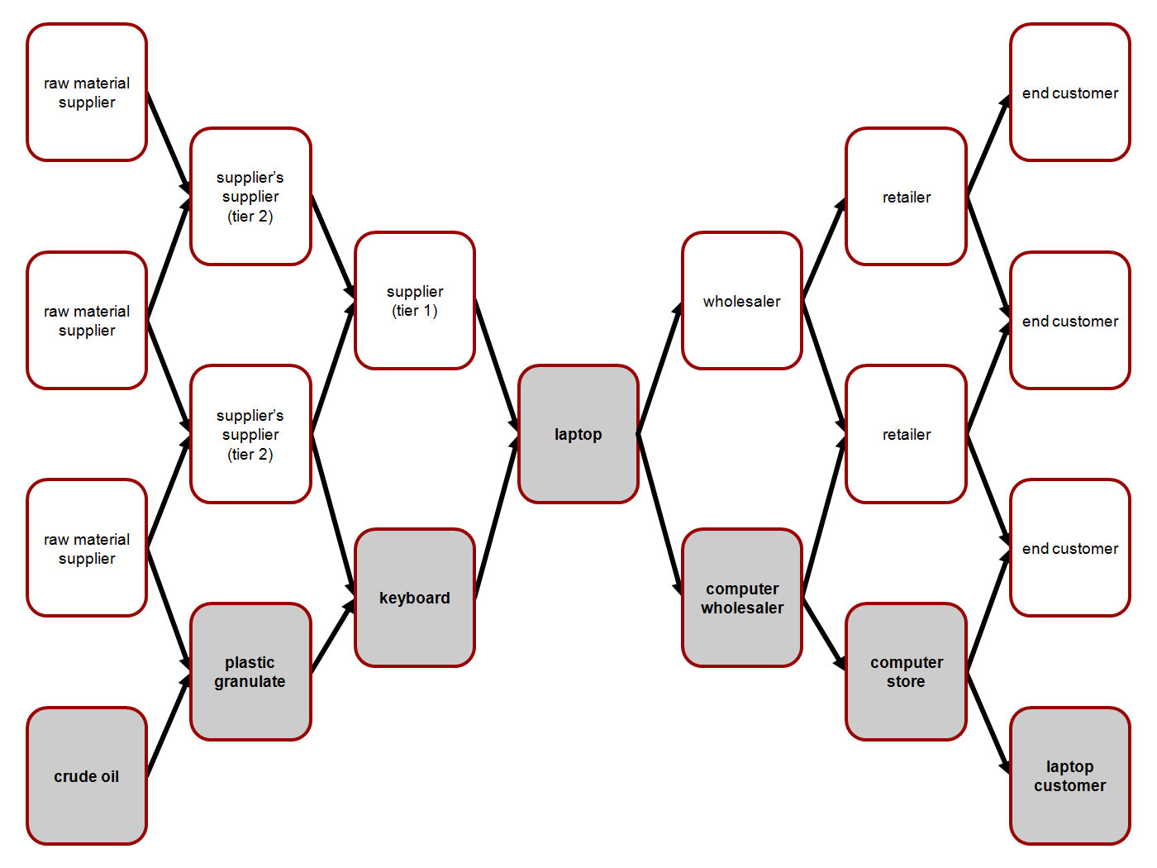
What is upstream, what is downstream?
Source: Wieland, Andreas; Wallenburg, Carl Marcus (2011): Supply-Chain-Management in stürmischen Zeiten. Berlin, p.8.

Slide 13
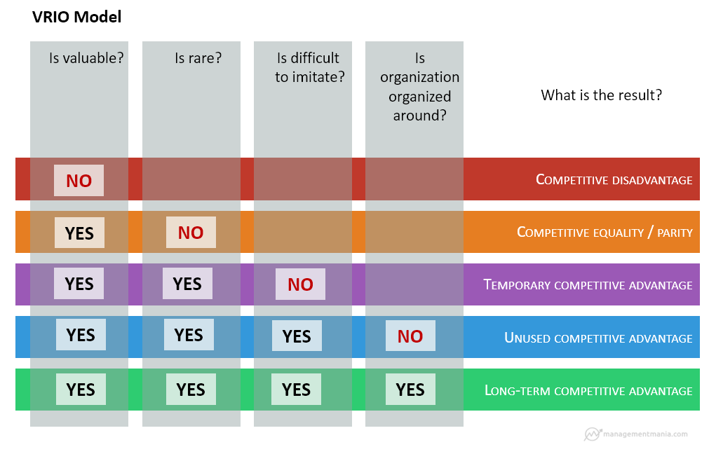
https://managementmania.com/en/vrio-analysis
Notes:
Students can use this model to answer the question what is an essential resource to the company. Can it be outsourced if it is considered not to be essential?

Slide 14
What does “Global Integration” mean?
When designing the value chain, two dimensions are of central significance:
dispersed: many locations per activity
concentrated: one location per activity
  Configuration of the value chain: Where and in how many places in the world is a value chain activity preformed?
  Coordination of the value chain: How closely are the different activities of the value chain coordinated with each other?
high coordination: centralised decisions
low coordination: decentralised decisions

Slide 15
Design Options of the Value Chain
high
Coordination
Activities
low
Configuration
Source: Porter, M. E. (1986), Changing Patterns of International Competition, in: California Management, Review, Vol. 28, No. 2, p.9-40.
dispersed
concentrated
Notes:
An integrated value chain, i.e. a value chain that serves the global market with standardized products, is characterized by
Geographically concentrated activities (configuration) and
Centrally coordinated activities (high coordination)

Slide 16
Conditions for Global Integration
Generating economies of scale with regard to every activity
Realising learning effects with regard to each activity
Realising relative competitive advantages by choosing a concentrated location
Realising coordination advantages by centrally coordinating the locations that are interconnected, e.g. with regard to R&D and production
Notes:
Why is the aircraft industry said to be an extreme case of a global integrated industry?

Slide 17
Local Responsiveness
What does local responsiveness mean?
A firm’s strategy is closely adapted to the needs of the foreign country
Subsidiaries are granted a margin of independent decision-making that is used to adapt the strategy to the requirements of the nondomestic market
Conditions in the foreign markets differ so strongly from the ones in the domestic market that central decision-making would be inefficient
The main driver of local responsiveness is the so-called liability of foreignness

Slide 18
What does “Local Responsiveness” mean?
Liability of Foreignness
Differences
Constant exposure to environment and functioning effectively and efficiently within the specific domestic social, cultural, economic, and legal environment
Consequently, a new firm that enters the market is systematically, compared to a domestic firm, at a disadvantage
To overcome this disadvantage it is necessary to accept high adjustment costs
Differences in languages and the ways people communicate are not exclusive factors
Environmental pressure and opportunities in the domestic market shape skills, structures, practices, and routines of companies
The same process takes place on behalf of the customers
Notes:
Liability of foreignness is a sociological concept with structural, relational and legitimacy dimensions (Zaheer, 2002). Differences in languages and the ways people communicate are important, but not exclusive factors (West and Graham, 2004). Environmental pressure and opportunities in the domestic market shape skills, structures, practices and routines of companies and their staff over time. A firm’s constant exposure to its environment and the interaction between the two leads to an organizational entity that functions effectively and efficiently within the specific domestic social, cultural, economic and legal environment. This process is typically an “automatic” by-product of company evolution. Foreign competitors find it difficult to acquire, substitute or imitate this knowledge because it is largely tacit and causally ambiguous (Barkema and Bell, 1996; Jensen and Szulanski, 2004). They lack local embeddedness and suffer from frictional losses in their host country engagements that materialize as lower levels of efficiency and effectiveness (Granovetter, 1985; Mezias, 2002a). Overcoming liability of foreignness is therefore closely related to time and experience
Source: The Pulse of Liability of Foreignness - Dynamic Legitimacy and Experience Effects in the German Car Market Ulrich Kaiser and Wolfgang Sofka

Slide 19
What does “Local Responsiveness” mean?
Adaptation takes place with regard to:
Design/Taste
Country-specific technical standards
Distribution channel
Product presentation
Services
Organisational structure

Slide 20
Design Options of the Value Chain
high
Activities
Coordination
low
Configuration
Source: Porter, M. E. (1986), Changing Patterns of International Competition, in: California Management, Review, Vol. 28, No. 2, p.9-40.
dispersed
concentrated

Slide 21


Conditions for Local Responsiveness
The decision to buy depends strongly on idiosyncratic motivations
Cultural factors play a central role
  Languages
  Ethnic groups, religions
  Different values, norms
Trust is tied to the feeling of being part of a group
Social networks are crucial for transactions

Slide 22
Integration/Responsiveness Matrix
As a matter of fact, not all of the firms pursue the same strategy with regard to the choice between integration and adaptation
Some firms tend to focus on:
  Worldwide standardisation (“global integration”) and others more on
  Adaptation to local needs of the host country (“local responsiveness”)

Slide 23
Alternative Strategies
Local Responsiveness
low
high
Global Integration
1 Global Strategy | 3 Transnational Strategy ► “Most challenging”
2 Home-Replication | 4 Multi-Domestic Strategy
high
low
(Bartlett & Ghoshal, 2002).

Slide 24

Cell 1: Global Strategy
1 Global Strategy | 3 Transnational Strategy
2 Home-Replication | 4 Multi-Domestic Strategy
Integration of all of the firm‘s activities into an overall system (high level of central decision-making, concentrated locations regarding activities)
Corporate objectives with regard to the world trade are formulated without specifically paying attention to local needs
Standardised mass production to reap benefits of economies of scale
Parent company and subsidiaries as integrative parts make worldwide division and specialisation of labour possible
The Global Strategy is the counterpart of the Multi-Domestic Strategy (cell 4)
"Dieses Foto" von Unbekannter Autor ist lizenziert gemäß CC BY-NC
Notes:
Can you think of an example product?

Slide 25

Cell 2: Home-Replication Strategy
1 Global Strategy | 3 Transnational Strategy
2 Home-Replication | 4 Multi-Domestic Strategy
Low level of integration, low level of local responsiveness
Often: internationalisation at an early stage
Firm focuses on the domestic market
The firm’s objective is to maintain the domestic company by realising profitable foreign business activities through exports
The firm’s inability of being sensitive to country-specific differences
The implementation of domestic management concepts in the foreign subsidiaries without modifying them
"Dieses Foto" von Unbekannter Autor ist lizenziert gemäß CC BY-SA
Notes:
Can you think of an example product?

Slide 26

Cell 3: Transnational Strategy
1 Global Strategy | 3 Transnational Strategy
2 Home-Replication | 4 Multi-Domestic Strategy
Tries to balance the concern for global cost advantages with the need for local responsiveness and global learning
Based on globally issued frameworks, the concepts are modified locally
The firm has understood the problem of strategies lacking adaptation and tries to be sensitive to country-specific differentiation advantages
Strategic components of a transnational firm are: global competitiveness, multinational flexibility, and a worldwide ability to learn that is guaranteed by the global network of activities
"Dieses Foto" von Unbekannter Autor ist lizenziert gemäß CC BY-SA-NC
Notes:
Can you think of an example product?

Slide 27



Cell 4: Multi-Domestic Strategy
1 Global Strategy | 3 Transnational Strategy
2 Home-Replication | 4 Multi-Domestic Strategy
Multi-domestic firms are economically active in various national markets
The objective is to guarantee the international corporate success
Subsidiaries are granted a margin of independent decision-making to adapt the strategy to the needs of the foreign market in question
They act as de facto autonomous national firms, as the conditions of the new foreign market differ so greatly from the ones of the domestic market, that central decision-making would be highly inefficient
The parent company acts as a holding company
"Dieses Foto" von Unbekannter Autor ist lizenziert gemäß CC BY-SA
Notes:
Can you think of an example product?

Slide 28

Transnational Strategy as an Emergent Strategy for Globalisation
Explicit recommendation from Bartlett and Ghoshal (1989):
Transnational strategy as strategy for globalisation
      Balance the concern for global cost advantages with the need for local responsiveness and global learning
      Adapt globally issued frameworks to local needs
      Be sensitive to country-specific differentiation advantages
      Take advantage of strategic competencies – global competitiveness, multinational flexibility and worldwide ability to learn that is guaranteed by the global network of activities
For the successful implementation of this strategy it is decisive for the subsidiaries to be capable of managing these tasks

Slide 29

Strategic Alternatives
Video
Notes:
This video releates on purpose to some of our other cases,
Another good e-tutorial: https://www.youtube.com/watch?v=C9NxcRCZsxQ

Slide 30
Homework: Strategy Questions on Internationalisation of SMEs
Watch the following videos : „Stories of entrepreneurs“ on the INTENSE website (http://intense.efos.hr/index.php/youtube-channel/)
For each entrepreneur compile a short story including strategic information provided and open questions that remain concerning the international strategy of the company
Try to determine the strategic alternative each company seems to follow

Slide 31
Summary
Companies face two contradicting pressures: pressure for local responsiveness and pressure for global integration
The strategic choice on which pressure to follow determines the international strategic alternative
A transnational approach tries to accommodate both pressures and is hence the most complex strategy

Slide 32
Learning Objectives
Understand the necessary steps to develop an international strategy
Be able to evaluate different strategic alternatives
Understand the relevance deciding for a strategic alternative for Internationalising

Slide 33
List of References
Bartlett, C. A., & Ghoshal, S. (1989). The transnational solution. Boston: Harvard Business School.
Bartlett, C. A., & Ghoshal, S. (2002). Managing across borders: The transnational solution. Harvard Business Press.
Bartlett, C. A., & Ghoshal, S. (2002). The transnational and beyond: reflections and perspectives at the millennium. In Advances in Comparative International Management (Vol. 14, pp. 3-36). JAI.
Brouthers, K. D., & Nakos, G. (2004). SME entry mode choice and performance: A transaction cost perspective. Entrepreneurship theory and practice, 28(3), 229-247.
Chandler, A. (1962). Strategy and Structure, Cambridge, MA: MIT press.
Cheng, H. L., & Yu, C. M. J. (2008). Institutional pressures and initiation of internationalization: Evidence from Taiwanese small-and medium-sized enterprises. International Business Review, 17(3), 331-348.
Daft, R. L., Murphy, J., & Willmott, H. (2014). Organization theory and design: an international perspective. Andover: Cengage Learning.
Dierickx, I., & Cool, K. (1989). Asset stock accumulation and sustainability of competitive advantage. Management science, 35(12), 1504-1511.
Fernández, Z., & Nieto, M. J. (2006). Impact of ownership on the international involvement of SMEs. Journal of international business studies, 37(3), 340-351.
Ghoshal, S., & Bartlett, C. A. (1990). The multinational corporation as an interorganizational network. Academy of management review, 15(4), 603-626.
Griffin, R.W.; Pustay, M. W. (2013) International Business, Pearson Education Limited.

Slide 34
List of References
Harzing, A. W. (2000). An empirical analysis and extension of the Bartlett and Ghoshal typology of multinational companies. Journal of international business studies, 31(1), 101-120.
Khalyd. M. (2017), Expansion of SMEs into Emerging Markets, Inaugural lecture given by Dr Mohammed Khalil, marking his professorship of International Trade Management at the Faculty of International Business and Communication, Zuyd University of Applied Sciences, on Friday 17 February 2017
Krishna Erramilli, M., & D′ Souza, D. E. (1995). Uncertainty and foreign direct investment: the role of moderators. International Marketing Review, 12(3), 47-60.
Nakos, G., & Brouthers, K. D. (2002). Entry mode choice of SMEs in Central and Eastern Europe. Entrepreneurship theory and practice, 27(1), 47-63.
Pinho, J. (2007). The impact of ownership: Location-specific advantages and managerial characteristics on SME foreign entry mode choices. International Marketing Review, 24(6), 715-734.
Peng, M. W., & Heath, P. S. (1996). The growth of the firm in planned economies in transition: Institutions, organizations, and strategic choice. Academy of management review, 21(2), 492-528.
Porter, M. E. (1986), Changing Patterns of International Competition, in: California Management, Review, Vol. 28, No. 2, p.9-40.
Wieland, Andreas; Wallenburg, Carl Marcus (2011): Supply-Chain-Management in stürmischen Zeiten. Berlin, p.8.

