Slide 1
C.1.2.2. Internal Company Analysis
What goes on inside the company?

Slide 2
Learning Objectives
Be able to determine the strengths and weaknesses of the organisation
Use models to analyse the internal environment of the organisation
Perform a limited financial analysis in order to determine the potential for growth

Slide 3
What is strategy? What isn't?
Notes:
Video 8.47 min
https://www.youtube.com/watch?v=TD7WSLeQtVw

Slide 4
Steps in Developing International Strategies
1. Mission and Objectives
2. External Analysis
3. Internal and Competitive Analysis
4. Strategy Alternatives
5. Strategic Choice, Implementation, Feedback, and Control
Notes:
Remember from last class…
However, developing an international strategy is far more complex than developing a domestic one. Managers developing an international strategy must understand and deal with multiple governments, currencies, accounting systems, political systems, and legal systems, as well as a variety of languages and cultures. They must also implement strategic plans among business units located in different parts of the world, as well as monitor and control strategic outcomes.

Slide 5
Content
Product Life Cycle
Porter’s Value Chain
Portfolio Analysis BCG Matrix
Financial Ratio Analysis
Conclusion

Slide 6
We Will Look Into …
RESOURCES
Tangible and Intangible
CAPABILITIES
Brand, product, product life cycle
Market share (position in the BCG Matrix)
Value adding activities: Porter’s Value Chain
Technology
People, talent/skills
Location
Intellectual property (patents)
Marketing information/databases/research
Partners
Financial position
Notes:
https://www.intemarketing.org/marketing-information/marketing-analysis/internal-analysis
https://onstrategyhq.com/resources/internal-and-external-analysis/’’
Internal Analysis can cover a lot of elements and be classified in different wasy. RESOURCES versus CAPABILITIES.
We will cover 4 analysis:
Product Lifecycle
Boston Matrix
Porter Value Chain
Financial Position

Slide 7
1. Product Life Cycle – Introduction Stage
Notes:
Video: 6:35
https://www.youtube.com/watch?v=KVMTMfCO1dY

Slide 8
1. Product Life Cycle – Growth Stage
Notes:
Video 3:03
https://www.youtube.com/watch?v=CgFYScrKFXg

Slide 9
1. Product Life Cycle – Maturity Stage
Notes:
Video 2:58
https://www.youtube.com/watch?v=YpFybc1ZTsE

Slide 10
1. Product Life Cycle – Decline Stage
Notes:
Video 6:52
https://www.youtube.com/watch?v=8xcGPADMbGk

Slide 11
1. Product Life Cycle
(Vernon, 1966).
Notes:
https://www.tutor2u.net/business/reference/product-life-cycle

Slide 12
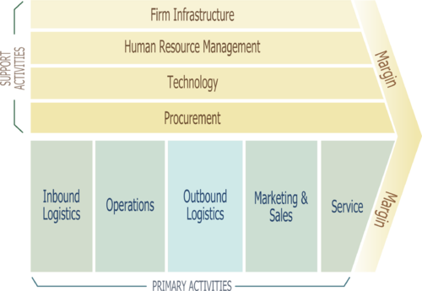
2. Porter’s Value Chain
Porter’s Value Chain
as explained on Youtube
(Porter, 1985).
Notes:
https://www.youtube.com/watch?v=aeshYi6lj2Y
Source image: Dinesh Pratap Singh's visualization for Porter's Value Chain on Wikipedia
Every organization is a collection of activities. In a business the activities can entail research and design, production, marketing delivery and after sales services. All these activities can be organized in a value chain.
Porters value chain is used to determine where the value is created. The value chain can be grouped in primary and secondary activities. This determination of value in the primary and secondary activities can be used to create competitive advantage. As competitors in similar markets or products can have different value creation in their value chain.
The Value Chain, or value plate, does breakdown the functions of a company into its activities to provide a way to assess the internal capacities of the business. The bottom half of the figure contains the primary activities that the firm conducts. These include inbound logistics, or the way in which the company receives, stores, etc. its inputs. Operations is the basic activity of producing your product. Outbound logistics are the activities associated with storing and distributing your final product. Marketing and sales are all of the activities associated with attracting and keeping customers for your products. Service is the activities associated with providing support to your customers for your products including users manuals, help lines, warranties, etc. Inbound logistics and Operations relate to your suppliers. Outbound logistics, marketing and sales and service relate to buyers.
As you move from left to right the primary activities move through time and increasing value. Linking these five primary activities together forms a chain.
The top half of the graph represents a set of activities that are conducted to support the primary activities of the firm. These would include procurement which are all of the activities associated with negotiating, financing, and paying for all inputs necessary for the business from raw inputs used in the final product to pencil used in the accounting office. Technology development is the activities associated with research and development and included R&D in all phases of the primary activities not just R&D associated with new product development (things like process improvement research, distribution improvement research, market research activities to support marketing, etc. Human resources are the support activities associated with hiring, firing, compensating, retaining, and training personnel for the company. Finally firm infrastructure is the top management activities of the firm which include, negotiating with the government, negotiating with competitors, developing the firms long-term strategy, development and maintenance of information systems for assessing firm performance, etc.

Slide 13
2. Porter’s Value Chain - Primary Activities
Inbound Logistics
Receiving, storing, and distributing inputs for the product
Operations
Turning inputs into finished products
Outgoing Logistics
Gathering and storing the product and physical distribution to buyers
As in processing materials, storage, stock control, arranging transport services, returning goods to suppliers
As in processing, packaging, assembly, maintenance of machines, testing and facilitating operations
As in storage in warehouse, physical control and order processing
Marketing and Sales
Provision of resources to enable buyer to buy the product
Service
Delivery of service in order to increase the value of the product
As in advertising, promotion, assignment of quotas, choice of distribution channel, pricing
As in installation, repairs, training, customer relations
Notes:
Primary activities are present in all companies to some extend. Compare for instance a hospitality organization with a production facility.

Slide 14
2. Porter’s Value Chain - Secondary Activities
Procurement (acquisition)
Negotiating, financing, and paying for all inputs across primary and secondary activities
Technology
Improve the product and production process
Human Resource Management
Recruiting, hiring, firing, and training employees for the entire value chain
Firm Infrastructure
General management, planning, financial control, accountancy, governmental issues, legal issues, quality management

Slide 15
2. Porter’s Value Chain - Analysing The Value Chain
Identify the activities which:
Have a distinctive economic importance
Potentially greatly influence differentiation
Represent important or growing proportion of costs
Think about how, for each item in the value chain, exceptional value could be created

Slide 16
Class Activity 1: IKEA (15 minutes)
Visit the website of IKEA
Think of your own experiences when visiting an IKEA store or when consulting an IKEA catalogue
According to you, in which of the activities of the value chain is IKEA adding value and can be considered its strength?
Notes:
Primary Activities: Logistics (inbound logistics) (very flat packaging, and therefor lower prices, lower storage costs, etc.) Huge quantities. Therefor price pressure, good prices with suppliers
Operations: efficient storage in shop you can get your product immediately
Secondary Activities”: HR: Hiring good designers, giving a lot of name/fame to the designs, so that they will be motivated, stay etc. Products are named after them.

Slide 17
IKEA’s Value Chain
Notes:
Video: 3:07
https://www.youtube.com/watch?v=ZFDkbWWyHI8

Slide 18
3. Portfolio Analysis Boston Consulting Group
Portfolio Analysis Matrix
 |  | Relative Market Share
 |  | High | Low
Market Growth | High | Stars | Question Marks
 | Low | Cash Cows | Dogs
Video
(Henderson, 1970).
Notes:
A very popular approach to analyzing the companies strategy is the Boston Consulting Group portfolio analysis. The model assumes you can put each strategic business unit (SBU) or division of a company in a matrix. In this way it can be established which activity has potential and which are too burdensome for the company.
Horizontal you can see the relative market share and vertically the market growth. If the expected growth of the company is higher than the growth of the GDP it is said to be high growth.
Cash cow: generate large amounts of money, but limited prospects for growth
Stars: Large share of a fast growing market.
Question mark: high-risk products. Maybe profitable in the future, but at this moment only small share of fast-growing market.
Dogs: generate little money, but further investment not needed. It will not enhance the performance of the company.
Video on Youtube: https://www.youtube.com/watch?time_continue=8&v=sNAUWpk_yvs

Slide 19
Class Activity 2: Cash Cows (10 minutes)
Search the Internet for companies that are marked as cash cows in articles
Check if market growth is low and market share is high so that you would indeed classify this product as a cash cow in the BCG Matrix
If the information on the Internet is older, try to find more recent information to check if the product is still a cash cow. If not, find the new position. You would expect that the product becomes a dog.
Notes:
Sometimes cash cows are wrongly classified, with high market growth and high share!

Slide 20
Financial Ratio Analysis
Measuring of the financial position of the company using financial indicators or ratios, like:
Liquidity
Solvency
Earning power (profitability)
Notes:
https://www.coursera.org/lecture/financial-ratios/1-3-efficiency-ratio-h5Xdl
min 3.54

Slide 21
Indicators to Establish Liquidity
Can expenses be paid in the near future?
Current ratio
Current ratio = current assets : short term loans
If value >1 means full coverage of debts, but because some stock might be unmarketable or debtors may be questionable a ratio of 1.5 to 2 is often used
Net working capital
Net working capital = current assets – short term loans
A positive value indicates a company can pay of debts
A liquidity budget, in which all incoming and outgoing money is opposed for every future period of time, is seen as more reliable predictor than indicators

Slide 22
Indicators to Establish Solvency
The proportions of various asset components
Solvency ratio: indicator of the degree to which the company is able to meet its obligations
Solvency ratio = after tax profits + depreciation : long-term + short-term liabilities
In practice a norm between 0.25 and 0.5 is used, depending on the sector of industry. In the case of liquidation of the company, depreciation of the assets of 25% to 50% may occur without jeopardising the total repayment of borrowed funds.
Debt ratio: in American business the debt ratio is often used to determine solvency
debt ratio = borrowed funds : total assets
What is considered a healthy debt ratio depends on the industry

Slide 23
Indicators to Determine Profitability
Profitability of total assets
Profitability of total assets = (net profit + interest/total assets) x 100%
Profitability of equity
Profitability of equity = (net profit/equity) x 100%
Profit margin
Gross profit margin = (profit before interest and taxes/turnover) x 100%
Net profit margin = (net profit/turnover) x 100%

Slide 24
Compare Financial Ratios
Basis for Comparison
Compare each data point individually as well as overall financial condition.
1) company’s past, to determine if your financial condition is improving or worsening. Typically, the past three years of performance is sufficient, but if access to older data is available=>spot trends. If, for example, liquidity has decreased consistently, you can make changes.
2) the direct competitors. This can provide an important reality check. Having revenue growth of 10 percent annually may sound good, but if competitors are growing at 25 percent, it highlights underperformance

Slide 25
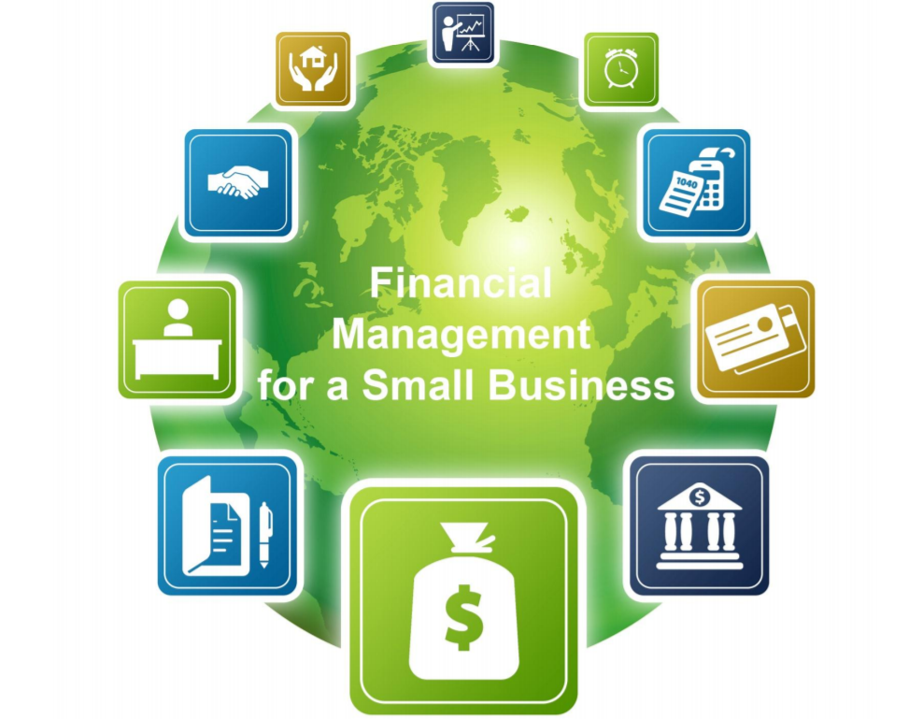
Financial Ratio’s in SME
Do you want to know more about Financial Ratio’s for Small Business? Have a look at the Financial Management for a Small Business training.
By:
Federal Deposit Insurance Corporation (FDIC) and U.S. Small Business Administration (SBA)
Source: SBA.
https://www.sba.gov/sites/default/files/files/PARTICIPANT_GUIDE_FINANCIAL_MANAGEMENT.pdf

Slide 26
Homework: Financial Ratio Analysis
find an SME that published its financial data.
search to determine
liquidity (current ratio or net working capital),
solvency ratio and debt ratio,
profitability of total assets,
profitability of equity, and
profit margin.
write a small paper describing the activities of the SME, some key facts, and the financial ratios. Do you consider the firm to be financial sustainable. Can you recommend that the organisation invests in internationalisation based on the ratios?
Notes:
Students need to find an SME that published its financial data. They should search to determine liquidity (current ratio or net working capital), solvency ratio and debt ratio, profitability of total assets, profitability of equity, and profit margin. Student can work in pairs. They need to write a small paper describing the activities of the SME, some key facts, and the financial ratios. In a short conclusion, they need to tell if they consider the firm to be financial sustainable. Can the students recommend that the organisation invest in internationalisation based on the ratios?

Slide 27
Summary
Internal analysis develops understanding of the capabilities of the organisation
Internal operations, product portfolio, and financial analysis are common tools
If related to external factors, a SWOT and confrontation matrix can be constructed

Slide 28
Learning Objectives
Be able to determine the strengths and weaknesses of the organisation
Use models to analyse the internal environment of the organisation
Perform a limited financial analysis in order to determine the potential for growth

Slide 29
References
SBA (n.a.) Financial Management for a Small Business - Participant Guide. https://www.sba.gov/sites/default/files/files/PARTICIPANT_GUIDE_FINANCIAL_MANAGEMENT.pdf (Retrieved, 15 August 2019)
Henderson, B. (1970). The Product Portfolio. BCG Henderson Institute. Online: https://www.bcg.com/publications/1970/strategy-the-product-portfolio.aspx.
Porter, M. E. (1985). Competitive advantage: creating and sustaining superior performance. 1985. New York: FreePress.
Porter, M. E. (1990). The competitive advantage of nations. Harvard Business Review, March.
Porter, M. (2008). The five competitive forces that shape strategy: Harvard Business Review, 86(1), p. 79-93 .
Vernon, R. (1966). International Investment and International Trade in the Product Cycle. in: Quarterly Journal of Economics, 2 p. 190–207.

