Slide 1
C1.2.1 External Analysis

Slide 2
Learning Objectives
Explain the importance of understanding the external environment in potential host countries
Be able to analyse the general country environment and the specifics of the industry
Notes:
Host country = a country to export to? to start foreign activities, FDI

Slide 3
Exercise 2: Actions for SME’s in Internationalisation
Form: Brainstorming based on World Café (30 minutes)
Objective: Brainstorming
Subject: Actions an SME can do to internationalise
JUST
Notes:
Lecuturer: Excercise 2 is called the World Cafe Objective: Collecting ideas about what actions SMEs need to take when internationalizing, (brainstorm).
The Facilitation is based on theory: http://www.theworldcafe.com/key-concepts-resources/world-cafe-method/
Needed: Whiteboard with a Map on a Piece of Paper. In the Map the word JUST is written.
,tables with chairs (4 persons per table)
JUST is linked to Engagement, Just do it
Procedure:
Sit at tables in groups of four.
Draw a map and write ‘JUST’ in it.
Jot down as many actions you can think of
that a SME can do to internationalise. (5’).
Internationalization of your business
Three students move to the other table.
The person who holds the table gives
a short summary of the results
And asks the three to add new ideas (5.
We move once more (5’).
We share and group our harvest (15’)
JUST
Can also be diversified
JUST: for People
JUST for Product
JUST: CONNECT
If group has few ideas you help a bit with adding a word to JUST
What comes in the discussion: Personality: Curiosity, likes uncertainty, like new things, likes discovering, networking
This is shown also in videos: you see this in the video of the architect: even in the holidays he makes contact with other people.
Just connect: go during the holidays to producers and discuss
PEOPLE Centricity:
Team Building: only in your company or also outside your company, can also with the consultant
(Logistic, laws will be to specific, then you have to contribute)

Slide 4
Stages of External Analysis and Market Selection
1. General market screening
3. Macro screening of general environment
Often a random process, based on trends, proximity
2. Initial screening
Is it worth considering?
Usually chambers of commerce are helpful here, e.g.
For Germany: IHK
For the US: ITA
For New Zealand: NZTE
E.g. PESTLE; Economist Model of Country Analysis
4. Micro screening of the industry
E.g. Five Forces Model (Porter)
5. Final selection
Notes:
Students need to understand that the initial screening process and the initial country selection is often random and not very scientific
Students should get a basic idea where to find easy accessible country information)

Slide 5
Stages of External Analysis and Market Selection
1. General market screening
3. Macro screening of general environment
Often a random process, based on trends, proximity
2. Initial screening
Is it worth considering?
Usually chambers of commerce are helpful here, e.g.
For Germany: IHK
For the US: ITA
For New Zealand: NZTE
E.g. PESTLE; Economist Model of Country Analysis
4. Micro screening of the industry
E.g. Five Forces Model (Porter)
5. Final selection
Notes:
We want to have a closer look at Macro screening possibilities first.

Slide 6
Level
Frequency
(years)
Purpose
Embeddedness:
Informal institutions, customs,
traditions, norms, religion
L1
Often noncalculative;
spontaneous
10² to 10³
Macro Level
Institutional Environment:
Formal rules of the game – esp.
property (polity, judiciary,
bureaucracy)
Get the institutional
environment right.
1st order economising
L2
10 to 10²
Governance: Play of the game –
esp. contract
(aligning governance
structures with transactions)
Get the governance
structures right.
2nd order economising
L3
1 to 10
Resource
allocation and employment
(prices and quantities;
incentive alignment)
Get the marginal conditions right.
3rd order economising
L4
continuous
L1: social theory L3: transaction cost economics
L2: economics of property rights/positive political theory L4: neoclassical economics/agency theory
Williamson (2000)
Notes:
Remember? The institutional environment. The higest levels are the Macro field. So when screening the macro field, you are looking at formal and informal institutions of the institutional environment, that is culture (informal) and laws and formal rules of the game (formal). So which „tools“ can be used?
Source: Williamson, O. E. (2000). The new institutional economics: taking stock, looking ahead. Journal of economic literature, 38(3), 595-613.

Slide 7
Macro Sceening
Video
Notes:
Video 1:33
Based on the INTENSE case study

Slide 8
Tools for Macro Screening - PESTLE
P
Political
Stability of Government
Changes to Legislation
Global Influences
E
Economic
Economic Growth
Employment Rates
Inflation Rates
Monetary Policy
S
Social
Income Distribution
Demographics
Lifestyle
Culture
T
Technology
L
Legal
E
Environment
Emerging Technologies
IT Infrastructure
Intellectual Property Rights
Taxation Laws
Employment Regulations
Industry Regulations
Regulations and Restrictions
Consumer Attitudes
Aguilar (1967); Brown, Weiner (1984)

Slide 9
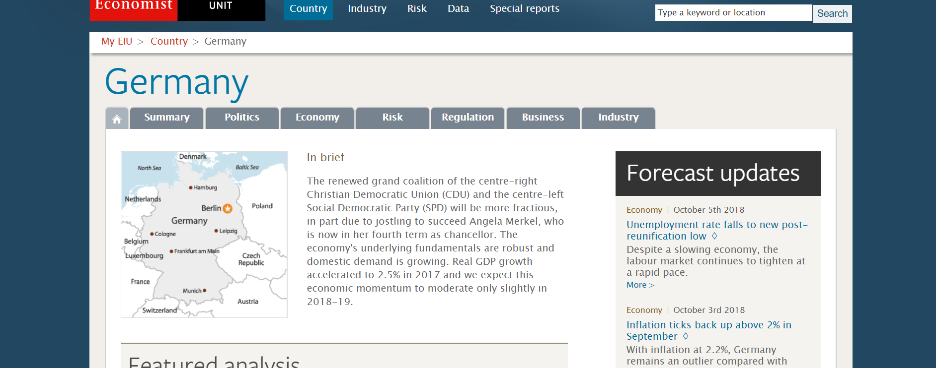
Macro Screening: The Economist Model of Country Analysis (1/3)

Slide 10
Macro Screening: The Economist Model of Country Analysis (2/3)
Political Environment
Macroeconomic Environment
Market Opportunities
Private Enterprise and Competition Policy
Risk of armed conflict
Risk of social unrest
Constitutional mechanisms for the transfer of power
Threat of politically motivated violence
International disputes
Government policy towards business
Inflation
Budget balance as % of GDP
Government debt as % of GDP
Exchange rate volatility
Current account balance as % of GDP
GDP, $ bn at PPP
GDP per head, $ at PPP
Real GDP growth
Share of world merchandise trade
Average annual rate of growth of exports
Average annual rate of growth of imports
The natural resource endowment
Profitability
Degree to which private property rights are protected
Government regulation on setting up new private businesses
Freedom of existing businesses to compete
Promotion of competition
Protection of intellectual property
Price controls
Distortion arising from lobbying by special interest groups
Distortion arising from state ownership/control
Effectiveness of political system in policy formulation and execution
Quality of the bureaucracy
Transparency and fairness of legal system
Corruption
Impact of crime
Infrastructure
Telephone density
Reliability of telecommunications network
Extent and quality of road/rail network
Production of electricity per head
Infrastructure for retail and wholesale distribution
Quality of ports’ infrastructure
Stock of personal computers
R&D expenditure as % of GDP
Rent of office space
(http://country.eiu.com/AllCountries.aspx)
Notes:
This serves as one set of criteria that are relevant for the macro-screening.
In the link below you find the ready made country analysis for almost all countries.
The complete list:
Political Environment
Risk of armed conflict
Risk of social unrest
Constitutional mechanisms for the orderly transfer of power
Threat of politically motivated violence
International disputes or tensions
Government policy towards business
Effectiveness of political system in policy formulation and execution
Quality of the bureaucracy
Transparency and fairness of legal system
Corruption
Impact of crime
Macroeconomic Environment
Inflation
Budget balance as % of GDP
Government debt as % of GDP
Exchange-rate volatility
Current-account balance as % of GDP
Market Opportunities
GDP, $ bn at PPP
GDP per head, $ at PPP
Real GDP growth
Share of world merchandise trade
Average annual rate of growth of exports
Average annual rate of growth of imports
The natural resource endowment
Profitability
Policy towards private enterprise and competition
Degree to which private property rights are protected
Government regulation on setting up new private
businesses
Freedom of existing businesses to compete
Promotion of competition
Protection of intellectual property
Price controls
Distortions arising from lobbying by special interest groups
Distortions arising from state ownership/control
Policy towards foreign investment
Government policy towards foreign capital
Openness of national culture to foreign influences
Risk of expropriation of foreign assets
Availability of investment protection schemes
Foreign trade and exchange controls
Capital-account liberalization
Tariff and non-tariff protection
Openness of trade
Restrictions on the current account
Taxes
The corporate tax burden
The top marginal personal income tax
Value-added tax
Employers’ social-security contributions
Degree to which fiscal regime encourages new investment
Consistency and fairness of the tax system
Financing
Openness of banking sector
Stock market capitalization
Distortions in financial markets
Quality of the financial regulatory system
Access of foreigners to local capital market
Access to medium-term finance for investment
The labor market
Incidence of strikes
Labor costs adjusted for productivity
Availability of skilled labor
Quality of workforce
Restrictiveness of labor laws
Extent of wage regulation
Hiring of foreign nationals
Cost of living

Slide 11
Macro Screening: The Economist Model of Country Analysis (3/3)
Policy Towards Foreign Investment
Foreign Trade and Exchange Controls
Taxes
Government policy towards foreign capital
Openness of national culture to foreign influences
Risk of expropriation of foreign assets
Availability of investment protection schemes
Capital account liberalisation
Tariff and non-tariff protection
Openness of trade
Restrictions on the current account
The corporate tax burden
The top marginal personal income tax
Value-added tax
Employers’ social-security contributions
Degree to which fiscal regime encourages new investment
Consistency and fairness of the tax system
Financing
Openness of banking sector
Stock market capitalisation
Distortions in financial markets
Quality of the financial regulatory system
Access of foreigners to local capital market
Access to medium-term finance for investment
The Labour Market
Incidence of strikes
Labour costs adjusted for productivity
Availability of skilled labour
Quality of workforce
Restrictiveness of labour laws
Extent of wage regulation
Hiring of foreign nationals
Cost of living
(http://country.eiu.com/AllCountries.aspx)
Notes:
This serves as one set of criteria that are relevant for the macro-screening.
In the link below you find the ready made country analysis for almost all countries.
The complete list:
Political Environment
Risk of armed conflict
Risk of social unrest
Constitutional mechanisms for the orderly transfer of power
Threat of politically motivated violence
International disputes or tensions
Government policy towards business
Effectiveness of political system in policy formulation and execution
Quality of the bureaucracy
Transparency and fairness of legal system
Corruption
Impact of crime
Macroeconomic Environment
Inflation
Budget balance as % of GDP
Government debt as % of GDP
Exchange-rate volatility
Current-account balance as % of GDP
Market Opportunities
GDP, $ bn at PPP
GDP per head, $ at PPP
Real GDP growth
Share of world merchandise trade
Average annual rate of growth of exports
Average annual rate of growth of imports
The natural resource endowment
Profitability
Policy towards private enterprise and competition
Degree to which private property rights are protected
Government regulation on setting up new private
businesses
Freedom of existing businesses to compete
Promotion of competition
Protection of intellectual property
Price controls
Distortions arising from lobbying by special interest groups
Distortions arising from state ownership/control
Policy towards foreign investment
Government policy towards foreign capital
Openness of national culture to foreign influences
Risk of expropriation of foreign assets
Availability of investment protection schemes
Foreign trade and exchange controls
Capital-account liberalization
Tariff and non-tariff protection
Openness of trade
Restrictions on the current account
Taxes
The corporate tax burden
The top marginal personal income tax
Value-added tax
Employers’ social-security contributions
Degree to which fiscal regime encourages new investment
Consistency and fairness of the tax system
Financing
Openness of banking sector
Stock market capitalization
Distortions in financial markets
Quality of the financial regulatory system
Access of foreigners to local capital market
Access to medium-term finance for investment
The labor market
Incidence of strikes
Labor costs adjusted for productivity
Availability of skilled labor
Quality of workforce
Restrictiveness of labor laws
Extent of wage regulation
Hiring of foreign nationals
Cost of living

Slide 12
2. Example for Macro Screening (Hitt et al., 2016) (1/2)
Demographic segment
Political/Legal segment
Population size
Age structure
Geographic distribution
Ethnic mix
lncome distribution
Economic segment
Inflation rates
Interest rates
Trade deficits or surpluses
Budget deficits or surpluses
Personal savings rate
Business savings rates
Gross domestic product
Antitrust laws
Taxation laws
Deregulation philosophies
Labour training laws
Educational philosophies and policies
Sociocultural segment
Women in the workforce
Workforce diversity
Attitudes about the quality of work life
Shifts in work and career preferences
Shifts in preferences regarding product and service characteristics

Slide 13
2. Example for Macro Screening (Hitt et al., 2016) (2/2)
Global segment
Technological segment
Product innovations
Applications of knowledge
Focus of private and government supported R&D expenditures
New communication technologies
Important political events
Critical global markets
Newly industrialised countries
Different cultural and institutional attributes
Physical Environment segment
Practices used to develop energy sources
Renewable energy efforts
Minimising a firm's environmental footprint
Availability of water as a resource
Producing environmentally-friendly products
Reacting to natural or man-made disasters

Slide 14
Macro Screening: Further Sources
World Bank
Doing Business Report
http://www.doingbusiness.org
Bertelsmann
Bertelsmann transformation index
https://www.bti-project.org
Transparency International
Corruption Perception Index
https://www.transparency.org/country
Moody‘s
Sovereigns Ratings List
https://countryeconomy.com/ratings/moodys
BERI
Business Risk Service (BRS)
http://www.beri.com/Publications/BRS.aspx
Coface
Economic Studies
https://www.coface.com/Economic-Studies-and-Country-Risks
Notes:
First one comers the world
Second one covers only transition economies
I ask students if they know further sources. i.e. the Corruption perception index of transparency internation on percieved corruption

Slide 15
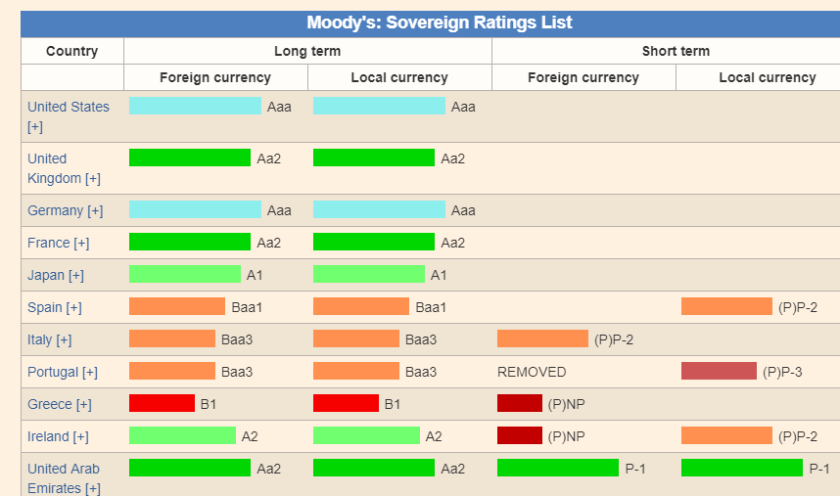
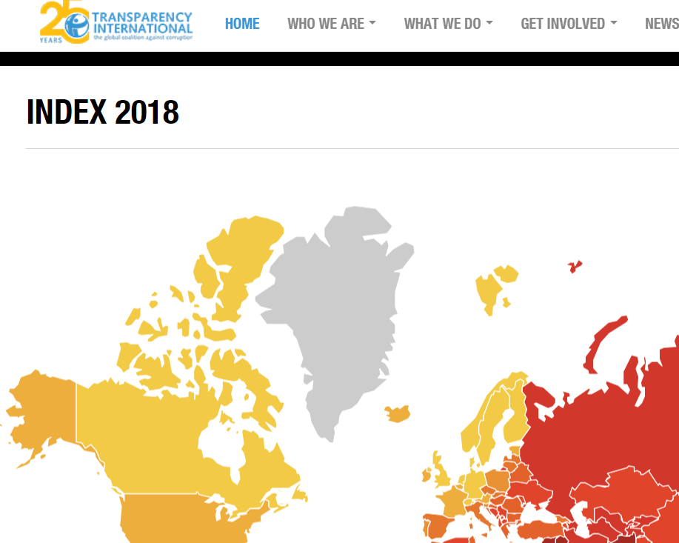
Macro Screening Country Index

Slide 16
Exercise
Let us assume you are a German consumer electronics retailer and want to expand internationally. You identified Finland and the Netherlands as potential host countries. Please evaluate both countries using either the criteria by the Economist or by Hitt et al. Please also look for appropriate online databases to get sufficient data.
Please rank the countries in the respective categories on a 7 point Likert-type scale
Should you prioritise some categories (higher weighting)? Which category is most important for your business?
Which country do you prefer overall?
What do you consider to be problems in the macro screening process?
Notes:
I actually have never seen a “good” macro-analysis from students and the idea here is that they realize the problems of these model themselves. This can also be a group exercise or a report outside of the classroom. Important is the reflection about problems after the exercise.
Students should understand that a comparison of many criteria is very tricky, particularly for countries with a similar economic situation. They should also understand that the weighting of categories does not always make sense and is rather arbitrary
The learning outcome here is that the macro-screening process is (in practice) less scientific than it appears at first glance..

Slide 17
Stages of the External Analysis and Market Selection
1. General market screening
3. Macro screening of general environment
Often a random process, based on trends, proximity
2. Initial screening
Is it worth considering?
Usually chambers of commerce are helpful here, e.g.
For Germany: IHK
For the US: ITA
For New Zealand: NZTE
E.g. PESTLE; Economist Model of Country Analysis
4. Micro screening of the industry
E.g. Five Forces Model (Porter)
5. Final selection

Slide 18
Micro Screening of the Industry
E.g. Porter’s Diamond or an application of Porter’s Five Forces in an international context (our example)
Please read: Porter. (2008). The five competitive forces that shape strategy. Harvard Business Review, 86(1), 79-93.
Notes:
Students should understand the basics of the 5 Forces model and its applicability for country comparisons

Slide 19
Level
Frequency
(years)
Purpose
Embeddedness:
Informal institutions, customs,
traditions, norms, religion
L1
Often noncalculative;
spontaneous
10² to 10³
Institutional Environment:
Formal rules of the game – esp.
property (polity, judiciary,
bureaucracy)
Get the institutional
environment right.
1st order economising
L2
10 to 10²
Governance: Play of the game –
esp. contract
(aligning governance
structures with transactions)
Get the governance
structures right.
2nd order economising
L3
1 to 10
Micro Level
Resource
allocation and employment
(prices and quantities;
incentive alignment)
Get the marginal conditions right.
3rd order economising
L4
continuous
L1: social theory L3: transaction cost economics
L2: economics of property rights/ positve political theory L4: neoclassical economics/ agency theory
Williamson (2000)
Notes:
Remember? The institutional environment. The higest levels are the Macro field. So when screening the macro field, you are looking at formal and informal institutions of the institutional environment, that is culture (informal) and laws and formal rules of the game (formal). So which „tools“ can be used?
Source: Williamson, O. E. (2000). The new institutional economics: taking stock, looking ahead. Journal of economic literature, 38(3), 595-613.

Slide 20
Micro Screening: Porter’s Five Forces
(Porter, 2008, p. 80)

Slide 21
Micro Screening: Porter’s Five Forces
Threat of New Entrants: Barriers to entry
Economies of scale
Product differentiation
Capital requirements
Switching costs
Access to distribution channels
Cost disadvantages independent of scale
Government policy
Expected retaliation
(Hitt et al., 2016)

Slide 22
Micro Screening: Porter’s Five Forces
Bargaining Power of Suppliers increases when
Suppliers are large and few in number
Suitable substitute products are not available
Individual buyers are not large customers of suppliers and there are many of them
Suppliers’ goods are critical to the buyers’ marketplace success
Suppliers’ products create high switching costs
Suppliers pose a threat to integrate forward into buyers’ industry
(Hitt et al., 2016)

Slide 23
Micro Screening: Porter’s Five Forces
Bargaining Power of Buyers increases when
Buyers are large and few in number
Buyers purchase a large portion of an industry’s total output
Buyers’ purchases are a significant portion of a supplier’s annual revenues
Buyers’ switching costs are low
Buyers can pose threat to integrate backward into the sellers’ industry
(Hitt et al., 2016)

Slide 24
Micro Screening: Porter’s Five Forces
The Threat of Substitute Products increases when
Buyers face few switching costs
The substitute product’s price is lower
Substitute product’s quality and performance are equal to or greater than the existing product
(Hitt et al., 2016)

Slide 25
Micro Screening: Porter’s Five Forces
Industry Rivalry increases when
There are numerous or equally-balanced competitors
Industry growth slows or declines
There are high fixed costs or high storage costs
There is a lack of differentiation opportunities or low switching costs
When the strategic stakes are high
When high exit barriers prevent competitors from leaving the industry
(Hitt et al., 2016)

Slide 26
Micro Screening: Porter’s Five Forces
Summary of the concept and discussion:
https://www.youtube.com/watch?v=mYF2_FBCvXw
Questions:
Where do you see strengths and weaknesses of the model?
Why is the soft drink industry attractive?
Can you really select your industry?
Is there a force missing?
Does the model work in dynamic/volatile industries?
Notes:
The model is very often used, but has it‘s pittfalls. Students should work out the strenghts and weaknesses of the model.
The main problem is that it takes the investor‘s perspective, but not the firm perspective. You can easily adjust your investments from the airline to the soft-drink industry, but it is hardly possible to change an airline into a softdrink producer.

Slide 27
Exercise
Let us assume you are a German consumer electronics retailer and you want to expand internationally. You identified Finland and the Netherlands as potential host countries. Please evaluate both countries’ electronic retail industries using the Five Forces Model. Identify appropriate databases for your comparison.
Which country do you prefer overall?
What do you consider to be problems in the Five Forces Model that limit your analysis?
Notes:
The idea here is similar to the macro screening process. It is really complicated to weight the forces and compare the industry on a scale. Although, the model generally appears conclusive, it is hard to implement it in practice. It is very hard to obtain usefull data here, expecially for SMEs
This can also be a group exercise or a report outside of the classroom.

Slide 28
Micro Screening: Porter’s Diamond
Notes:
The Porter Diamond or the Porter Diamond Theory of National Advantage
Model designed to
help understand the competitive advantage nations or groups possess due to certain factors available to them
explain how governments can act as catalysts to improve a country's position in a globally competitive economic environment.
The model was created by Michael Porter, a recognized authority on corporate strategy and economic competition, and founder of The Institute for Strategy and Competitiveness at the Harvard Business School.

Slide 29
Differences for SMEs?
Can you apply the model to SMEs?
What is different for SMEs here?
Notes:
The macro screening does only slightly differ for SMEs. The same rules and problems apply.
One additional problem are the limited ressources for individual market research. However, even with good quality data is it hard to evaluate the importance and the weighting of the criteria.

Slide 30
Macro Sceening
Which Models/Factors would have been relevant criteria for Grüne‘s macro screening?
Notes:
Rememberthe Video on Grüne

Slide 31
Summary
External analysis and market selection has several stages
There are different tools to support the structure of macro screening of the external environment, PESTLE is just one of them
Micro screening is an industry analysis, supported, for example, by Porter’s Five Forces

Slide 32
Summary - Learning Objectives
Explain the importance of understanding the external environment in potential host countries
Be able to analyse the general country environment and the specifics of the industry

Slide 33
References
Aguilar, F. j. (1967). Scanning the Business Environment. Macmillan.
Brown, A. Weiner, E. (1984). Supermanaging: How to Harness Change for Personal and Organizational Success. McGraw-Hill.
Hitt, M. A., Ireland, R. D., & Hoskisson, R. E. (2016). Strategic management: Concepts and cases: Competitiveness and globalization. Cengage Learning.
Economist Model of Country Analysis. http://country.eiu.com/AllCountries.aspx
Porter, M. E. (1985). Competitive advantage: creating and sustaining superior performance. New York: FreePress.
Porter, M. E. (1990). The competitive advantage of nations. Harvard Business Review, March.
Porter (2008). The five competitive forces that shape strategy: Harvard Business Review, 86(1), p. 79-93
Williamson, O. E. (2000). The new institutional economics: taking stock, looking ahead. Journal of economic literature, 38(3), 595-613.

