Slide 1
C1.1.3 Readiness for Internationalisation of SMEs
SMEs, Born Globals, Start-Ups, Hidden Champions
Notes:
http://www.seat-styler.de/
http://www.manager-magazin.de/fotostrecke/0,2828,26159,00.html
https://www.companisto.com/de/view-all-startups
http://www.youtube.com/watch?v=mtdf_b6T4Xo&feature=relmfu min 6:40
http://www.youtube.com/watch?v=mO7_EM9NDdY&feature=relmfu until 2:40

Slide 2
Introduction – Class Exercise 1
What is entrepreneurship? From MIT open courseware min 4:40
This video distinguishes local SMEs vs. the type that has world market growth potential
Anita Roddick Interview (Founder of the BodyShop) min 6:26
What does it mean to be an entrepreneur, especially as a woman? Ethical entrepreneurship
Make notes, write down keywords of what you find important, didn’t know or didn’t understand
Notes:
Class discussion on keywords and questions
First video: 2 types of entrepreneurship
Sme – focus on local markets, constant growth
Innovation driven enterprise entrepreneurship – more risky, capital intensive, focos on global market
Body shop video:
Entrepreneurship is mainly transitory, not mainly about accumulation of wealth and power
Fun, activism,
Female entrepreneurship: women manage entirely different. More intuative, more networking, but still spend more time with family
Difficulty of getting cash

Slide 3
Learning Objectives
Understanding the internationalisation of SMEs
Understanding different stages of internationalisation
Understanding the motives for engaging in international business
Understanding different types of SMEs, like Born Globals
Understanding how SMEs can compete successfully
Understanding the typical challenges facing SMEs

Slide 4
SME Internationalisation – Remember?
Video
Notes:
Video was already included in section 1.1.1 This is to refresh and focus on a different discussion

Slide 5
Class Exercise 2: Motives for Internationalisation
Can you think of some motives for an SME to internationalise?
Write 5 motives on a piece of paper
Share

Slide 6
Why internationalise?
Import
Export
Production elsewhere
Better know-how, historic reasons
Close proximity to raw material, which can be better processed locally or cheaper
Product or service not (yet) supplied
Bring new technologies to less developed markets
Domestic market too small
Too little demand, too much supply
Cost price of product is very competitive
Overcapacity
Continuous search for new markets to maintain growth
Notes:
In motives for internationalisation you can look at the import or export side of business

Slide 7
Motives for International Business
Proactive
Reactive
Profit and growth goals
Managerial urge
Competitiveness of the product
Anticipating opportunities
Economies of scale
Integration of the supply chain
Tax benefits
Small and/or saturated home market
Utilisation of overproduction/excess capacity
Competitive pressures
Reduction of dependencies (customers/suppliers)
Proximity of customers/suppliers
Stabilisation of seasonal factors/perishable products
Notes:
Albaum, G. (2016). International Marketing & Export Management (Reprint edition). Harlow, United Kingdom: Pearson Education., p. 76

Slide 8
Grouping of Internationalisation Factors
Notes:
Overview of Internationalisation factors, grouped. Can be used as input for students when they will write the questionnaire. It can be used for the internal analysis. In the following classes attention will be paid to exploring the external environment (external analysis).
Questionnaire: Is the SME ready for internationalisation?
For instance: Under Management, commitment: Why do you want to internationalise? Who else in the organisation is committed to this goal? Etc.
Data from 2010 about how many and how SMEs internationalise. Also, important when market entry strategies are discussed later in program.

Slide 9
Some Facts on the Current Situation of Internationalisation
SME internationalisation has contributed to growth.
EU-28 SME exports of goods have increased by 20% since 2012.
The Single Market is the go-to market for EU-28 SMEs.
It accounted for 70% of the value of SME exports, with 80% of exporting SMEs selling to other Member States.
The economic significance of the indirect contribution made by SMEs to exports is frequently underestimated.
SMEs internationalise based on strategic choices. Available policy support can play a decisive role in influencing that choice.
(European commission, 2018)
Notes:
European Commission (2018). Annual Report on European SMEs 2017/2018 . Directorate-General for Enterprise and Industry, Brussels.
Later in program the different market entry strategies are discussed. From this data it becomes apparent that import and export are the major modes of internationalisation

Slide 10
Current Situation of Internationalisation
The larger the company, the more it tends to internationalise
Exporting and importing activities increase in intensity by age of enterprise
Most often SMEs start international activities by importing
Companies involved in e-commerce are more internationally active
Awareness of public support programmes among SMEs is low and the use of these programmes is low
The relationship between internationalisation and innovation is strong
(European Commission, 2010)
Notes:
Commission, E. (2010). Internationalisation of European SMEs. Directorate-General for Enterprise and Industry, Brussels.
The larger the company, the more it tends to internationalise. This applies to any
single mode of internationalisation. For exports 24% of micro, 38% of small and
53% of medium-sized SMEs are active, for imports the respective percentages are
28%, 39% and 55%.
The relationship between internationalisation and innovation is strong
26% of internationally active SMEs introduced products or services that were new
for their sector in their country, for other SMEs this is only 8%. These internationally
active SMEs are also more active with process innovations that are new for
their sector in their country (11% vs 3% for the SMEs without international activities).

Slide 11
How do SMEs Internationalise

Slide 12
Class Exercise 3: Is internationalisation always gradual?
The Uppsala model vs. Born Globals
Class divides into two groups, one starts to find sources on the Uppsala model and the other on Born Globals
Make a list of the characteristics
Of each group the representative writes down the list on the whiteboard
15 min
Notes:
Born Globals:
“firms that engage in significant international activity a short time after being established“
They are start-ups as well as SMEs

Slide 13
Gradual Steps of Internationalisation
Gradual Steps
Psychic Distance
→ Uppsala-internationalisation
(Johanson & Vahlne, 1977).
Notes:
Typically, firms start exporting to a country via an agent, later establish a sales subsidiary, and eventually, in some cases, begin production in the host country
Not so much physical but psychic distance plays a role
The psychic distance is defined as the sum of factors preventing the flow of information from and to the market. Examples are differences in language, education, business practices, culture, and industrial development.
successive establishment of operations in new countries
Uppsala-internationalisation
Johanson, J., & Vahlne, J. E. (1977). The internationalisation process of the firm-a model of knowledge development and increasing foreign market commitments. Journal of international business studies, 23-32.

Slide 14
Critique of Uppsala
Cultural distance becomes less (Westernisation)
Geographic distances become less important (Internet, advances in transportation)
For some countries there are too few proximate countries close by (e.g. Asia Pacific, Israel)
Ignores some options like M&As
Does not explain small international companies
Does not explain arbitrage seeking

Slide 15
Uppsala and International Management Structure
Most of IM theory is based on the assumption of gradual internationalisation (entry modes, strategy, structure, etc.)
A non-gradual entry mode, thus challenges a lot of those assumptions
Empirical findings have shown that SMEs do not follow a common internationalisation path or pattern in general
Notes:
Schulz, A., Borghoff, T., & Kraus, S. (2009). International entrepreneurship: towards a theory of SME internationalisation. International Journal of Business and Economics, 9(1), 1-12.

Slide 16
Born Globals
“Firms that engage in significant international activity a short time after being established”
They are start-ups as well as SMEs

Slide 17
Uppsala
Internationalisation in stages
Born Global
Internationalisation right from the start
Home market is most important
Perception of risky internationalisation
Selection of proximate countries first
Home market is not important
Perception of internationalisation as an opportunity
Independence of country-specific markets/forces

Slide 18
Born Globals’ Behaviour
Start international operations simultaneously with domestic operations
Firm strategy is based on a global market, but a core product
Products, structures, systems, and finance are planned based on arbitrage considerations
Fast growth (gusher-effect)
Often become leaders in niche markets

Slide 19
Born Globals’ Behaviour
Characterized by AAA-Model
Arbitrage (high): exploitation of local differences (pricing, resources)
Aggregation (high): national market would be too small
Adaptation (low): no responsiveness to local preferences
Notes:
Ghemawat, P. (2007). Redefining Global Strategy: Crossing Borders in a World where Differences Still Matter. Harvard Business Press.

Slide 20
Some International Born Global Examples
Biohit: Diagnosis tools for stomach cancer without endoscopy
Futuremark: Software to measure 3D performance of PCs
Environics: Chemical detection for defense forces
Former HTW-Student: Seat Styler
http://www.seat-styler.de/

Slide 21
The Story of Bread
Which of approach did the Althus Brothers from „Bread Lovers“ follow?
Uppsala
Internationalisation in stages
Born Global
Internationalisation right from the start
Home market is most important
Perception of risky internationalisation
Selection of proximate countries first
Home market is not important
Perception of internationalisation as an opportunity
Independence of country-specific markets/forces

Slide 22
How Can SMEs Compete Successfully

Slide 23
Niche vs. Whole Market
Niche
Whole
Focused on specific customer needs
Easy market entry
Premium pricing
Less competition
but
Limited customers/market
Strong dependency
Huge market potential
High turnover
Fast growth
but
High cost for market entry
Fierce competition
Customer needs cannot fully be covered

Slide 24
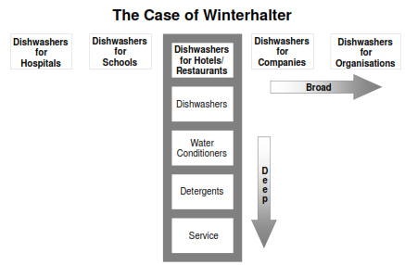
Deep Instead of Broad
Source: Simon (2009).
Notes:
Winterhalter was established in 1947 as a manufacturer of dishwashers to businesses (B2B) and is best described as a ‘hidden champion’.
Winterhalter’s biggest problem in the beginning, was defining its market. One reason was the fragmentation of the B2B dishwasher market: what a hospital needed was very different from large hotels and military requirements.
In the mid-seventies, founder Jurgen Winterhalter and his fellow directors made a bold move. He realised that they were serving too many verticals, with a hugely broad-ranging set of needs that lacked focus. Jurgen knew the brand was just another option or as he called it, an “also ran” in all of the verticals they served. They decided to become nichist. They were going to serve hotels and restaurants and nobody else. They would change the name of the company from just Winterhalter to ‘Winterhalter Gastronom’, and make their offering more comprehensive but focused on a specific vertical:
Quality, flexibility, and personal service are proving to be effective tools for carving out a niche in even the most competitive of markets.
Small firms will never win on price, but they can compete on value and service, while the more specialised their product or service, the better.
They can be flexible and adaptable to meet customers' needs, and through the clever use of social media, they can make their brand more 'loveable', which gives them the edge.“
Source; https://www.theguardian.com/small-business-network/2013/jan/10/sme-compete-big-business

Slide 25
Summing Up SMEs - The Long Tail (Anderson, 2004)
Long Tail: A broad offer of individually less demanded products (niches become big enough to successfully operate)
The price/profit per item is higher as with highly demanded products (less competition and more willingness to pay for a rare product)
Increased success since the Internet is available as a distribution channel
Examples: music, books, travel destinations, bachelor theses….
Notes:
Anderson, C. (2004). The Long Tail: Why the Future of Business is Selling Less of More. The New York Times bestseller.

Slide 26
Mass Customisation
Long Tail for bigger companies
Based on modularity of products
Examples
Dell’s “individual” computer order
135 million USD sales a day in 2005 with the website
Mymuesli.de

Slide 27
Hidden Champions – Definition (Hermann Simon)
Nr. 1, 2, 3 in their industry worldwide or at least on their continent
Limited visibility, brand reputation
Characteristics
1 product and 1 market
Mostly in b2b relationships (hidden in value chain)
High equity-to-assets ratio
Often family owned → patriarchic leadership
http://www.manager-magazin.de/fotostrecke/0,2828,26159,00.html
Notes:
Simon, Hermann: Hidden Champions of the 21st Century : Success Strategies of Unknown World Market Leaders. London: Springer, 2009.- ISBN 978-0-387-98147-5. P. 15.

Slide 28
Class Exercise 4: Look Up Some ‘Hidden Champions’
Look up some ‘hidden champions’ on the internet of your home country
Make sure the example you find meets the definition of the hidden champion
Make some slides with pictures explaining what the company is about, 3 slides
Slide 1: name and facts about hidden champion
Side 2: pictures of products/services of market
Slide 3: internationalisation, explain in which markets they are active and how

Slide 29
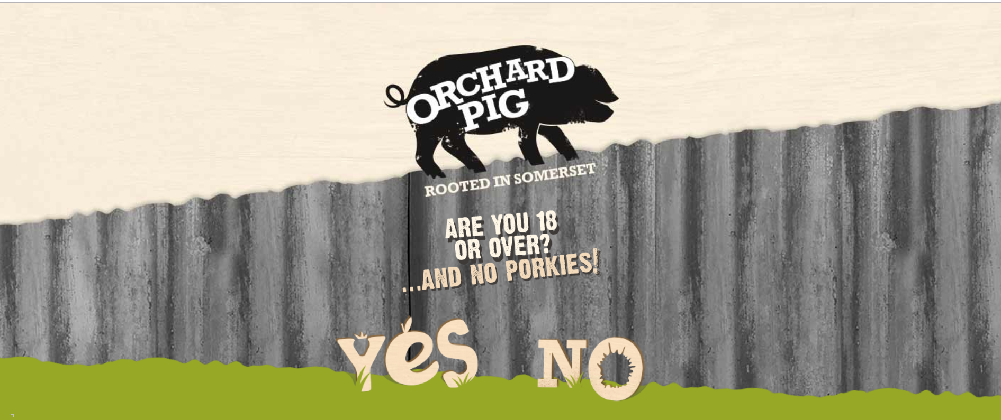
Example
Notes:
Andrew Quinlan decided to turn his hobby, brewing cider, into the premium brand cider business Orchard Pig in 2007.
At that time, the UK cider market was on an upward growth trajectory. new cider brands were being launched by Stella Artois and Carlsberg to capitalise on its popularity.
"The alcohol market is fiercely competitive and it is notoriously hard for smaller, unknown brands to achieve standout.
But there was a gap between the traditional scrumpy products and the mainstream brands
Quinlan: "We are making progress in retail, but the pub trade is also important; it's where people can actually get to taste the cider, and hopefully become ambassadors for the brand, spreading the word. The cider sector is expanding, but Orchard Pig will remain a niche product, and that is the key; knowing where your brand sits in that market."

Slide 30
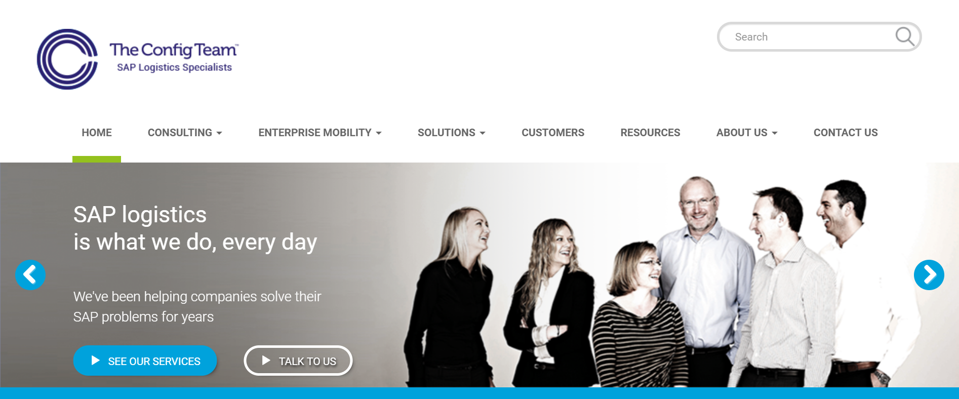
Example
Notes:
In the complex field of logistics and the technology behind the systems applications processes (SAP) that enable a company's many operations and functions to all run smoothly, the market is being led by huge IT firms such as IBM and Accenture.
But it is their size and the generalist nature of the services they provide that has created opportunities for smaller firms like The Config Team.
Based in Leyland in Lancashire, the company's 20-strong team specialises in bespoke SAP solutions.
Managing director Andrew Moses explained: "A big company can implement the payroll, HR, payments and ledger applications of SAP on a broad general business basis, but might struggle to come up with a solution for a complex manufacturing plant. And that's the gap in the market that we have been able to fill; tailoring IT solutions for very specific requirements."
“More than that, he adds, their core team of consultants has remained unchanged for seven years, presenting a consistency and continuity that fosters a sense of trust and which has helped The Config Team build long-term business relationships; something that the larger providers struggle to achieve in quite the same way. Significantly, this is attracting growing interest from IT managers from some large organisations who see the value in a more personalised offering.”

Slide 31
What are Typical Challenges of SMEs

Slide 32
Barriers to Internationalisation of SMEs
Shortage of working capital to finance exports
Limited information to locate/analyse markets
Inability to contact potential overseas customers
Lack of managerial time, skills, and knowledge
(Lloyd-Reason, 2009)
Notes:
Lloyd-Reason, L. (2009). SMEs AND THE GLOBAL MARKET PLACE. Review of International Comparative Management / Revista de Management Comparat International, 10, 27.

Slide 33
The Story of Bread
Which of these barriers might the Althus Brothers from „Bread Lovers“ encounter?
Shortage of working capital to finance exports
Limited information to locate/analyse markets
Inability to contact potential overseas customers
Lack of managerial time, skills, and knowledge

Slide 34
Challenges of Born Globals, SMEs, Start-Ups
Small firms with limited markets have to globalise soon and quickly
Young age of firms (resource access)
Young founder and personnel
Difficulty to hire high potentials, although knowledge requirements are exceptional
Problems of financial support (venture capitalists)
R&D takes normally too long and is too expensive
Normally inefficient transformation process from idea to market
Marketing cost wrongly estimated
Weak revenue flows in the beginning

Slide 35
Financing a Born Global, SME, Start-Up
Phase I
Phase II
Phase III
Knowledge
Acquisition
Concept
Investigation
Basic
Design
Prototype
Building
Market
Entry
Manufacturing
Ramp-Up
Government Programmes
Public Issues
Commercial Banks
Non-Financial Corporations
Venture Capital Funds
Wealthy Family Funds
Private Investors
Family and Friends
Personal Savings
Notes:
Traditional financing based on debts and ‘normal‘ investors mostly fails
Too risky
Hard to monitor for a local bank (not in the business of risk capital)
No regular returns in the beginning
Venture Capital: Typically provided by
Institutional investors
Governmental support
Expected Internal Rate of Return (IRR) > 50%
VC owns shares of the start-up
No monthly rate, but payback after 5-7 years through exit

Slide 36
Comparison of SMEs and Larger Companies
Governmental support in the host country
IP protection
Strategy
Organisation
Entry modes

Slide 37
The Story of Bread
Coming back to our initial assumption on the Althus Brothers from „Bread Lovers“:
Should we revise/add?
Do you think the venture will be successful?

Slide 38
Summary
SMEs face barriers in internationalisation that are often related to their small size and a lack of resources
The two main internationalisation patterns are the Uppsala Model and Born Globals
SMEs need to wisely decide upon their strategic setup in order to be internationally competitive
There are different pull and push factors for SME Internationalisation

Slide 39
Learning Objectives
Understanding the internationalisation of SMEs
Understanding different stages in internationalisation
Understanding the motives for engaging in international business
Understanding different types of SMEs, like Born Globals
Understanding how SMEs can compete successfully
Understanding the typical challenges facing SMEs

Slide 40
Homework 1: Make a Questionnaire
Interview the manager/owner of an SME
Understand the motives and drivers
Understand the ideas about internationalisation of the SME
What are the barriers to internationalise?
You need to understand the strategy
First, make a long list with open questions (25) and select out of that a short list with the most relevant questions (10) in a team of 4 students, during the next class we’ll compare results
Notes:
In the project this questionnaire can be used to ask the SME about their motives for internationalisation. It can serve as an internal analysis and determine whether the SME is ready to internationalize.
This can be used for the student consultancy phase

Slide 41
Homework 2: Find a failed internationalisation attempt
Form teams of 5
Find an example of a company operating in a foreign market that didn’t understand the local conditions, culture, consumer preference, or local competition.
Then, give a 6-minute presentation in PowerPoint, introduce the company, product and/or service, and answer what was the motive to internationalise?
Explain what went wrong; give an analysis of the cause. Offer advice on what could the company have done to avoid this.
Use at least 5 sources.
Notes:
Students should form teams of 5 and find an example of a company operating in a foreign market that didn’t understand the local conditions, culture, consumer preference, or local competition. Then, give a 6-minute presentation in PowerPoint, introduce the company, product and/or service, and answer what was the motive to internationalise? Explain what went wrong; give an analysis of the cause. Offer advice on what could the company have done to avoid this. Use at least 5 sources.

Slide 42
Homework 3: Insights from Videos of Entrepreneurs
Human Library: Search the Internet for videos of three international entrepreneurs (10 minutes)
Listen to their testimonials (10 minutes)
You can use the following as sources:
- Buckingham Enterprise (https://www.youtube.com/channel/UCFyxtf_nifsrhlrDsbhLqCA)
Erasmus entrepreneurs (http://www.erasmus-entrepreneurs.eu)
- Other entrepreneurs (http://www.innogatetoeurope.eu/en)
Link the testimonials to challenges on internationalisation of SME’s (10 minutes)
Visualise a reflection of the conversation (10 minutes)
Notes:
Excercise 4b from entrepreneurial mindset toolbox

Slide 43
References
Albaum, G. (2016). International Marketing & Export Management (Reprint edition). Harlow, United Kingdom: Pearson Education.
Anderson, C. (2004). The Long Tail: Why the Future of Business is Selling Less of More. The New York Times bestseller.
European Commission (2010). Internationalisation of European SMEs. Directorate-General for Enterprise and Industry, Brussels.
European Commission (2018). Annual Report on European SMEs 2017/2018. Directorate-General for Enterprise and Industry, Brussels.
Ghemawat, P. (2007). Redefining Global Strategy: Crossing Borders in a World where Differences Still Matter. Harvard Business Press.
Johanson, J., & Vahlne, J. E. (1977). The internationalisation process of the firm-a model of knowledge development and increasing foreign market commitments. Journal of international business studies, 23-32.
Lloyd-Reason, L. (2009). SMEs AND THE GLOBAL MARKET PLACE. Review of International Comparative Management / Revista de Management Comparat International, 10, 27.
Schulz, A., Borghoff, T., & Kraus, S. (2009). International entrepreneurship: towards a theory of SME internationalisation. International Journal of Business and Economics, 9(1), 1-12.
Simon, H. (2009). Hidden champions of the twenty-first century: The success strategies of unknown world market leaders. Springer Science & Business Media.

Slide 44
Further Reading
IESE Business School. (2015, April 20.). How SMEs Can Internationalize. Retrieved from: https://www.forbes.com/sites/iese/2015/04/20/how-smes-can-internationalize/
Evans, M. (2015, March 4). 10 Key Steps To Expanding Your Business Globally. Retrieved from: https://www.forbes.com/sites/allbusiness/2015/03/04/10-key-steps-to-expanding-your-business-globally/

