Slide 1
Team Work Skills

Slide 2
Learning Objectives
Understand what is teamwork, which roles exist in teams, how to evaluate team members and use them in teams in accordance to their preferred team roles
Understand the need for teams, how to successfully build a team and go through team life cycle
Understand how to implement successful team management and leadership in everyday operations

Slide 3
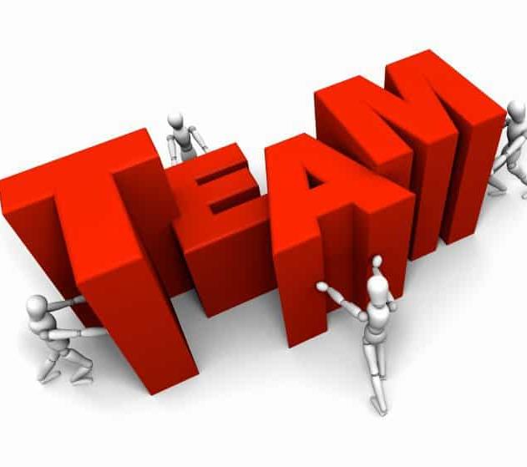
What is a TEAM?
This Photo by Unknown Author is licensed under CC BY-ND
Notes:
Small group of people with complementary skills who are committed to a common purpose, set of performance goals, approach for which they hold themselves mutually accountable

Slide 4
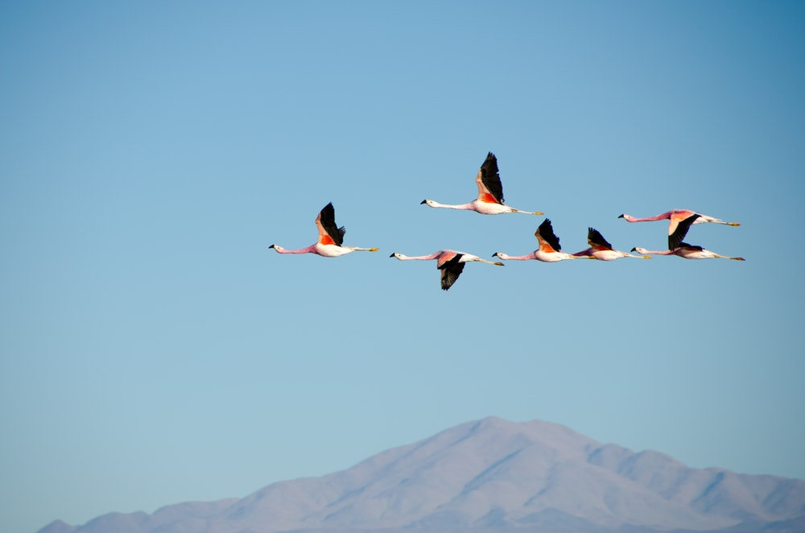
“V” formation or ...
What can geese teach us about team work?
Photo by Shwetha Shankar on Unsplash
Notes:
Have interdependent members
They are more efficient working together
They develop their own magnetism - Geese honk at each other for support
Geese rotate leadership
Geese help each other

Slide 5
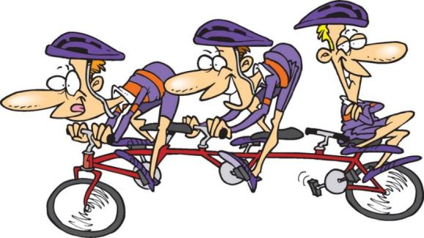
… AND WHY SOME PEOPLE DON’T LIKE TO WORK IN TEAMS
Why some people LIKE TO WORK IN TEAMS
This Photo by Unknown Author is licensed under CC BY-SA-NC
http://www.team-building-bonanza.com/teamwork-cartoons
Notes:
Safety
Status
Self-confidence
A sense of belonging
A sense of accomplishment
The presence of an expert in a team
Lack of self-confidence
Group thinking
Disfunctional atmosphere

Slide 6
The Benefits of Working in a Team
Customer Satisfaction
Product and Service Quality
Speed and Efficiency in Product Development
Employee Job Satisfaction
Decision Making
Multiple Perspectives
More Alternate Solutions
Commitment to Decisions

Slide 7
Disadvantages of a Team
Initially High Employee Turnover
Social Loafing
Disadvantages of Group Decision Making
Groupthink
Minority Domination
Inefficient Meetings
Lack of Accountability

Slide 8
When (not) to Use Teams
+
-
There is a clear purpose
The job can’t be done unless people work together
Team-based rewards are
possible
Ample resources exist
Teams have authority
There is no clear purpose
The job can be done
independently
Only individual-based rewards
exist
Resources are scarce
Management controls

Slide 9
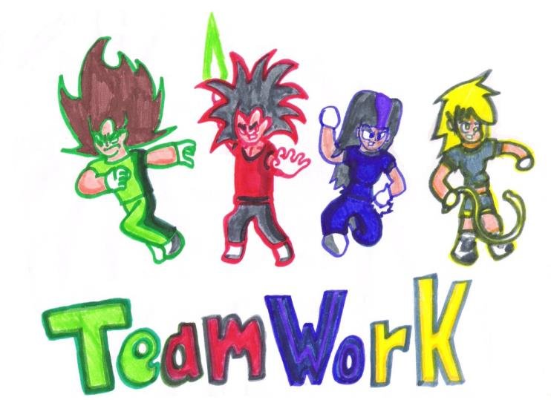
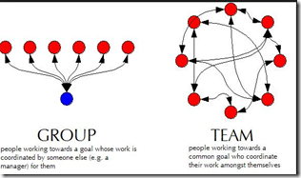
Working Groups vs. Team Work
This Photo by Unknown Author is licensed under CC BY-SA
This Photo by Unknown Author is licensed under CC BY
Notes:
GROUP - I do my job and you do yours, Working together but achieving different goals, Communication in case of a crisis/problem, The loudest person determines the course of action
TEAM - How are we connected?, Working together on achieving the same goals, Communication – all the way – to predict, avoid and solve problems, Every team member has the chance to speak up his/her mind

Slide 10
Working Groups vs. Team Work (2)
Working Groups | vs. | Teams
Sharing information | GOAL | Collective
Neutral | SYNERGY | Positive
Individual | RESPONSIBILITY | Individual and joint
Random and heterogeneous | SKILLS | Complementary

Slide 11
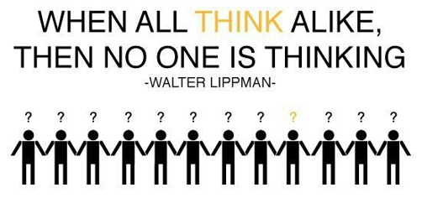
Groupthink
… occurs when a group values harmony and coherence over accurate analysis and critical evaluation. It causes individual members to make wrong decisions because of the group pressure or due to unquestioningly following the word of the leader.
Irving Janis, 1972
https://steemit.com/philosophy/@steemtruth/when-everyone-thinks-alike-who-is-thinking

Slide 12
Symptoms of Groupthink
An illusion of invulnerability
Collective rationalisation
Belief in inherent morality
Stereotyped views of out-groups
Direct pressure on dissenters
Self-censorship
Illusion of unanimity
“Mind guards” are appointed
This Photo by Unknown Author is licensed under CC BY-SA-NC

Slide 13
Some Solutions to Groupthink …
Open Discussion/Brainstorming
Delphi Method
Devil’s Advocate Technique
Second-Chance Meetings
Nominal Group Technique
Latter Technique

Slide 14
Life Cycle of a Team
Forming
Storming
Norming
Performing
Photo by rawpixel on Unsplash
Source: Tuckman (1965;2001).

Slide 15
1st Stage – Forming
Aggregation of individuals sharing common settings
Not feeling integrated with the group
Asking questions:
Who are these other people?
What is expected of me?
Who is going to lead?
Relationship based on: silence, self-consciousness, dependence, and superficiality
Tasks – FOCUS ON DEVELOPING THE TEAM RATHER THAN ON PRODUCING THE OUTPUT:
Orienting members and getting questions answered
Establishing trust
Establishing relationship with leaders
Establishing the clarity of purpose, norms, procedures, and expectations
Photo by Hans-Peter Gauster on Unsplash

Slide 16
2nd Stage – Storming
Exploring different roles
Stage of potential conflict and counter dependence
Asking questions:
How will we handle dissension?
How can we make decisions amidst disagreement?
How will we communicate negative information?
Do I want to maintain my membership in a team?
Relationship based on: coalitions or cliques, competition among members, disagreement with the leader, challenging others’ points of view
Tasks – FOCUS ON MANAGING CONFLICT:
Legitimise productive expressions of individuality
Turn counter dependence into interdependence
Turn challenges into constructive suggestions for improvement
Support the members to legitimately express their personal uniqueness and idiosyncrasies (as long as they are not destructive to overall team)
This Photo by Unknown Author is licensed under CC BY-NC-ND

Slide 17
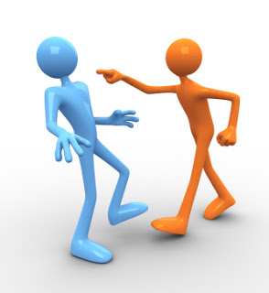
Types of Conflicts in a Team
C-Type Conflict - cognitive conflict
Task conflict
Disagreement about the work that is being done in a group
PRODUCTIVE CONFLICT
A-Type Conflict - or affective conflict
Relationship conflict
Emotional conflict
Personal disagreements based on personal and social issues usually not related with the work
DISFUNCTIONAL CONFLICT in team
This Photo by Unknown Author is licensed under CC BY

Slide 18
3rd Stage – Norming
Creating cohesive unit or a sense of a team
Developing common behaviours and perspectives
Strong peer pressure
Asking questions:
What are the values of the team?
How can I best get along with everyone else?
How can I show my support to others?
How can I fit in?
Relationship based on: loyalty, cooperativeness, conformity to standards and expectations, interpersonal attraction, ignoring disagreements
Tasks – FOCUS ON RELATIONSHIP BUILDING ROLES:
Maintain unity and cohesion
Facilitate participation and empowerment
Show support to team member
Provide feedback on team and team member performance
This Photo by Unknown Author is licensed under CC BY

Slide 19
4th Stage – Performing
Highly effective and efficient team functioning
Team has overcome issues of uncertainty, non-participation, dependence and self-centeredness; developed a clear mission and personal commitment to the team, high degree of loyalty and morale; overcome tendency toward groupthink and conflict.
Asking questions:
How can we help our members thrive?
How can we foster continuous improvement and creativity?
How can we build on our core competencies?
How can we maintain a high level of energy in a team?
Relationship based on: high mutual trust, unconditional commitment, mutual development, and entrepreneurship
Tasks – FOCUS ON FOSTERING SUCCESS:
Capitalise on core competencies and fostering innovation and improvement
Enhance flourishing relationships
Encourage positive deviance
This Photo by Unknown Author is licensed under CC BY-NC

Slide 20
PROJECT ACTIVITIES
Life Cycle of a Team
PROCESS
FORMING project orientation testing and dependence
STORMING emotional responses to conflicts
project requirements
NORMING open dialogue and sharing info team cohesion
PERFORMING solutions effective and efficient team functioning
Notes:
open dialogue and sharing info team cohesion

Slide 21
Belbin’s Team Roles
http://www.belbin.com
Notes:
PLANT (PL)
Plants are innovators and inventors and can be highly creative. They provide the source of original ideas to support innovation. Usually they prefer to operate by themselves at some distance from other members of the team, using their imagination and often working in an unorthodox way. They tend to be introverted and react strongly to criticism and praise. Their ideas may often be radical and may lack practical constraint. They are independent, and usually regarded as being clever as a result of their original and radical perspective. They don’t always manage to communicate in a compelling way and offer their ideas in a practical and relevant framework.
Function: The main use of a PL is to challenge conventional and established ways of doing things and provide suggested solutions for solving complex problems. PLs are often needed in the initial stages of a project or when a project is failing to progress. PLs have usually made their mark as founders of companies or as originators of new products. However, too many PLs in one team or group may be counter-productive as they tend to spend their time reinforcing their own ideas and engaging each other in combat.
RESOURCE INVESTIGATOR (RI)
Resource Investigators are usually enthusiastic extroverts. They are natural communicators with people both inside and outside the company. They are natural negotiators and are adept at exploring new opportunities and developing contacts. Although not a great source of original ideas, the RI is effective when it comes to picking up other people's ideas and promoting them. As the name suggests, they are adept at finding out what is available and from whom. RIs are generally relaxed people with a strong inquisitive sense and a readiness to see the possibilities in anything new. However, unless they remain stimulated by others, their enthusiasm can rapidly fade.
Function;
RIs are good at exploring and reporting back on ideas, developments or resources outside their immediate group. They are the natural people to set up external contacts and to carry out any subsequent negotiations. They have an ability to think on their feet and to probe others for information
CO-ORDINATOR (CO)
The distinguishing feature of Co-ordinators is their propensity for helping others to work towards shared goals. Mature, trusting and confident, they delegate readily. In interpersonal relations they are quick to spot individual talents and to use them in pursuit of group objectives. While COs are not necessarily the cleverest or most senior member of a team, they are likely to have a broad outlook and perspective. The natural goal focus of CO’s can sometimes lead to them manipulating others to achieve their personal objectives. In some situations COs are inclined to clash with Shapers due to their contrasting management styles.
Function: COs are well placed when put in charge of a team of people with diverse skills and personal characteristics. They perform better in dealing with colleagues of near or equal rank than in directing junior subordinates. Their motto might well be "consultation with control“ and they usually believe in tackling problems calmly.
SHAPER
Shapers are highly goal oriented people with great drive and energy. They push themselves and others and tend to overcome obstacles by sheer determination. They tend to be highly assertive and have very directive management styles. Shapers also tend to be competitive and like to win. They frequently progress upward in organisations because they get results and because many people are impressed by their courageous and decisive leadership style. SHs are not noted for their interpersonal sensitivities and can be argumentative and even aggressive.
Function:
SHs are generally perceived as ideal managers because they generate action and thrive under pressure. They come into their own when quick and decisive action is called for to overcome threats and difficulties or when progress towards goals and objectives is unacceptably slow.
MONITOR EVALUATOR (ME)
Monitor Evaluators are serious-minded, prudent individuals with a built-in immunity for being over-enthusiastic. They are likely to be slow in making decisions preferring to carefully think things over. Usually they have a high critical thinking ability. They have a good capacity for shrewd judgements that take all factors into account. A good ME is unlikely to make intuitive and reckless mistakes. They deal in facts and logic rather than emotion when considering options. They are often regarded as over-critical and can be seen to be slow and boring.
Function:
MEs are best suited to analysing problems and evaluating ideas and suggestions. They are very good at weighing up the pro's and con's of options. In a managerial position their ability to make high quality decisions consistently is likely to make them highly regarded.
IMPLEMENTER
Implementers are characterised by their practical approach and possess higher than normal levels of self-control and discipline. They are prepared to work hard to ensure things are done as prescribed in a systematic way. They are typically loyal to the organization and prescribed and established ways of doing things. They are likely to be regarded as someone who will not seek personal agendas and self-interest. On the downside IMPs may be inflexible in accepting new ways of doing things, particularly if they are radical or impracticable.
Function:
IMPS are valuable in an organisation because of their reliability and capacity for application. They succeed because they are efficient and because they have a sense of what is feasible and relevant. While many people might stray favouring the tasks they like to do and neglect things they find not to be to their liking an IMP is more likely to do what needs to be done in a systematic and relentless way.
TEAMWORKER (TW)
Teamworkers possess a mild and sociable disposition and are generally supportive and concerned about others. They have a great capacity for flexibility and adapting to different situations and people. TWs are perceptive, diplomatic and caring and tend to be good listeners. Because of these qualities it is hardly surprising that they are popular with their colleagues. Their concern about creating harmony and avoiding conflict can make them indecisive when faced with having to make difficult solo decisions.
Function:
The TW may be legitimately compared to the lubricating oil in a car engine. We don’t always appreciate how important it is until it isn’t there. Because of their ability to be able to resolve interpersonal problems TW’s come into their own when situations are tense and people feel uncared for and not appreciated. They can rise to senior positions because they have few enemies and the fact that they are ready to listen to the views and suggestions of others.
COMPLETER-FINISHER (CF)
Completer Finishers have a great capacity for the attention to detail. They constantly strive for perfection and correct errors. CFs are quite introvert and require less external stimulus than most people. The CF can be trusted to do work to the highest standard and to complete it on time. The combination of striving for perfection and meeting dead lines often creates anxiety though and CFs are likely to be reluctant to trust others to do work to their own high standards.
Function:
The Completer Finisher is invaluable where tasks demand close concentration and a high degree of accuracy. The standards they set make them well suited to situations where precision and high standards are essential. CFs will also demand the same high standards from people around them and therefore create their own micro culture where the only standard acceptable is perfection.
SPECIALIST (SP)
The Specialist Team Role and the functional title of Specialist is often a cause for confusion. While it is true that both uses of the term may relate to people who are a source of technical knowledge and expertise the Specialist in Team Role terms has some very specific attributes. Their main distinguishing feature is their love of learning. They see learning and the accumulation of knowledge as the main reason for their existence and their single minded and resolute pursuit of this end is their main motivation. The SP is likely to be recognised by colleagues as an expert to turn to for help and guidance. The SP will usually try to avoid being involved in unstructured meetings and discussions or those of a social nature. They may also be somewhat unyielding when challenged about the validity of their knowledge or field of expertise.
Function:
While SPs may not be regarded as natural team players teams will be wise to engage the SP as a means of providing in depth research. As managers, they command respect because of their in-depth knowledge and they can be used to mentor others to raise their technical expertise.

Slide 22
Managing a Team
Selection
Connections
Development
Optimizing performance
Evaluation
This Photo by Unknown Author is licensed under CC BY
Notes:
SELECTION
Analysing roles of members
Forming the team
Setting goals
Understanding the mission and assignments
CONNECTIONS
Building trust
DEVELOPMENT
Balancing the skills and competencies of team members
Maximizing team performance
Increasing the efficacy and efficiency of a team
OPTIMIZING A PERFORMANCE
Maximizing productivity
Encouraging the high level of energy in team
Managing conflict
EVALUATION
Evaluation of achieved goals

Slide 23
Leading a Team
Two critical factors for leading a team:
Credibility
Motivating vision and goals for the team
This Photo by Unknown Author is licensed under CC BY-SA-NC
Notes:
Two critical factors for leading a team:
Credibility - members of a team will not trust the message if they don’t trust the leader
Establishing a motivating vision and goals for the team

Slide 24
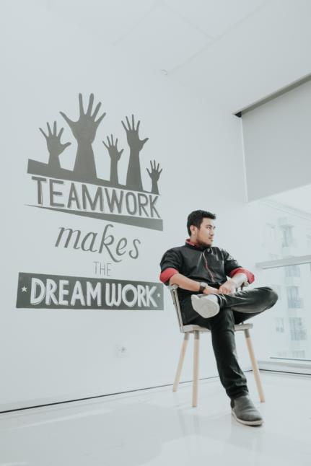
Developing Credibility
Be clear and consistent
Create positive energy
Build a base of agreement with the focus on task accomplishment
Manage agreement and disagreements among team members
Encourage and coach team members
Share information
Provide perspective from external sources
Encourage participation
Photo by Ali Yahya on Unsplash
24
Notes:
Demonstrating integrity – ‘Walk the talk’
Being clear and consistent
Creating positive energy by being optimistic and complementary
Building a base of agreement among team members moving on, with the focus on task accomplishment
Managing agreement and disagreements among team members using one-sided and two-sided arguments appropriately
Encouraging and coaching team members to help them improve
Sharing information about the team itself, providing perspective from external sources and encouraging participation

Slide 25
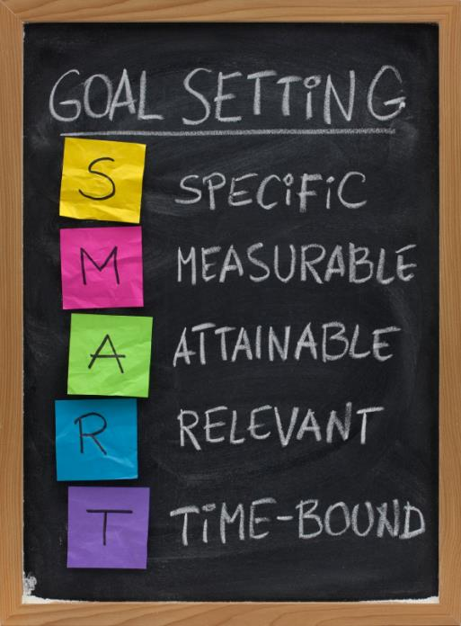
Establishing SMART and EVEREST Goals
EVEREST Goals:
Go beyond normal goal setting
Ultimate achievement
Visionary
Extraordinary effort and luck
This Photo by Unknown Author is licensed under CC BY-SA-NC
25
Notes:
EVEREST goals:
Go beyond normal goal setting
Represents ultimate achievement, extreaordinary acomplishment and beyond the norm outcome
It is visionary, not just tactical or strategic
Requires extraordinary effort to achies and a little bit of luck as well

Slide 26
Competencies of a Good Team Member
4Cs
Personality
Interpersonal skills
Managing conflict
Collaborative problem solving
Communication skills
Management skills
Establishing goals
Controlling, monitoring, and
providing a feedback
Establishing norms and regulations
Assigning tasks
Competence
Communication
Character
Collaboration

Slide 27
Straw Tower Building
Divide students into teams
Each team has 60 straws
Task: build the highest tower
Time: 15 minutes
Photo by Meghan Rodgers on Unsplash

Slide 28
Summary
The Law of Significance - Teams can do more than a lone individual.
The Law of the Big Picture - Subordinate personal goals to the good of the team.
The Law of the Niche - Place the right person in the right team position.
The Law of Mount Everest - As a task becomes greater, the need for teamwork increases.
The Law of the Chain - Any team is dependent on its weakest member.
The Law of the Catalyst - Teams need “get it done” people.
The Law of the Compass - Vision gives team members directions and confidence.
The Law of the Bad Apple - Rotten attitudes ruin a team.
Maxwell, J.C. 17 Indisputable Laws of Teamwork

Slide 29
Summary
The Law of Accountability - Team members have to rely on each other.
The Law of the Price Tag - Teams must pay a price to win.
The Law of the Scoreboard - Teams can make adjustments when it knows where it stands.
The Law of the Bench - Do not dismiss people on the bench as having limited potential.
The Law of Identity - Shared values form the common bond that makes a team cohesive.
The Law of Communication - Interaction is a basic component of winning teams.
The Law of the Edge - The difference between two equally talented teams is leadership.
The Law of High Morale - High morale psychologically prepares teams for difficult tasks.
The Law of Dividends – Investing in the team compounds over time.
Maxwell, J.C. 17 Indisputable Laws of Teamwork

Slide 30
Learning Objectives
Understand what is teamwork, which roles exist in teams, how to evaluate team members and use them in teams in accordance to their preferred team roles
Understand the need for teams, how to successfully build a team and go through team life cycle
Understand how to implement successful team management and leadership in everyday operations

Slide 31
References
Belbin, R. M. (2012). Team roles at work. Routledge.
Maxwell, J.C., The 17 Indisputable Laws of Teamwork, Thomas Nelson © 2001
Montier, J., The Little Book of Behavioral Investing: How Not to Be Your Own Worst Enemy, John Wiley & Sons, 2010
Tuckman, Bruce W (1965): Developmental sequence in small groups. Psychological Bulletin. 63 (6): 384–399.
Tuckman, Bruce (Spring 2001). Developmental Sequence in Small Groups. Group Facilitation: A Research and Applications Journal: 71–72.
Whetten, D.A. & K.S. Cameron: Developing management Skills, Pearson Prentice Hall, 2007
Williams, C. Managing teams, B-books, Ltd http://occonline.occ.cccd.edu/online/scatlin/MGMT3_PPT_CH10_slides.pdf

