Slide 1
Graduate Employability
Notes:
Start with an open question: What is employability?

Slide 2
Learning Objectives
Understand the need for a proactive approach in career search
Identify the key elements of career decision making
Identify personal strengths, weaknesses, and areas requiring further development
Identify general trends in graduate employment and recognize opportunities for employment
Create a short/medium/long-term career development action plan

Slide 3
Graduate Employability
“European universities are increasingly required to produce highly mobile graduates able to respond to the ever-changing needs of the contemporary workplace. (…) Indeed, serious concerns have been expressed about an increasingly wide ‘gap’ between the skills and capabilities of graduates, and the requirements and demands of the work environment in an increasingly mobile and globalised society.”
Source: Andrews, Jane & Higson, Helen (2008): Graduate Employability, ‚Soft Skills‘ Versus ‚Hard‘ Business Knowledge: A European Study. Higher Education in Europe, 33(4), pp.411.

Slide 4
Graduate Employability?
“Set of skills, knowledge, understanding, and personal attributes that make a person more likely to choose and secure occupations in which they can be satisfied and successful” (Dacre Pool & Sewell, 2007, p.280)
“graduates’ abilities to adapt and use personal and academic skills” (Andrews & Higson 2008, p.412)
“the capacity to obtain and/or create work” (Kinash 2017)
This Photo by Unknown Author is licensed under CC BY-SA
Notes:
Comment on definition 2: capacity to obtain and/or create work = Taking and making jobs
Open question to students: Based on these definitions, what skills does ‚employability‘ refer to? What type of skills do students need in order to be ‚employable‘?

Slide 5
What kind of job could you be doing?
Make a list of all the jobs you think you could be doing in different sectors:
One in the academic sector
One in the public sector
One in the private sector
One by self-employment
One that has nothing to do with your profession
One connected with your hobby
Time: 5 min

Slide 6
This Photo by Unknown Author is licensed under CC BY-ND
Notes:
There is difference between job (job based search) and career (people based search)

Slide 7
Job-Based Search
Qualifications
Job requirements
Activities
This Photo by Unknown Author is licensed under CC BY-NC-ND

Slide 8
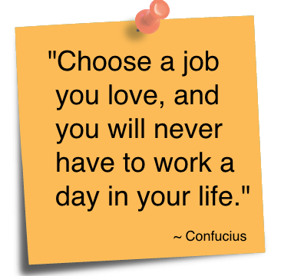
People-Based Search
3Ps of Career Development:
Passion
Power
Purpose
http://www.quotesvalley.com/
This Photo by Unknown Author is licensed under CC BY-SA
Notes:
PASSION – know hot to answer the question ”Why would I hire you”?!! And „Why would you like to work for me”
POWER – strenght, skills, charisma, expertise
PURPOSE - of your life, of the work…

Slide 9
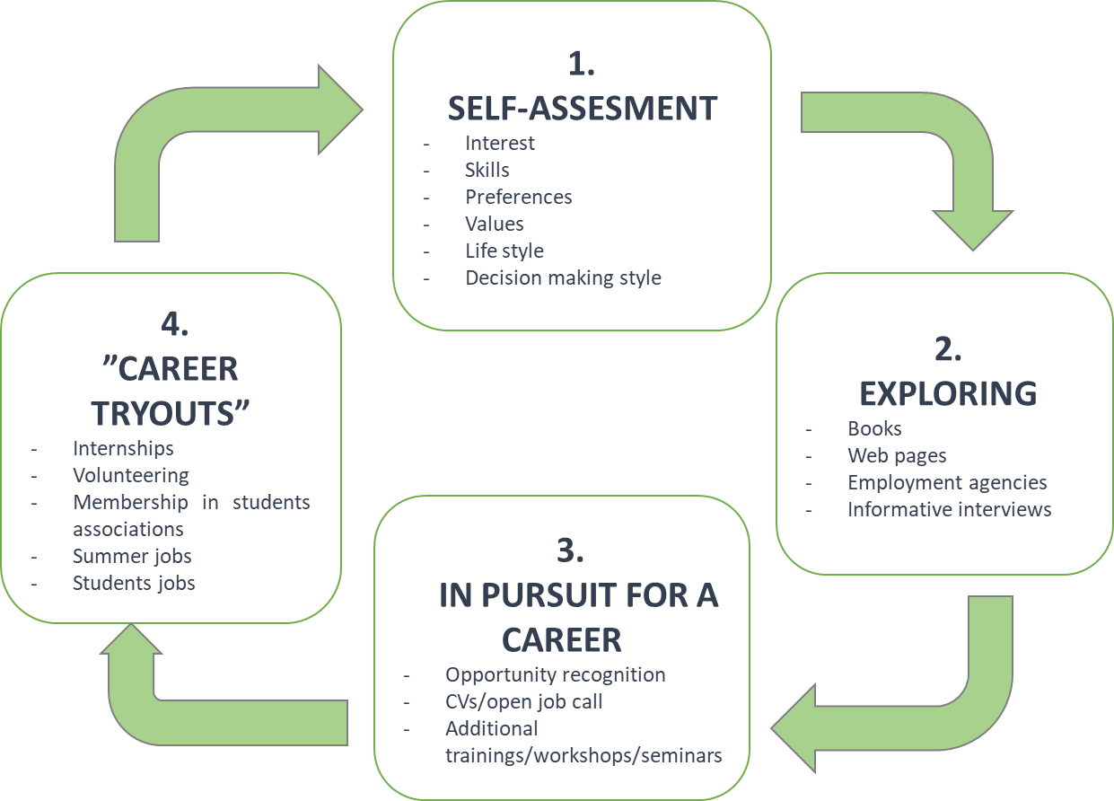
Career Development: Decision Making Process

Slide 10
Self-Assessment
Evaluate yourself based on the SWOT analysis
10 minutes
STRENGTHS:
- How do I differ from other people (skills, certificates,
education)?
- What do I do better than others?
- What do others see as my competitive advantage?
- What am I most proud of? - What are my values?
WEAKNESSES:
- What assignments do I avoid because I do not
think I am competitive enough?
- What do others see as my weaknesses?
- Am I completely confident in skills gained through
formal education? If not, what are my weaknesses?
- What are my negative behaviours (e.g. being late, poor stress and time management, disorganised)?
OPPORTUNITIES:
- How can I use my strengths?
- What opportunities do I see for my own personal and
professional development?
- What do I need to change in order to make personal
and professional progress?
THREATS:
- What obstacles do I notice when studying?
- Who are my competitors (e.g. for projects, tasks, activities)?
- Can some of my weaknesses become a threats?

Slide 11
2. Exploring
Be realistic
Labour market is complex. You will probably change at least 2-3 job positions by the age of 35. Ten of the most-wanted jobs in 2013 did not exist in 2004. Ask WHAT and WHERE questions:
WHAT
is important to you?
(values, skills, knowledge, work atmosphere, money, life style, working hours…)
WHERE
can you find it?
(opportunity for personal and professional development)

Slide 12
3. In Pursuit of a Career
Dream Jobs = desire + investment
FIND something you love doing so much that you would do it for free
BECOME so good at it people are willing to pay you so you could do it
THINK what you dream job would be if you were not afraid to try or take risks
FIND CREATE THAT JOB!!!
This Photo by Unknown Author is licensed under CC BY-SA-NC

Slide 13
In Pursuit of a Career(2)
https://www.youtube.com/watch?v=gHXKitKAT1E
DO NOT GIVE UP!
DO NOT ASK “WHY?” (why is this happening to me?) because it will only lead to discontent
You are showing your passion if you come to a job interview
And even if you do not get the job, ask WHAT questions: what can I learn from this? What does it mean?...
Notes:
Scenario: You are on your way to a dream job interviw and only five minutes to the building when it started raining.... and of course you are completely wet (the meteorologists did not even come close when forcasting the weather so you did not bring your umbrella :) ). What are you going to do?

Slide 14
4. Career “Tryouts”
Student associations
Volunteering
Internship
Summer jobs
Different kinds of student engagement
=
CV reference
Recommendations
Networking

Slide 15
What do employers seek from their future employees?
http://www.youtube.com/watch?v=a9JLJ4cm3W8
ABILITY – Can you do the job?
MOTIVATION?
Do YOUR VALUES fit the ORGANISATIONAL values?

Slide 16
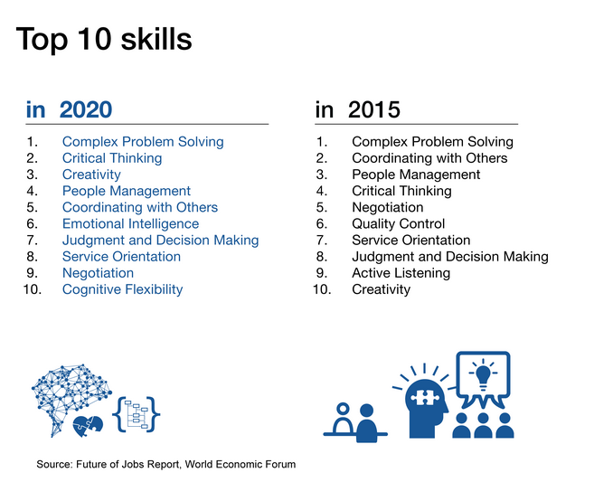

Slide 17
What about your soft skills?
Soft Skills:
This Photo by Unknown Author is licensed under CC BY-NC-ND
Professionalism Reliability Ability to cope with uncertainty Ability to cope with pressure Ability to plan/think strategically Capability to communicate/ interact with others (networking) Willingness to learn and accept responsibility | Good written and verbal communication skills Information and communication technology skills Creativity (think outside the box) Self-confidence Good self-management Time-management skills Problem solving skills
Source: Andrews, Jane & Higson, Helen (2008): Graduate Employability, ‚Soft Skills‘ Versus ‚Hard‘ Business Knowledge: A European Study. Higher Education in Europe, 33(4), pp.411-422.

Slide 18
What about your soft skills?(2)
Which of these soft skills are you acquiring at university?
Gap between graduate skills and needs of contemporary workplace?
For those soft skills that you are not acquiring at university, make a plan to acquire them elsewhere!
This Photo by Unknown Author is licensed under CC BY-SA
18

Slide 19
Networking
“It’s not what you know, it’s who you know”
76% of job findings is through person’s own network:
Family, friends, friends of a friends…
Mentorship
Recommendations
This Photo by Unknown Author is licensed under CC BY-NC
Being a part of a social network– YES, but BE CAREFUL!
LinkedIn, Facebook, Twitter….
“Google” information about yourself
39% of employers reject job applications because of what people posts on social networks
This Photo by Unknown Author is licensed under CC BY-SA-NC

Slide 20
Networking(2)
Develops Relationships
Increases Visibility
Filters Information and Saves Time
Requests Preparation
Allows Feedback
“Networking means the act of exchanging information with people
who can help you professionally” Michele Jennae

Slide 21
Unconventional (More Creative) Ways of Job Applications
http://www.youtube.com/watch?v=Kb-UdRa0Vaw&list=PLA570C901AB66E15F
http://www.youtube.com/watch?v=7FRwCs99DWg&list=PLA570C901AB66E15F&index=4
https://www.youtube.com/watch?v=sBGZTqXVz8M

Slide 22
7 Tips to Make You More Employable
https://graduateemployability.com/
http://www.inspiringinterns.com/blog/2012/02/5-tips-for-becoming-more-employable/

Slide 23
A Short/Medium/Long-Term Career Development Action Plan
What will you do for your career within the next TEN DAYS?
What will you do for your career within the next TEN MONTHS?
Where do you see yourself in TEN YEARS?
This Photo by Unknown Author is licensed under CC BY
23

Slide 24
Summary
Take responsibility and develop an entrepreneurial approach to your job search (the importance of proactivity)
Be aware of your skills, strengths, and weaknesses
Develop entrepreneurial skills – importance of soft skills
Be informed
Develop a network
Build your profile
Get different experience
This Photo by Unknown Author is licensed under CC BY-SA

Slide 25
Learning Objectives
Understand the need for a proactive approach in career search
Identify the key elements of career decision making
Identify personal strengths, weaknesses, and areas requiring further development
Identify general trends in graduate employment and recognize opportunities for employment
Create a short/medium/long-term career development action plan

Slide 26
Literature
Andrews, J. & Higson, H. (2008): Graduate Employability, ‚Soft Skills’ Versus ‚Hard‘ Business Knowledge: A European Study. Higher Education in Europe, 33(4).
Dacre Pool, L. & Sewell, P. (2007): The key to employability: developing a practical model of graduate employability, Education &Training, 49 (4), pp. 277-89.
Kinash, S., Crane, L., Hamlin, G. & Bannatyne, A. (2017) Metaphors postgraduates use to depict their student experience: Individual, community and digital presence, paper presented at ASCLITE 2017, 4-6 December

