Slide 1
Business Etiquette
There is no accomplishment so easy to acquire as politeness, and none more profitable.
George Bernard Shaw

Slide 2
Learning Objective
Understand the need for and importance of business etiquette in today’s global economy,
Understand how to prepare before meeting international clients and during different business occasions.

Slide 3
Professional Etiquette - First Impressions
Within 30 seconds people judge your:
Economic level
Educational level
Social position
Level of sophistication
Level of success
Within 4 minutes people decide your:
Trustworthiness
Compassion
Reliability
Intelligence
Capability
Humility
Friendliness
Confidence
https://www.salesforce.com/ca/blog/2017/04/aspects-of-first-impression
You only have ONE opportunity to make a good first impression!
Notes:
→ What do people judge within 30 seconds?

Slide 4
Cultural Faux Pas
“I recently asked a Chinese business associate how many children he had. This was an insensitive blunder on my part...”
Stephen Flowers, President of Global Freight Forwarding at UPS
Source: Flowers, Stephen (2012): Business Etiquette Tips for International Travel. Forbes, 15.06.2012. URL: https://www.forbes.com/sites/susanadams/2012/06/15/business-etiquette-tips-for-international-travel/#2aa1f8833743 [04.01.2018].
Notes:
→ Until recently, the Chinese Government limited members of the ethnic Han majority to have only one child

Slide 5
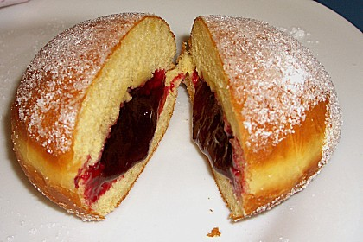
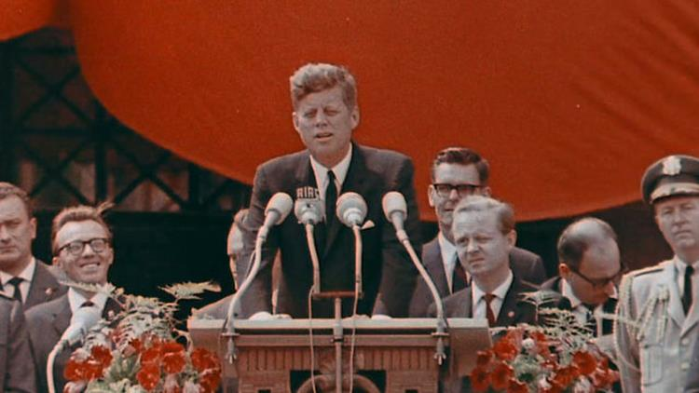
Cultural Faux Pas
„Ich bin ein Berliner!“
https://storyterrace.com/ich-bin-ein-berliner/
https://memim.com/berliner.html
This Photo by Unknown Author is licensed under CC BY
Think of a cultural faux pas you have made in a business context (or other context).
Notes:
In India, Africa and the Middle East people always use their right hand for greeting, touching, eating, handing people things. The left hand is considered unclean due the fact that it is used to perform tasks most westerners typically reserve for toilet paper. So you should never use it for anything publicly.
A Berliner is the name for a tasty pastry in some parts of Germany.
Business Etiquette is important! But how to ‚learn‘ business etiquette in intercultural contexts?

Slide 6
Basic Principles of Professional Business
Adopt a positive attitude.
1
Be professionally competent.
2
Overcome self centeredness.
3
Be discreet.
4
Be considerate and sensitive.
5
Be punctual.
6
Learn the forms of courtesy and respect.
7

Slide 7
What we think or what we know, or what we believe is, in the end, of little consequence. The only consequence is what we do.
John Ruskin

Slide 8
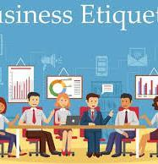
Business Etiquette
What is Business Etiquette?
Business etiquette is the set of written and unwritten rules of conduct that make social interactions run more smoothly.
The code of behaviour that delineates expectations for social behaviour according to contemporary conventional norms within a society, social class, or group.
Etiquette is not one uniform set of standards around the world!
https://www.mytectra.com/business-etiquette-training.html

Slide 9
Who wants to be a Global Etiquette Millionaire?
Let’s play a game of Kahoot https://play.kahoot.it/#/k/aead398e-b422-4ccd-b90d-2557b5ea2889
Name of the game:
Intense Business Etiquette
All participants need to have:
Kahoot app on smart phone
Access Kahoot on web
Notes:
.

Slide 10
Culture, Generations, ...
Etiquette is culture specific
Work Culture is different from School Culture
Common goal vs. individual goals
People of different ages and backgrounds
Not all company cultures are alike
Multigenerational Workplace
Different age influences communication, management styles, meanings of work loyalty, rewards, and career advancement ideas
Generation values affect behaviours of managers and company policies

Slide 11
Good Manners
Manners are a sensitive awareness of the feelings of others. If you have that awareness, you have good manners, no matter what fork you use. Emily Post

Slide 12
Elements of Business Etiquette
Professional Etiquette
Office Etiquette
Spoken Communication
Correspondence Etiquette
Meeting Etiquette
Etiquette Abroad
https://www.stoneward.com/blog/archive/2012/12/17/business-etiquette-101-essential-success-part-1
Notes:
Etiquette is simply practicing the “golden rule”. We have come to accept a general set of rules that defines who is and who isn’t polite. Business etiquette is a slight variation of that.

Slide 13
Professional Etiquette - Meeting and Greeting
Handshake: offer entire hand, web-to-web, shake lightly and release
Know whom to introduce first
Junior to senior
Fellow worker to client
Eliminate slang/jargon from your vocabulary
Always be on time, organized, and ready
Always have your calendar, notebook, and pen
Never bring up personal problems/issues in a professional situation
Avoid “you” talk
In conference rooms, hang back until power players have taken seats, ends and middle sides of table are power seats

Slide 14
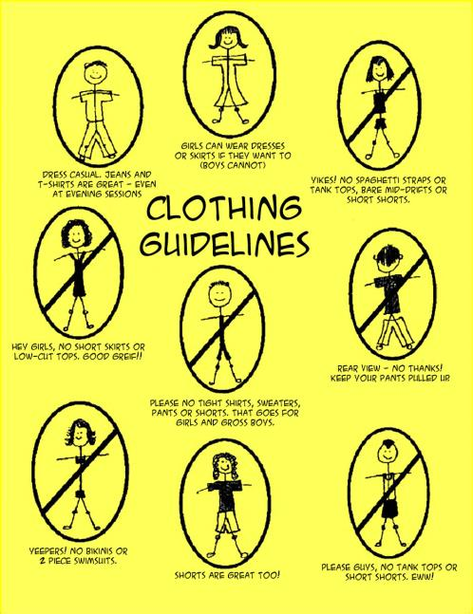
Professional Dress
Dress Codes:
Business Tailored
Business Casual
Casual
And anything in between
This Photo by Unknown Author is licensed under CC BY-NC-ND

Slide 15
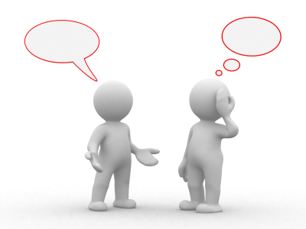
Spoken Communication
Interpersonal conversation:
Start out speaking formally
Do not SWEAR
Do not spread office gossip
Be careful about saying anything negative
Watch your co-workers, follow their lead
This Photo by Unknown Author is licensed under CC BY

Slide 16
Showing Respect
Always use last names with customers unless they are about your age and rank.
Don’t keep customers waiting.
Escort clients out
When someone of higher rank or from outside the organization enters, everyone in the office stands.
Junior employees stand until seniors sit.

Slide 17
Office Etiquette
With colleagues:
With subordinates:
Shoulder your fair share of work
Show appreciation to colleagues for helping you
Seek permission before using colleagues’ possessions
Avoid criticizing your colleagues
Give people their space – both physical and mental
Everyone, including your subordinates, has a right to be treated with courtesy
Give appropriate feedback and praise
Avoid being over intimate
Be objective
Give clear and accurate instructions

Slide 18
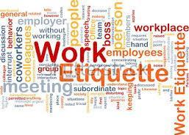
Office Etiquette (2)
Be self-aware and use common sense
Mind your own business
Avoid strong cologne
Never ever go over your supervisor’s head
Obey your company’s business dress attire
Keep your germs to yourself
Treat every employee with the same respect
Do not post things of an offensive nature
No matter your job or your title, always hold yourself to a higher standard
https://www.123rf.com/photo_9550060_background-concept-wordcloud-illustration-of-work-etiquette.html

Slide 19
Good manners will open doors that the best education cannot.
Clarence Thomas

Slide 20
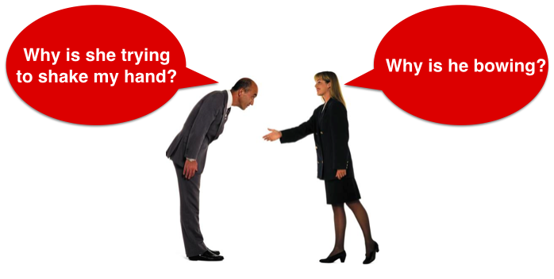
https://www.acc.com/chapters/colo/index.cfm?eventID=16809

Slide 21
Business Card Exchange Protocol
This Photo by Unknown Author is licensed under CC BY-NC-ND
Notes:
The business card exchange is extremely important in Japan -- almost ceremonial. Always give business cards with two hands and make a point to admire and examine the card. The more time you spend looking at it indicates the more respect you have for the person. In Italy, do not exchange business cards at social occasions; it is the norm at business functions and meetings. Always present with your right hand or both hands. Never your left hand in Arab countries. Never write on the card. The Japanese feel it’s like writing on their face.

Slide 22
Exchanging Business Cards
Give your business card when a person asks for it
Present card face up
Be aware of international card etiquette (e.g. in Japan or India business cards are given and received by both hands)
Be selective when distributing cards
NEVER turn down an offered card
Acknowledge it with a “thank you”
Do take time to look at the card and read it before putting it away
Do not glance at it and flick it away carelessly
Don’t write on a card in the presence of the giver, but make notes later

Slide 23
BUSINESS MEETING ETIQUETTE
This Photo by Unknown Author is licensed under CC BY-NC

Slide 24
Etiquette for Informal Meetings
The person calling the meeting or “the chair”, should be the most senior or with the most direct interest in the topic at hand
The chair should decide the time, place, and agenda
These details should be communicated to everybody
The chair must make the purpose of the meeting clear to the attendees, how long it will last, and what is expected of them
Punctuality is a must
Ensure that the meeting stays within the agenda
Someone should be pre-appointed to record the proceedings
The results of the meeting should be communicated to everyone concerned

Slide 25
Etiquette for Formal Meetings
Prepare well
Dress well and be punctual
Switch off your mobile phone or keep it on silent mode
Sit as per the seating arrangement, if not sure, then ask
Acknowledge any introductions or opening remarks with a brief recognition of the chair and other participants
When discussions are under way it is good business etiquette to allow the more senior figures to contribute first
Never interrupt anybody
When speaking – KISS
Always address the chair
Be discreet and never disclose information about the meeting to others

Slide 26
Business Networking in Social Situations
Never introduce yourself by your title
Name tags on your right shoulder
Keep your right hand free
Stay informed of current events
Maintain eye contact
Notes:
Be interested in others and what they do for a living
Do not pretend to be an expert on topics that you are not
Do NOT correct another’s grammar or pronunciation in public
Gracefully accept compliments given to you
Do NOT ask for professional advice or information at a social function

Slide 27
CORRESP-ONDANCE ETIQUETTE
This Photo by Unknown Author is licensed under CC BY-NC-ND

Slide 28
E-mail Etiquette
Include a clear, direct subject line
Use a professional e-mail address
Think twice before hitting “reply all”
Include a signature block
Use professional salutations
Be cautious with humour
Know that people from different cultures speak and write differently (e.g. Japanese and Chinese might be more personal in their writings than German, American, or Scandinavian)
E-mail only those people to whom your messages actually pertain to—don’t send mass or chain letters
Make a point of responding to messages promptly
Always use spell check and grammar check before sending messages—be brief and clear

Slide 29
Invitation Letters
Every written invitation should get a response, unless it asks for money
Respond to an invitation within a week
Follow directions for response
Special instructions (dress code) will be in lower corners
Envelope will indicate if you may bring guest
Send thank-you letters
Always include a cover letter for written documents
Sit on written documents for 24 hours (if possible)
Notes:
Address people by name Use paragraphs Punctuate Don’t type in caps Make the subject line specific Clean up forwards Sign messages

Slide 30
Written Communication
Proofread it!
No typos
Correct grammar, no slang
Business jargon is ok, however
Be careful what you say
Nothing is confidential — so write accordingly
You don’t know who will read it
You don’t know where it will go

Slide 31
PHONE ETIQUETTE
https://onpointexecutivecenter.com/the-importance-proper-phone-etiquette-has-on-your-business/

Slide 32
Telephone Manners
Answer
Answer the phone with your name and company (or department)
State
When placing calls, state your name and company or department immediately when phone is answered
Speak
Speak clearly
Purpose
State the purpose of your call
Use
Only use speakerphone for conference calls
Smile
Always smile when using the phone
Politeness
Say please and thank you
Judge
Judge your audience before making small talk
Return
Return your calls

Slide 33
Phone Etiquette
Speaker phones
Putting someone on speaker phone
Mute your phone while others are presenting information
Voice mail
Remember: It’s the company’s message system not yours, leave a professional message.
Leaving a voice message:
State your name clearly
Keep the message brief – for longer topics use email
Repeat your name and number at the end

Slide 34
Voice Mail/Mobile Phone Use
Realise proper usage of mobile phones in business
Understand how to leave an adequate voice message
Check messages frequently, on a daily basis
Avoid using in a restaurant, movie, church, or meeting
Limit your conversation when in close quarters
Use a quiet voice
Don’t give out credit card number
Refrain from using when driving

Slide 35
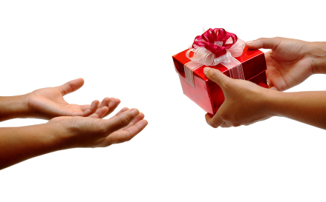
Gift-Giving Taboos
This Photo by Unknown Author is licensed under CC BY-NC-ND
Notes:
In Asia and the Middle East use only your right hand, or both hands, to offer or accept a gift. In Japan and Hong Kong, use both hands. Avoid giving gifts with your company logo to Belgium, France, Greece, Italy, Portugal and Spain. Be cognizant of religious laws when selecting gifts. Pork is prohibited in Jewish and Muslim religions, so you wouldn’t select a gift made from pigskin. In India, don’t offer a gift made from cowhide.

Slide 36
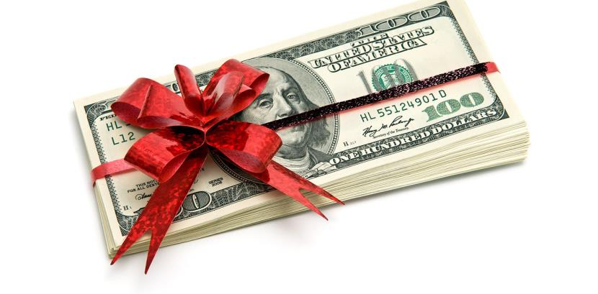
Gift Do's and Don'ts
Accepting
Presenting
Protocol
Superstitions
Numbers and colours
Costs
This Photo by Unknown Author is licensed under CC BY-ND

Slide 37
5 Keys to Doing Business Globally
Be aware of your own culture and its impact on you
Do not expect others to think the same way you do
Accept local customs and norms and try to adapt your behaviour, but do not try to imitate or act against your own norms and values
Be open, flexible, self-critical, tolerant, sensitive and show willingness to get involved in another culture
Open your senses – be attentive and stay patient! Listen, observe and try to understand before judging and evaluating other behaviours
Source: KeKCo - Kerstin Kühlborn Coaching & Consulting

Slide 38
Why is Global Business Etiquette Important?
With the shrinking world effect of globalisation, a critical element of success is the demonstration of respect and appreciation for cultural differences.
The ability to manage and do business with people from different countries is no longer just a nice skill to have; it is a necessity.
Business etiquette is important but how can one “learn” business etiquette in intercultural contexts?

Slide 39
Working on Cross-Cultural Teams
Working with foreign colleagues should not be regarded as a burden, but as an opportunity for enrichment.
Be helpful when recognizing language barriers, but do not be arrogant or correct every sentence.
Take an interest in other cultures. Encourage colleagues to share their unique experiences.
Be careful not to mock or joke culturally sensitive issues. Humour is highly subjective and varies widely across cultures.
Source: KeKCo - Kerstin Kühlborn Coaching & Consulting
Notes:
Getting to know another culture can be very interesting. Be open for new things and offer your help, if necessary!

Slide 40
Summary
Rules of conduct and business etiquette exist in every culture and help us to know how to behave in each situation.
We know how to behave in our culture of origin, but we don’t know how to behave in a foreign culture – there are no general international rules of etiquette.
Global etiquette can make the difference between opening or closing doors to business opportunities.
We need to build cultural awareness and seek specific knowledge of other cultures to navigate global business and partnership opportunities.

Slide 41
Be Aware of:
Management style:
Don’t be offended if your input is not universally accepted or encouraged
You may need to seek out mentoring rather than have it provided
Policies and procedures:
Take them seriously
If you need to do something outside of the rules, ask. If the answer is no, then it is no

Slide 42
How Can You Know All of This Stuff!!
You can’t – so relax
No one expects you to get it all right the first time
No one expects you to “just know”
How do you can learn
Watch your co-workers
Ask secretaries or assistants
Ask your manager
Get a mentor
If you make a mistake – apologise and move on

Slide 43
Business Etiquette - Kahoot #2
Let’s play a game of Kahoot
https://play.kahoot.it/#/k/551bd139-5232-480d-957f-4974e0360489
Name of the game:
Intense Business Etiquette #2
All participants need to have:
Kahoot app on smart phone
Access Kahoot on web

Slide 44
Learning Objective
Understand the need for and importance of business etiquette in today’s global economy,
Understand how to prepare before meeting international clients and during different business occasions.

Slide 45
References and Reading List
Andrews, J. Higson, H. (2008) Graduate Employability, ‘Soft Skills’ Versus ‘Hard’ Business Knowledge: A European Study, available at http://dx.doi.org/10.1080/03797720802522627
Flowers, Stephen (2012): Business Etiquette Tips for International Travel. Forbes, 15.06.2012. URL: https://www.forbes.com/sites/susanadams/2012/06/15/business-etiquette-tips-for-international-travel/#2aa1f8833743 [04.01.2018].
Lázár, T. (2017). Some sources of misunderstandings in intercultural business communication. International Journal of Engineering and Management Sciences (IJEMS), 2(3), 91-101.
Mukherjee, S., & Ramos-Salazar, L. (2014). " Excuse Us, Your Manners Are Missing!" The Role of Business Etiquette in Today's Era of Cross-Cultural Communication. TSM Business Review, 2(1), 18.
Star Alliances – Global Guide to Business Etiquette
Swierkocki, J. (2016) Practical Aspects in Doing International Business, University Lodz, Poland, chapter 1
http://www.businessinsider.com/email-etiquette-rules-every-professional-needs-to-know-2016-1#2-use-a-professional-email-address-2

