Slide 1
Project Management

Slide 2
Review – Your Project Ideas
Be ready to present your project in class within one or two minutes

Slide 3
1. Project Selection 2. Conceptual Development
3. Initiating a Project
3

Slide 4
Learning Objectives
Students understand the need to conceptualise their projects, in offer an acceptable, narrow objective
Students are able to formulate a SMART
Students understand the importance of scope management for project success
Students understand the significance of developing a scope statement
Students understand the importance of a work breakdown structure

Slide 5
Next steps?
Now that you decided on a project, what are the next steps/inputs that you need to develop your project?
Notes:
Now that each team has a rough idea about their project. What do you need to develop a more detailed concept?
Brainstorm. Gather in mindmap on board

Slide 6
How much project planning should I do?
Who will be implementing it?
Extensive planning needed to share knowledge and co-ordinate tasks
Extensive research and planning needed to check knowledge and co-ordinate tasks
Too difficult: break into sub-projects
You and strangers
You and close colleagues
Extensive research needed for definition and planning stages Seek expert advice
Moderate planning to find/share knowledge and coordinate tasks
Very easy: only outline plans needed
Moderate planning needed, mainly for definition stage
Extensive research needed, especially for definition stage
Seek expert advice
You alone
Some of the team have done it before, or you have a little
Nobody has done it before
You’ve done it often before
How novel is the project to the team?

Slide 7
Conceptual Development
The process that addresses project objectives by finding the best ways to meet them.
Key steps in information development:
Problem or need statement
Requirements gathering
Information gathering
Constraints
Alternative analysis
Project objectives
Business case
Source: Pinto (2015).

Slide 8
Objectives
S
Specific
M
Measurable
A
Achievable
R
Realistic
T
Timely
Notes:
Try to make your objectives SMART:
- Specific. What precisely do you hope to achieve from undertaking the research?
• Measurable. What measures will you use to determine whether you have achieved
your objectives? (e.g. secured a career-level first job in software design).
• Achievable. Are the targets you have set for yourself achievable given all the possible
constraints?
- Realistic. Given all the other demands upon your time, will you have the time and
energy to complete the research on time?
• Timely. Will you have time to accomplish all your objectives in the time frame you
have set?

Slide 9
Objectives
Notes:
Video. On SMART
2:38 min

Slide 10
Project Scope
Project scope is everything about a project, work content as well as expected outcomes.
Scope management is the function of controlling a project in terms of its goals and objectives and consists of:
1) Conceptual development 4) Scope reporting
2) Scope statement 5) Control systems
3) Work authorisation 6) Project closeout
Source: Pinto (2015).
Notes:
In line with defining an objective for your project you also need to define the project scope. So what is part of your project and what not?

Slide 11
Statement of Work (SOW) (“Terms of Reference” (TOR); Specification for Tender)
A SOW is a detailed narrative description of the work required for a project.
Effective SOWs contain:
Introduction and background
Technical description of the project
Timeline and milestones
Source: Pinto (2015).
Notes:
The statement of work (SOW) is a narrative description of products and services to be delivered by the project. For internal projects, the project initiator or sponsor provides the statement of work based on business needs, product or service requirements. For external projects, the statement of work can be received from the customer as part of a bid document, for example, request for proposal, request for information, request for bid, or as part of a contract. The SOW references:
Business need. An organization’s business need may be based on a market demand, technological advance, legal requirement, or government regulation.
Product scope description. This documents the characteristics of the product that the project will be undertaken to create. The description should also document the relationship between the products or services begin created and the business need that the project will address.
Strategic plan. The strategic plan documents the organization’s strategic goals. Therefore, all projects should be aligned with the strategic plan.
I usually show different examples of statements of work, to demonstrate that they vary in size and content

Slide 12
Statement of Work Components:
Background
Objectives
Scope
Task or Requirements
Selection Criteria
Deliverables or Delivery Schedule
Security
Place of Performance
Period of Performance
Notes:
Many organizations establish after the SOW

Slide 13
Project Charter
Many organisations establish after the SOW
A document issued by the project initiator or sponsor
Formally sanctioning existence of project and
Authorises project manager to begin applying organisational resources to project activities
Is created once project sponsors have done their “homework” to verify that:
A business case for the project exists
Elements of project are understood
Company-specific information for the project has been applied
Demonstrates formal company approval of the project

Slide 14
Project Proposal
Write proposal with objective, indicators, deliverables
Turn in to donor/sponsor
Donor approves/ declines/ negotiates
Execute based on statement of work
Notes:
Statement of work can equal proposal (GIZ)
Can be somesthng new develped jointly with the donor
Can be someting new coming from donor (grant agreement EU)

Slide 15
Quiz
A statement of work identifies:
A need
A project organisation
Members of the project team
Alternatives
Notes:
1A

Slide 16
Project Group Work
In your teams:
Discuss the scope of your project and develop an objective
Write the objective on a piece of paper
Exchange the paper with another group
Read the other group’s objective to the class and reflect on the SMART criteria
Notes:
Groups get 15 min to develop an objective. They should write it on a paper. Papers will be exchanged between groups afterwards. The other group reads the objective and reflects on whether this is SMART

Slide 17
Project Management Processes
Project Management Plan
Initiation
Scope
(definition)
WBS
Project Charter
Project Scope
Statement
Cost
(estimates, …)
Time
(activity diagrams, …)
Human Resources
(RACI matrix, …)
Also to consider: Quality, Risk, Communication, Procurement, Integration (PMBOK® knowledge areas)
Notes:
As an overview.
Once you have your objective defined you need to start thinking about different activities

Slide 18
Work Breakdown Structure (WBS)
A deliverable-oriented grouping of project elements which organises and defines the total scope of the project. Each descending level represents an increasingly detailed definition of a project component. Project component may be products or services.
Source: PMBoK.
Notes:
Is the most vital planning mechanism.
When we start a project it might be hard to know where and with what to start. One of the best ways to beginn is by realizing that a project is just a collection of discrete steps, that together add up to the overall deliverable.
A WBS is a deliverable-oriented grouping of project components that organizes and defines the total scope of the project
Work not in the WBS is outside the scope of the project
WBS is usually an operative tool used by contractors
First step towards constructing a schedule
Central role in project monitoring and control
Imagine you work on a group paer: what would be potentiall „Steps“ (WBS) that you can defide the project in?

Slide 19
Work Breakdown Structure Purpose
WBS serves six main purposes:
Echoes project objectives
Organisation chart for the project
Creates logic for tracking costs, schedule, and performance specifications
Communicates project status
Improves project communication
Demonstrates control structure
Notes:
An instrument for tracking costs and work performance.
Provides a coordinating framework for the various parts of a project.
Defines authority and responsibilities for the details of the project.
Provides the capacity to sum or “roll up” the cost of each project phase.
Identifies “work packages.”

Slide 20
The Work Breakdown Structure in the PMBOK®
Source: PMBoK.
Notes:
WBS:
Used as a basis for a number of processes in particular to produce the subsidiary plans of the Project Management Plan.
The WBS is a deliverable-oriented hierarchy of decomposed project components that organises and defines the total scope of the project. The WBS is a representation of the detailed project scope statement that specifies the work to be accomplished by the project.
The elements comprising the WBS assist the stakeholders in viewing the end product of the project.
The work at the lowest-level WBS component is estimated, scheduled, and tracked.
WBS Dictionary:
A WBS dictionary is a companion document to the WBS that describes each WBS element. For each WBS element, the WBS dictionary includes a statement of work, a list of associated activities, and a list of milestones.
Other information can include the responsible organisation, start and end dates, resources required, an estimate of cost, charge number, contract information, quality requirements, and technical references.
WBS elements should be cross-referenced as appropriate.

Slide 21
WBS
Deliverables are major project components
1.0 Objective
1.1 Deliverable 1
1.2 Deliverable 2
1.3 Deliverable 3
1.1.1
Work package 1
1.1.2
Work package 2
1.1.3
Work package 3
1.2.1
Work package 1
1.2.2
Work package 2
1.2.3
Work package 3
1.3.1
Work package 1
1.3.2
Work package 2
1.3.3
Work package 3
Work Packages are individual project activities (lowest level in WBS)
Notes:
Eines als beispiel auf zurüf an der tafel entwickeln? Mit sticky notes
Select a suitable category (work, product or other relevant structure)
is not constrained by sequence
final box is a product or deliverable which is measurable and definable
lowest level indicate work packages, which can be used for estimates, schedule monitoring and control
Entire project team should be involved

Slide 22
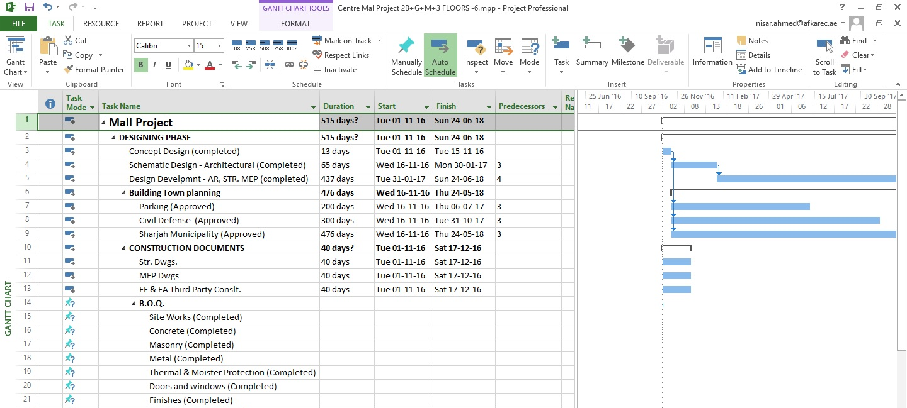
Sample WBS in MS Project 2013
Picture licenced as CC BY-SA
Notes:
You can also use excell.
We will talk about ms project later on in more detail.
The HTW has MS project licences on the coputer rooms in the 7th floor.

Slide 23
Tips for Breaking Down the Project
Breakdown the work until you can do an estimate that is accurate enough for your purposes
If you are pricing a project to submit a competitive bid then you are likely to go down to the work package level
Tasks should be limited as best as possible to one day or more to complete
Activities should have clearly defined start and end
Avoid open-ended tasks like “research” or “market analysis”
Accountability and control are important! Break the work down so that one individual is clearly responsible for each unit

Slide 24
Tips for Breaking Down the Project
Now you have broken the project into tasks you can work on each one independently
Specify what it is, in more detail
Decide resources needed
Estimate duration and costs
Decide which task must be completed before it starts (“precedents”)
Assign a person to make it happen

Slide 25
Group Work - Homework
In your team: develop a WBS for your project for the next class
Remember that the combination of all the defined work packages should result in the fulfillment of your project objective
The WBS is the first tool needed in your project plan
Notes:
I let the teams work on each tool in their selfstudy time each week. If you have more class time you can as well include this in the class session.

Slide 26
Summary
The necessary detail o project planning depends on the number of stakeholders and the novelty of the project
Project objectives should be SMART
Project scope is everything about a project, work content as well as expected outcomes.
A WBS is a deliverable-oriented grouping of project elements which organises and defines the total scope of the project.
26

Slide 27
Learning Objectives
Students understand the need to conceptualise their projects, in offer an acceptable, narrow objective
Students are able to formulate a SMART
Students understand the importance of scope management for project success
Students understand the significance of developing a scope statement
Students understand the importance of a work breakdown structure

Slide 28
References
Graham, R. J. (1992). A survival guide for the accidental project manager. In Proceedings of the Annual Project Management Institute Symposium (pp. 355-361). Project Management Institute Drexel Hill, PA.
Horine, Greg (2013): Absolute Beginner’s Guide to Project Management, Que Sams/Pearson Education, 3rd ed.
Pinto, J. K. (2015): Project management. Achieving competitive advantage, Pearson Education, Harlow, Essex, 4th ed.
Project Management Institute (2013): A Guide to the Project Management Body of Knowledge: PMBOK(R) Guide, Project Management Institute; 5th ed.
Sohmen, V. (2002, July). Project termination: Why the delay?. In PMI Research Conference.

Slide 29
Additional Reading for next class
Globerson, S. (1994). Impact of various work-breakdown structures on project conceptualization. International Journal of Project Management, 12(3), 165-171.
Newcombe, R. (2003). From client to project stakeholders: a stakeholder mapping approach. Construction Management and Economics, 21(8), 841-848.
Aaltonen, K., & Kujala, J. (2010). A project lifecycle perspective on stakeholder influence strategies in global projects. Scandinavian Journal of Management, 26(4), 381-397.

