Slide 1
Project Management

Slide 2
1. Stakeholder Management 2. Project Scheduling 3. Budget Planning 4. Risk Management
4. Planning a Project
2

Slide 3
Budget Planning
3

Slide 4
Learning Objectives
After completing this chapter, you should be able to:
Understand and recognise the difference in the various types of common project costs
Apply common forms of cost estimation for project work
Understand the uses of activity-based budgeting and time-phased budgets for cost estimation and control
Recognise the appropriateness of applying contingency funds for cost estimation
4

Slide 5
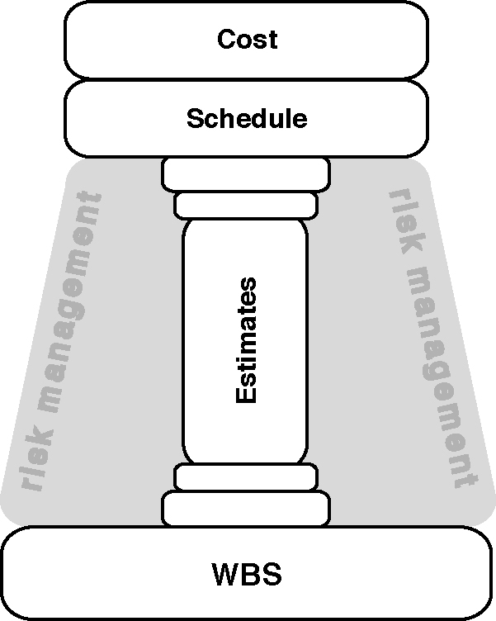
WBS and Work Estimates
Source: Horine (2013).
Figure: The foundational role the WBS and work estimates play in the overall planning process
5
Notes:
Use this figure to review and discuss, how WBS, Time planning (schedule) and Budget planning are related and depend on each other.

Slide 6
Cost Management
Cost management has been defined to encompass data collection, cost accounting, and cost control
Cost accounting and cost control serve as the chief mechanisms for identifying and maintaining control over project costs
Cost estimation processes create a reasonable budget baseline for the project
6

Slide 7
Sources and Types of Project Cost
Sources:
Labour
Materials
Subcontractors
Equipment & Facilities
Travel
Types:
Direct vs. Indirect
Recurring Vs. Nonrecurring
Fixed Vs. Variable
Normal Vs. Expedited
7
Notes:
Who can explain?
indirect: ex: overheads to direct labor costs
3.fixed: do not vary with th repect to usage
4. expedited= unplanned costs when steps are taken to speed up the project

Slide 8
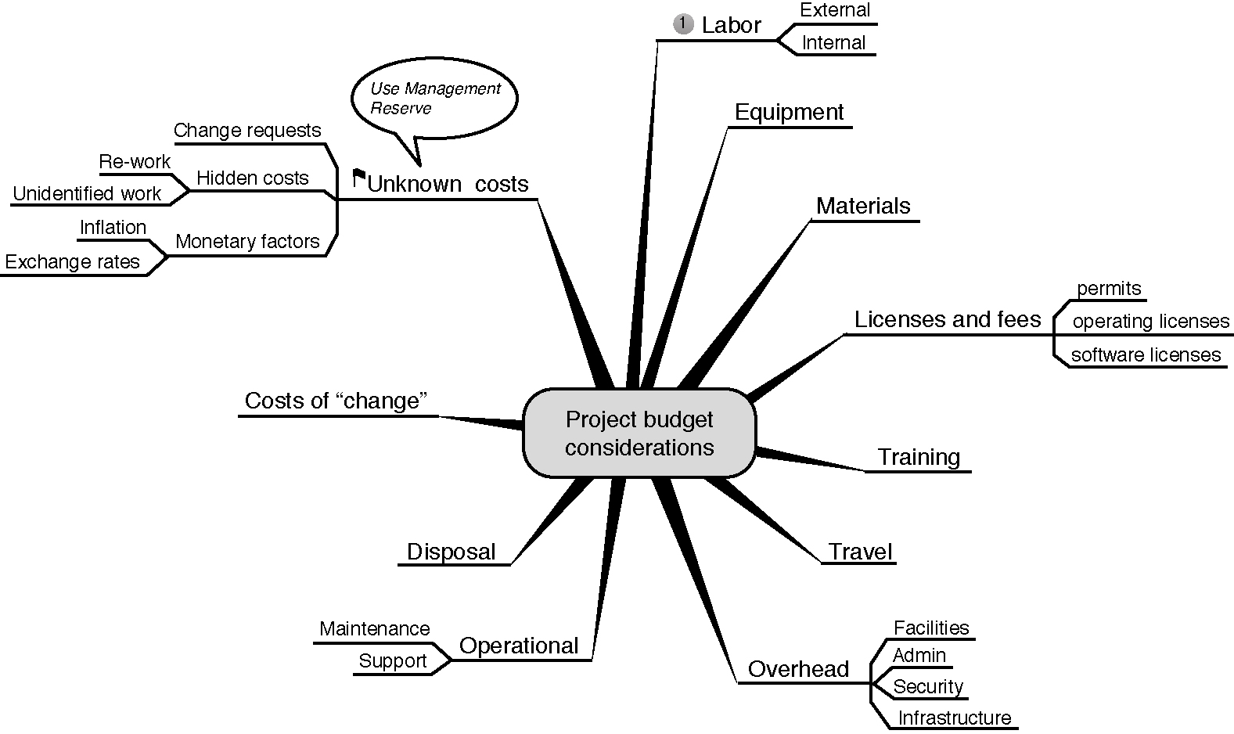
Budget Costs to Consider
Figure: The budget costs to consider.
Source: Horine (2013).
8
Notes:
Figure:

Slide 9
Cost Classifications
 | Type |  | Frequency |  | Adjustment |  | Schedule
Costs | Direct | Indirect | Recurring | Non-recurring | Fixed | Variable | Normal | Expedited
Salaries | x |  | x |  | x |  | x
Office rent |  | x | x |  | x |  | x
Material | x |  | x |  |  | x | x
Contrac-tual penalties | x |  |  | x |  | x |  | x
Source: based on Pinto (2015).
9

Slide 10
Cost Estimation
Ballpark (order of magnitude) ±30%
Comparative ±15%
Feasibility ±10%
Definitive ±5%
Source: Pinto (2015).
10
Notes:
Wenn es schnell gehen muss. Daumen rechnung nach erfahrung
Vergleich zu ähnlichen kosten in vorherigen projekten
Based on baseline, first data and figures
Can only be given at the completion of thhe most design work, so when the scope of the project is qell understood, know prices of orders and purches.. Etc.

Slide 11
Problems with Cost Estimation
Low initial estimates
Unexpected technical difficulties
Lack of definition
Specification changes
External factors
Source: Pinto (2015).
11

Slide 12
Creating a Project Budget
WBS
Project Plan
The budget is a plan that identifies the resources, goals, and schedule that allows a firm to achieve those goals.
Scheduling
Budgeting
Top-down
Bottom-up
Activity-Based Costing (ABC)
Source: Pinto (2015).
12

Slide 13
Activity-Based Costing
Projects use activities & activities use resources
Assign costs to activities that use resources
Identify cost drivers associated with this activity
Compute a cost rate per cost driver unit or transaction
Multiply the cost driver rate times the volume of cost driver units used by the project
Source: Pinto (2015).
13

Slide 14
Sample Project Budget
Activity | Direct Cost | Overhead | Total Costs
1.3 Feasability study | 300 | 60 | 360
2.1 Catering | 2500 | 500 | 3000
2.2 Music | 500 | 100 | 600
3.2 Flyers and Posters | 300 | 30 | 330
Social media adds | 300 | 30 | 330
14

Slide 15
Sample Budget Tracking Planned and Actual Activity Costs
Activity | Planned | Actual | Variance
1.3 Feasability study | 300 | 400 | -100
2.1 Catering | 2500 | 2500 | 0
2.2 Music | 500 | 550 | -50
3.2 Flyers and Posters | 300 | 250 | +50
Social media adds | 300 | 300 | 0
15

Slide 16
Example of a Time-Phased Budget
Activity | January | February | March | April | Total by activity
1.3 Feasability study | 300 |  |  |  | 300
2.1 Catering |  |  | 1000 | 1500 | 2500
2.2 Music |  |  |  | 500 | 500
3.2 Flyers and Posters |  | 200 | 100 |  | 300
Social media adds |  | 300 |  |  | 300
Monthly planned | 300 | 500 | 1100 | 2000
Cumulative | 300 | 800 | 1900 | 3900
16

Slide 17
Budget Contingencies
The allocation of extra funds to cover uncertainties and improve the chance of finishing on time
Contingencies are needed because:
Project scope may change
Murphy’s Law is present
Cost estimation must anticipate interaction costs
Normal conditions are rarely encountered
Source: Pinto (2015).
17
Notes:
Benefits of Contingency funding:
Recognizes future contains unknowns
Adds provision for company plans for an increase in project cost
Applies contingency fund as an early warning signal to potential overdrawn budget

Slide 18
Quiz
A systems analyst is paid at the rate of $50/hour and will be needed for 40 hours. Her employer uses an overhead multiplier of 60% and does not factor in personal time. Her total labor cost should be billed at:
$2,000
$3,200
$1,250
$4,500
18
Notes:
1b

Slide 19
Discussion
Do the majority of projects have cost overruns or underruns?
Overrun Examples:
Sydney Opera House: more than 14 times over budget
The Boeing Dreamliner : initial estimate was $6 billion vs. final cost of $32 billion
Elbe Philharmonic Hall in Hamburg: Initial estimate was 77 million EUR → 789 million EUR = 1024%
Berlin Brandenburg Airport: initial estimate 1 billion EUR → current plan: 6 billion EUR = 600%
What are reasons for these frequent cost overruns?
Notes:
Have students either read the artcle of Flyvbjerg, B., Holm, M. S., & Buhl, S. (2002). Underestimating costs in public works projects: Error or lie?. Journal of the American planning association, 68(3), 279-295. Or summarize the results of the article after the discussion. (reasons are economic and political calculations (smaller budget get easier project approvals.. Etc.) at least in public sector projects.

Slide 20
Exercise: Active Plenum to Develop a Budget
Volunteer Team?
Team presents their project in short
2 team members moderate the development of the budget on the board
Rest of the class provides input based on brainstorming and/or questions by the moderators

Slide 21
Homework
Develop a budget plan for your project in your team for next week
Be aware of the different cost estimation approaches. Your budget should be as accurate as possible. Hence, you will need to invest some research and provide the sources in your budget plan.
This is the fourth tool of your project plan
Notes:
I let the teams work on each tool in their selfstudy time each week. If you have more class time you can as well include this in the class session.

Slide 22
Additional reading
Ward, S., & Chapman, C. (2003). Transforming project risk management into project uncertainty management. International Journal of Project Management, 21(2), 97-105.

Slide 23
Summary
WBS, Time planning (schedule) and Budget planning are related and depend on each other.
The budget is a plan that identifies the resources, goals, and schedule that allows a firm to achieve those goals
Different cost categories need to be considered when establishing a project budget
The allocation of extra funds to cover uncertainties and improve the chance of finishing on time
23

Slide 24
Learning Objectives
After completing this chapter, you should be able to:
Understand and recognise the difference in the various types of common project costs
Apply common forms of cost estimation for project work
Understand the uses of activity-based budgeting and time-phased budgets for cost estimation and control
Recognise the appropriateness of applying contingency funds for cost estimation
24

Slide 25
References
Horine, Greg (2013): Absolute Beginner’s Guide to Project Management, Que Sams/Pearson Education, 3rd ed.
Pinto, J. K. (2015): Project management. Achieving competitive advantage, Pearson Education, Harlow, Essex, 4th ed.
Project Management Institute (2013): A Guide to the Project Management Body of Knowledge: PMBOK(R) Guide, Project Management Institute; 5th ed.

