Slide 1
Project Management

Slide 2
Review
Project Environment
Stakeholder
Culture
Organisational Context
Project Structure
Objective
Organisational Structure
WBS
Team
2
Notes:
You know: s. slide
Now time for more deteiled planning: scheduling!

Slide 3
1. Stakeholder Management 2. Project Scheduling 3. Budget Planning 4. Risk Management
4. Planning a Project
3

Slide 4
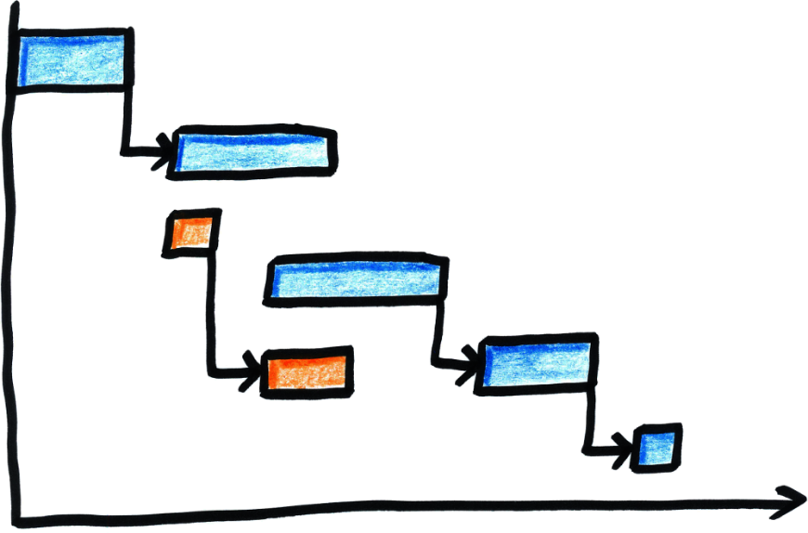
Project Scheduling
4

Slide 5
Learning Objectives
After completing this chapter, you should be able to:
Be aware of different methods of project time planning
Understand how scheduling contributes to achieving project management objectives
Be able to apply common scheduling tools for your project
5

Slide 6
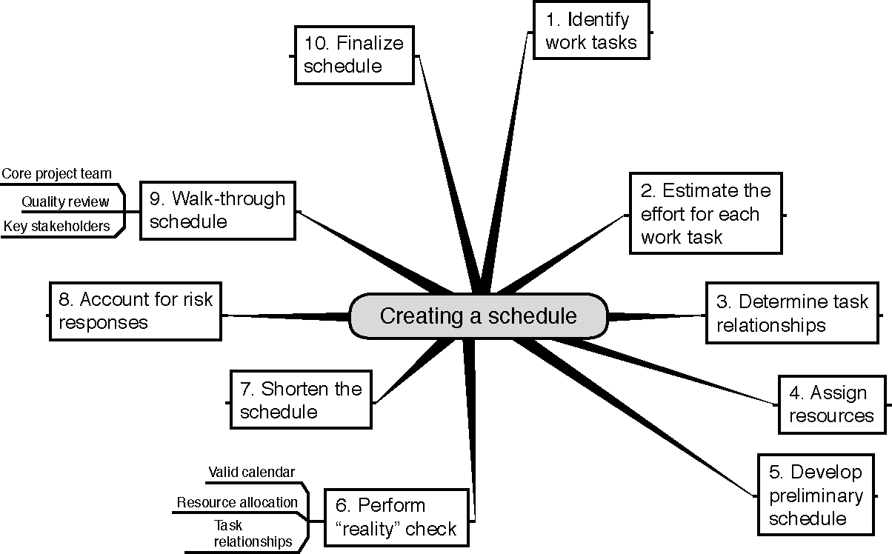
Ten Steps to Create a Schedule
Source: Horine (2013).
6
Notes:
Review Scheduling as discussed last week.

Slide 7
Scheduling Methods
Gantt Chart
Network Diagrams
Critical Path Method (CPM)
7
Notes:
Bar Charts (Gantt Charts)
length of bar = task’s duration
commonly used, require little training
precedence relationships difficult to show
precedence = the sequencing relationship between tasks
Network Diagrams
Critical Path Method (CPM)
w/in construction - most important
Identifies those chains of activities (critical paths) that control how long a project will take

Slide 8
Remember? Network Diagram Exercise: Writing a Term Paper
Which activities are necessary when writing a term paper?
In which sequence/order do these activities take place?
8
Notes:
Include here a picture from the network plan developed I the last session

Slide 9
Duration Estimation
Experience
Expert opinion
Mathematical derivation – beta distribution
Most likely (m)
Most pessimistic (b)
Most optimistic (a)
9

Slide 10
Complete Activity Network
2.1
Install library software
2.2
Further Literature search
1.1
Identify research Topic
1.2
Literature search
1.3
Write outline
3.1
Draft paper
1.4
Write Abstract
1.5
Feedback from supervisor
10
Notes:
On this example i want to demonstrate scheduling in more detail

Slide 11
Activity Duration and Variance
Activity | Name | Most Optimistic (days) | Most Likely (days) | Most Pessimistic (days)
1.1 | Identify research topic | 1 | 2 | 9
1.2 | First literature search | 3 | 5 | 7
1.3 | Write outline | 1 | 2 | 3
1.4 | Write abstract | 1 | 3 | 5
1.5 | Feedback from supervisor | 2 | 3 | 4
2.1 | Install library software | 1 | 2 | 3
2.2 | Further literature search | 2 | 6 | 10
11
Notes:
Our estimations from experience and expert oponion

Slide 12
Duration Estimation
Experience
Expert opinion
Mathematical derivation – beta distribution
Most likely (m)
Most pessimistic (b)
Most optimistic (a)
Source: Pinto (2015).
12

Slide 13
Project Information
Activity | Description | Predecessors | Estimated Duration (TE)
1.1 | Identify research topic | None | 3
1.2 | First literature search | 1.1 | 5
1.3 | Write outline | 1.2 | 2
1.4 | Write abstract | 1.3 | 3
1.5 | Feedback from supervisor | 1.4 | 3
2.1 | Install library software | 1.2 | 2
2.2 | Further literature search | 2.1 | 6
13
Notes:
Estimated duration TE

Slide 14
Remember? Network Diagram Exercise: Writing a Term Paper
14
Notes:
Include here a picture from the network plan developed I the last session
→ back to the board to apply it to the term paper example

Slide 15
Partial Project Activity Network with Task Durations
2.1
Install library software
2
2.2
Further Literature search
6
1.1
Identify research Topic
3
1.2
Literature search
5
1.3
Write outline
2
3.1
Draft paper
10
1.4
Write Abstract
3
1.5
Feedback from supervisor
3
Source: Pinto (2015).
15

Slide 16
Constructing the Critical Path
Forward pass – an additive move through the network from start to finish
Backward pass – a subtractive move through the network from finish to start
Critical path – the longest path from end to end which determines the shortest project length
Source: Pinto (2015).
16

Slide 17
Activity Network with Forward Pass
10 2.1 12
Install library software
2
12 2.2 18
Further Literature search
6
0 1.1 3
Identify research Topic
3
3 1.2 8
Literature search
5
8 1.3 10
Write outline
2
18 3.1 28
Draft paper
10
10 1.4 13
Write Abstract
3
13 1.5 16
Feedback from supervisor
3
17

Slide 18
Activity Network with Backward Pass
10 2.1 12
Install library software
10 2 12
12 2.2 18
Further Literature search
12 6 18
0 1.1 3
Identify research Topic
0 3 3
3 1.2 8
Literature search
3 5 8
8 1.3 10
Write outline
8 2 10
18 3.1 28
Draft paper
18 10 28
10 1.4 13
Write Abstract
12 3 15
13 1.5 16
Feedback from supervisor
15 3 18
18

Slide 19
Project Network with Activity Slack and Critical Path
10 2.1 12
Install library software
10 2 12
12 2.2 18
Further Literature search
12 6 18
0 1.1 3
Identify research Topic
0 3 3
3 1.2 8
Literature search
3 5 8
0
0
8 1.3 10
Write outline
8 2 10
18 3.1 28
Draft paper
18 10 28
0
0
0
0
10 1.4 13
Write Abstract
12 3 15
13 1.5 16
Feedback from supervisor
15 3 18
2
2
Source: Pinto (2015).
19
Notes:
Critical path in bold

Slide 20
Remember? Network Diagram Exercise: Writing a Term Paper
20
Notes:
Include here a picture from the network plan developed I the last session
→ back to the board to apply it to the term paper example

Slide 21
Scheduling Methods
Gantt Chart
Network Diagrams
Critical Path Method (CPM)
21
Notes:
Lets now turn to gantt charts
Bar Charts (Gantt Charts)
length of bar = task’s duration
commonly used, require little training
precedence relationships difficult to show
precedence = the sequencing relationship between tasks
Network Diagrams
Critical Path Method (CPM)
w/in construction - most important
Identifies those chains of activities (critical paths) that control how long a project will take

Slide 22
Example Gantt Chart - Following Client (EU) Format
22

Slide 23
Example Project Schedule
23

Slide 24
Partial Schedule
Source: Horine (2013).
24
Notes:
An example of a partial schedule displayed in table form.

Slide 25
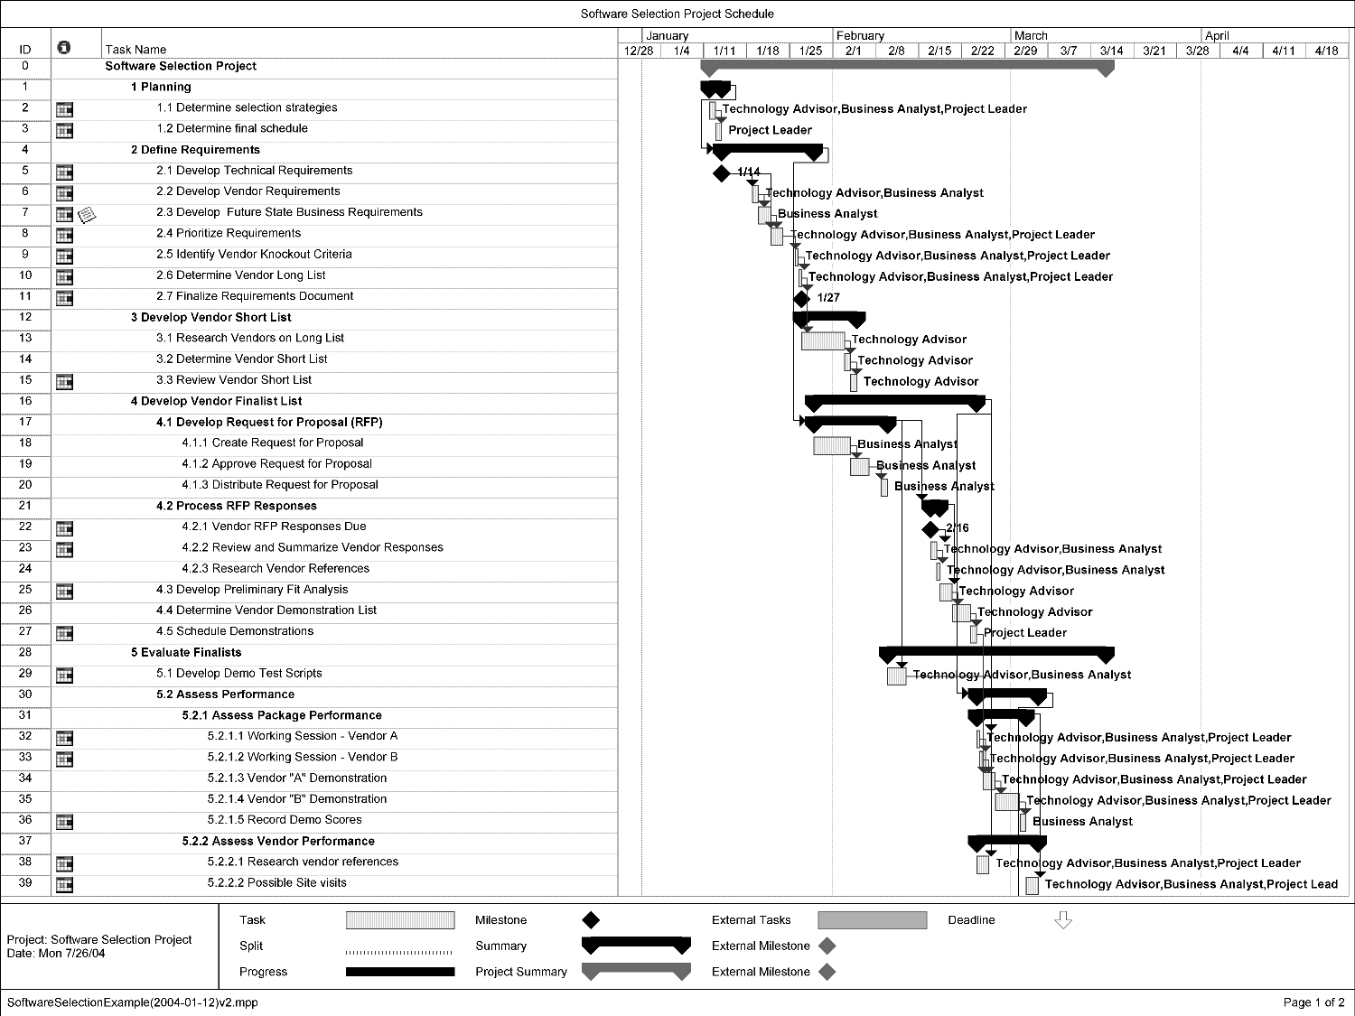
Partial Schedule: Gantt Chart
Source: Horine (2013).
25
Notes:
Figure: An example of a partial schedule displayed in Gantt chart form.

Slide 26
MS Project
Microsoft Project is a project management software program
It is designed to assist project managers in:
Developing plans
Assigning resources to tasks
Tracking progress
Managing budgets
Analysing workloads
26
Notes:
The first version of Microsoft Project was released for DOS in 1984 by a company working for Microsoft
Microsoft bought all rights to the software in 1985
During 1980’s couple of versions for DOS were released
It is not nessessarily the best working one (all have their flaws) but potentially widely known. Hence it does not hurt to get some working experience with it to built your own opinion.

Slide 27
MS Project
Notes:
Getting started tutorial
13.34 min
In moodle
Did you find other tools??

Slide 28
Summary: Ten Steps to Create a Schedule
Source: Horine (2013).
28
Notes:
11. Understand that your timeplan is going to change…

Slide 29
Summary - Discussion
What are the pro’s and con’s of different time planning methods?
Milestone planning
Gantt chart (Excel version vs. MS Project)
Network plan with critical path analysis
29
Notes:
Let students discuss in open plenum
Milestone planing is k for small and not very complex projects
Gantt charts: used most often. Disadvantage of excel: does not show predecessors of activities, hence logic and dependencies are not obvios (there are additional apps that provide such features in excel as well. Advantage: easy to do and understand
Gantt Chart based on Software (MS Project): advantage: demonstrates predecessors, creats network plan. Disadvantage: most softwares have flaws
Network plan: disadvantage: takes more time to construct. But advantage: accourding to research by Caughron, J. J., & Mumford, M. D. (2008). It creates more effective time plans and projects that use this approach have less time overruns.

Slide 30
Homework
Develop a network plan incl. a critical path analysis + a Gantt chart with dependencies for your project in your team for next week
This is the third tool of your project plan
Upload it to the Moodle forum before next session to receive feedback
Notes:
I let the teams work on each tool in their selfstudy time each week. If you have more class time you can as well include this in the class session.
I offer feedback for each group in moodle, if they upload their tools in the moodle before the next class. I use the moodle forum function for this.

Slide 31
Additional Reading
Flyvbjerg, B., Holm, M. S., & Buhl, S. (2002). Underestimating costs in public works projects: Error or lie?. Journal of the American planning association, 68(3), 279-295.

Slide 32
Summary
Project scheduling is an output of a schedule model that presents linked activities with planned dates, durations, milestones, and resources.
Research has shown that projects that use the critical path analysis have less time overruns than projects using Gantt charts.
Project Network Diagram is a schematic display of the logical relationships of project activities.
32

Slide 33
Learning Objectives
After completing this chapter, you should be able to:
Be aware of different methods of project time planning
Understand how scheduling contributes to achieving project management objectives
Be able to apply common scheduling tools for your project
33

Slide 34
References
GIZ GmbH. (2015). Cooperation Management for Practitioners: Managing Social Change with Capacity WORKS, 225-276.
Pinto, J. K. (2015): Project management. Achieving competitive advantage, Pearson Education, Harlow, Essex, 4th ed.
Project Management Institute (2013): A Guide to the Project Management Body of Knowledge: PMBOK(R) Guide, Project Management Institute; 5th ed.

