Slide 1
Project Management

Slide 2
1. Stakeholder Management 2. Project Scheduling 3. Budget Planning 4. Risk Management
4. Planning a Project
2

Slide 3
Discussion
How useful were the stakeholder management tools?
Questions on the tools?
How did the team cooperation work?
Any intercultural differences?
How was your team organised?
3

Slide 4
Review
Project Environment
Stakeholder
Culture
Organisational Context
Project Structure
Objective
Organisational Structure
WBS
Team
4
Notes:
You know: s. slide
Now time for more deteiled planning: scheduling!

Slide 5
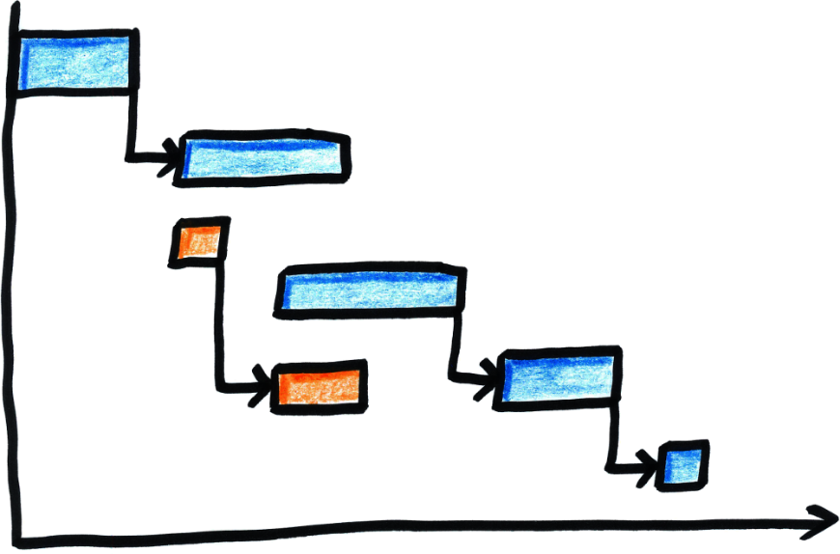
Project Scheduling
5

Slide 6
Learning Objectives
After completing this chapter, you should be able to:
Be aware of different methods of project time planning
Understand how scheduling contributes to achieving project management objectives
Be able to apply common scheduling tools on your project
6

Slide 7
Project Scheduling & Planning
Project Scheduling
PMBoK defines it as “an output of a schedule model that presents linked activities with planned dates, durations, milestones, and resources.”
Project Planning
“The identification of the project objectives and the ordered activity necessary to complete the project including the identification of resource types and quantities required to carry out each activity or task.”(PMBoK)
Source: PMBoK.
7
Notes:
Project scheduling requires us to follow some carefully
laid-out steps, in order, for the schedule to take shape.
PMBoK states, “an output of a schedule model that presents linked activities with planned dates, durations, milestones, and resources.”
Project planning, as it relates to the scheduling process, has been defined by the PMBoK as:
The identification of the project objectives and the ordered activity necessary to complete the project including the identification of resource types and quantities required to carry out each activity or task.

Slide 8
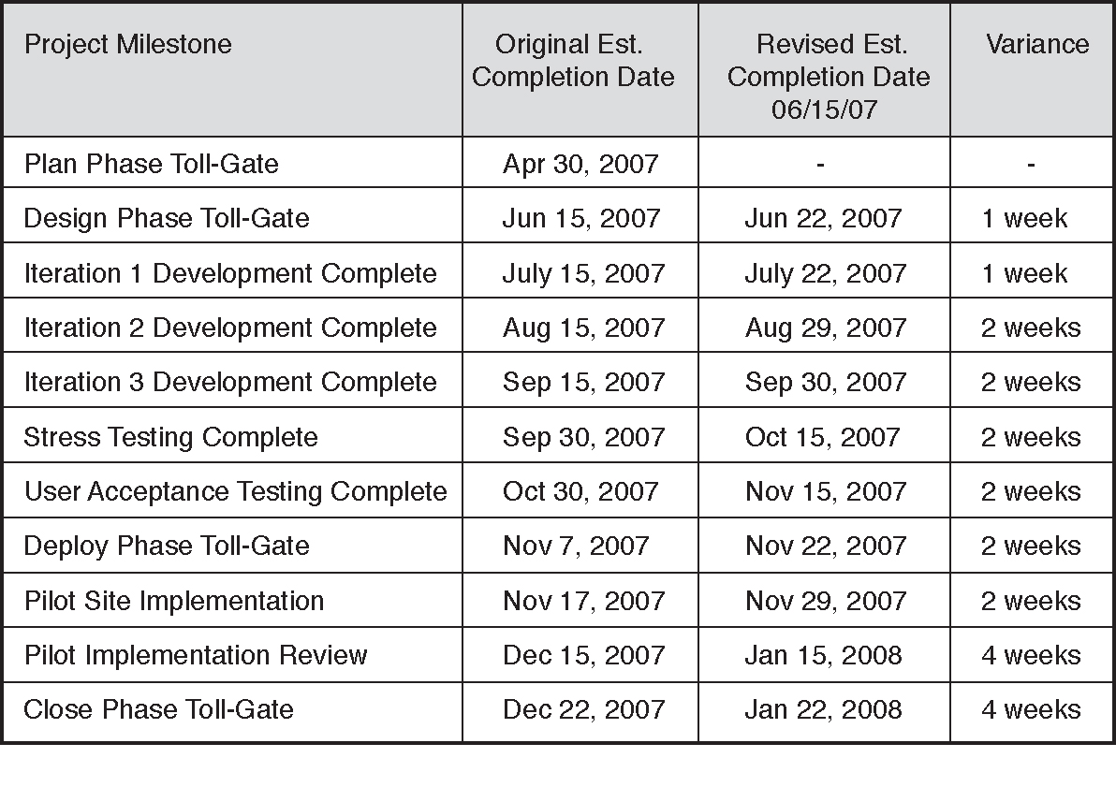
Milestone Schedule
Source: Horine (2013).
8
Notes:
You usually start of with this..
Figure: Example of a milestone schedule summary that tracks any approved schedule variances.
Milestones are tools used in project management to mark specific points along a project timeline. These points may signal anchors such as a project start and end date, a need for external review or input and budget checks, among others. In many instances, milestones do not impact project duration. Instead, they focus on major progress points that must be reached to achieve success. Milestones are frequently used to monitor the progress, but there are limitations to their effectiveness. They usually show progress only on the critical path, and ignore non-critical activities. A milestone is a task of zero duration that shows an important achievement in a project. Milestones are a way of knowing how the project is advancing if you are not familiar with the tasks being executed. They have zero duration because they symbolize an achievement, a point of time in a project.

Slide 9
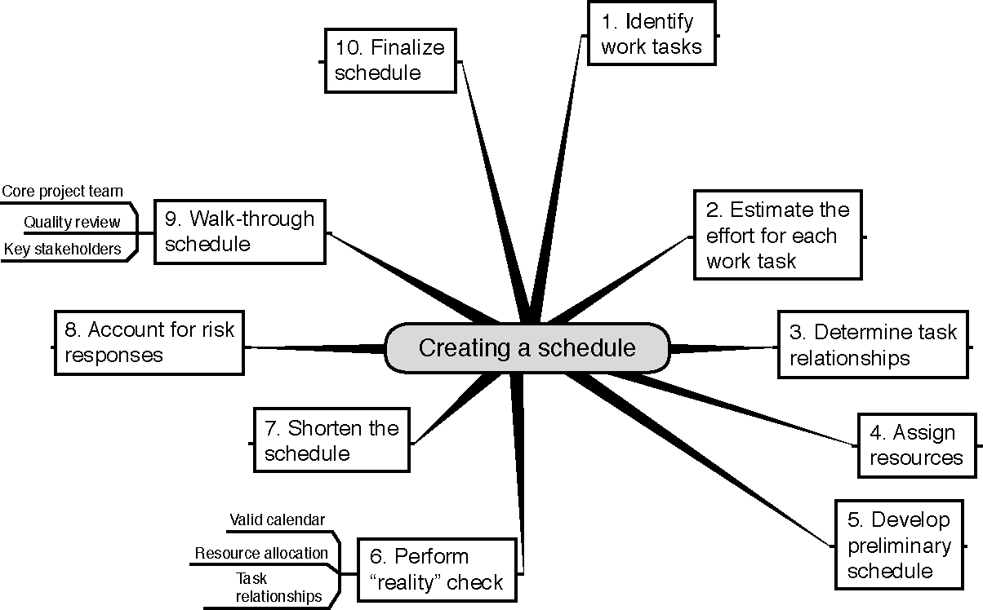
Ten Steps to Create a Schedule
Source: Horine (2013).
9
Notes:
Review Scheduling as discussed last week.

Slide 10
Scheduling Methods
Gantt Chart
Network Diagrams
Critical Path Method (CPM)
10
Notes:
Bar Charts (Gantt Charts)
length of bar = task’s duration
commonly used, require little training
precedence relationships difficult to show
precedence = the sequencing relationship between tasks
Network Diagrams
Critical Path Method (CPM)
w/in construction - most important
Identifies those chains of activities (critical paths) that control how long a project will take

Slide 11
Project Scheduling Terms
Project Network Diagram: any schematic display of the logical relationships of project activities
Path: a sequence of activities defined by the project network logic
Event: a point when an activity is either started or completed
Node: one of the defining points of a network; a junction point joined to some or all of the other dependency lines (paths)
Predecessors: those activities that must be completed prior to initiation of a later activity in the network
Successors: activities that cannot be started until previous activities have been completed, these activities follow predecessor tasks
Source: Pinto (2015).
11
Notes:
Float = the amount of time an activity can be delayed without delaying the project
Critical = activities with no float; these activities can not be delayed w/o extending project duration
Contingency = include a time allowance to account for time slippage & other delays
Slippage = difference between actual and scheduled progress

Slide 12
Network Diagram Exercise: Writing a Term Paper
Which activities are necessary when writing a term paper?
In which sequence/order do these activities take place?
12
Notes:
Question: Which activities in which order do you undergo when you write a term paper?
Students shall first brainstorm in the different activities. Ask, if they stay to superficial. Should be 15 – 20 activities. → write them on sticky notes.
Then develop the sequence of the activities in a network diagram. If they activities are too linear, question which ones can take place parallel.

Slide 13
Precedence Relationships Finish to Start
The “from” activity, Task 1.1, must finish before the “to” activity, Task 1.2, can start
Task 1.1
Task 1.2
13

Slide 14
Precedence Relationships Start to Start
Task 1.1
Tasks 1.1 and 1.2 may start at the same time, but the successor (1.2) cannot start until the predecessor (1.1) begins
Task 1.2
The direction of the arrow defines which task is the predecessor and which is the successor
14

Slide 15
Precedence Relationships Finish to Finish
Task 1.1
Tasks 1.1 and 1.2 may end at the same time, but the successor (1.2) cannot finish until the predecessor (1.1) finishes
Task 1.2
15

Slide 16
Precedence Relationships Start to Finish
Task 1.1
Task 1.1 must start before Task 1.2 can finish (seldom used)
Task 1.2
16

Slide 17
Serial Activities
Serial activities are those that flow from one to the next, in sequence.
1.1
Identify research Topic
1.2
Literature search
1.3
Write outline
Source: Pinto (2015).
17

Slide 18
Network Diagram – Nonserial Sequential Logic
2.1
Install library software
2.2
Further Literature search
1.3
Write outline
3.1
Draft paper
1.4
Write Abstract
1.5
Feedback from supervisor
18

Slide 19
Concurrent Activities
When the nature of the work allows for more than one activity to be accomplished at the same time, these activities are called concurrent, and parallel project paths are constructed through the network.
2.1
Install library software
2.2
Further Literature search
1.3
Write outline
3.1
Draft paper
1.4
Write Abstract
1.5
Feedback from supervisor
Source: Pinto (2015).
19

Slide 20
Complete Activity Network
2.1
Install library software
2.2
Further Literature search
1.1
Identify research Topic
1.2
Literature search
1.3
Write outline
3.1
Draft paper
1.4
Write Abstract
1.5
Feedback from supervisor
20

Slide 21
Quiz
A sequence of activities defined by the project network logic is a(n):
Event
Path
Node
Route
21
Notes:
1B

Slide 22
Homework
Search for other software/online tools for project scheduling. What are advantages and disadvantages?
Additional Reading: Caughron, J. J., & Mumford, M. D. (2008). Project planning: The effects of using formal planning techniques on creative problem‐solving. Creativity and Innovation Management, 17(3), 204-215.
22

Slide 23
References
Horine, Greg (2013): Absolute Beginner’s Guide to Project Management, Que Sams/Pearson Education, 3rd ed.
Pinto, J. K. (2015): Project management. Achieving competitive advantage, Pearson Education, Harlow, Essex, 4th ed.
Project Management Institute (2013): A Guide to the Project Management Body of Knowledge: PMBOK(R) Guide, Project Management Institute; 5th ed.
Notes:
No summary slide as chapter goes on in session 8

