Slide 1
Project Management

Slide 2
1. Project Selection 2. Conceptual Development
3. Initiating a Project
2

Slide 3
Review - Homework
Homework was to develop a WBS for your project until next class
Exchange your WBS with the team next to you
Review the other team’s WBS and provide feedback (10 min)
Is the WBS structured well and logical?
Is it complete (i.e. do all work packages contribute to the objective? Are work packages missing?)
Notes:
I let the teams work on each tool in their selfstudy time each week. If you have more class time you can as well include this in the class session.

Slide 4
Open Questions on WBS
Notes:
5 min for open Questions.

Slide 5
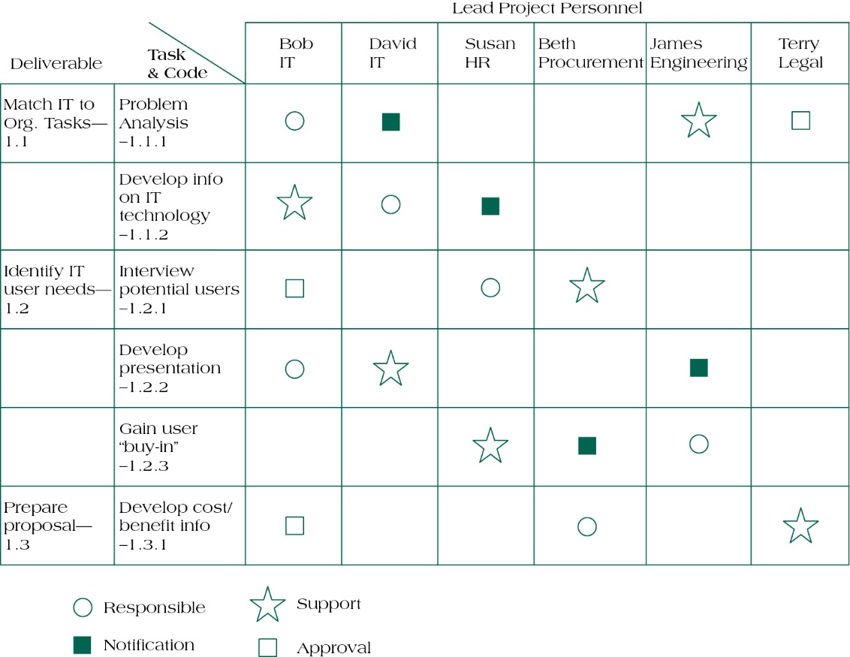
Responsibility Assignment Matrix - Combining WBS & Team Management
Source: Pinto (2015).
Notes:
A possible next step and good use of WBS.
There are different forms/layouts and methods to do so.
I recommend this one for your teams.

Slide 6
1. Stakeholder Management 2. Project Scheduling 3. Budget Planning 4. Risk Management
4. Planning a Project
6

Slide 7
4.1 Stakeholder Management
Picture licenesed by CC BY-SA-NC
7
Notes:
Stakeholder Analysis is a useful tool for demonstrating some of the seemingly irresolvable conflicts that occur through the planned creation and introduction of new projects.
Because stakeholder management is so important to project success, the Project Management Institute decided to create an entire knowledge area devoted to it as part of the Fifth Edition of the PMBOK® Guide in 2012!!

Slide 8
Learning Objectives
Understand the importance of project stakeholder management throughout the life of a project
Discuss the process of identifying stakeholders, how to create a stakeholder register, and how to perform a stakeholder analysis
Describe the contents of a stakeholder management plan
Understand the process of managing stakeholder engagement
8

Slide 9
Stakeholder Management
Project Stakeholders are defined as: all individuals or groups who have an active stake in the project and can potentially impact, either positively or negatively, its development.
Source: PMBoK.
9
Notes:
The purpose of project stakeholder management is to identify all people or organizations affected by a project, to analyze stakeholder expectations, and to effectively engage stakeholders

Slide 10
Managing Stakeholders
Assess the environment
Identify the goals of the principal actors
Assess your own capabilities
Define the problem
Develop solutions
Test and refine the solutions
Source: Pinto (2015).
10
Notes:
Identifying stakeholders: Identifying everyone involved in the project or affected by it, and determining the best ways to manage relationships with them.
Planning stakeholder management: Determining strategies to effectively engage stakeholders
Managing stakeholder engagement: Communicating and working with project stakeholders to satisfy their needs and expectations, resolving issues, and fostering engagement in project decisions and activities
Controlling stakeholder engagement: Monitoring stakeholder relationships and adjusting plans and strategies for engaging stakeholders as needed

Slide 11
Understand the Project Context
High
New product development projects
Complex, capital-intensive and high-visibility projects such as dams, roads, power stations, and pipelines
No. of Project Stakeholders
Projects being implemented in and for individual departments of organisations
Some social development projects undertaken by NGO’s
Low
Low
Level of Heterogenity of the Project Stakeholders and Complexity of Managing Them
High
11

Slide 12
Stakeholder Management Processes
Initiating
Planning
Executing
Process: stakeholder identification
Output: stakeholder register
Process plan stakeholder management
Output: stakeholder map, action profile, involvement plan
Process: manage stakeholder engagement
Output: e.g. issue log, change requests, updates in WBS etc.
Monitoring and Control
Process: control stakeholder engagement
Outputs: project document + process updates
Source: PMBoK.
12
Notes:
Stakeholder Management Processes along the Project Live Cycle
More details on each phase on the next slides

Slide 13
Identifying Project Stakeholders
Initiate
Plan
Execute
Monitor
Internal Stakeholders:
Top management
Accountant
Other functional managers
Project team members
External Stakeholders:
Clients
Competitors
Suppliers
Environmental, political, consumer, and other intervener groups
Source: Pinto (2015).
13
Notes:
Internal project stakeholders generally include the project sponsor, project team, support staff, and internal customers for the project. Other internal stakeholders include top management, other functional managers, and other project managers
External project stakeholders include the project’s customers (if they are external to the organization), competitors, suppliers, and other external groups that are potentially involved in the project or affected by it, such as government officials and concerned citizens
Client – not always the whole client organization – in reality often more complex

Slide 14
Identification of All Project Stakeholders
Initiate
Plan
Execute
Monitor
Brainstorming
Survey
Ask the consultant
Ask experienced team members
Ask other project managers
Organisation’s existing documentation
Locals
Case studies
Other organisation stakeholder directory
Website
Source: Pinto (2015).
14

Slide 15
Sample Stakeholder Register
Initiate
Plan
Execute
Monitor
Name | Position | Internal/External | Project Role | Contact Information
Tim | CFO | Internal | Senior manager/ provides funds | Tim@ourcompany.com
Sally | IT Specialist | Internal | Team member | Sally@ourcompany.com
Barbara Max | Consultant | External | Supplier/Advisor | Barbara@Max.de
John Mora | Leader NGO X | External | Advisor/Multiplier | John@NGO-x.com
15
Notes:
A stakeholder register includes basic information on stakeholders:
Identification information: The stakeholders’ names, positions, locations, roles in the project, and contact information
Assessment information: The stakeholders’ major requirements and expectations, potential influences, and phases of the project in which stakeholders have the most interest
Stakeholder classification: Is the stakeholder internal or external to the organization? Is the stakeholder a supporter of the project or resistant to it?

Slide 16
Stakeholder Map
Initiate
Plan
Execute
Monitor
Secondary Stakeholder
Primary stakeholder
Key Stakeholder
Barbara Max
Tim
John Mora
Sally
Source: GIZ (2015).
16
Notes:
Tool to classify/prioritize stakeholders
In managing projects in decentralized teams one is confronted with numerous actors. All of them are to different extent and in different ways involved in the project and may have to be considered in project negotiations and project steering. These actors with at least potential interests in the project are considered “Stakeholders”. These stakeholders are in a system of mutual relations and dependencies. All actors have specific roles that come with certain interests and power relations. However, these roles can also change within the course of the project. Their strategies are not only determined by cultural orientation and knowledge, but also how they experience relations to other actors and their interpretation of their influence on the project. Therefore, the actors need to agree on roles and the distribution of tasks. Thus, the design and management of the relations between actors is essential.
The basic communication and steering mechanisms of the actors are coordination and hierarchy. Some topics need to be negotiated; other can be decided via the hierarchical power.
Basic groups of stakeholders are:
Primary Stakeholder: directly affected by the topic/project, either as beneficiaries or as the ones that want to gain or will lose privileges and power.
Secondary Stakeholders: are just relatively influenced by the projects, such i.e. intermediary service providers
Actors which can influence the project significantly, due to their knowledge and their position, are considered key stakeholders. If without the support of these actors, the envisaged impacts cannot be achieved then they are considered veto players. The more power an actor has, the higher are the chances that he/she considers him-/herself as the main player or aims at excluding other players.
The mapping of actors provides an overview of the playing fields and the different influences of the actors. The discussion of actors can be used to generate strategic options. Mostly, the mapping of actors also reveals voids in information and lacks in participation.
Method:
Identification of actors and grouping it in types
Which actors are mentioned?
In which group are they in? (primary, secondary, key stakeholder)
Are there veto players?
Agree on rules on the team
Is an adaption of the tool necessary?
How should the actors between the groups be differentiated?
Map the actors

Slide 17
Stakeholder Map
Initiate
Plan
Execute
Monitor
Key stakeholders are essential to the survival of the project
Primary stakeholders are those stakeholders that have a direct stake in the organization and its success
Secondary stakeholders are those that have a public or special interest stake in the organisation
17

Slide 18
Classifying Stakeholders
Initiate
Plan
Execute
Monitor
High
Power
Low
Keep Satisfied | Manage Closely
Monitor | Keep Informed
Tim
John Mora
Barbara Max
Sally
Low Interest High
18
Notes:
Next step: tools to analyse engagement + interest
Different tools on the following slides
After identifying key project stakeholders, you can use different classification models to determine an approach for managing stakeholder relationships
A power/interest grid can be used to group stakeholders based on their level of authority (power) and their level of concern (interest) for project outcomes
After identifying and analyzing stakeholders, project teams should develop a plan for management them
The stakeholder management plan can include:
Current and desired engagement levels
Interrelationships between stakeholders
Communication requirements
Potential management strategies for each stakeholders
Methods for updating the stakeholder management plan
Because a stakeholder management plan often includes sensitive information, it should not be part of the official project documents, which are normally available for all stakeholders to review
In many cases, only project managers and a few other team members should prepare the stakeholder management plan
Parts of the stakeholder management plan are not written down, and if they are, distribution is strictly limited

Slide 19
Stakeholder Engagement Assessment Matrix
Initiate
Plan
Execute
Monitor
Stakeholder Name | Unaware | Resistant | Neutral | Supportive | Leading
Tim | x |  | X
Sally |  | x
Barbara Max |  |  |  | X | x
John Mora |  | x |  | x
19
Notes:
Next step: tools to analyse engagement
Different tools on the following slides
The engagement level of the stakeholders can be classified as follows
Unaware. Unaware of project and potential impacts.
Resistant. Aware of project and potential impacts and resistant to change.
Neutral. Aware of project yet neither supportive nor resistant.
Supportive. Aware of project and potential impacts and supportive to change.
Leading. Aware of project and potential impacts and actively engaged in ensuring the project is a success
This example shows that stakeholder 3 is at the desired engagement level, while stakeholders 1 and 2 require further communications and additional actions to move them to the desired level of engagement

Slide 20
Initiate
Plan
Execute
Stakeholder Participation Matrix
Monitor
Actors | Information | Information + | Consultation | Participation | Responsibility
Tim | x |  |  |  | x
Sally | x
Barbara Max |  | x | x | x
John Mora |  | x | x | x
Source: GIZ (2015).
20
Notes:
Next step: tools to analyse engagement
Different tools on the following slides
Tool to asses participation of the stakeholders in more detail
Define participation in the project
Who should be involved and how?
Information: e.g. recieve a newsletter every Month/ recieve status e-mail
Information +: more detailed information. E.g. weekly phone call or meeting
Consultation: is consulted for project issues
Participation: participates in project meetings (carefull: not simply everyone who participates in the project in general)
Responsibility: is responsible for the project (be carefull: do not confuse with having a task in the project)

Slide 21
Stakeholder Matrix
Initiate
Plan
Execute
Monitor
Stakeholder Name | What do they gain/lose from the project? | How are they impacted by the project? | What does the project need from them? | What do they know/think about the project?
Tim | Gain: recognition? Lose: money | - | Money | -
Sally | Lose: work time for other projects | High workload | IT knowledge/support | Low priority
Barbara Max | Gain: reputation/ new contracts | Workload + CV enhancement | Knowledge/experience/ contacts | Big fan of the project
John Mora | Lose/Gain: Influence in community | Workload, standing in the community | Knowledge/experience/ contacts | Can develop into fan or into veto player
21
Notes:
Next step: tools to analyse engagement + interests
Different tools on the following slides

Slide 22
Stakeholder Action Profile
Initiate
Plan
Execute
Monitor
Actor (function) | Agenda (mission, strategic objective) | Arena (field and width of influence) | Alliances (relations to other actors)
Tim | Save money for the company Do not have extra work Gain recognition for successful project | Top management Financial department | -
Sally | Do not have extra work | IT | Good friends with HR and contract department in the company…
Barbara Max | Gain: reputation for successful project New contracts for later projects Enhance CV Money for this project | Politicians in the community Has worked with John Mora Knows company top management Thematic working groups | John Mora? Top management (friend of manager X)
John Mora | Enhance standing in the community Benefits for his friends? A better job? Promote his NGO | Community Barbara Max? | Barbara Max?
Source: GIZ (2015).
22
Notes:
Next step: tools to analyse engagement + interest
Different tools on the following slides
Tool to asses interest of the stakeholders in more detail
It is important to not mix roles/tasks with Agandas. Try to think of potentially hidden agendas as well
Alliances should also try to consider informal relations

Slide 23
Ways to Control Engagement
Initiate
Plan
Execute
Monitor
Participation in kick-off meetings
Meet beforehand with key stakeholders
Engagement activities and deliverables throughout the project
Stakeholders as key project team members
On some IT projects, important stakeholders are invited to be members of the project teams (example: Northwest Airlines and ResNet)
23

Slide 24
Quiz
1) Which statement about stakeholders is BEST?
Stakeholders wield considerable power
Stakeholders can potentially impact project development
Stakeholders are external to a company
By definition, clients are not stakeholders, they are customers
24
Notes:
1B

Slide 25
Exercise
Volunteer team?
Stakeholder Map?
Stakeholder Action Profile?
Stakeholder Participation Matrix?
Secondary Stakeholder
Primary stakeholder
Key Stakeholder
Actor (functi-on) | Agenda (mission, strategic objective) | Arena (field and width of influence) | Alliances (relations to other actors)
Actors | Information | Information + | Consultation | Participation | Responsibility
Notes:
I ask for a volunteer team and prepare these three tools with them on the board. For the map, I first Identify stakeholders by brainstorming and writing them on sticky notes. In a next step I place the sticky notes in the relevant areas.
Of course you can also pick different tools
One disadvantage is, that the volunteer team gets preferencial treatment. However I try to use a different team each week. This way the class gets to know some of the other teams projects more in detail and can observe the process of the tool development

Slide 26
Homework
Develop a stakeholder map, action profile, and participation matrix for your project in your team until next week
This is the second tool of your project plan
Notes:
I let the teams work on each tool in their selfstudy time each week. If you have more class time you can as well include this in the class session.

Slide 27
Summary
Project Stakeholders are defined as: all individuals or groups who have an active stake in the project and can potentially impact, either positively or negatively, its development.
There are internal and external stakeholders to the project.
All actors have specific roles that come with certain interests and power relations.
27

Slide 28
Learning Objectives
Understand the importance of project stakeholder management throughout the life of a project
Discuss the process of identifying stakeholders, how to create a stakeholder register, and how to perform a stakeholder analysis
Describe the contents of a stakeholder management plan
Understand the process of managing stakeholder engagement
28

Slide 29
References
GIZ GmbH. (2015). Cooperation Management for Practitioners: Managing Social Change with Capacity WORKS, 225-276.
Pinto, J. K. (2015): Project management. Achieving competitive advantage, Pearson Education, Harlow, Essex, 4th ed.
Project Management Institute (2013): A Guide to the Project Management Body of Knowledge: PMBOK(R) Guide, Project Management Institute; 5th ed.

