Slide 1
Project Management

Slide 2
1. Project Selection 2. Conceptual Development
3. Initiating a Project
2

Slide 3
Learning Objectives
After completing this chapter, students will be able to:
Explain criteria for a useful project selection/screening model
Understand how to employ scoring models to select projects
Recognise the challenges that arise in maintaining an optimal project portfolio for an organisation
Understand the three keys to successful project portfolio management

Slide 4
Portfolio Management
Portfolio
Programme A
Programme B
Project A
Project A
Project B
Project B
Project C
Project D
Notes:
Usually firm are literally bombarded with opportunities to engange in projects, but no organization has infinite resources. Hence choices must be made and processes established to ensure that the managers select the most viable projects. There are a number of decision models available, some we will discuss in the following. However, out of these models, most firms tjhen develop tailor made models for their specific needs
A companies project portfolio consits usually of multiple projects and programs.
i.e. An event planning company will have Program A (weddings) under which all wedding projects run and Program B (Public events) under which the planning and organization of larger public event projects run.

Slide 5
Project Group Work for This Course
During this course you are to develop and plan a project of your choice
Today:
Choose a team of 4 – 5 Students
Needs to be able to be in working mode in 2 weeks
Develop different project ideas with your team
Can be real or fictitious
Choose a project idea that your team will follow for the rest of this course
5
Notes:
I usually provide general theme, fitting to social/political situation going on currently (i.e. „go vote“; „dealing with the refugee crisis“) something that is easy to access for students.

Slide 6
Generating Project Ideas
Rational Thinking
Examining your own strengths and interests
Looking at past project titles
Discussion
Searching literature
Scanning media
Notes:
Here some ways that might help you to generate ideas:
Examining own strengths and interests
It is important that you choose a topic in which you are likely to do well and were you already have some academic knowledge. One way of doing this is to look at those assignments for which you have received good grades. In addition, you may, as part of your reading, be able to focus more precisely on the sort of ideas about which you wish to conduct your research.
As noted in Section 2.2, there is the need to think about your future. If you plan to work in financial management it would be sensible to choose a research project in the financial management field. One part of your course that will inevitably be discussed at any job interview is your research project. A project in the same field will provide you with the opportunity to display clearly your depth of knowledge and your enthusiasm.
Looking at past project titles
Many of our students have found looking at past projects a useful way of generating research ideas. A common way of doing this is to scan your university’s list of past project titles for anything that captures your imagination. Titles that look interesting or which grab your attention should be noted down,
as should any thoughts you have about the title in relation to your own research idea. In this process the fact that the title is poorly worded or the project report received a low mark is immaterial. What matters is the fact that you have found a topic that interests you. Based on this you can think of new ideas in the same general area that will enable you to provide fresh insights.
Scanning actual research projects may also produce research ideas.
Discussion
Colleagues, friends and university tutors are all good sources of possible project ideas. Often project tutors will have ideas for possible student projects, which they will be pleased to discuss with you. In addition, ideas can be obtained by talking to practitioners and professional groups (Gill and Johnson 2002). It is important that as well as discussing possible ideas you also make a note of them. What seemed like a good idea in the coffee shop may not be remembered quite so clearly after the following lecture!
Searching the literature
As part of your discussions, relevant literature may also be suggested. Of particular use are academic review articles. These articles contain both a considered review of the state of knowledge in that topic area and pointers towards areas where further research needs to be undertaken. In addition, you can browse recent publications, in particular journals, for possible research ideas (Section 3.5). For many subject areas your project tutor will be able to suggest possible recent review articles, or articles that contain recommendations for further work. Reports may also be of use. The most recently
published are usually up to date and, again, often contain recommendations that may form the basis of your research idea. Books by contrast are less up to date than other written sources. They do, however, often contain a good overview of research that has been undertaken, which may suggest ideas to you.
Searching for publications is only possible when you have at least some idea of the area in which you wish to undertake your research. We will talk about how to do literature research in chapter 3.
Scanning the media
Keeping up to date with items in the news can be a very rich source of ideas. The stories which occur everyday in the ‘broadsheet’ or ‘compact’ newspapers (e.g. The Times, Financial Times, Guardian and the Daily Telegraph), in both traditional print and online versions, may provide ideas which relate directly to the item.

Slide 7
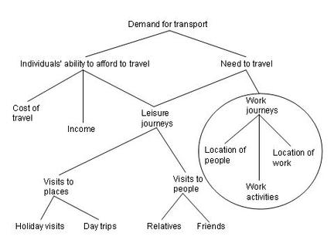
Generating Project Ideas
Creative Thinking
Keeping a notebook of ideas
Exploring personal preferences using past projects
Relevance trees
Brainstorming
Notes:
Keeping a notebook of ideas
It involves is simply noting down any interesting research ideas as you think of them and, of equal importance, what sparked off your thought. You can then pursue the idea using more rational thinking techniques later. You may keep a notebook by your bed so you can jot down any flashes of inspiration that occur to him in the middle of the night! I keep one in my purese.
Exploring personal preferences using past projects
Another way of generating possible project ideas is to explore your personal preferences using past project reports from your university. To do this you:
1 Select six projects that you like.
2 For each of these six projects, note down your first thoughts in response to three questions (if responses for different projects are the same this does not matter):
a What appeals to you about the project?
b What is good about the project?
c Why is the project good?
3 Select three projects that you do not like.
4 For each of these three projects, note down your first thoughts in response to three questions (if responses for different projects are the same, or cannot be clearly expressed, this does not matter; note them down anyway):
a What do you dislike about the project?
b What is bad about the project?
c Why is the project bad?
You now have a list of what you consider to be excellent and what you consider to be poor in projects. This will not be the same as a list generated by anyone else. It is also very unlikely to match the attributes of a good research project (Box 2.2). However, by examining this list you will begin to understand those project characteristics that are important to you and with which you feel comfortable. Of equal importance is that you will have identified those that you are uncomfortable with and should avoid. These can be used as the parameters against which to evaluate possible research ideas.
Relevance trees
Relevance trees may also prove useful in generating research topics. In this instance, their use is similar to that of mind mapping (Buzan 2006), in which you start with a broad concept from which you generate further (usually more specific) topics. Each of these topics forms a separate branch from which you can generate further, more detailed subbranches. As you proceed down the sub-branches more ideas are generated and recorded. These can then be examined and a number selected and combined to provide a research idea (Sharp et al. 2002).
Brainstorming
The technique of brainstorming (Box 2.4), taught as a problem-solving technique on many business and management courses, can also be used to generate and refine research ideas. It is best undertaken with a group of people, although you can brainstorm on your own. To brainstorm, you:
1 Define your problem – that is, the sorts of ideas you are interested in – as precisely as possible. In the early stages of formulating a topic this may be as vague as ‘I am interested in marketing but don’t know what to do for my research topic’.
2 Ask for suggestions, relating to the problem.
3 Record all suggestions, observing the following rules:
• No suggestion should be criticised or evaluated in any way before all ideas have been considered.
• All suggestions, however wild, should be recorded and considered.
• As many suggestions as possible should be recorded.
4 Review all the suggestions and explore what is meant by each.
5 Analyse the list of suggestions and decide which appeal to you most as research ideas and why.

Slide 8
Generating Project Ideas - Approach
Step 1: Silent brainstorm (5 minutes)
Write down your thoughts and/or ideas on post-its/cards. If you want, you can visualise your ideas with little drawings; use one post-it/card per idea.
Step 2: Sharing (10 minutes)
Present your ideas to the other group members and put your post-its/cards on the table or a flip-chart
Other group members can add ideas spontaneously
Step 3: Voting (5 minutes)
Use the two stickers to vote for the two project ideas that you like most
Choose the two project ideas with the most votes
Step 4: Specifying your project ideas (10 minutes)
Specify the two remaining project ideas within your team: what could your project look like?
Collect your ideas on post-its/cards
Notes:
As a result, each group should have a list with several project ideas

Slide 9
Quality Factors of Screening Models
Realism
Capability
Flexibility
Ease of Use
Cost Effectiveness
Comparability
Source: Souder and Sherman (1994)
Notes:
Now, the question is: how to pick the “right” project?
Screening models help managers pick winners from a pool of projects. Souder and Sherman (1994) identify five issues one should consider when evaluating screening models
Realism – an effective model must reflect organizational objectives. Criteria must be reasonable in the light of constraints. Model must take technical and commercial risks into consideration.
Capability – Model should be flexible enough to respond to changes in the conditions, but also robut enough to accommodate new criteria and constraints
Flexibility – should be easily modified
Ease of use – simple enough to be used by people in all areas of the organization. Results should be clear and easy to understand
Cost effectiveness -
Comparability as an addition criterial: - model must be broard enough to apply to several project types
Screening models are numeric or nonnumeric. (qualitative and quantitative)

Slide 10
Screening & Selection Issues
Risk – unpredictability to the firm
Technical
Financial
Safety
Quality
Legal exposure
2. Commercial – market potential
Expected return on investment
Payback period
Potential market share
Long-term market dominance
Initial cash outlay
Ability to generate future business/new markets
Source: Pinto (2015)
Notes:
The list of factors that can be considered when evaluating project alternatives is enourmous. This and the next slight provide only a partial lists

Slide 11
Screening & Selection Issues
Internal operating – changes in firm operations
Need to develop/train employees
Change in workforce size or composition
Change in physical environment
Change in manufacturing or service operations
4. Additional
Patent protection
Impact on company’s image
Strategic fit
All models only partially reflect reality and have both objective and subjective factors imbedded
Source: Pinto (2015)

Slide 12
Approaches to Project Screening
Checklist Model
Simplified Scoring Models
Analytic Hierarchy Process
Profile Models
Financial Models
Notes:
Here some of the more common project selection methods
Checklist model:
A checklist is a list of criteria applied to possible projects.
Requires agreement on criteria
Assumes all criteria are equally important
Checklists are valuable for recording opinions and stimulating discussion.
Othes As discussed in the following

Slide 13
Simplified Checklist Model
Checklist Model
Source: Pinto (2015)
Notes:
example

Slide 14
Simple Scoring Model
Simplified Scoring Models
Source: Pinto (2015)
Notes:
Example
In a simplified scoring model, each criteria is ranked according to its relative importance.
A simple scoring model consists of the following steps (slide)
Each project receives a score that is the weighted sum of its grade on a list of criteria. Scoring models require:
agreement on criteria
agreement on weights for criteria
a score assigned for each criteria

Slide 15
Analytic Hierarchy Process
Analytic Hierarchy Process
The AHP is a four-step process:
Construct a hierarchy of criteria and sub criteria
Allocate weights to criteria
Assign numerical values to evaluation dimensions
Determine scores by adding the products of numeric evaluations and weights
Unlike the simple scoring model, these scores can be compared!
Notes:
Stepes:
Hierachy of criteria: → criteria and subcriteria to specify
Allocating weights: for criteria and then again for subcriteria

Slide 16
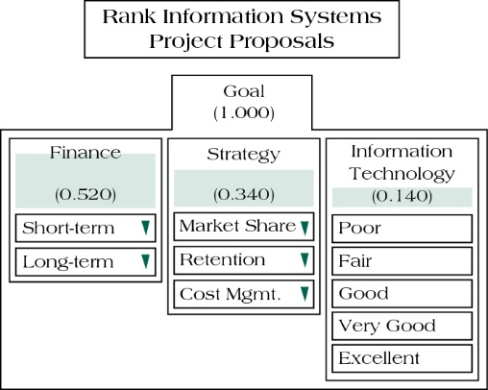
Sample AHP with Rankings for Salient Selection Criteria
Analytic Hierarchy Process
Source: Pinto (2015)
Notes:
Step2: weight: ex: Financial benefits: 52%, in which shortterm weigh 30% and longterm 70%. This means that longterm financial benefits receive and overall weighting of 0.52*0.7= 36,4%

Slide 17
Profile Models
Profile Models
X₇
X₆
Maximum
Desired Risk
X₂
Criteria selection as axes
Rating each project on criteria
Risk
X₄
X₅
Efficient Frontier
X₃
X₁
Minimum
Desired Return
Return
Source: Pinto (2015)
Notes:
Allows managers to plot risks/returns for various alternatives and select the projects that maximizes returns while stying at a certain range of min. accaptable risk
Figure shouws 6 project alternatives.
Ove course the eveluations of risks are again subjective…

Slide 18
Financial Models - Payback Period
Financial Models
Determines how long it takes for a project to reach a breakeven point
Cash flows should be discounted
Lower numbers are better (faster payback)
Notes:
One of many financial models. Simply to decide which project pays back faster

Slide 19
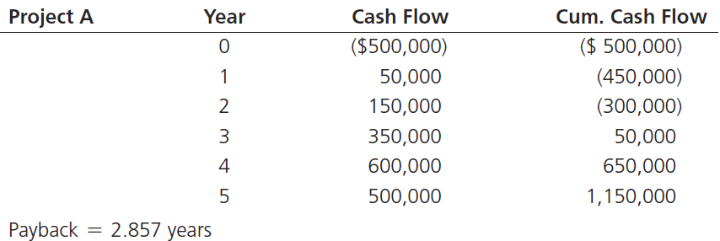
Payback Period Example
Financial Models
Divide the cumulative amount by the cash flow amount in the first positive year and subtract from that year to find out the moment the project breaks even
3 - 50,000 = 2.857
350,000
Source: Pinto (2015)
19
Notes:
Excersise_ calcultae for Project B (result next slide)

Slide 20
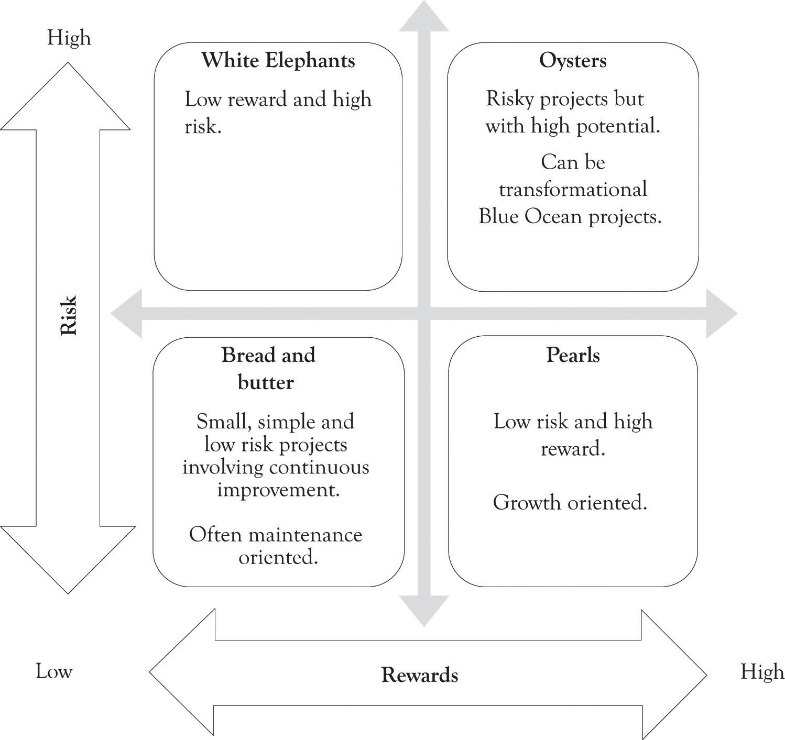
Proactive Portfolio Matrix
Source: Pinto (2015)
"Dieses Foto" von Unbekannter Autor ist lizenziert gemäß CC BY-SA-NC
Notes:
Done with the models.
Now to general portfolio management
The systematic process of selecting, supporting, and managing the firm’s collection of projects.
Portfolio management objectives and initiatives require:
decision making
prioritization
review
realignment
reprioritization of a firm’s projects
To develop a proactive portfolio management is an important component of strategic management. This matrix combines the two issues of commercial success and technical feasibility
1.Bread and Butter: Typically evolutionary improvements of existing products
2.pearls:can be used to gain strategic competitive advantage in the market
3.Oysters: early stage projects , involve unknown or revolutionary technologies
4.White elephant: firms do not on purpose select such projects most of these started as bread and butter or oyster and never lived up to their potential __> waste of time and resources
Matrix helps to set strategic objectives… do we have some white elephants that need to be killed? Etc.

Slide 21
Generating Project Ideas - Approach
Step 5: Select a project
As a team, review the list of generated projects
Discuss selection criteria for your projects (remember, it lasts the entire semester! So, consider your schedule, other courses (your “portfolio”) and issues influencing selection discussed before)
Choose one of the screening models we discussed (consider the quality criteria for screening models when choosing an appropriate model)
Apply the screening model to come to a final decision of your project
Write down your final project idea in one sentence and be as clear and as precise as possible
Be ready to present your project in class within one sentence
Notes:
If you do not have time to let the students present their ideas, either collect the papers with the 1 sentence or postpone it to the next session

Slide 22
Summary
Choosing the right screening model and considering the project portfolio is essential when choosing a new product
Some of the more common project selection methods are Checklist model, Simplified screening model, Analytical hierarchy model, profile models and financial models
General portfolio management is the systematic process of selecting, supporting, and managing the firm’s collection of projects
22

Slide 23
Learning Objectives
After completing this chapter, students will be able to:
Explain criteria for a useful project selection/screening model
Understand how to employ scoring models to select projects
Recognise the challenges that arise in maintaining an optimal project portfolio for an organisation
Understand the three keys to successful project portfolio management

Slide 24
References
Horine, Greg (2013): Absolute Beginner’s Guide to Project Management, Que Sams/Pearson Education, 3rd ed.
Pinto, J. K. (2015): Project management. Achieving competitive advantage, Pearson Education, Harlow, Essex, 4th ed.
Project Management Institute (2013): A Guide to the Project Management Body of Knowledge: PMBOK(R) Guide, Project Management Institute; 5th ed.
Souder, W. E., & Sherman, J. D. (1994). Managing new technology development. Columbia University Press.

