Slide 1
Project Management

Slide 2
2. Project Team and Management
2.2 Team Management
Roles and Responsibilities of Team Members
Team Development
Team Roles
Teams in Transition
2

Slide 3
Learning Objectives
Be aware of characteristics of effective teams and team development stages
Students can explain the functions, strengths, and weaknesses of different team roles and are able to evaluate their own
Students reflect their own behaviour in teams

Slide 4
When do teams fail?
Think of an example where teamwork failed
Share the story with your neighbour
Share with the class and try to come up with a generalised guideline
Notes:
Think-pair-share:
Step 1: students think of an example where team work failed.
Step 2: Students share their story with their neighbour and discuss why the team work has failed.
Step 3: Make a collection of reasons for failed teamwork on the white board and discuss this with students.

Slide 5
Roles and Responsibilities in Teams
Video
Notes:
Video reviews roles of team managers and their difficulties from the last session and also highlights the importance of roles of team members.
8:30 (do as e-leaning in case you find it to long)

Slide 6
Reasons Why Teams Fail
Poorly developed or unclear goals
Poorly defined project team roles & interdependencies
Lack of project team motivation
Poor communication
Poor leadership
Turnover among project team members
Dysfunctional behaviour

Slide 7
Effective Project Teams
Clear Sense of Mission
Productive Interdependency
Cohesiveness
Trust
Enthusiasm
Results Orientation
7

Slide 8
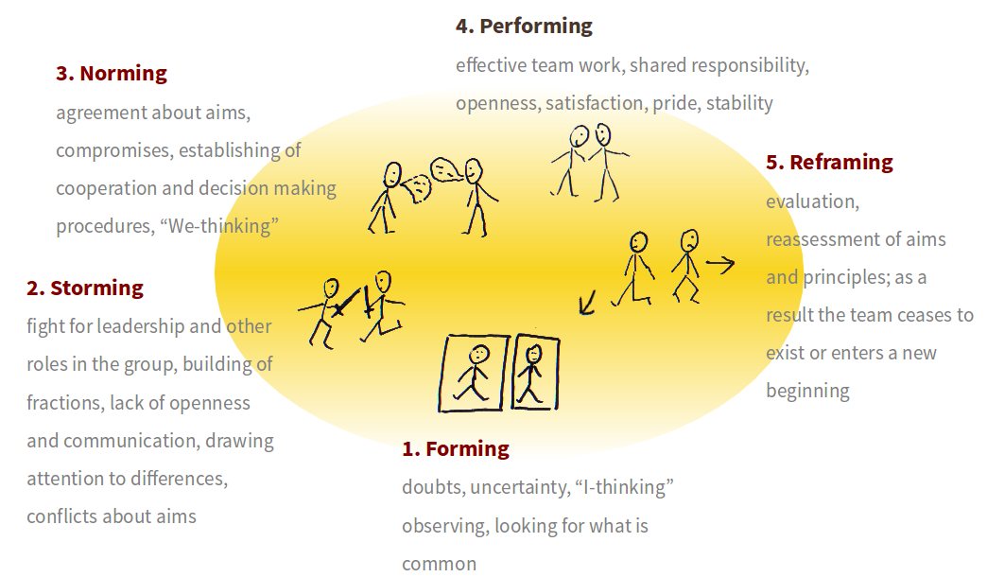
Team Development Stages
Picture License CC BY-SA
Baded on: Tuckman(1965).
8
Notes:
Forming – members become acquainted, are unsure of goal and roles. Preliminary standards of behavior are established.
Storming – conflict begins → natural reaction, members test limits and reaction, personal agendas
Norming – members reach agreement. (norm = unwritten rule of behavior), mutual concern
Performing – members work together
Adjourning – group disbands

Slide 9
What is your role in a team?
Assessing Your Team Roles:
Now, enter the scores and add up the points to find out your own team role and the team role of your partner
Discuss with your partner
a) whether the results of the test were what you expected and
b) the issue of self- and outside perception.
Notes:
Students enter the scores and add up the points to find out their own team role and the team role of their partner. Students discuss with their partner a) whether the results of the test were what they expected and b) the issue of self- and outside perception.
See worksheet.
Time: 10 min

Slide 10
Belbin’s Team Roles
Team Role:“A tendency to behave, contribute, and interrelate with others in a particular way.”(Meredith Belbin)
http://www.belbin.com
10
Notes:
A Team Role as defined by Dr Meredith Belbin is “A tendency to behave, contribute and interrelate with others in a particular way.” The value of Belbin Team Role theory lies in enabling an individual or team to benefit from self-knowledge and adjust according to the demands being made by the external situation.
The concept was derived from a study of successful and unsuccessful teams competing in Business Games at Henley Management College, England. Managers taking part in the exercise were given a battery of psychometric tests and put into teams of varying composition. As time progressed different clusters of behaviour were identified as underlying the success of the teams. These successful clusters of behaviour were then given names.
The most successful companies tended to be those with a mix of different people, i.e. those with a range of different behaviours. Eight distinct clusters of behaviour turned out to be distinctive and useful. These were called “Team Roles,” and in fact, a ninth based on specialist knowledge was to emerge later. These Team Roles have been used in organisations and teams across the world ever since.

Slide 11
Belbin’s Team Roles
http://www.belbin.com
Notes:
PLANT (PL)
Plants are innovators and inventors and can be highly creative. They provide the source of original ideas to support innovation. Usually they prefer to operate by themselves at some distance from other members of the team, using their imagination and often working in an unorthodox way. They tend to be introverted and react strongly to criticism and praise. Their ideas may often be radical and may lack practical constraint. They are independent, and usually regarded as being clever as a result of their original and radical perspective. They don’t always manage to communicate in a compelling way and offer their ideas in a practical and relevant framework.
Function: The main use of a PL is to challenge conventional and established ways of doing things and provide suggested solutions for solving complex problems. PLs are often needed in the initial stages of a project or when a project is failing to progress. PLs have usually made their mark as founders of companies or as originators of new products. However, too many PLs in one team or group may be counter-productive as they tend to spend their time reinforcing their own ideas and engaging each other in combat.
RESOURCE INVESTIGATOR (RI)
Resource Investigators are usually enthusiastic extroverts. They are natural communicators with people both inside and outside the company. They are natural negotiators and are adept at exploring new opportunities and developing contacts. Although not a great source of original ideas, the RI is effective when it comes to picking up other people's ideas and promoting them. As the name suggests, they are adept at finding out what is available and from whom. RIs are generally relaxed people with a strong inquisitive sense and a readiness to see the possibilities in anything new. However, unless they remain stimulated by others, their enthusiasm can rapidly fade.
Function;
RIs are good at exploring and reporting back on ideas, developments or resources outside their immediate group. They are the natural people to set up external contacts and to carry out any subsequent negotiations. They have an ability to think on their feet and to probe others for information
CO-ORDINATOR (CO)
The distinguishing feature of Co-ordinators is their propensity for helping others to work towards shared goals. Mature, trusting and confident, they delegate readily. In interpersonal relations they are quick to spot individual talents and to use them in pursuit of group objectives. While COs are not necessarily the cleverest or most senior member of a team, they are likely to have a broad outlook and perspective. The natural goal focus of CO’s can sometimes lead to them manipulating others to achieve their personal objectives. In some situations COs are inclined to clash with Shapers due to their contrasting management styles.
Function: COs are well placed when put in charge of a team of people with diverse skills and personal characteristics. They perform better in dealing with colleagues of near or equal rank than in directing junior subordinates. Their motto might well be "consultation with control“ and they usually believe in tackling problems calmly.
SHAPER
Shapers are highly goal oriented people with great drive and energy. They push themselves and others and tend to overcome obstacles by sheer determination. They tend to be highly assertive and have very directive management styles. Shapers also tend to be competitive and like to win. They frequently progress upward in organisations because they get results and because many people are impressed by their courageous and decisive leadership style. SHs are not noted for their interpersonal sensitivities and can be argumentative and even aggressive.
Function:
SHs are generally perceived as ideal managers because they generate action and thrive under pressure. They come into their own when quick and decisive action is called for to overcome threats and difficulties or when progress towards goals and objectives is unacceptably slow.
MONITOR EVALUATOR (ME)
Monitor Evaluators are serious-minded, prudent individuals with a built-in immunity for being over-enthusiastic. They are likely to be slow in making decisions preferring to carefully think things over. Usually they have a high critical thinking ability. They have a good capacity for shrewd judgements that take all factors into account. A good ME is unlikely to make intuitive and reckless mistakes. They deal in facts and logic rather than emotion when considering options. They are often regarded as over-critical and can be seen to be slow and boring.
Function:
MEs are best suited to analysing problems and evaluating ideas and suggestions. They are very good at weighing up the pro's and con's of options. In a managerial position their ability to make high quality decisions consistently is likely to make them highly regarded.
IMPLEMENTER
Implementers are characterised by their practical approach and possess higher than normal levels of self-control and discipline. They are prepared to work hard to ensure things are done as prescribed in a systematic way. They are typically loyal to the organization and prescribed and established ways of doing things. They are likely to be regarded as someone who will not seek personal agendas and self-interest. On the downside IMPs may be inflexible in accepting new ways of doing things, particularly if they are radical or impracticable.
Function:
IMPS are valuable in an organisation because of their reliability and capacity for application. They succeed because they are efficient and because they have a sense of what is feasible and relevant. While many people might stray favouring the tasks they like to do and neglect things they find not to be to their liking an IMP is more likely to do what needs to be done in a systematic and relentless way.
TEAMWORKER (TW)
Teamworkers possess a mild and sociable disposition and are generally supportive and concerned about others. They have a great capacity for flexibility and adapting to different situations and people. TWs are perceptive, diplomatic and caring and tend to be good listeners. Because of these qualities it is hardly surprising that they are popular with their colleagues. Their concern about creating harmony and avoiding conflict can make them indecisive when faced with having to make difficult solo decisions.
Function:
The TW may be legitimately compared to the lubricating oil in a car engine. We don’t always appreciate how important it is until it isn’t there. Because of their ability to be able to resolve interpersonal problems TW’s come into their own when situations are tense and people feel uncared for and not appreciated. They can rise to senior positions because they have few enemies and the fact that they are ready to listen to the views and suggestions of others.
COMPLETER-FINISHER (CF)
Completer Finishers have a great capacity for the attention to detail. They constantly strive for perfection and correct errors. CFs are quite introvert and require less external stimulus than most people. The CF can be trusted to do work to the highest standard and to complete it on time. The combination of striving for perfection and meeting dead lines often creates anxiety though and CFs are likely to be reluctant to trust others to do work to their own high standards.
Function:
The Completer Finisher is invaluable where tasks demand close concentration and a high degree of accuracy. The standards they set make them well suited to situations where precision and high standards are essential. CFs will also demand the same high standards from people around them and therefore create their own micro culture where the only standard acceptable is perfection.
SPECIALIST (SP)
The Specialist Team Role and the functional title of Specialist is often a cause for confusion. While it is true that both uses of the term may relate to people who are a source of technical knowledge and expertise the Specialist in Team Role terms has some very specific attributes. Their main distinguishing feature is their love of learning. They see learning and the accumulation of knowledge as the main reason for their existence and their single minded and resolute pursuit of this end is their main motivation. The SP is likely to be recognised by colleagues as an expert to turn to for help and guidance. The SP will usually try to avoid being involved in unstructured meetings and discussions or those of a social nature. They may also be somewhat unyielding when challenged about the validity of their knowledge or field of expertise.
Function:
While SPs may not be regarded as natural team players teams will be wise to engage the SP as a means of providing in depth research. As managers, they command respect because of their in-depth knowledge and they can be used to mentor others to raise their technical expertise.

Slide 12
What is your role in a team? Part 2
Assessing Your Team Roles:
Find a partner
Fill out the test for assessing team roles (pp. 1-4) for you and for your partner
Notes:
Each student finds a partner. All students fill out the Belbin test for assessing team roles (pp. 1-4) for themselves and for their partner (no group task). At this stage, students only complete the test without entering any scores.
See worksheet.
Time: 10 min

Slide 13
“Teams” in Transition
Team members working at one place, at one time
→“traditional” team
International team members working at one place at one time
→ multicultural team
International team members working locally dispersed
→ transnational team
Notes:
Transnational team:
A team consisting of members of multiple nationalities and functions working locally dispersed on a particular project that is clearly limited to a short period of time and has a specific objective
Advantages:
Greater opportunity for global competition
Opportunities for cross cultural understanding
Exposure to different view points
Disadvantages:
Problems resulting from differences in languages
Complex decision making processes
Personality conflicts

Slide 14
Managing Transnational Teams
Advantages:
Greater opportunity for global competition
Opportunities for cross-cultural understanding
Exposure to different view points
Disadvantages:
Problems resulting from differences in languages
Complex decision making processes
Personality conflicts
14

Slide 15
Virtual Project Teams
Uses electronic media to link members of a geographically dispersed project team
How Can Virtual Teams Be Improved?
Use face-to-face communication when possible
Don’t let team members disappear
Establish a code of conduct
Keep everyone in the communication loop
Create a process for addressing conflict
15

Slide 16
Review Intercultural Management
Which cultural differences have you encountered in student or working groups?
Which cultural dimension will influence your team structure?
Which cultural dimensions will influence project processes?

Slide 17
Quiz - Review
Virtual teams are often slowed down by difficulty establishing:
A) Superordinate goals
B) Task outcomes
C) Trust
D) Psychosocial outcomes
2. According to Belbin a “plant” is:
A) A highly creative person
B) A perfectionist
C) An extrovert and good communicator
D) A self-controlled and disciplined person
Notes:
1C
2A

Slide 18
Review Chapter 1 and 2
What is a project?
What is the difference between a process and a project?
What are the stages of a project life cycle?
Why is project management leader intensive?
Which stages is the team undergoing?
→ Remember, a project plan is part of your exam. So, consider starting to assemble your project team now
18
Notes:
A project is a temporary endeavor undertaken to create a unique product, service, or result.
2. A process referes to an ongoing day to day activity. As a result a project represents an exiting alternative to business as usuall
3. initiating, plannung, executing, monitoring, closing
4. leader= innovative, strive for change etc.
5. forming, storming, norming, performing

Slide 19
Summary
Understand the steps involved in project team building and
Know the characteristics of effective project teams and why teams fail
Know the stages in the development of groups
Understand and reflect your own role on a project team
19

Slide 20
Learning Objectives
Be aware of characteristics of effective teams and team development stages
Students can explain the functions, strengths, and weaknesses of different team roles and are able to evaluate their own
Students reflect their own behaviour in teams

Slide 21
References
Belbin, R. M. (2012). Team roles at work. Routledge.
Dulewicz, V. (1995). A validation of Belbin's team roles from 16PF and OPQ using bosses' ratings of competence. Journal of Occupational and Organizational Psychology, 68(2), 81-99.
Pinto, J. K. (2015): Project management. Achieving competitive advantage, Pearson Education, Harlow, Essex, 4th ed.
Swailes, S., & McIntyre-Bhatty, T. (2002). The “Belbin” team role inventory: reinterpreting reliability estimates. Journal of Managerial Psychology, 17(6), 529-536.
Tuckman, Bruce W (1965): Developmental sequence in small groups. Psychological Bulletin. 63 (6): 384–399.
Tuckman, Bruce (Spring 2001). Developmental Sequence in Small Groups. Group Facilitation: A Research and Applications Journal: 71–72.

