Slide 1
Project Management

Slide 2
Administration & Preliminary Schedule
Preface

Slide 3
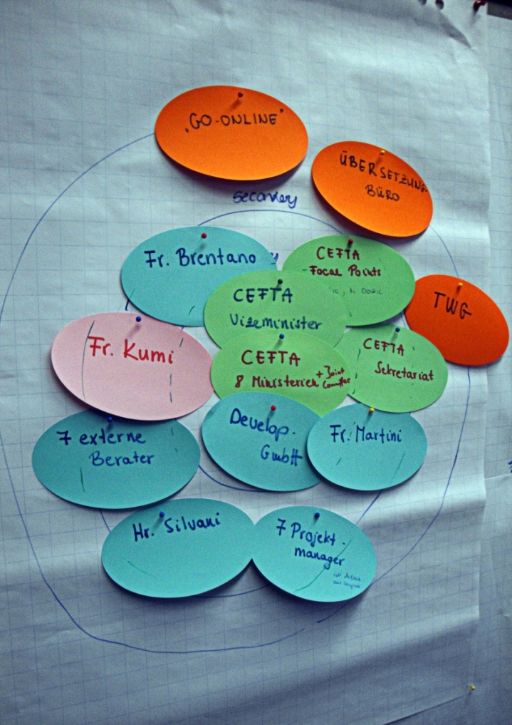
Exercise
What do you expect from this Project Management course?
Write key terms on the cards
One key term per card
Write so others can read it!
3 min
Cluster cards on a mind map
Notes:
Write on cards. Bring to front
Ask students to write their expectations on cards and cluster them on the board. Explain which you can fulfil and which not.
Also reflect on the method and why clarifying expectations is necessary in project management (i.e. in a workshop with stakeholder)

Slide 4
Learning Objective in Terms of Competence
Analysis
Application
What?
Independently analyse small projects, understand typical challenges in terms of goals, deadlines, budgeting and capacity planning
With?
Selected project management methods and tools
For?
Support a project's implementation
Notes:
*explain the learning objective

Slide 5
Learning Objectives (details)
Learning Objective 1: Students are able to apply project management tools by planning a regular-sized project
Learning Objective 2: Students are able to critically reflect on different project management tools and choose the appropriate tools for their project planning
Learning Objective 3: Students train and critically reflect on different communication approaches within their team and when approaching stakeholders
Learning Objective 4: Students train their conceptual, writing, and presentation skills by writing a project plan and pitching their project

Slide 6
Features of the Course
Language: English
Combination of lecture, seminar, group work, and other forms of learning as appropriate
2 hours of 45 minutes per week = 25h/Semester
5 ECTS-Credit Points = 150 h/Semester
→ 125h/Semester self-study time!!!
Slides will be made available on Moodle
Office Hours:
Communication via Moodle
Notes:
example. Please adapt
Highlight the amount of self study time!!

Slide 7
Examination
Module-accompanying study-test-performance
Project group work (5 students per team)
Written project plan (incl. 6 tools: WBS, stakeholder analysis, time plan, budget plan, risk management, and monitoring plan; + Team reflection)
80% of final grade
Final due date:
Project pitch
20% of final grade
*Insert Date* (Everyone needs to be present)
Notes:
Example. Please adapt

Slide 8
Literature
Pinto, J. K. (2015): Project management. Achieving competitive advantage, Pearson Education, Harlow, Essex, 4th ed.
Horine, Greg (2013): Absolute Beginner’s Guide to Project Management, Que Sams/Pearson Education, 3rd ed.
Project Management Institute (2013): A Guide to the Project Management Body of Knowledge: PMBOK(R) Guide, Project Management Institute; 5th ed.

Slide 9
1. Introduction to Project Management
What is a Project?
Types of Projects
Project Life Cycle

Slide 10
Learning Objectives
Understand why project management is becoming such a powerful and popular practice in business
Recognise the basic properties of projects, including their definition
Differentiate between project management practices and more traditional, process-oriented business functions
Understand what project management is and what it is not
Be aware of the project management life cycle
10

Slide 11
What is a project?
11
Notes:
Brainstorm!
-mindmap an tafel

Slide 12
What is a project?
Projects are complex, one-time processes
Projects are limited by budget, schedule, and resources
Projects are developed to resolve a clear goal or set of goals
Projects are customer-focused
A project is a temporary endeavour undertaken to create a unique product, service, or result. PMBoK 5th edition
Source: Pinto (2015).
12
Notes:
Arises out o a concrete need. To meat a clear goal
Traditional management functions of planning, organizing, motivation, directing, and control apply to project management.
Principal outcomes of a project are the satisfaction of customer requirements within the constraints of technical, cost, and schedule objectives.
Projects are terminated upon successful completion of performance objectives
The simpliest definition is found in the „Project Management Body of knowledge guide“ the „PMBoK“ published by the Project Management Institut. The PMI is the worlds largest professional project management assosciation.

Slide 13
Process & Project Management
PROCESS
Repeat process or product
PROJECT
New process or product
Several objectives
Ongoing
People are homogenous
Well-established systems
Greater certainty
Part line organisation
Established practices
Supports status quo
One objective
One-shot-limited life
More heterogeneous
Integrated system efforts
Greater uncertainty
Outside of line organisation
Violates established practice
Upsets status quo
Source: Pinto (2015).
13
Notes:
Also there are a number of definitions, we must differentiate projects from organizational processes. A process referes to an ongoing day to day activity.
*slide*
As a result a project represents an exiting alternative to business as usuall. The challanges are great but so are the rewards with ist success.

Slide 14
Quiz: Project or Process?
A student group has to organise the HTW employee summer party at HTW
The student council organises the welcome rally for the new student intake
A company produces a car
A company tests a new engine
A student writes a term paper
A student writes a bachelor thesis
14
Notes:
Project
Project if they do it once, Process if they do it every year
Process
Project
Project if they do it once, Process if they do it every year
Project, unless she has written several already

Slide 15
Differentiating Types of Projects
Differentiating Characteristics | Examples
Content | Investment, research, development, change management projects, automotive, IT industry
Client | External vs. internal projects Private vs. public
Social complexity | Multicultural projects vs. single culture projects
Number of participants/ $ involved | Big vs. small
Duration | Several days vs. several years
Importance | Importance within the company/organisation
Source: Pinto (2015).
15
Notes:
Projects are very different. And not all projects are very new. Very often similar projects were done in the past.
However, different types of projects entail different challenges and potentials.
Project Experience in the room? Which experiences do we have here in which type of projects? Collect

Slide 16
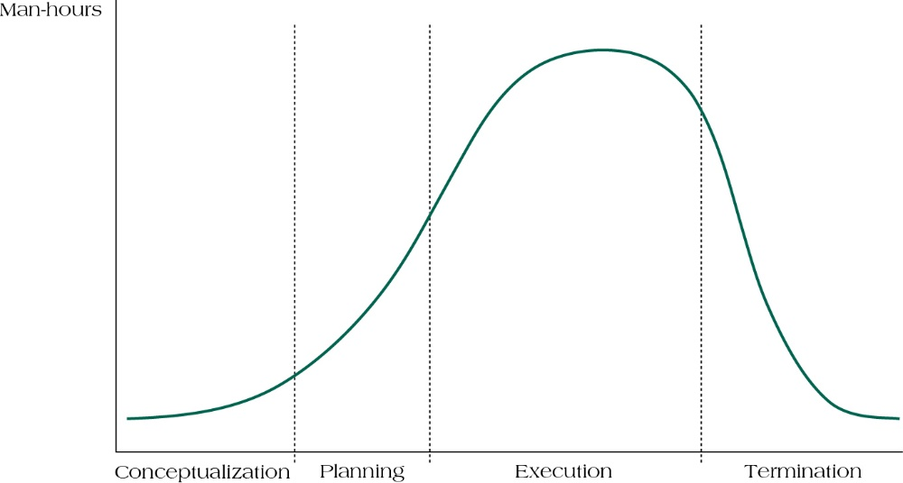
Project Life Cycles
Source: Pinto (2015).
16
Notes:
Imagine: recieving a term paper assignment in class, like you will afterwards…
1.step: develop an understanding of the assignment itself: what is the prof. looking for?
2.step: develop a plan how you want tp proceed → rough guess on how much time we need for which step. → you will start to develop sometentative milestones in your heard, like till when you have finished literature research and start writing..
Next step: beginn to execute plan…going to library, doing literature research.. Etc.
Your goal is probably to complete the assignment on time and in your best ability.
After turning in your paper, you will file materials, bring back books to the library..
Thats a simplified project life cycle.
A project life cycle refers to the stages in a project’s development and are divided into four distinct phases:
Conceptualization – development of the initial goal and technical specifications of the project. Key stakeholders are identified and signed on at this phase.
Planning – all detailed specifications, schedules, schematics, and plans are developed.
Execution – the actual “work” of the project is performed.
Termination – project is transferred to the customer, resources reassigned, project is closed out

Slide 17
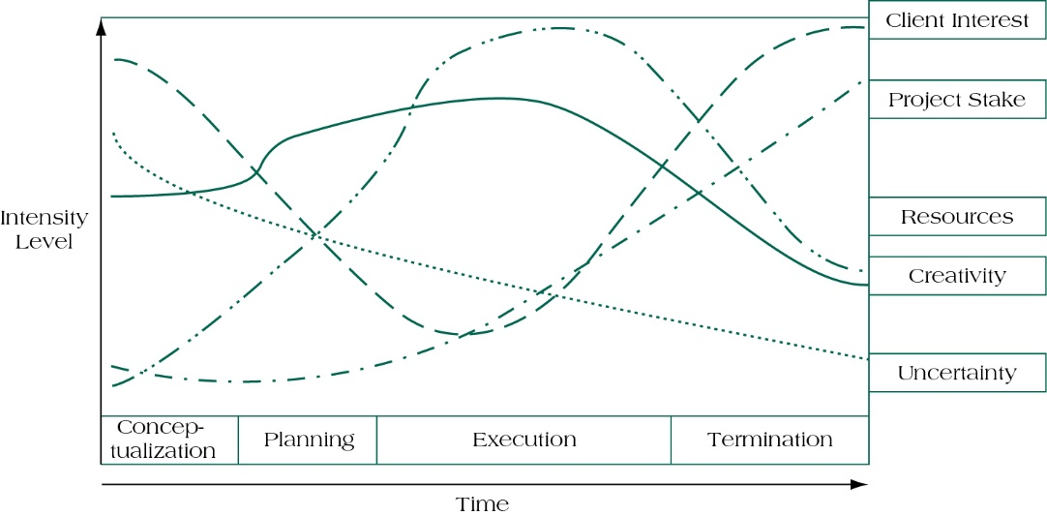
Project Life Cycle and its Effects
Source: Sohmen (2002).
17
Notes:
As you can see, each of this factors has his own dynamic.
*slide
The project life cycle is also a useful means of visualizing activities required and challenges to be faced during the life of a project. These five components my change over the course of a project:
Client interest: level of enthusiasm or concern expressed by the projects client
Project stake: The amount of corporate investment in the project. The longer the life of a project the greater the investment.
Resources: The commitment of financial, human, and technical resources
Creativity: the degree of innovation required by the project, especially during certain development phases
Uncertainty: The degree of risk associated with the project. Riskiness here reflects the number of unknowns, including technical challenges.
Balancing the requirements of these elements across the project life cycle is just one of many demands placed on a project team.

Slide 18
Quiz – PMP certification sample questions
The majority of the project budget is expended upon:
Project plan development
Project plan execution
Project termination
Project communication
18
Notes:
1b. Majority of budget is spend during execution

Slide 19
Summary
A project is a temporary endeavour undertaken to create a unique product, service, or result
A project represents an existing alternative to business as usual and is differentiated from a process
Projects are increasingly important in today's world
Understand and explain the project life cycles, its stages, and the activities that typically occur at each stage in the project
19

Slide 20
Learning Objectives
Understand why project management is becoming such a powerful and popular practice in business
Recognise the basic properties of projects, including their definition
Differentiate between project management practices and more traditional, process-oriented business functions
Understand what project management is and what it is not
Be aware of the project management life cycle
20

Slide 21
References
Graham, R. J. (1992). A survival guide for the accidental project manager. In Proceedings of the Annual Project Management Institute Symposium (pp. 355-361). Project Management Institute Drexel Hill, PA.
Horine, Greg (2013): Absolute Beginner’s Guide to Project Management, Que Sams/Pearson Education, 3rd ed.
Pinto, J. K. (2015): Project management. Achieving competitive advantage, Pearson Education, Harlow, Essex, 4th ed.
Project Management Institute (2013): A Guide to the Project Management Body of Knowledge: PMBOK(R) Guide, Project Management Institute; 5th ed.
Sohmen, V. (2002, July). Project termination: Why the delay?. In PMI Research Conference.

Slide 22
Additional Reading in Preparation for Next Class:
Gehring, D. R. (2007). Applying traits theory of leadership to project management. Project Management Quarterly, 38(1), 44.
Müller, R., & Turner, R. (2010). Leadership competency profiles of successful project managers. International Journal of Project Management, 28(5), 437-448.

