Slide 1
Project Management

Slide 2
Review - Homework
Homework was to develop a budget plan for your project for the next class
Exchange your budget plan with the team next to you
Review the other team’s budget plan and provide feedback
Is the budget structured well and logical?
Is it complete?
Are the amounts calculated reasonable and transparent?
Notes:
I let the teams work on each tool in their selfstudy time each week. If you have more class time you can as well include this in the class session.

Slide 3
1. Stakeholder Management 2. Project Scheduling 3. Budget Planning 4. Risk Management
4. Planning a Project
3

Slide 4
Risk Management
4

Slide 5
Learning Objectives
After completing this chapter, you should be able to:
Define project risk
Recognise four key stages in project risk management and the steps necessary to manage risk
Recognise four primary risk mitigation strategies
5

Slide 6
Risk Management
Risk Management: the art and science of identifying, analysing, and responding to risk factors throughout the life of a project and in the best interest of its objectives.
Project Risk – an uncertain event or condition that, if it occurs, has a positive or negative effect on one or more project objectives such as scope, schedule, cost, or quality.
Risk = (Probability of Event) * (Consequences of Event)
Source: PMBoK.
6

Slide 7
Questions to Consider in Risk Management
What is likely to happen (the probability and impact)?
What can be done to minimise the probability or impact of these events?
What cues will signal the need for such action (i.e. what clues should I actively look for)?
What are the likely outcomes of these problems and my anticipated reaction?
7

Slide 8
Risk vs. Amount at Stake: Challenge in Risk Management
Source: Wideman (2004).

Slide 9
Four Stages of Risk Management
Risk identification
Analysis of probability and consequences
Risk mitigation strategies
Control and documentation

Slide 10
Risk Types
Risk identification
Analysis of probability and consequences
Risk mitigation strategies
Control and documentation
Financial
Technical
Commercial
Execution
Contractual or legal risk
Further Common Types of Risks
Absenteeism
Resignation
Staff pulled away
Time overruns
Skills unavailable
Ineffective training
Specs incomplete
Change orders
Source: Pinto (2015).

Slide 11
Risk Factor Identification
Risk identification
Analysis of probability and consequences
Risk mitigation strategies
Control and documentation
Brainstorming meetings
Expert opinion
Past history
Multiple (or team-based) assessments

Slide 12
Discussion
Ward, S., & Chapman, C. (2003). argues that project risk management should be transferred into project uncertainty management.
Would you agree?
What is the difference between risk and uncertainty?
Notes:
Ward, S., & Chapman, C. (2003). Transforming project risk management into project uncertainty management. International Journal of Project Management, 21(2), 97-105.
They mainly argue that “Risk” has a negative connotation, hence when we conduct risk management we only think about risks that have a negative impact on our project. However, it is important to consider all uncertainties, also the once that have a positive impact on the project as we might need to react on them as well.

Slide 13
Risk Breakdown Structure (RBS)
Risk identification
Analysis of probability and consequences
Risk mitigation strategies
Control and documentation
External
Consumer
Low Consumer acceptance
Low Profit potential
Environment
Pollution risks
Internal
Organization
Limited management support
Low funding
Team
Missing resources
Notes:
Use again an exaple and sticky notes.

Slide 14
Risk Impact Matrix
Risk identification
Analysis of probability and consequences
Risk mitigation strategies
Control and documentation
Risk (Likelihood)
Impact (Consequences)
Source: Pinto (2015).
Notes:
Continue with example

Slide 15
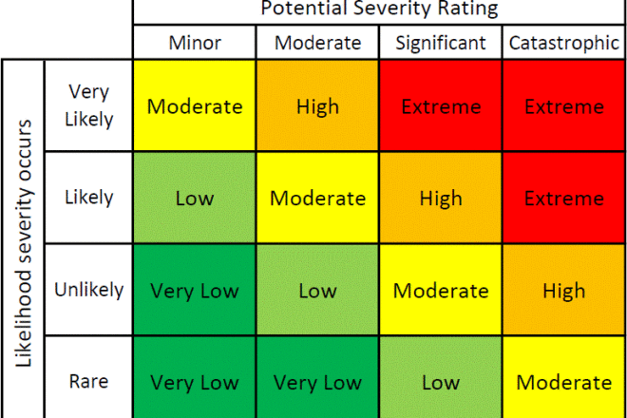
Risk Impact Matrix
Risk identification
Analysis of probability and consequences
Risk mitigation strategies
Control and documentation
Licensed under CC BY-NC-ND
Notes:
example

Slide 16
Exercise
External
Consumer
Low Consumer acceptance
Low Profit potential
Environment
Pollution risks
Volunteer Team?
Risk Breakdown Structure?
Risk Impact Matrix?
Internal
Organization
Limited management support
Low funding
Team
Missing resources
Notes:
I ask for a volunteer team and prepare these three tools with them on the board.
One disadvantage is, that the volunteer team gets preferencial treatment. However I try to use a different team each week. This way the class gets to know some of the other teams projects more in detail and can observe the process of the tool development
I end with explaining that this is just the beginning → step 1 (identification (RBS) and step 2 (analysis) of the risk management process.

Slide 17
Project Risk Scoring
Risk identification
Analysis of probability and consequences
Risk mitigation strategies
Control and documentation
Use project team’s consensus to determine the score for each probability of failure category: e.g. Maturity (P_{m}), Complexity (P_{c}), and Dependency (P_{d})
Calculate overall probability
Use project team’s consensus to determine the score for each consequence of failure category: e.g. Cost (C_{c}), Schedule (C_{s}), Reliability (C_{r}), and Performance (C_{p})
Source: Pinto (2015).
Notes:
A different and more quantitative approach to step 1 and step 2:
Can by any categoy. These here are just example. Important to average themout. Or weigh them,if that fits better.

Slide 18
Project Risk Scoring
Risk identification
Analysis of probability and consequences
Risk mitigation strategies
Control and documentation
Calculate C_{f} by adding the four categories and dividing by 4:
Calculate overall risk factor for the project:
Rule of Thumb:
Low Risk RF < 0.30
Medium Risk RF = 0.30 to 0.70
High Risk RF > 0.70
Source: Pinto (2015).
Notes:
Beispiel hier weiterziehen

Slide 19
Quiz
The greatest project risk occurs when:
The probability of the event is high and the consequences of the event are high
The probability of the event is high and the consequences of the event are low
The probability of the event is low and the consequences of the event are high
The probability of the event is low and the consequences of the event are low
2. A project team assigns probabilities of 0.1, 0.2, and 0.4 respectively to the maturity, complexity, and dependency categories. The probability of failure can be calculated as:
0.23
0.33
0.65
0.70
Notes:
1A
2A

Slide 20
Example Test Question
Garman yawned as he sat at his kitchen table. His plans to corner the world's supply of peanut valves required detailed planning and an honest assessment of the risks involved in this highly speculative venture. He first identified the primary factors that might contribute to the project's failure. These factors were employee related, market maturity related, and health related. The best estimates he could come up with for these probabilities were 0.6, 0.2 and 0.3, respectively. The consequences of failure were less certain, but he finally decided that the cost consequences rated a 0.2, the schedule consequences rated a 0.4, the reliability consequences rated 0.1, and the company goodwill consequences were a robust 0.6. What is the overall project risk factor for this undertaking?
Source: Pinto (2015).
Notes:
Answer: The overall project risk factor is 0.5725, perhaps too risky for Garman and his henchman.
PF = (PE + PM + PH)/3 = (0.6 + 0.2 + 0.3)/3 = 0.3
CF = (CC + CS + CR + CG)/4 = (0.2 + 0.4 + 0.1 + 0.6)/4 = 0.325
RF = PF + CF - PFCF
RF = 0.3 + 0.325 - 0.3 × 0.325
RF = 0.5725

Slide 21
Risk Mitigation Strategies
Risk identification
Analysis of probability and consequences
Risk mitigation strategies
Control and documentation
Accept
Minimise
Share
Transfer
Contingency Reserves
Task contingency
Managerial contingency
Insurance
Other Mitigation Strategies
Mentoring
Cross training
Control and Documentation
Change management
Notes:
Now step 3. difining mitigations

Slide 22
Control & Documentation
Risk identification
Analysis of probability and consequences
Risk mitigation strategies
Control and documentation
Helps managers classify and codify risks, responses, and outcomes
Change management report system answers:
What?
Who?
When?
Why?
How?

Slide 23
Example Risk Register
Dziadosz, Agnieszka, and Mariusz Rejment. "Risk Analysis in Construction Project-Chosen Methods." Procedia Engineering 122 (2015): 258-265.
Notes:
I actually show different excel templates that I have used in my previous projects.
Then I go back to the board and brainstorm shortly on some mitigation strategies for the student example project.

Slide 24
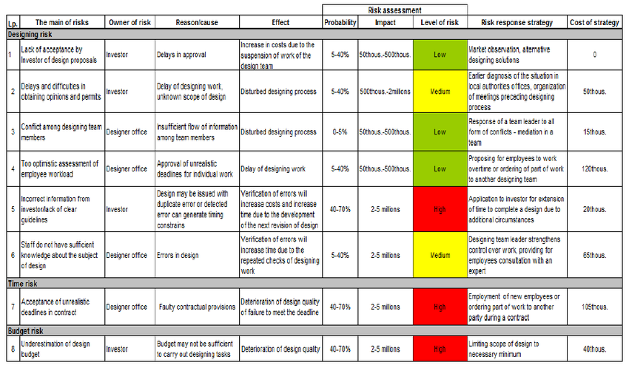
Homework
Develop a risk template including a risk impact matrix and mitigation strategies for your project in your team for next week
This is the fifth tool of your project plan
Notes:
I let the teams work on each tool in their selfstudy time each week. If you have more class time you can as well include this in the class session.

Slide 25
Summary
Risk Management is about identifying, analysing, and responding to risk factors throughout the project cycle and in the best interest of its objectives
Project Risk – an uncertain event or condition that, if it occurs, has a positive or negative effect on one or more project objectives
Different risk factors need to be considered when establishing a project risk template
25

Slide 26
Learning Objectives
After completing this chapter, you should be able to:
Define project risk
Recognise four key stages in project risk management and the steps necessary to manage risk
Recognise four primary risk mitigation strategies
26

Slide 27
References
Dziadosz, Agnieszka, and Mariusz Rejment. "Risk Analysis in Construction Project-Chosen Methods." Procedia Engineering 122 (2015): 258-265.
Horine, Greg (2013): Absolute Beginner’s Guide to Project Management, Que Sams/Pearson Education, 3rd ed.
Pinto, J. K. (2015): Project management. Achieving competitive advantage, Pearson Education, Harlow, Essex, 4th ed.
Project Management Institute (2013): A Guide to the Project Management Body of Knowledge: PMBOK(R) Guide, Project Management Institute; 5th ed.
Wideman, R. M. (2004). A Management Framework: For Project, Program and Portfolio Integration. Trafford Publishing.

