Slide 1
C.1.4.4. Financial Plan

Slide 2
Learning Objectives
Understand the importance of financial planning
Become aware that no plan is perfect and various assumptions and scenario planning is required
Familiarise yourself with the practical problems in financial planning

Slide 3
No plan is ever accurate, why do we need to plan at all?
Notes:
For a solution see the slide for budgeting (slide 13). I compare the student answers later with that.

Slide 4
Financial Plan of International Endeavours
An essential part of going abroad is to know:
What type of cost will occur?
When are we breaking even?
At which stage do I need what amount of additional money to finance the project?
At what point in time do we create positive cash flows?

Slide 5
Nature of Costs
Direct costs vs. indirect costs (=overhead)
Direct cost are (conveniently and economically) traceable to a cost object
Indirect costs are not
Variable costs vs. fixed costs
Variable costs change (in total) proportionally to changes in activity/volume levels
Fixed cost (in total) do not
This is the opposite on a per unit level
Fixed cost are only fixed within a relevant range (step-cost function)
Inventoriable costs vs. period costs
Inventoriable costs are capitalised (B/S) and later become COGS
Period costs are expensed in the period incurred (P/L)
Notes:
I usually take some random object I can find in the classroom (e.g. a chair or water bottle) and discuss types of costs that are needed to produce this specific object. Estimating the cost for a more complex project (e.g. opening a store in a host country is to complex for the beginning). I write down the mentioned cost positions on the board and let the students classify them as direct/indirect, etc.. I later let the students estimate the costs of this object and discuss the breakeven analysis also based on this example

Slide 6
Break-even Analysis
Assumptions Break-even Analysis
Revenues and costs behave in a linear way (straight line)
Revenues and costs are known and constant
The time value of money is not considered
The production volume is the only cost driver (ceteris paribus)
Basic equation
$Operating Income=Revenues−Costs$
$OI=R −Cvar−Cfixed$
$OI=Price ∗units sold −Cvar per unit∗units sold−Cfixed$

Slide 7
Break-even Analysis
Adjustment of the basic equation
$Operating Income=0$
$0=Revenues−Costs$
$0=R −Cvar−Cfixed$
$0=Price ∗units sold −C var per unit∗units sold−Cfixed$
Break-even
$BE units=\frac{Cfixed}{Price−Cvar per unit}$
$BE Revenue=\frac{Cfix ed}{R−Cvar}$

Slide 8
Break-even Analysis
Notes:
Using the numbers from the previous excercise (the costs that the students guessed) I calculate the break-even (in units) for the discussed object.

Slide 9
Break-even Analysis – Dealing with Uncertainty
As the future is ambiguous, this should be included in your calculations
Scenario planning, e.g. best-case, worst-case, most probable case
Sensitivity tests: “What happens if…” (e.g. the numbers change slightly)
If various variables are uncertain, more advanced computations are helpful, e.g. Monte Carlo simulations
→ More information on forecasting: e-learning: https://mediathek.htw-berlin.de/video/Financial-Plan/3cb438554742ba9761c60d64ff14a6ca

Slide 10
Break-even Analysis-Scenario Planning
An Example:
Notes:
The idea here is that there is a lot of uncertainty in the estimation of the cost numbers and that students should calculate multiple scenarios (worst case, best case, etc.)

Slide 11
Break-even Analysis – ”What if?”
Notes:
To use the What-if Function of Excel, simply create a table like this and type in the titles and the values you want to compare.
Insert the formula in the top left corner of the table
Go to Insert→ What-if→ follow the instructions

Slide 12
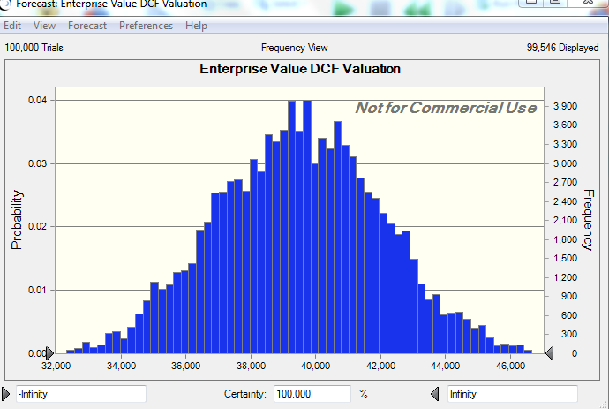
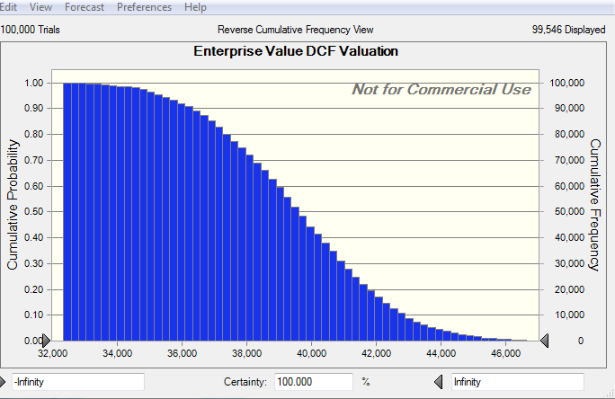
Advanced Sensitivity Tests, e.g. Monte Carlo Simulation
Notes:
Simply explain how a Monte-Carlo Simulation works, if you do not have Crystall Ball (or a comparable software) available:
The potential ranges for different variables are defined and the probability of the occurance for the specific values of the variables are defined as well.
The computer-based Monte Carlo simulation than randomly creates scenarios, given the provided probabilites.
What you see in the charts above is the distribution of the results, which help to estimate future values if many unknown variables, that interact with each other, exist.

Slide 13
Budgeting and the Financial Plan
A budget is a quantified expression of a proposed plan of action for a specific period
A budget is useful for:
Clarifying future needs (e.g. financing needs)
Communicating future goals and targets
Coordinating the activities of subunits
A basis for performance judgment and motivation of employees
Notes:
Link „ A budget is useful for“ to the answers you received at „why do we need to plan at all“ in the beginning.

Slide 14
Budgeting and the Financial Plan
The financial plan/budget is part of the master budget
Building on the operating budget and the firm’s strategy, the financial needs are elaborated
The financial plan requires a budgeted balance sheet and a budgeted statement of cash flows

Slide 15
Basics Steps for a Financial Plan
Budget the revenues
Budget the operating expenses (period costs)
Budget future investments in assets
Budget the cash flows
Budget the respective cost of goods sold (labour, direct material, etc.)
Budget the income
Budget changes in working capital
Judge the future financial needs
Notes:
The important message here is that no department can plan without accurate input from the previous department in the budgeting process
Usually the marketing department starts with forecasting the amount of sold units and revenues („pull-marketing“). This is different if the production capacity is the main starting point in the planning process („push-marketing“)

Slide 16
Basics Steps for a Master Budget
Operating budgets
Financial budgets
Revenue budget
Production budgets
- Direct materials
- Direct labour
- Overhead
Cost of goods manufactured and sold budget
Selling & administrative expenses budgets
- Marketing expenses
- Administration
- R&D
Cash budget
Budgeted income statement
Budgeted balance sheet
Budgeted cash flow statement
Capital expenditure budget
Notes:
Most students assume that the accounting/finance departments are the main drivers of the budgeting process. However, they can only work with previous input (it is a firm spanning process).

Slide 17
The Relationship between Specific Budgets and the Financial Plan
The budgeting process usually starts within the marketing department (unless your firm operates with “push-marketing”)
The marketing departments elaborate how many units it can sell at which price (this is why revenues are planned first in the budgeting process)
The operating departments (operations, production, logistics) produce according to the forecasts of the marketing department→ all production costs, etc. are a consequence of the marketing plan and are “pulled” by the marketing department
The financial plan (and the financial needs) are the last steps in the budgeting process, since they rely on that information

Slide 18
The Relationship between Specific Budgets and the Financial Plan
You cannot create a financial plan without knowing
The entry mode, because of necessary related investments (capital expenditure budget)
The scope of entry and the timing (gradual, all at once, etc.)
The forecasted demand (revenue budget, marketing budget)
The price of your products and all related costs (all operating budgets)
Notes:
The Budgeting process also involves the forecasting of a capital expenditure budget, a budgeted income statement, a budgeted balance sheet, and a budgeted cash flow statement
The budgeted income statement and balance sheet are preliminary useful for management accounting purposes and a later variance analysis
The budgeted cash flow statement is in addition useful to judge the future financing needs and is therefore essential for a financial plan
Do NOT assume that (budgeted) profitability (as provided by the income statement) is an indicator for financing needs!
Particularly when going abroad a lot of capital is tied up in accounts receivable and inventory, as well as invested in additional assets
Cash is a fact, profit is an opinion!

Slide 19
The Relationship between Financial Budgets and the Financial Plan
The budgeting process also involves the forecasting of a capital expenditure budget, a budgeted income statement, a budgeted balance sheet, and a budgeted cash flow statement
The budgeted income statement and balance sheet are preliminarily useful for management accounting purposes and a later variance analysis
The budgeted cash flow statement is, in addition, useful to judge the future financing needs and is therefore essential for a financial plan
Do NOT assume that (budgeted) profitability (as provided by the income statement) is an indicator for financing needs
Particularly when going abroad a lot of capital is tied up in accounts receivable and inventory, as well as invested in additional assets
Cash is a fact, profit is an opinion!

Slide 20
Where can I get information about the cost structures in the target country?
The easiest solution is to find publicly listed, but comparable organisations (benchmark), and check their financial statements → with this information you might be able to get information on EBIT-margins, cost for stores, rent, production costs, etc.
Other benchmarking opportunities are industry reports, reports by financial analysts
It is often complicated to evaluate how comparable those benchmarks really are
You should compare the identified information to accounting data of your current operations

Slide 21
Forecasting
Simple methods
Average and moving average (e.g. last three months)
Regression analysis to estimate trends
Estimate the correlation and regression coefficients to analyse trends
Integrate typical indices (seasonal effects, economic cycle)
Extrapolation
Please note that a simple mathematical relation is not sufficient, but needs some logical extension

Slide 22
Forecasting
Regression analysis – example:
This is the information of the last working days
For tomorrow you estimated that your workers can work for 30 hours
Please estimate tomorrow’s output units
Day | 1 | 2 | 3 | 4 | 5 | 6 | 7 | 8 | 9
Working hours | 50 | 70 | 25 | 55 | 20 | 60 | 40 | 25 | 35
Output units | 352 | 555 | 207 | 508 | 48 | 498 | 310 | 153 | 264
Notes:
Solution see xls

Slide 23
Forecasting - Seasonal Effects

Slide 24
Forecasting - Seasonal Effects
Example:
Compute the seasonal indices for the quarterly turnover
Estimate the regression equation using de-seasonalised data
Estimate the turnover for all quarters in 2018
Quarter | 1/16 | 2/16 | 3/16 | 4/16 | 1/17 | 2/17 | 3/17 | 4/17
Turnover in ‘000 € | 986 | 1245 | 902 | 704 | 812 | 1048 | 706 | 514
Notes:
Solution see xls

Slide 25
Exercise
Please see the video and the Excel file for an example
https://mediathek.htw-berlin.de/video/Financial-Plan/3cb438554742ba9761c60d64ff14a6ca
Develop a financial plan for an expansion of a publicly listed firm (information access) to a country of your choice.
How much additional capital do we need and at which point in time?
Which assumptions influenced your choices?
How accurate do you consider your forecast?
What could help you to improve your plan?

Slide 26
Summary
A budget plan is useful to clarify future needs, communicate future goals and targets, coordinate the activities of subunits, and as a basis for performance judgment and motivation of employees
Budget Plans should consider uncertainties
Different forcasting methods allow you to predict budgets

Slide 27
Learning Objectives
Understand the importance of financial planning
Become aware that no plan is perfect and various assumptions and scenario planning is required
Familiarise yourself with the practical problems in financial planning

Slide 28
Further Readings
Break-even analysis and budgeting:
Datar, S.M. & Rajan, M.V. (2017). Horngren‘s cost accounting: A managerial emphasis, Harlow: Pearson.
Forecasting:
Curwin, J., Slater, R., & Eadson, D. (2007). Quantitative methods for business decisions. Hampshire: Cengage.
Financial planning:
Sengupta, C. (2004). Financial modeling using Excel and VBA. Chichester: Wiley
Schüler, A. (2016). Finanzmanagement mit Excel. München: Vahlen.

