Slide 1
C.1.4.3 Organisational Plan and International Human Resources
How to Organise International Business

Slide 2
Learning Objectives
Students can determine the international organization’s structure setup
Students are able to describe the nature of human resource management in international business
Students are able to detail how firms recruit and select managers for international assignments
Students can explain how international businesses train and develop expatriate managers

Slide 3
Organisational Structure
Stability:
Flexibility:
Provides the capacity to operate consistently and predictably
(exploit)
Provides the capacity to identify opportunities and allocate resources
(explore)
Maintain a balance between structural stability and flexibility
Organisations change their structures when inefficiencies force them to
Daft, Murphy, Willmott, (2014).
Notes:
According to Alfred Chandler organizations change their structures when inefficiencies force them to. Often organization show inertia to change their organizational structure, even though the changes in the internal or external environment gives rise to adaptation of it.
Structure can be used to exercise control over organization. The value chain activities and the support functions can be studied .
From: Daft, R. L., Murphy, J., & Willmott, H. (2014). Organization theory and design: an international persepective. Andover: Cengage Learning.

Slide 4
International Division
0
International Division was often used when companies begin to explore international opportunities
Daft, Murphy, Willmott, (2014).
Notes:
From: Daft, R. L., Murphy, J., & Willmott, H. (2014). Organization theory and design: an international persepective. Andover: Cengage Learning.

Slide 5
Global Matrix Structure
0
Global matrix structure can be used to achieve vertical and horizontal coordination simultaneously
Daft, Murphy, Willmott, (2014).
Notes:
From: Daft, R. L., Murphy, J., & Willmott, H. (2014). Organization theory and design: an international persepective. Andover: Cengage Learning.

Slide 6
Remember? Alternative Strategies
Local Responsiveness
low
high
Global Integration
1 Global Strategy | 3 Transnational Strategy ► “Most challenging”
2 Home-Replication | 4 Multi-Domestic Strategy
high
low
(Bartlett & Ghoshal, 2002).
Notes:
Globalization strategy means that products design, manufacturing and marketing strategy are standardized throughout the world. It can help an organization reap economy-of-scale efficiencies.
Multidomestic strategy means that competition is handled in each country independently.
Organizations needs to decide whether their goal is
to achieve global integration or national
responsiveness.

Slide 7
Class Activity 1
Under what condition should a company consider adopting a global geographic structure as opposed to a global product structure?
Name some companies that you think could succeed today with a globalisation strategy and explain why you selected those companies. How does the globalisation strategy differ from a multi-domestic strategy?
When would an organisation consider using a matrix structure. Find an example of an organisation with a international matrix structure.

Slide 8
Solution: Alternative Strategies
Local Responsiveness
low
high
Global Integration
1 Global Strategy | 3 Transnational Strategy
2 Home-replication | 4 Multi-domestic Strategy
Global Product Structure
Global Matrix Structure
high
low
International Division
Global Geographic Structure
(Bartlett & Ghoshal, 2002).

Slide 9
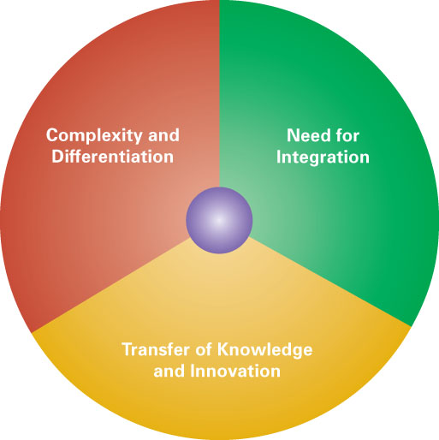
The Global Organisational Challenge
0
Daft, Murphy, Willmott, (2014).
Notes:
From: Daft, R. L., Murphy, J., & Willmott, H. (2014). Organization theory and design: an international persepective. Andover: Cengage Learning.
Increased complexity and differentiation
Greater level of internal and external complexity
Numerous differences include economic development, language, political system, cultural norms and values, etc.
Increasing needs for greater response to local preferences.
Integration
It is necessary for a global organization to reap the benefit of economies of scale, economies of scope and low-cost production.
Knowledge transfer
International environment offers opportunities for
learning and the development of diverse capabilities.

Slide 10
Global Coordination Mechanisms
0
Global team
Also called transnational teams, are cross-border work groups made up of multi-skilled, multinational members whose activities span multiple countries
Intercultural teams and virtual global teams
Headquarters planning
Headquarters take an active role in planning, scheduling, and control to keep the global organisation working together
Expanded coordination roles
A possible way to integrate different aspects of the organisation to achieve a strong competitive position

Slide 11
International Human Resource Management
Intercountry Differences Effecting HRM
Cultural Factors
Labour Cost Factors
Industrial Relation Factors (e.g. Role Of Labour Unions)
Economic Factors
Source: (Dessler, 2016)
Notes:
Human resource management is the set of activities directed at attracting, developing, and maintaining the effective workforce necessary to achieve a firm’s objectives.
Additional challanges in international HRM
International HR managers must deal with differences in cultures, levels of economic development, and legal systems among the countries in which a firm operates. These differences may force it to customize its hiring, firing, training, and compensation programs on a country-by-country basis.
Kick off question: Who has worked in an international company (probably many) Do you know what their hiring policy was? Were intercultural issues a topic?

Slide 12
Centralisation versus Decentralisation of Control
Staffing Strategies
Centralised firms
Favour home country managers
Most common amongst international division form
Decentralised firms
Favour host country managers
Most common amongst multidomestic firms
Notes:
An international business’s HRM needs are affected by whether the firm wants decision making to be centralized at corporate headquarters or delegated (decentralized) to operating subsidiaries. Firms that use a centralized approach often favor employing home country managers; firms that follow a decentralized decision-making philosophy are more likely to employ host country managers. Certain organizational approaches and forms affect the choice of centralization or decentralization. Firms that view themselves as multidomestic rather than multinational are likely to favor decentralization of decision making. The global area form facilitates delegating responsibility to managers of the firm’s foreign subsidiaries. Conversely, the international division form favors centralizing decision making at corporate headquarters.

Slide 13
Discussion
Do you gain more know-how by transferring expatriates from your existing operations into the new market or are you better served by hiring local employees?
The expat employee will carry a deep understanding of your organisation’s products, policies, systems, and culture. On the downside, the expat employee may know little about the local market you're entering (its laws, language, purchasing habits, culture, etc.)
The local hire, on the other hand, will likely have a wealth of knowledge pertaining to the local market, but will know little about your organisation and the overarching strategy driving your expansion
Notes:
Employee Knowledge for International Expansion. (n.d.). Retrieved 23 September 2018, from http://www.adp.com/spark/articles/2016/03/employee-knowledge-for-international-expansion-hiring-locally-vs-transferring-expats.aspx

Slide 14
Staffing Strategies
Parent-country nationals
Host Country
Nationals
Expatriates
Third-country
nationals
Potential reasons for recruiting:
Preference of most people to work in their own country
Lower costs compared to expatriates
Better citizen view of MNC due to local talent
Government requirement
Long-term perspective
Potential reasons for recruiting:
Technical competence which is not available locally
Required step for promoting top managers in MNC
Control by implementing the HQ’s instructions, policies, and culture
Problems with hiring local employees (e.g. unclear certifications)
Notes:
The extent of the firm’s internationalization and its degree of centralization or decentralization affects (and is affected by) its philosophy regarding the nationality of its international managers.
Host country nationals (HCNs) are residents of the host country. HCNs are commonly used by international businesses to fill middle-level and lower-level jobs, but they also often appear in managerial and professional positions.
TCNs and PCNs collectively are known as expatriates, or people working and residing in countries other than their native country.
Parent country nationals (PCNs) are residents of the international business’s home country. Use of PCNs in an MNC’s foreign operations provides many advantages to the firm. Because PCNs typically share a common culture and educational background with corporate headquarters staff, they facilitate communication and coordination with corporate headquarters.
An international firm may hire third-country nationals (TCNs), who are not citizens of the firm’s home country or of the host country. Like PCNs, TCNs are most likely to be used in upper-level and/or technical positions.

Slide 15
Staffing Strategies
Staffing Strategy | Ethnocentric | Policentric | Geocentric
Explanation | Key management positions are filled by parent-country nationals | Host-country nationals in foreign subsidiary, home-headquarter with parent- country nationals | Best-suited person, regardless of nationality, in appropriate position
Reasons | Lack of qualified local staff Maintaining home-country corporate culture Transfer of firm’s core competencies | Reduction of cultural misunderstandings locally Less expensive | Most efficient use of HR Building stronger consistent corporate culture
Source: (Dessler, 2016)
Notes:
Most international firms develop a systematic strategy for choosing among HCNs, PCNs, and TCNs for various positions. Some firms rely on the ethnocentric staffing model, whereby they primarily use PCNs to staff higher-level foreign positions. This approach is based on the assumption that home office perspectives should take precedence over local perspectives and that expatriate PCNs will be most effective in representing the views of the home office in the foreign operation. Other international firms follow a polycentric staffing model; that is, they emphasize the use of HCNs in the belief that HCNs know the local market best. Finally, the geocentric staffing model puts PCNs, HCNs, and TCNs on an equal footing. Firms that adopt this approach want to hire the best person available, regardless of where that individual comes from.
Any experience? Which would you chose/ think that the company you worked in should have chosen?

Slide 16
Selecting Expatriates
Structured Interview
Psychological Tests and Questionnaires
Biographical Questionnaire
Self-evaluation of the Employee
(Inter-cultural) Assessment Center
Thematic capabilities and competences Intercultural competence Family support Motivation to go abroad
Bergemann/Sourisseaux (2003)
Notes:
Kick off question: who has worked as an expatriate? (what were salary components? Why did you do it? Did you like it? Special training?) Who would want to be one? Why?

Slide 17
Expatriation as an Employee Development Tool
Principal Agent Theory
Salary increase and/or career option due to new qualifications gained to solve Moral Hazard
Transaction Cost Theory
Limited usability on the external job market ensures contractual (hierarchy) relation
Becker (2002)

Slide 18
Expatriation as an Employee Development Tool
Experiences abroad:
Enrich the employees experience base
Increase transparency about human resources and practices within the company
Improve innovation and integration capabilities
After an expatriation, the employees:
Have a longer term, company orientation and less egocentric perspective
Have an increase understanding for organisational change
For the company, expatriation is:
A measure for socialisation with the company
Support a global corporate culture
Wirth (2003)

Slide 19
Challenges of Expatriation
Failure of Expatriation
Reasons for Failed Expatriation:
Early return of the expatriate to his/her home country
High Costs of Failed Expatriation
Approx. ¾ of the early salary of the expatriate plus moving allowance
Inability to adapt by the spouse
Family problem
Personal/emotional unfitness of the manager
Difficulties with the new environment
Missing technical competence
Inability to handle higher responsibility abroad

Slide 20
Challenges of Expatriation
Level of Satis-faction
High
Medium
Low
Honeymoon
Acceptance
Reentry shock
Adjustment
Crisis
Beginning Middle End Time of Stay
Notes:
Parent country nationals on long-term foreign assignments face great acculturation challenges. Living and working in a foreign culture can lead to culture shock, which may lead to feelings of fear, helplessness, irritability, and disorientation. Such feelings can hamper the effectiveness and productivity of an expatriate manager.
International businesses cannot assume that repatriation (bringing a manager back home after a foreign assignment has been completed) will be easy. Returning home can be almost as traumatic as the original move abroad, especially for managers and family members who have become comfortable with working and living in the foreign culture. By some estimates, one-quarter of repatriated employees leave their employer within a year after returning home. Each repatriated executive who leaves the firm represents a million-dollar investment walking out the door.
Ask students about their cultural shock experience!

Slide 21
Example Methods for Intercultural Training
Content of the training | Culture general | Culture specific
Cognitive | Presentations about intercultural communication | Country-specific information and traditional language programmes
Affective | Case studies about intercultural problem | Role play/case studies specific to the culture of the destination country
Behavioural oriented | Simulations, e.g. “Bafá Bafá” Sensitivity training with different cultures participating | Host-family surrogate with a family from the destination country
Breuer, Gürtler (2013)
Notes:
Cognition is "the mental action or process of acquiring knowledge and understanding through thought, experience, and the senses".
affective. [ə-fĕk′tĭv] Concerned with or arousing feelings or emotions; emotional. Influenced by or resulting from the emotions,

Slide 22
Intercultural Leadership
Cultural environment home country
Cultural environment host country
Personal characteristics of the leader
Personal characteristics of the host-country employees
Own preference for leadership style and perceived leadership expectations of the host-country employees
Leadership expectations
Congruency of discrepancy
Subjective perceived satisfaction
Positive/negative influence on satisfaction and performance
Further constraints of the leadership situation
Welge Holtbrügge (2010)

Slide 23
Leadership Preferences
Countries | Leadership characteristics
USA The Netherlands, Sweden UK | Leadership through joint-decision preparation Leaders are bound by informal norms to avoid abuse of power Low security needs of employees
Belgium, France Denmark, Norway, Australia, Japan Spain, Germany, Italy | Leadership mainly oriented at the consultation and opinion of employees Medium delegation degree Employees do not expect a high degree of decision autonomy
Greece, Turkey, South American countries Malaysia, Indonesia, Thailand, Arab countries India, Pakistan | Very low degree of centralisation; centralised decision making Status symbols and privileges for leaders are visible and legitimate Authority not questioned but accepted Limited information flow between hierarchy levels
Participative
Leadership
Authoritarian
Leadership
Welge Holtbrügge (2010)

Slide 24
International Comparison of Motivators
Source: Rehu, Lusk, Wolff (2005).
Notes:
Kick off: what would motivate you?

Slide 25
International Comparison of De-Motivators
Source: Rehu, Lusk, Wolff (2005).
Notes:
Study is just a few years old, however, the change in the society in germany indicates that the motivators and non-motivators are chinging even in the past 10 years.

Slide 26
Performance Appraisals and Compensation
Likelihood of managers being successful in overseas assignment increases if the managers:
Can freely choose whether to accept or reject the assignment
Have been given a realistic preview of the job and assignment
Have been given a realistic expectation of what their repatriation assignment will be
Have a mentor back home who will guard their interests and provide support
See a clear link between the expatriate assignment and their long-term career path
Source: Griffin, Pustay (2013)

Slide 27
Performance Appraisals and Compensation
Functions of Performance Appraisal
To provide feedback to individuals on how well they are doing
To provide a basis for rewarding top performers
To identify areas in which additional training and development may be needed
To identify problem areas that may call for a change in assignment
Source: Griffin, Pustay (2013)
Notes:
Performance appraisal is the process of assessing how effectively people are performing their jobs.
Do you have experience with performance appraisals?

Slide 28
Compensation Packages
Performance Appraisals and Compensation
Cost-of-living allowance
Hardship premium
Tax equalisation system
Source: Griffin, Pustay (2013)
Notes:
Most international businesses find it necessary to provide these managers with differential compensation to make up for dramatic differences in currency valuation, standards of living, lifestyle norms, and so on. When managers are on short-term assignments abroad, their home country salaries normally continue unchanged. If foreign assignments are indefinite or longer term, compensation is routinely adjusted to allow the managers to maintain their home country standard of living. This adjustment is particularly important if a manager is transferred from a low-cost location to a high-cost location or from a country with a high standard of living to one with a lower standard of living. Figure 20.5 (shown on the next slide) summarizes cost-of-living differences for the twenty most expensive international business centers. The starting point in differential compensation is a cost-of-living allowance, which is intended to offset differences in the cost of living in the home and host countries. Sometimes firms find they must supplement base pay to get a manager to accept an assignment in a relatively unattractive location. Although it may not be difficult to find people willing to move to England or Japan, it may be much more difficult to entice people to move to Colombia or Afghanistan. Called either a hardship premium or a foreign-service premium, this supplement is essentially an inducement to the individual to accept the international assignment.

Slide 29
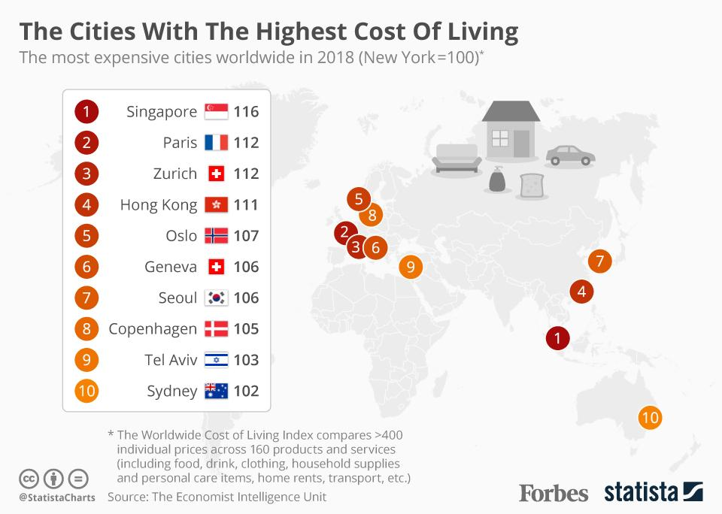
Performance Appraisals and Compensation

Slide 30
Costs of Expatriate Managers
Performance Appraisals and Compensation
Notes:
Ensure that the expatriate does not have to pay additional expenses as a result of working abroad

Slide 31
Summary
Organisational structure has to maintain a balance between structural stability and flexibility
Organisational structure and HR strategies have to be in line with the alternative international strategy chosen
The common staffing strategies are Ethnocentric, Policentric, and Geocentric
Notes:
Staffing Strategy
Ethnocentric
Policentric
Geocentric

Slide 32
Learning Objectives
Students can determine the international organization’s structure setup
Students are able to describe the nature of human resource management in international business
Students are able to detail how firms recruit and select managers for international assignments
Students can explain how international businesses train and develop expatriate managers

Slide 33
List of References
Becker, Manfred (2002): Personalentwicklung, 3. Aufl., Stuttgart: Schäffer-Poeschel, S. 4 ff.
Bergemann, Niels/Sourisseaux, Andreas L: (2003): Internationale Personalauswahl, in: dies. (Hrsg.): Interkulturelles Management, 3. Aufl., S. 181-235.
Breuer, W., & Gürtler, M. (Eds.). (2013). Internationales Management: Betriebswirtschaftslehre der internationalen Unternehmung. Springer-Verlag.
Chandler, A. (1962). Strategy and Structure, Cambridge, MA: MIT press.
Daft, R. L., Murphy, J., & Willmott, H. (2014). Organization theory and design: an international perspective. Andover: Cengage Learning.
Dessler, G. (2016) Human Resource Management, Pearson Education Limited.
Griffin, R.W.; Pustay, M. W. (2013) International Business, Pearson Education Limited.
Rugman, A. M., Collinson, S., & Hodgetts, R. M. (2006). International business. Pearson Education.
Rehu, M., Lusk, E. J., & Wolff, B. (2005). A performance motivator in one country, a non-motivator in another? An empirical study. In Academy of Management Proceedings (Vol. 2005, No. 1, pp. K1-K6). Briarcliff Manor, NY 10510: Academy of Management.
Welge, M. K., & Holtbrügge, D. (2010). Internationales management - Theorien, Funktionen, Fallstudien. Schäffer-Poeschel.
Wirth, Ekkehard 2003 in Bergemann/Sourisseaux, 2003: Interkulturelles Management, Springer Verlag, Berlin, Heidelberg, New York, S 337 ff

Slide 34
Homework
The Schneider Case
Introduction: Antoinette Schneider is an Austrian designer and some years ago she designed a number of high quality, exclusive series of ladies handbags. She had them produced in Turkey and offered them directly to Austrian shops of leather goods with her own name Schneider as the brand. After a while her bags become very popular and she hired a sales manager, a logistics manager, and an administration manager. After a fashion show in Frankfurt, she received much interest from exclusive German shops, including some very big department stores. She knew that her organisation had to be changed drastically, especially since her supplier had said that he can hardly keep up with production. Also, there were a number of complaints from her customers that the quality was not as it used to be (stitches came loose, some stains on the bags, etc.). Antoinette had made new designs for her collection which she expected would do very well in other countries in Europe, especially in countries like France, Italy, and Spain. At the fair there were also some purchasing agents from China, who were very interested in her products. Antoinette was very happy with her success and had the ambition to grow her organisation globally. At the same time, she got very worried about her supply problems and the specific needs and demands from customers worldwide.
Question 1) What does Antoinette need to do to follow her dream and become a worldwide success? What should her organisation look like if she wanted to develop a global brand? Draw an organisation chart of how the organisation will look like in a number of years?
Question 2) What would be your advice to Antoinette on how she could hire the best qualified people for her organisation? Would they be hired primarily in Austria where her headquarters will be, or do you advise her to hire people from other countries?

