Slide 1
C1.1.2 Small and Medium-Sized Enterprises in Europe
The role of SMEs in the European Economy

Slide 2
Learning Objectives
Describe the organisational life cycle
Describe the stages of growth of a small business
Explain the significance of SMEs on the economy
Understand qualitative and quantitative definitions of small and medium-sized enterprises
Describe some characteristics of SMEs
Describe advantages and disadvantages of small-sized companies
Notes:
Ask the class if they ever paid attention to SMEs in other courses. Check previous knowledge base

Slide 3
In-Class Exercise 1: Is this a small business?
Notes:
Short discussion.
What does constitute a small business?
Attempt to write your own definition. Keywords: self employed vs. group of people, legal entity, goal orientation, ownership, planned activities, structured, for profit.

Slide 4
Size of firm
Age of firm
Notes:
SMEs are seen as the first step in the growth of the large firm
Internal: In the different stages of development new organisational requirements, systems, structures, roles and division of labor. Role of owner manager will change.
External: In time new products and services need to be developed. Diversification of product portfolio. Competitors will follow or appear as visibility of larger firm increases. Market saturation, new market seeking.
Based on:
Greiner, L. E. (1972). Evolution and revolution as organizations grow.
Quinn, R. E., & Cameron, K. (1983). organisational life cycles and shifting criteria of effectiveness: Some preliminary evidence. Management science, 29(1), 33-51.
The model describes 4 phases (later a 5th phase about collaboration was added). Throughout a phase it is an evolution, gradual development and growth, then sudden revolutions bring about crises that needs to be solved before entering a new phase. Also known as evolution/revolution model

Slide 5
Organisational Practices in the Phases of Growth
Category | Phase 1 Creativity | Phase 2 Direction | Phase 3 Delegation | Phase 4 Coordination | Phase 5 Collaboration
Management Focus | Make and sell | Efficiency of operations | Expansion of market | Consolidation of organization | Problem solving and innovation
Organisational Structure | Informal | Centralised and functional | Decentralised and geographical | Line staff and product groups | Matrix of teams
Top Management Style | Individualistic and entrepreneurial | Directive | Delegative | Watchdog | Participative
Control System | Market results | Standards and cost centers | Reports and profit centers | Plans and investment centers | Mutual goal setting
Management Reward Emphasis | Ownership | Salary and merit increases | Individual bonus | Profit sharing and stock options | Team bonus
(Greiner, 1998)
Notes:
Greiner, L. E. (1998, May 1). Evolution and Revolution as Organizations Grow. https://hbr.org/1998/05/evolution-and-revolution-as-organizations-grow
Greiner's model is also criticized. Other studies failed to replicate it. But the model can show specific management, knowledge and org. structure demands.

Slide 6
Decline or liquidate?
(Greiner, 1998)
Notes:
Decline can occur in any stage.
Some statistics:
Bureau of Labor Statistics report – This quarterly report finds that approximately 44 percent of businesses fail after 5 years. The problem with this report is that it excludes sole proprietorships, which make up almost three quarters of American businesses.
Harvard Business School study – This study found that 75 % of venture capital-backed startups don’t return cash to investors, and that 30 % of those businesses have to liquidate all their assets. The problem with this study is that it only looks at failure rates among venture capital-backed startups, which represent fewer than 1 percent of all businesses. Failure rates among ordinary businesses may differ significantly.
SBA Economists study – This study, which builds upon data collected by the US Census Bureau, found that 33 % of business owners considered their businesses to be failures 4 years after they exited the market. The problem with this study is that it relies on business owners’ subjective interpretations of whether their business was successful or not.

Slide 7
5 Stages of Growth for Small Businesses
Stage | Top Management Role | Management Style | Organisational Structure
1: Inception | Direct supervision | Entrepreneurial, individualistic | Unstructured
2: Survival | Supervised supervision | Entrepreneurial, administrative | Simple
3: Growth | Delegation/co-ordination | Entrepreneurial, co-ordinate | Functional, centralised
4: Expansion | Decentralisation | Professional, administrative | Functional, decentralised
5: Maturity | Decentralisation | Watchdog | Decentralised functional/product
(Scott & Bruce, 1987)
Notes:
Scott, M., & Bruce, R. (1987). Five stages of growth in small business. Long range planning, 20(3), 45-52.

Slide 8
Notes on Growth Model for SMEs
Not all SMEs move through stages; bankruptcy, take-over, stuck in phase
Management style might be more or less advanced than the stage
Some SMEs have no intention of growth
Little empirical evidence for crisis and subsequent movement through stages
But stages can give understanding about different organisational needs in relation to age and size
(Storey , 2016)
Notes:
Storey, D. J. (2016). Understanding The Small Business Sector. Routledge.

Slide 9
In-Class Exercise 2: What is the role of small businesses?
What kind of contributions does small business make to the local economy (that larger business is less capable of doing)
Look for different sources of information on the Internet. Based on what you have read, write a list of at least 5 items
Discuss in a group of 5 students your list and create a final group list of 5 items
Each group gives a short presentation of the 5 items on a poster
Short class discussion. Which items did you leave out of the final list and why?
Notes:
In class exercise
Students write first individually and then share in teams a list of items. Teams report back to the class their findings. Discuss results in class.

Slide 10
Economic Role of Small Business
Provide Jobs
New Products/Services: Innovation
Suppliers of Large Corporations
Contribution to Economy
Niche Markets
Notes:
So what do you think: how likely is it that you end up working in an SME?
See data on next slides

Slide 11
Some Facts on the Importance of SMEs:
Comprise 99.8% of all enterprises in the non-financial business sector in the EU28 (22.3 million SMEs)
Almost all SMEs (93%) are micro SMEs employing less than 10 people
About three quarters of SMEs are active in the five key sectors: wholesale and retail trade, manufacturing, construction, business services, and accommodation and food services
In 2014, SMEs in the non-financial business sector generated more than EUR 3.7 trillion of value added (58% of the sector’s total value added) and employed almost 90 million people (67% of the sector’s total employment)
(Muller et al., 2015)
Notes:
Muller, P., Caliandro, C., Peycheva, V., Gagliardi, D., Marzocchi, C., Ramlogan, R., & Cox, D. (2015). Annual Report on European SMEs 2014/2015 (SMEs start hiring again). Luxembourg: European Union. DOI, 10, 886211.

Slide 12
Some Facts on the Importance of SMEs:
http://ec.europa.eu
Notes:
Infographic: Presents the latest data on European SMEs based on the annual report of 2016
ANNUAL REPORT ON EUROPEAN SMEs 2015/2016
http://ec.europa.eu/DocsRoom/documents/21251/attachments/4/translations/en/renditions/native

Slide 13
Some Facts on the Importance of SMEs:
http://ec.europa.eu

Slide 14
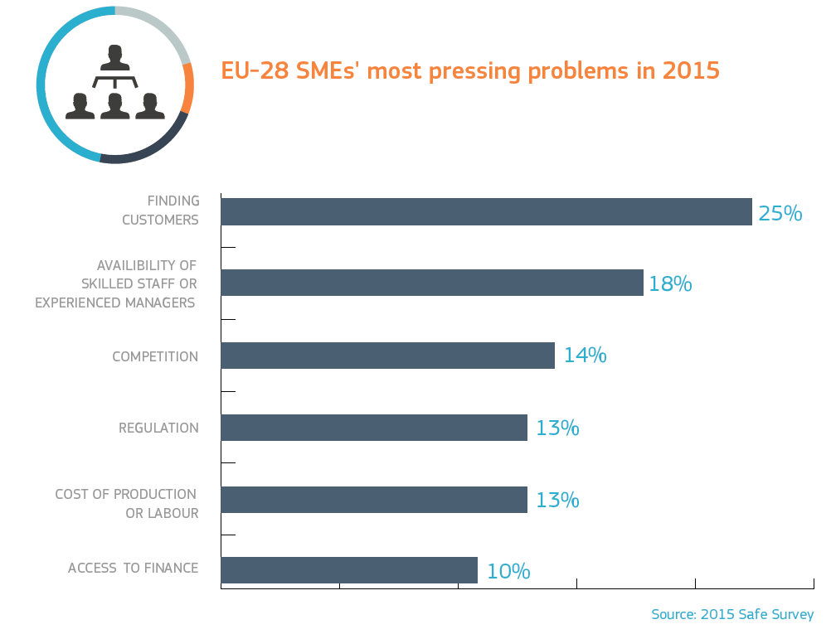
Some Facts on the Importance of SMEs:
http://ec.europa.eu

Slide 15
Definitions of SMEs
Small firms are difficult to define
A small firm is managed by its owner(s) in a personalised way
It has a relatively small share of the market in economic terms
It is independent (not part of a larger enterprise), owners relatively free from outside control in principal decision
(Bolton Report, 1971)
Notes:
The Committee of Inquiry on Small Firms set up by UK government wrote an influential report which became known as the Bolton Report (1971)

Slide 16
Definitions of SMEs
But,
Low market share is not always a characteristic, as they can operate in specialised niche, or limited geographical market, with a high share
Independence is hard to measure; what if you just supply to one customer? Or what if you supply to a powerful customer?
And basically small business is so diverse, often these businesses have little in common with each other, so why bother?

Slide 17
Definitions of SMEs
US Small Business Administration
Independently owned and operated
Not dominant in its field
Relatively small in in terms of annual sales
Fewer than 500 employees
NAICS (North American Industry Classification System) classify business establishments according to type of economic activity (process of production) in Canada, Mexico, and the United States of America
Per classification different SME definitions apply
What kind of classification system is used in your home country?
Notes:
www.sba.gov
www.naics.com
NACE classification for EU, but is not used like in the USA to determine the definition of what is considered small per code.
http://ec.europa.eu/competition/mergers/cases/index/nace_all.html
EUROPA - Competition - List of NACE codes. (n.d.). http://ec.europa.eu/competition/mergers/cases/index/nace_all.html

Slide 18
Definitions of SMEs in the EU
Company Category | Staff Headcount | Turnover | or |  | Balance Sheet Total
Medium-Sized | < 250 | ≤ € 50 m |  | ≤ € 43 m
Small | < 50 | ≤ € 10 m |  | ≤ € 10 m
Micro | < 10 | ≤ € 2 m |  | ≤ € 2 m
(EU, 2017)
Notes:
What is an SME? - Growth- European Commission. Retrieved 24 June 2017, from ec.Europa.eu/growth/smes/business-friendly-environment/sme-definition_nl

Slide 19
Exercise
How are SMEs defined in your country?
"Dieses Foto" von Unbekannter Autor ist lizenziert gemäß CC BY-NC-ND
Notes:
Let students google a few minutes and collect differences.

Slide 20
Limitations of Quantitative Definition
Headcount vs. FTE (Full Time Equivalent), many people work part-time
Per sector large differences between number of employees
Some sectors have large turnovers but low margins (like wholesalers)
Positives are:
Micro category for very small businesses
Easy categorisation
Used throughout the EU

Slide 21
Qualitative Definition
SME characterised by:
Uncertainty
SME is price taker
Limited customer and product base
Motivation of owner key influence on financial performance
Innovation
Although lack of resources for intensive R&D, SME is more willing to introduce radical innovation, because of less commitment to existing practices and products
Evolution
SMEs seen as in state of constant change, because of the uncertainty or growth; which pertains to the structural changes as new stages of development are reached
(Wynarczyk et al.. 1991)
Notes:
Storey, D. J. (2016). Understanding The Small Business Sector. Routledge.
Wynarczyk, P., Watson, R., Storey, D. J., Short, H., & Keasey, K. (2016). Managerial Labour Markets in Small and Medium-Sized Enterprises. Routledge. New publication of 1991 article
A price-taker is an individual or company that must accept prevailing prices in a market, lacking the market share to influence market price on its own

Slide 22
Limitations of Qualitative Definition
Aren’t uncertainty, innovation and evolution also part of the environment of larger corporations?
Definition not much used today as it lacks clarity and differentiation from larger firms

Slide 23
Perceptions of SMEs’ importance to the Economy
1950-60s SMEs out of date, MNCs are the future
1970-80s SMEs are saviours of the economy
1990s onwards, SMEs are key to fuller employment
(Stokes & Wilson, 2010)
Notes:
Stokes, D., & Wilson, N. (2010). Small business management and entrepreneurship (6th ed). Andover: Cengage Learning.

Slide 24
Why SMEs Were Neglected…
Economies of scale need large capital investment, so stimulate growth of large firms for manufacturing
Products with high development costs, only large firms can overcome this threshold
With globalisation large MNCs had competitive advantage, with international marketing campaigns and distribution resources
So scientists and policymakers thought large units would be the dominant form of business
…. And still most business schools only have MNC case studies

Slide 25
Characteristics of SMEs
Influence of the owner
Minimal degree of differentiation
Horizontal: high centralisation
Vertical: flat structures
Spatial: usually geographically close
No bureaucracy
Culture younger
Low barriers to communication
Less entrenched
Management style reflection of own personality
High level of innovation
Often aimed at niche market
Lack of:
Economies of scale
Access to capital, skills, and other resources
Influence over the external environment
Smooth workflow
Low formalisation
Change less required and easier to obtain if needed
Decides location, product, target market, inputs, HR
Notes:
Also as a summary from last class. Combine the major characteristics of SMEs
Minimal degree of differentiation
Horizontal: High centralization, Fewer specialized roles
Vertical: flat structures
Spatial: usually geographically close
From: Robbins, S. P., & Barnwell, N. (2006). Organisation theory: concepts and cases (5. ed). Frenchs Forest, NSW: Pearson Education Australia.
p197-198

Slide 26
Financial Aspects of SMEs
Making a sale and producing product or service
Generate profit and cash flow
Improve the efficiency of how profits are generated
Profits not the most important aspect
Cash flow and liquidity is
To grow you must survive
SME Manager
(Welsh & White, 1981)
Notes:
Welsh, J. A., & White, J. F. (1981). A small business is not a little big business. Harvard business review, 59(4), 18-.

Slide 27
Benefits of Size
Size:
Size:
Leads to lower employee satisfaction
Provides leverage for capturing significant market share
Improves access to low-cost capital
Improved brand recognition and advertising benefits
Permits greater investment in research and development
Permits global reach
Facilitates expertise and systems development
Leads to resistance to innovation
Leads to coordination problems
Leads to high formalisation
Often highly scrutinised
Disadvantages of Size
(Lawler, 1997)
Notes:
Source: adapted from: Lawler, E. E. (1997). Rethinking organization size. organisational Dynamics, 26(2), 24–35. https://doi.org/10.1016/S0090-2616(97)90003-6

Slide 28
Reasons for Growth of Small Businesses
Growth of the service sector
Information technology
Flexible specialisation and networks
Subcontracting and fragmentation
Public sector reorganisation
Unemployment
Enterprise culture
Environmental and alternative movements
Notes:
Stokes, D., & Wilson, N. (2010). Small business management and entrepreneurship (6th ed). Andover: Cengage Learning.

Slide 29
Large Can Learn Form Small
Large firms try to adopt the SME approach while using the benefits of being big
Economies of Scale
Global Reach
Vertical Hierarchy, Mechanistic
Complex
Stable Markets
‘Organisation men’
Responsive, Flexible
Regional Reach
Flat Structure, Organic
Simple
Niche Finding
Entrepreneurs
Large
Small
Notes:
Adapted from: Daft, R. L., Murphy, J., & Willmott, H. (2014). Organization theory and design: an international perspective. Andover: Cengage Learning.

Slide 30
Current Perspectives for SMEs
Collaborate to create economies of scale and scope
Forming coalitions with other small firms
Piggy-backing small firm on larger firm
Access to data and information systems easier
Outsourcing activities that do not belong to core
Access to capital easier
Crowd sourcing
Subsidy and stimulation programmes

Slide 31
In-Class Exercise 3: Family Business
What are the advantages and disadvantages of having a business run by members of the same family?
"Dieses Foto" von Unbekannter Autor ist lizenziert gemäß CC BY
Notes:
A bit on the side: many small businesses are family run. Discuss the special characteristics.
Ethical considerations:
Plus: strong bonds, long term perspective, often not overly focussed on profits
Minus: no transparency, if your not part of the family you’re , in the outer circle. Promotion to higher position could be affected if you’re not part of the family, not based on merits but fam relation.
Interesting read is: Kachaner, N., George Stalk, J., & Bloch, A. (2012, November 1). What You Can Learn from Family Business. Retrieved 1 September 2018, from https://hbr.org/2012/11/what-you-can-learn-from-family-business

Slide 32
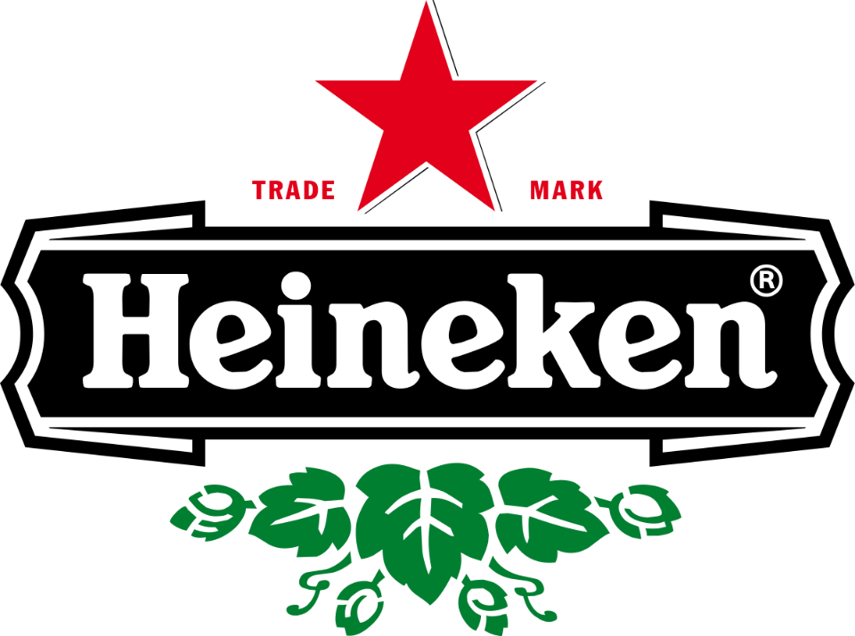
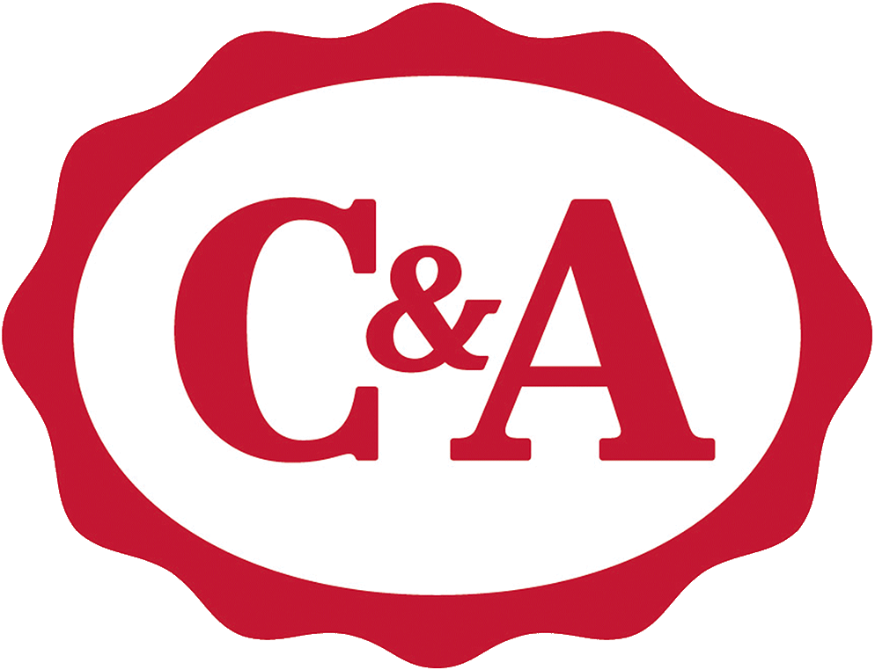
Some Examples of Family Businesses
"Dieses Foto" von Unbekannter Autor ist lizenziert gemäß CC BY-SA
"Dieses Foto" von Unbekannter Autor ist lizenziert gemäß CC BY-SA
"Dieses Foto" von Unbekannter Autor ist lizenziert gemäß CC BY-SA

Slide 33
Family-Owned Businesses – Some Facts
GDP
Jobs
Start-Ups
Job Growth
Importance
In most countries around the world they are 60-90% of non-governmental GDP
In most countries around the world they are 50-80% of all private sector jobs
85% of all business start-ups are started with family money
In the Unites States, family businesses represent more than 75% of net job growth
In most countries around the world, family businesses are between 70 and 95% of all business entities
Notes:
As many SMEs are familiy businesses:
Definition: A business actively owned and/or managed by more than one member of the same family

Slide 34
Family-Owned Businesses
Focus on income and job generation for family members, influences strategic objectives and motives
Little difference in performance between family and non-family business
Management of people
Preference might be given to family members, for recruitment, training, and remuneration
Pros: high level of loyalty, trustworthiness, conflict resolution
Cons: nepotism and incompetence
Succession
Notes:
Stokes, D., & Wilson, N. (2010). Small business management and entrepreneurship (6th ed). Andover: Cengage Learning.
European Family Businesses, www.europeanfamilybusinesses.eu, June 2012
Family businesses in Europe have been widely equated to Small and Medium-Sized Enterprises (SMEs) in public and policy discussions. However, this neglects the
fact that there are also large family businesses. Family businesses can be small, medium sized or large, listed or unlisted. Arguably, the most defining features of
family businesses are the ownership aspects as they are crucial to the business life of the firm. ‘Taking the ‘ownership perspective’ rather than the ‘company size’ perspective can help improve understanding of the phenomenon.
1’ Why family businesses are important?
Field research into family businesses has shown that this form of enterprise has significant benefits to the economy and society at large:
−Most studies show that in terms of accounting performance, family businesses are more profitable over the long term
−Family businesses are less likely to lay people off and more likely to hire
−Family businesses are generally better for the communities in which they live and invest more in their communities both for business investment and
in terms of philanthropic activities
−Family business generally take a long-term view and thus balance short-term rewards with long-term sustainability and prosperity
−Family businesses use less debt and are therefore more stable. Particularly in economic times such as the ones we are in now
However, family businesses have vulnerabilities
−Around the world, family businesses typically have successful transitions at the rate of 30% per generation which means that 30% make it in the family from first to second generation, 10% from
second to third generation, 3% from third to fourth and fewer than 1% from fourth to fifth and beyond.
According to the best available research, the importance of family business has been equated to:
−GDP - in most countries around the world they are 60 - 90% of non-governmental GDP
−Jobs - in most countries around the world they are 50 – 80% of all private sector jobs
−Start-Ups - 85% of all business start-ups are started with family money
−Job growth - in the Unites States, family business represent more than 75% of net job growth
−Weighting - in most countries around the world, family businesses are between 70 and 95% of all business entities

Slide 35
What help do SMEs get in the EU?
2 broad types of potential benefits:
Eligibility for support in EU business-support programmes in areas of: research funding, competitiveness, and innovation funding; plus similar national support programmes that could otherwise be banned as unfair government support
Fewer requirements or reduced fees for EU administrative compliance

Slide 36
Assignment: Support/funding in the EU and your home country for SMEs
What types of support and/or funding can SMEs get for their internationalisation?
In the EU
In in your home country (national/regional/local)
In general vs. to specific countries
Notes:
Will be useful for the export cases!
You can either make this an assignment for homework and/or grading (give students 2-3 weeks) or you make this a group work in class, where teams do research and present the results on a poster (approx. 60 min)

Slide 37
Summary
SMEs are often seen as the first step in the growth to a large firm, this growth comes often in stages
Definitions of SMEs vary between countries but most rely on quantitative criteria (turnover, number of employees, etc.)
SMEs have specific character and resource endowments that distinguish them from larger companies
SMEs are the major contributor to the economy
Many SMEs are family owned

Slide 38
Learning Objectives
Describe the organisational life cycle
Describe the stages of growth of small businesses
Explain the significance of SMEs on the economy
Understand qualitative and quantitative definitions of small and medium-sized enterprises
Describe some characteristics of SMEs
Describe advantages and disadvantages of small-sized companies

Slide 39
References
Bolton, J.E. (1971). Report of the Committee of Enquiry into Small Firms.
Daft, R. L., Murphy, J., & Willmott, H. (2014). Organization theory and design: an international perspective. Andover: Cengage Learning.
EUROPA - Competition - List of NACE codes. (n.d.) Retrieved from http://ec.europa.eu/competition/mergers/cases/index/nace_all.html
What is an SME? - Growth - European Commission. (n.d.)., Retrieved from http://ec.europa.eu/growth/smes/business-friendly-environment/sme-definition_nl
Greiner, L. E. (1998). Evolution and Revolution as Organizations Grow
Muller, P., Caliandro, C., Peycheva, V., Gagliardi, D., Marzocchi, C., Ramlogan, R., & Cox, D. (2015). Annual Report on European SMEs 2014/2015 (SMEs start hiring again). Luxembourg: European Union. DOI, 10, 886211.
Quinn, R. E., & Cameron, K. (1983). organisational life cycles and shifting criteria of effectiveness: Some preliminary evidence. Management science, 29 (1), 33-51.
Robbins, S. P., & Barnwell, N. (2006). Organisation theory: concepts and cases. Frenchs Forest, NSW: Pearson Education Australia, 5, 197-198

Slide 40
References
Scott, M., & Bruce, R. (1987). Five stages of growth in small business. Long range planning, 20 (3), 45-52.
Stokes, D., & Wilson, N. (2010). Small business management and entrepreneurship, 6. Andover: Cengage Learning.
Storey, D. J. (2016). Understanding The Small Business Sector. Routledge.
Welsh, J. A., & White, J. F. (1981). A small business is not a little big business. Harvard business review, 59(4), 18.
Wynarczyk, P., Watson, R., Storey, D. J., Short, H., & Keasey, K. (2016). Managerial Labour Markets in Small and Medium-Sized Enterprises. Routledge.

Slide 41
Recommended Reading
Greiner, L. E. (1998). Evolution and Revolution as Organizations Grow. Retrieved from https://hbr.org/1998/05/evolution-and-revolution-as-organizations-grow
Storey, D. J. (2016). Understanding The Small Business Sector. Routledge.
ANNUAL REPORT ON EUROPEAN SMEs 2015/201. Retrieved from http://ec.europa.eu/DocsRoom/documents/21251/attachments/4/translations/en/renditions/native

